Slide 1
Publications Report: J-MASS
John L. Schmalzel
Fall 2019 AdCom Meeting

Slide 2
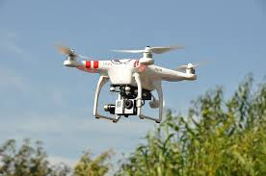
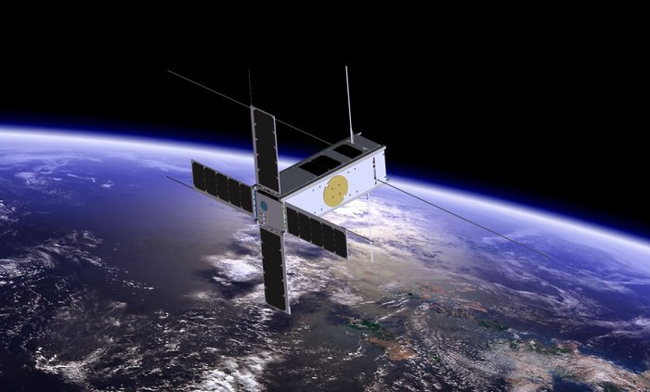
J-MASS
Journal on Miniaturization for Air and Space Systems (J-MASS)
Financial sponsors
IEEE Systems Council: 35%
IEEE Geospatial & Remote Sensing: 25%
IEEE Sensors Council: 25%
IEEE Instrumentation & Measurement Society: 10%
IEEE Aerospace & Electronic Systems Society: 5%
Launch: 2019
4 Issues per year, electronic only, available to all IEEE members, and non-members
Annual page count (Overlength > 8 pages)
Year 1 (2019): 300
Year 2 (2020): 450
Year 3 (2021): 600

Slide 3
J-MASS: Paper Status
Year | Submitted | Published | Rejected | Withdrawn | In-process
2019 | 10 | 0 | 5 | 0 | 6

Slide 4
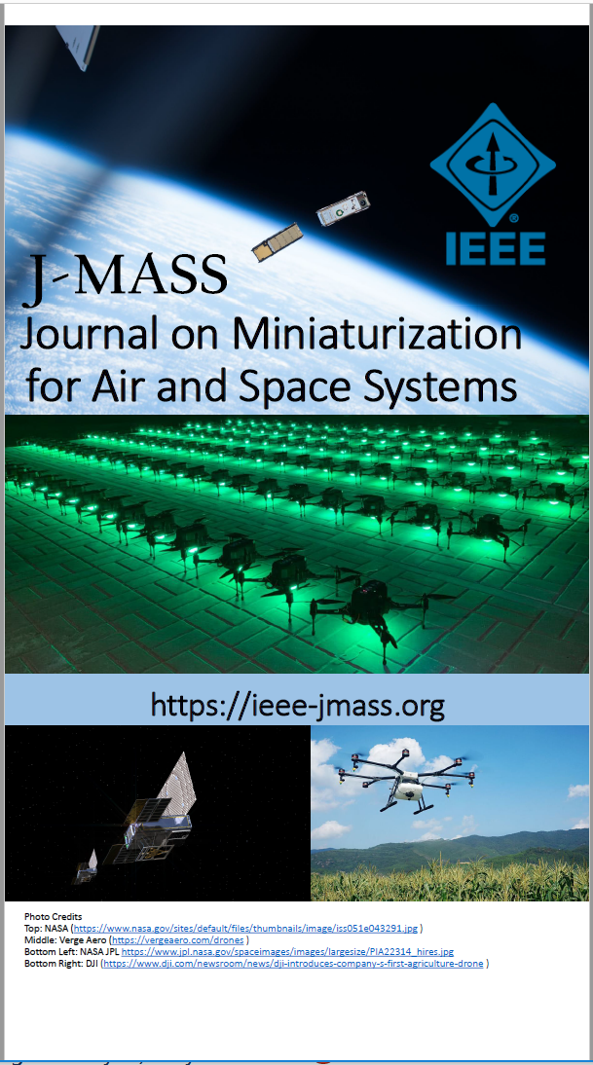
J-MASS Marketing
Information website (J. Ritchie)
https://ieee-jmass.org
Directed Outreach
Conference Catalysts (E-mail, etc.)
Systems Council Member Newsletters
Conference/Trade Show
Space Tech Expo
Small Sat
Planned
Drone venue

Slide 5
J-MASS Marketing: Space Tech Expo
Trade Show (May)
>3000 Participants
>250 Exhibitors
Presentations
360 Roundtable
http://www.spacetechexpo.com

Slide 6
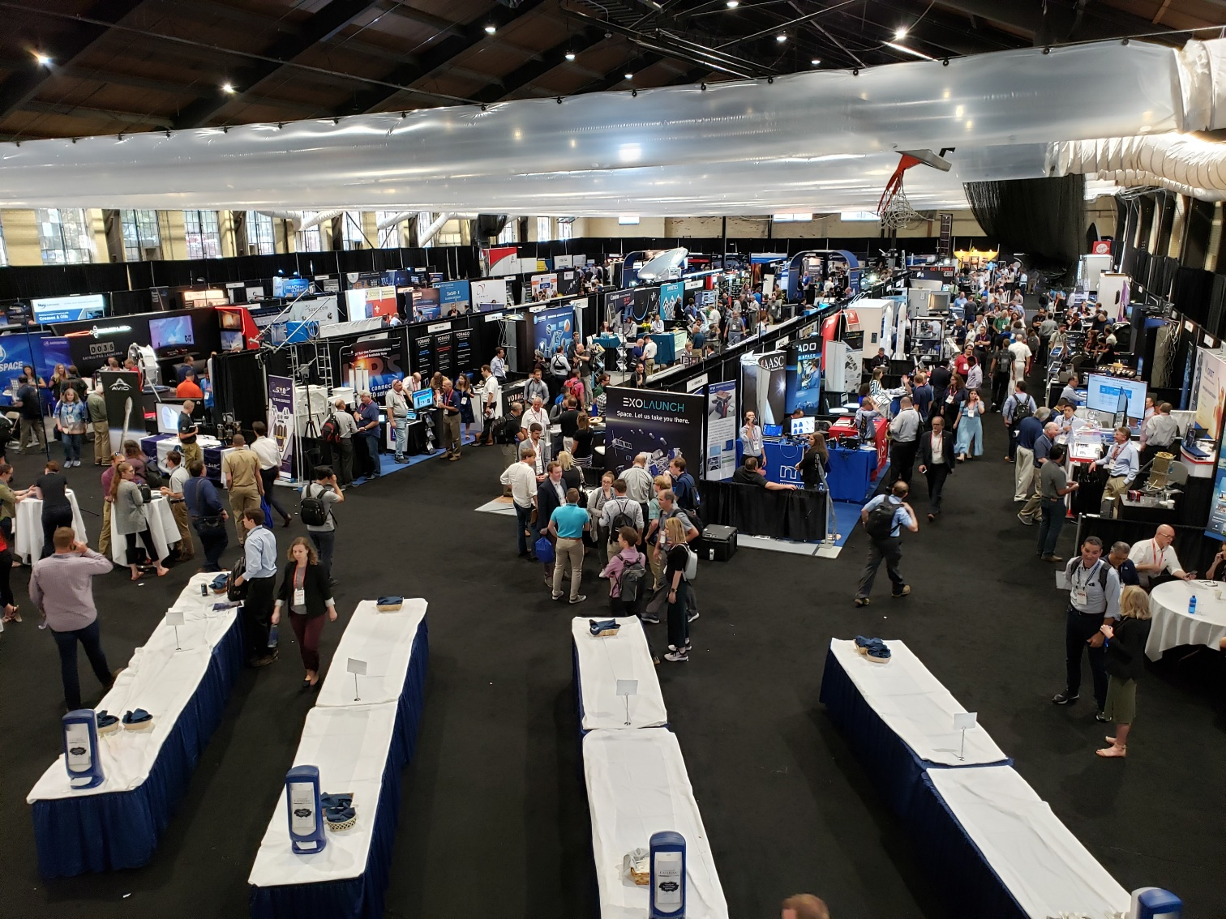
J-MASS Marketing: Small Sat
AIAA/Utah State University (Aug)
3460 Participants
1100 Organizations
45 Countries
383 Students
Exhibitors
235 Commercial
20 University
Presentations
134 Poster
150 Oral
Requested Attendee List
https://smallsat.org/

Slide 7
J-MASS Special Issues
Special Issues present opportunities to develop core mass of papers and establish thematic “go-to” resources
SI-1: “2019 Metro AeroSpace Workshop” 4Q19
Papers from the 2019 IEEE Metrology for AeroSpace Workshop
http://www.metroaerospace.org/home
SI-2: "From Payload to Uses“ 4Q19/1Q20
Papers from the 2019 Grenoble NewSpace Week International Workshop
https://gnsw.sciencesconf.org/
SI-3: “Concept to Realization” 3Q20
Papers from the 2020 Federated Satellite Systems Workshop
http://golkar.scripts.mit.edu/fss/

Slide 8
J-MASS Special Issue Guidelines
1. Original Source. What activity is the original source and who were the sponsors?
2. Title. What name best captures the essence of the theme of the intended body of papers?
3. Summary. Describe the Special Issue theme. What developments reported within the conference emerged as a coalescing topics that form the foundation of the SI?
4. Guest Editors. Identify the slate of Guest Editors for the Special Issue.
5. Timetable. Due to the purely on-line e-publishing format of J-MASS, between 3-6 months is expected between announcement and issue publication.

Slide 9
J-MASS Challenges
Developing paper feeds
Getting the word out as effectively as possible
Soliciting Special Issues
Cold calls
Adding AEs (Drones, etc.)
Thematic Conference

