Slide 1
Circuits and Systems Society Rep Report
Robert Chen-Hao Chang
2019/8/30

Slide 2
Executive Committee
President, Yong Lian, York University, Canada
President-Elect, Amara Amara, "Terre des hommes" Foundation, Switzerland
Past President, Franco Maloberti, University of Pavia, Italy
Vice President – Conferences, Myung Hoon Sunwoo, Ajou University, Korea
Vice President - Technical Activities, Eduard Alarcon, Campus Nord UPC, Spain
Vice President - Financial Activities, Guoxing Wang, Shanghai Jiao Tong Univ., China
Vice President – Publications, Mohamad Sawan, Westlake University, Hangzhou, China
Vice President – Regional Activities and Membership, Yoshifumi Nishio, Tokushima Univ., Japan

Slide 3
Technical Committees
Analog Signal Processing
Biomedical and Life Science Circuits and Systems
Cellular Nanoscale Networks and Array Computing
Circuits & Systems for Communications
Circuits and Systems Education and Outreach
Digital Signal Processing
Multimedia Systems & Applications
Nanoelectronics and Gigascale Systems
Neural Systems & Applications
Nonlinear Circuits & Systems
Power and Energy Circuits and Systems
Sensory Systems
Visual Signal Processing & Communications
VLSI Systems & Applications

Slide 4
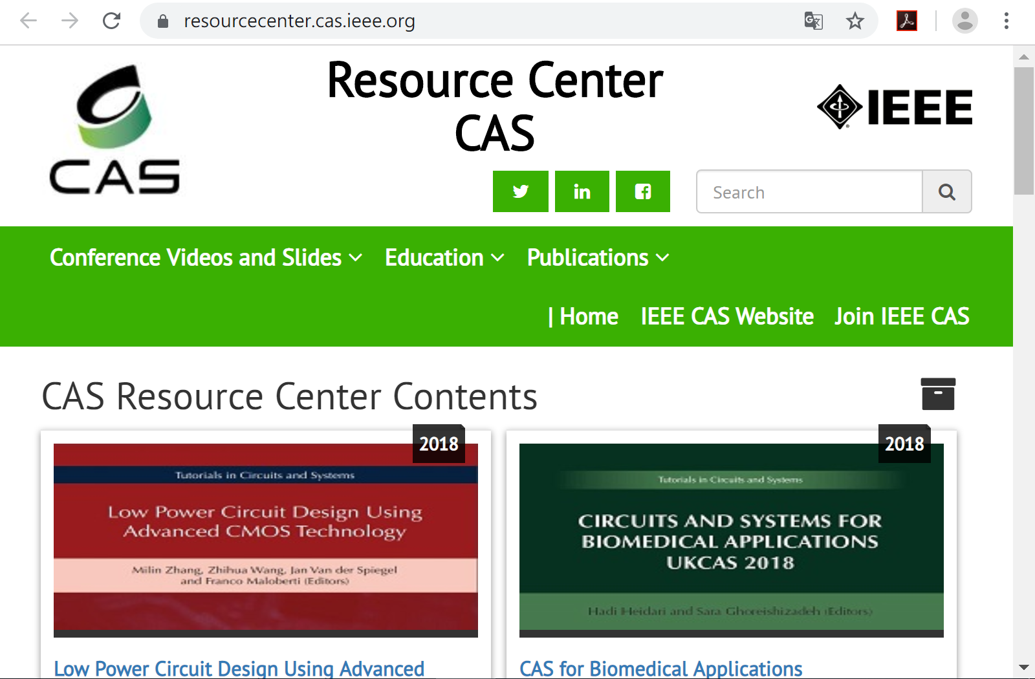

Slide 5
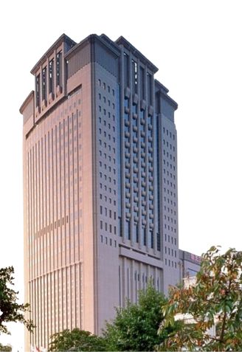
AICAS 2019
Conference Date March 18-20, 2019
Conference Venue Ambassador Hotel Hsinchu 新竹國賓大飯店
http://www.aicas2019.org
Organizational Sponsors
Local Organizers

Slide 6
Future AICAS
AICAS 2020
23-25 March 2020 Genova, Italy www.aicas2020.eu
AICAS 2021
March 2021
WASHINGTON DC, USA

Slide 7
The 2nd IBM IEEE CASS/EDS AI Compute Symposium
IBM Research Together with the IEEE Circuits and Systems Society and the IEEE Electron Devices Society
the IBM T.J. Watson Research Center THINKLab in Yorktown Heights, New York
17 October 2019.
explore AI Compute challenges and future research directions
https://www.zurich.ibm.com/thinklab/AIcomputesymposium.html

Slide 8
The Third IEEE CAS-SV Artificial Intelligence For Industry Forum
together with IEEE CASS, CIS, CS, SPS, SSCS, &ComS local chapters of the IEEE Santa Clara Valley Section
6 September 2019, Intel Santa Clara Campus
https://www.eventbrite.com/e/ieee-cass-scv-artificial-intelligence-for-industry-ai4i-forum-fall2019-tickets-66694279385?aff=erelexpmlt

