Slide 1
Experiences in developing a light footprint, optimum fidelity, Digital Twin of a legacy system, incrementally (and preventing it from becoming an Evil-twin)
Rao Mannepalli
Chief Scientist, Leidos
Copyright © by Rao Mannepalli/Leidos
Published by the American Institute of Aeronautics and Astronautics, Inc., with permission.

Slide 2
Survey Questions
Are you a Systems Engineer, Software Engineer, Software Systems Engineer, or Operational Analyst?
Have you worked on M&S (Modeling and Simulation)?
Are you familiar with Digital Engineering, Digital Twin, etc.?
What is the first thing that comes to your mind when you hear “Digital Twin”?
Have you built/worked on any Digital Twin?

Slide 3
Digital Engineering**
Weapon systems critical to national security are increasingly becoming more complex and expensive. Most of the time, these are system of systems.
A study by Deloitte estimated the total cost overruns (for the US alone) at $468 billion making it the undisputed second largest defense budget in the world.
To address these problems, the US Department of Defense (DOD) under the leadership of Dr. Michael Griffin, Undersecretary for Acquisition, Technology and Logistics (ATL), introduced in 2018 DOD’s Digital Engineering initiative.
This is a far-reaching vision intended to revolutionize the way DOD weapon systems are designed, built, tested, maintained, and sustained.
It is expected to result in greater efficiency and improve the quality of all the acquisition activities.
The crux of Digital Engineering is the creation of computer-readable models to represent all aspects of the system and to support all the activities for the design, development, manufacture, and operation of the system throughout its lifecycle.
The strategy/vision is laudable in terms of breadth and depth, and it goes much beyond “engineering.” However, there is a certain poverty of imagination in selecting the name.

Slide 4
Digital Twins
Digital Twins are an important part of Digital Engineering.
Even though the term “Digital Twin” is a recent one, made popular by NASA, the concept is not new.
For example, the Partial Nuclear Test Ban Treaty signed on August 5, 1963, prohibited nuclear weapons tests and nuclear explosions underwater, in outer space, and in the atmosphere.
The digital models developed by the National Labs like Lawrence Livermore Lab (LLL) are used to validate the real weapons without resorting to actual testing.
Highly complex system-of-systems are analyzed by distributed simulation using independently developed models federated using High Level Architecture (HLA) and Distributed Interactive Simulation (DIS)

Slide 5
What is a Digital Twin?
Digital Twin is a virtual representation of a complex object or system.
It can be used to predict future operational capabilities.
It spans the entire lifecycle of the physical (real-world) system.
It is updated using real-time data from its physical twin.
It uses simulation, machine learning, and reasoning to help with decision-making.
First used by NASA in 2010 to improve a model simulation of a spacecraft.
The digital twin concept has also been employed by the healthcare sector to develop treatment for cardiac patients and by the energy industry to optimize power plant operations.
Critics argue that it lends an unwarranted air of infallibility to data and technology and should be deployed with caution ("When a Digital Twin becomes the Evil Twin").

Slide 6
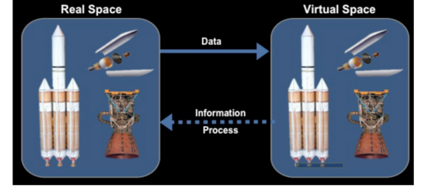
NASA’s Concept of Digital Twin
Digital Twin integrates:
Ultra-high-fidelity simulation
With vehicle’s on-board integrated vehicle health management system,
Maintenance history
All available historical and fleet data
To mirror the life of its flying twin and enable unprecedented levels of safety and reliability

Slide 7
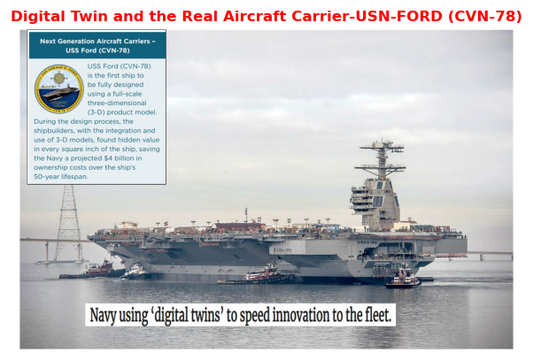
Some Examples of Digital Twins

Slide 8
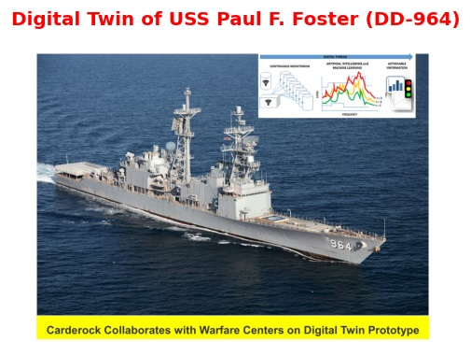
Some Examples of Digital Twins (contd.)

Slide 9
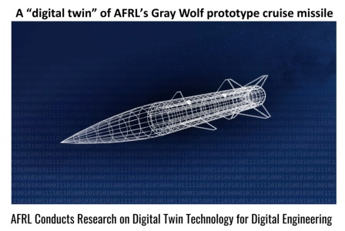
Some Examples of Digital Twins (contd.)

Slide 10
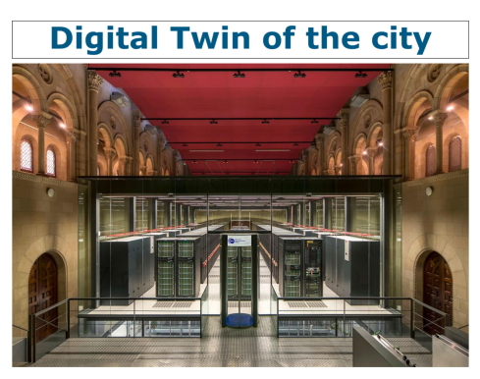
Some Examples of Digital Twins (contd.)

Slide 11

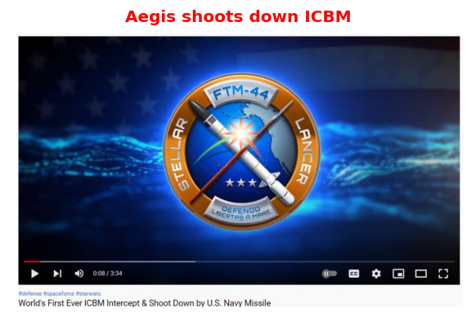
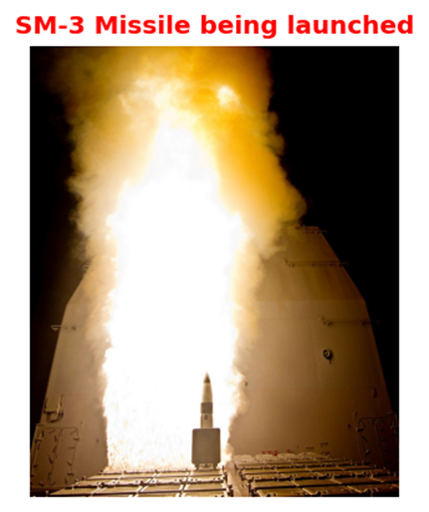
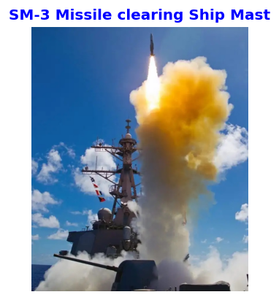
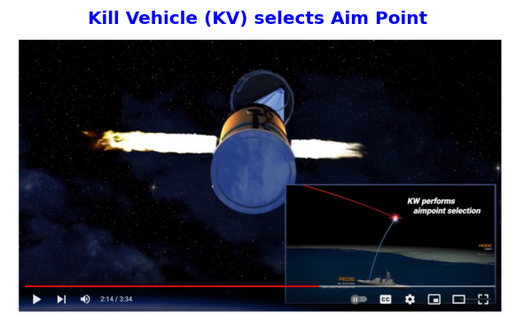
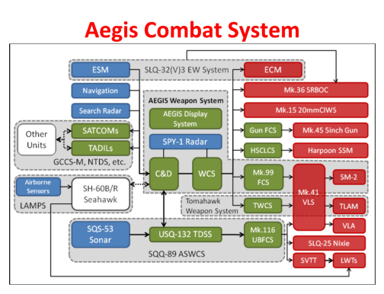
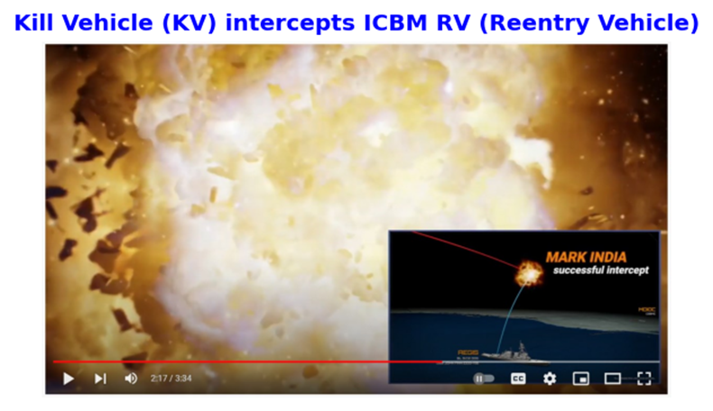
Aegis Ballistic Missile Defense System (BMD)

Slide 12
Some of the questions Aegis Digital Twin has answered:
Can the Aegis BMD shoot down a satellite instead of regular missile? If not, what changes are needed for Radar, Discrimination, SM-3 missile, Kill Vehicle, and Terminal Guidance?
If one ship with an Aegis Ballistic Missile Defense System can handle “n” threats, how many threats 2 ships can handle (2n, <2n, or >2n)?
How the total number of threats handled changes if CEC (Cooperative Engagement Capability) is used?
How these numbers change for “Launch on Remote” and “Engage on Remote”?
How the numbers change for “shoot”, “shoot-look-shoot”, “shoot-shoot-look-shoot” and “shot-shoot-look-shoot-Shoot”?
Sensitivity analysis for QOS (Quality Of Service)
How the Probability of Single Shot Kill (Pₛₛₖ) changes if SPY-1 Radar is replaced by AMDR (Air and Missile Defense Radar)?
How the Probability of Raid Annihilation (PRA) changes with (1 ship, 2 ships, ..., n-ships)?

Slide 13
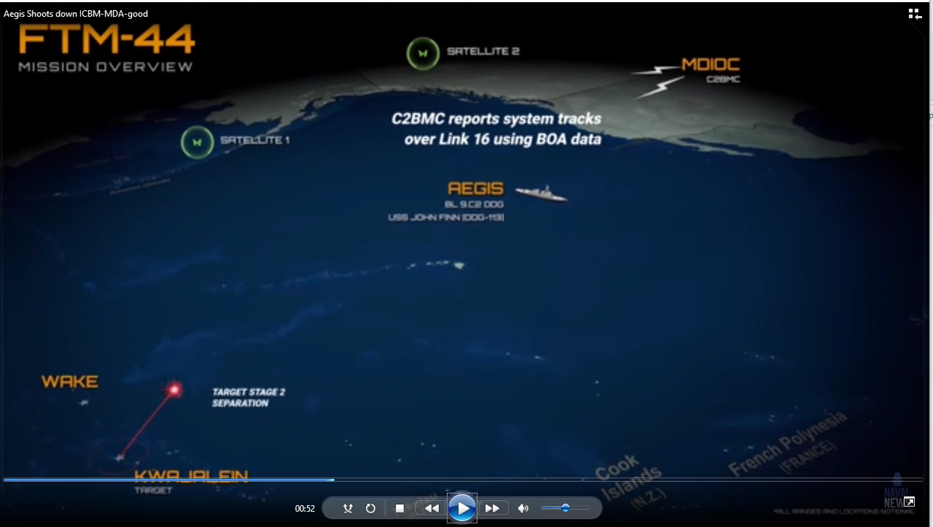
Aegis shoots down an ICBM (video)
https://www.youtube.com/watch?v=DYs3be0qs6Q

Slide 14
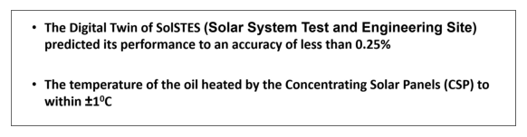
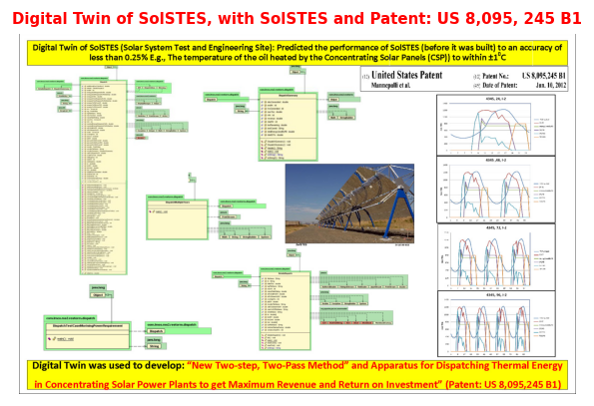
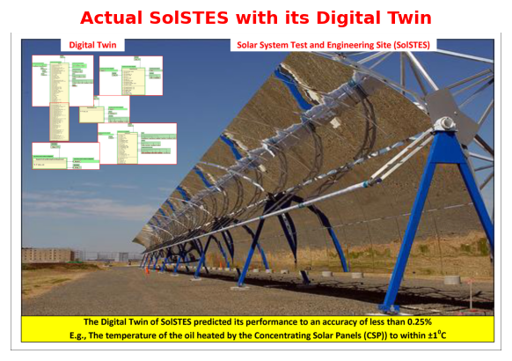
Solar System Test and Engineering Site (SolSTES)

Slide 15
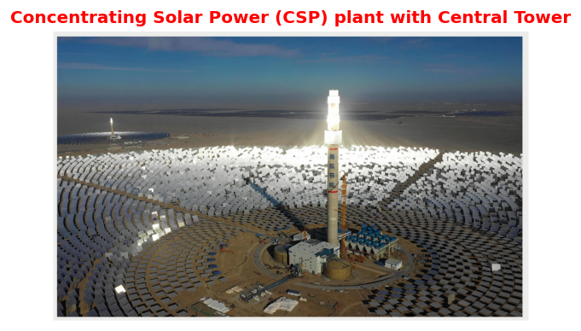
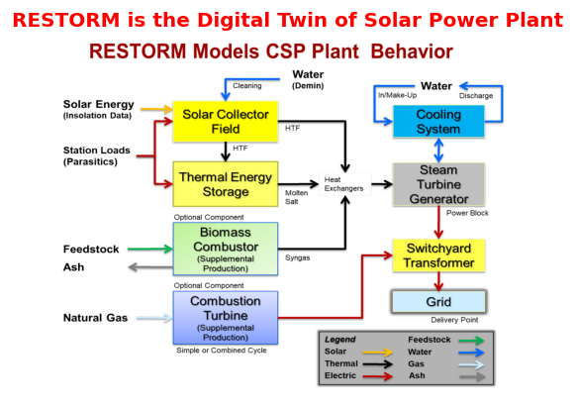
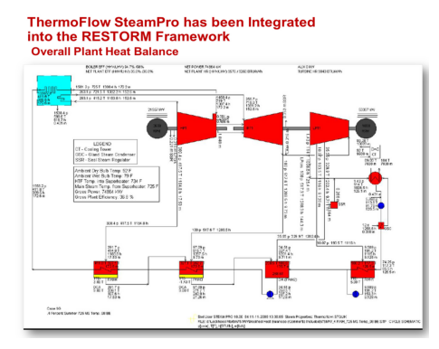
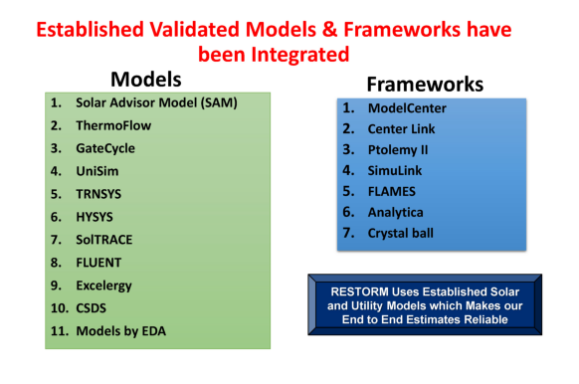
Concentrating Solar Power Plant (RESTORM)

Slide 16
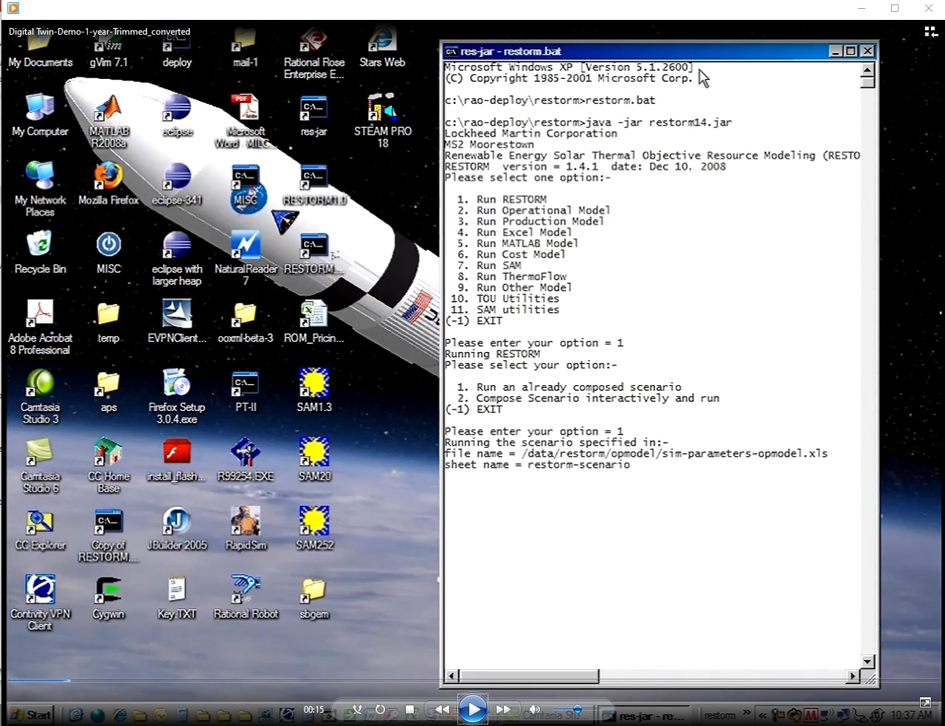
RESTORM Demo Video

Slide 17
RESTORM (Digital Twin of a Solar Power Plant) has answered
How much it will cost to build a 295 MW (or any specified size) Solar power plant in Arizona (or any specified location e.g., Ascension Island in the Atlantic Ocean)?
What would be the LCOE (Levelized Cost of Energy)?
What would be the LCOE without incentives from the federal govt?
Can we improve the ROI of any power plant by at least 8%? (Patents: US 8,095,245 B1, US 8,903,561 B1)
Can a new Energy Dispatch Algorithm take into account the PPA (Power Purchase Agreement) and TOD (Time of the day) pricing?
Do we really need the NREL (National Renewable Energy Labs) recommended 6 hours of storage (of molten salt) which costs $80 million/hour?
How can we reduce the capital cost of the 295 MW power plant from $1.8 billion by $200–300 million?

Slide 18
Digital Twin for City Planning (Barcelona, Spain)
Officials in Barcelona, Spain, are using the Barcelona Supercomputing Center’s MareNostrum supercomputer to improve urban planning through the use of a digital twin of the city.
Planners can use the digital replica to trial-run potential urban planning projects. “Instead of implementing flawed policies and then have to go back and correct them, we're saving time by making sure those decisions are right before we execute them,” said Barcelona Deputy Mayor Laia Bonet.
The city is using the program to explore ways to implement the 15-minute city framework, which proposes that residents have access to all needed services within a 15-minute walk or bike ride from home.
We're using the supercomputer to make sure the urban planning process isn't just based on clever ideas and good intentions, but on data that allows us to anticipate its impacts and avoid the negative ones,” said Barcelona Deputy Mayor Laia Bonet, who is in charge of the city's digital transition, climate goals and international partnerships.
As part of a pilot project launched with the Italian city of Bologna earlier this year, Barcelona has created a data-based replica of itself “a digital twin” where it can trial run potential city planning projects.
Instead of implementing flawed policies and then have to go back and correct them, we're saving time by making sure those decisions are right before we execute them,” said Bonet.
Although the scheme is still in its test phase, Bonet said she expects the city's high-tech approach to urban development will soon be the norm in cities across the EU.
“Within a five-year horizon I expect to see this as a basic urban planning tool,” she said.
Creating a revolutionary tool to test future urban scenarios

Slide 19
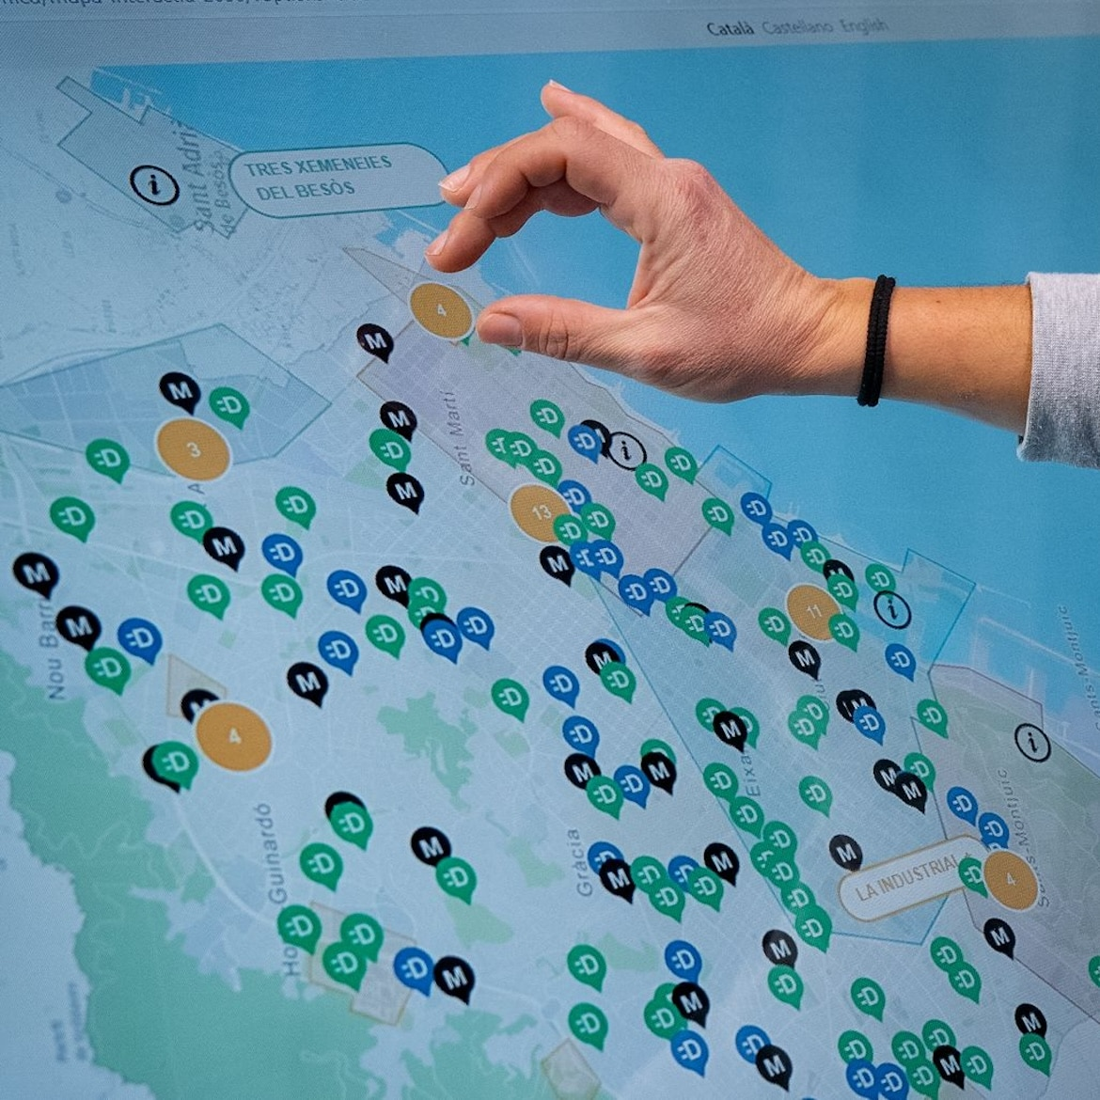

Digital Twin for City Planning (Barcelona, Spain)
Creating a revolutionary tool to test future urban scenarios

Slide 20
Digital Twin of Singapore
Recently, Singapore completed work on the world's first digital twin of an entire nation. Bentley Systems tools accelerated the process of transforming raw GIS, lidar, and imagery data into reality mesh, building, and transportation models of the country.
"We envisaged that these building blocks will be part and parcel towards the building of the metaverse starting with 3D mapping and digital twins," Hui Ying Teo, senior principal surveyor at the Singapore Land Authority, told VentureBeat.
She says she thinks of digital twins as a replication of the real world through intense digitalization and digitization. They are critical for sustainable, resilient, and smart development. Her team has been developing a framework that enables a single source of truth across multiple digital twins that reflect different aspects of the world and use cases.
Singapore is an island nation, and rising sea levels are a big concern. An integrated digital twin infrastructure is already helping Singapore respond to various challenges such as the impact of climate change. A single, accurate, reliable, and consistent terrain model supports national water agency resource management, planning, and coastal protection efforts.
The digital twin efforts are also helping in the rollout of renewable energy. An integrated source of building model data helped craft a solar PV roadmap to meet the government's commitment to deploy two gigawatts peak (GWp) solar energy by 2030.
The world’s first digital twin of a nation has the potential to help create better cities

Slide 21
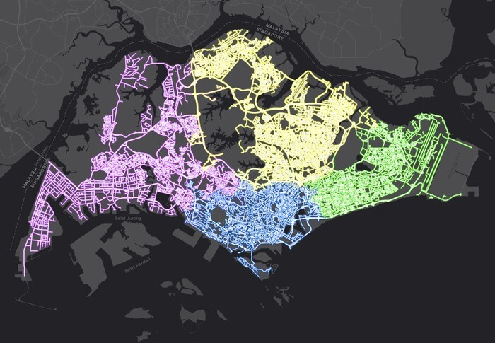
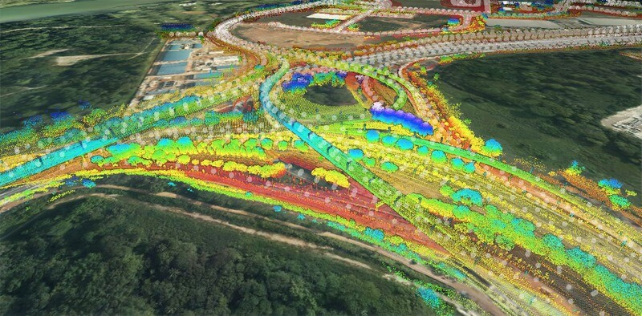
Digital Twin of Singapore
Singapore Land Authority Develops Digital Twin of all Public Roads

Slide 22
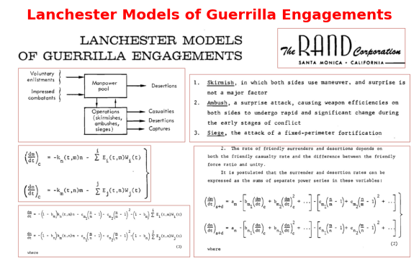
RAND’s Lanchester Models of Guerrilla Engagements

Slide 23
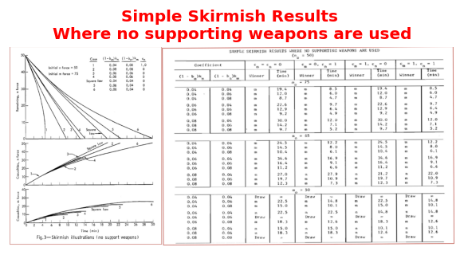
RAND’s Lanchester Models of Guerrilla Engagements (contd.)

Slide 24
Digital Engineering, MBSE, and Digital Twins
Digital Engineering
The US Under Secretary of Defense for Research and Development released the US Department of Defense (DoD) Digital Engineering Strategy in June 2018 describing five goals to streamline the DoD acquisition process through the creation of a digital thread enabling the conception, design, and development of complex weapon systems The crux of digital engineering is the creation of computer readable models to represent all aspects of the system and to support all the activities for the design, development, manufacture, and operation of the system throughout its lifecycle. These computer models would have to be based on shared data schemata so that in effect a digital thread integrates all the diverse stakeholders involved in the acquisition of new weapon systems. The Digital Engineering Strategy anticipates digital engineering will lead to greater efficiency and improved quality of all the acquisition activities.
Relationship with MBSE (Model-based systems engineering)
MBSE is a subset of digital engineering. MBSE supports the systems engineering activities of requirements, architecture, design, verification, and validation. These models would have to be connected to the physics-based models used by other engineering disciplines such as mechanical and electrical engineering. One challenge remaining for digital engineering is the integration of MBSE with physics-based models. Foundation to digital engineering is the representation of the system data in a format sharable between all stakeholders. SysML 2.0 is one of several future developments promising to provide a representation sufficient to support digital engineering. An ontology defining the entities and relationships between them can be used to define the concepts relevant to systems engineering. Such a representation is necessary to create the digital thread linking all the models together in a cohesive and useful manner.
Digital Engineering is too important to be left alone to MBSE Practitioners

Slide 25
Digital Engineering, MBSE, and Digital Twins (contd.)
Digital Engineering as a Transformation
  For many organizations, digital engineering represents a transformation of how they normally conduct systems engineering since most organizations conduct a document-intensive systems engineering process. The adoption of digital engineering requires concomitant changes to how organizations perform system engineering activities. Everything from documenting requirements, technical reviews, architecture design, and so forth would be based on the models in a digital engineering environment. The digital thread would be the authoritative source of truth concerning the system data.
Digital Twin
  A digital twin is a related yet distinct concept to digital engineering. The digital twin is a high-fidelity model of the system which can be used to emulate the actual system. An organization would be able to use a digital twin to analyze design changes prior to incorporating them into the actual system.

Slide 26
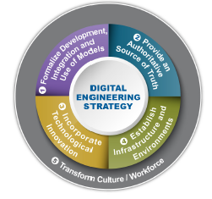
Digital Engineering Strategy by DOD
5 Goals
Formalize the development, integration, and use of models to inform enterprise and program decision making.
Provide an enduring, authoritative source of truth.
Incorporate technological innovation to improve the engineering practice.
Establish a supporting infrastructure and environments to perform activities, collaborate, and communicate across stakeholders.
Transform the culture and workforce to adopt and support digital engineering across the lifecycle. The final goal incorporates

Slide 27
Some of the models used in Digital Engineering
Digital System Models
Performance Models
Cost Models
Design Models
System Safety Models
Cybersecurity Models
Manufacturing Models
Verification & Validation Models
Quality Models
Mission Assurance Models
Maintainability & Sustainability Models
Management Models
Acquisition Reference Models
Government Reference Models
Specialty Engineering Models
Product Support Models
Reliability Models
Environment Models
Human Performance Requirements Models.

Slide 28
Some of the questions a Digital Twin (of a legacy system)** has answered
Given a choice between a single machine with speed s, or n machines each with speed s/n, which should we choose for upgrading the communication subsystem?
If both the arrival rate and service rate double, will the mean response time stay the same for the system?
Should the Enterprise Database system really aim to balance load, or is this a convenient myth?
If a scheduling policy favors one set of jobs, does it necessarily hurt some other jobs or are these “conservation laws” being misinterpreted?
Do greedy, shortest-delay, routing strategies make sense in a server farm or is what is good for the individual may be disastrous for the system as a whole?
How do high message size variability and heavy-tailed workloads affect the choice of a scheduling policy for the system?
How should one trade off energy and delay in designing a computer system for enterprise?
If 12 servers are needed to meet delay guarantees when the arrival rate is 9 jobs/s, will we need 12,000 servers when the arrival rate is 9,000 jobs/s?
**Developed from scratch using Python in less than 3 months, by 1 person

Slide 29
Some of the features available in the Digital Twin
Main Menu:-
1. Demo Digital Twins
2. Portfolio Analysis
3. Message Analysis
4. Rubric Management
5. Bandwidth Analysis
6. Classification Analysis
7. Policy Analysis
8. Scenario Analysis
9. Performance Analysis
10. Algorithms Analysis
11. Cyber Security Analysis
12. Blue Skies Analysis
(-1) EXIT

Slide 30
Demo of Digital Twins
Aegis BMD (Ballistic Missile Defense)
CVN-78 USS Ford (Aircraft Carrier)
DDG-964 (US Destroyer)
Gray Wolf Missile (US-AFRL)
Solar Engineering Testbed (SolSTES)
Solar Power Plant (RESTORM)
RapidSIM
City Planning
Replay RESTORM demo (Video)
Replay Aegis-ICBM demo (Video)
Lanchester Models of Guerrilla Engagements
999. ALL
(-1) EXIT

Slide 31
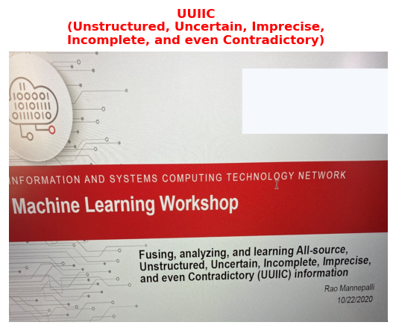
Analysis of Sensor/Information Fusion Algorithms done using the Digital Twin
UUIIC (Unstructured, Uncertain, Imprecise, Incorrect, and even Contradictory)
Dempster-Shafer Theory (DST)
Dezert-Smarandache Theory (DSmT)
Kalman Filter (KF)
Extended Kalman Filter (EKF)
Unscented Kalman Filter (UKF)
Multi-Hypothesis Tracking (MHT)
Interacting Multiple Model (IMM)
Hidden Markov Model(HMM)
Particle Filter (PF)
Deep Neural Network (DNN)
Recurrent Neural network (RNN)
Convolutional Neural Network (CNN)
Most accurate
All Threatening
Special Processing

Slide 32
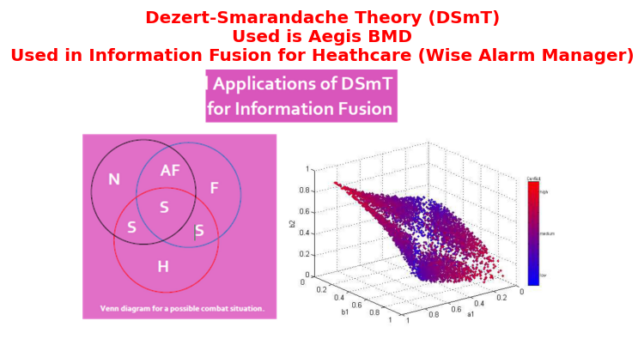
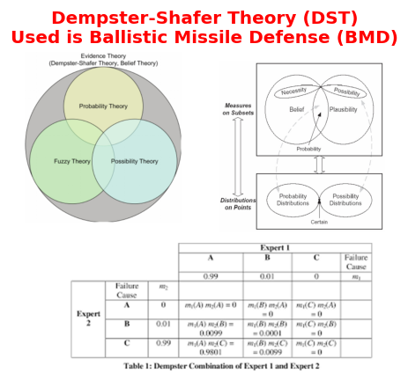
Analysis of Sensor/Information Fusion Algorithms done using the Digital Twin

Slide 33
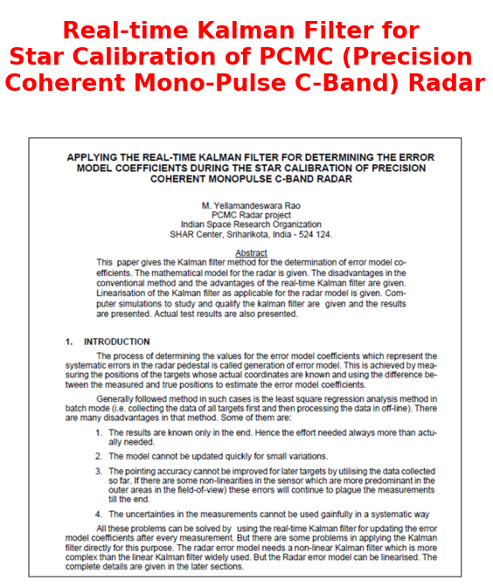
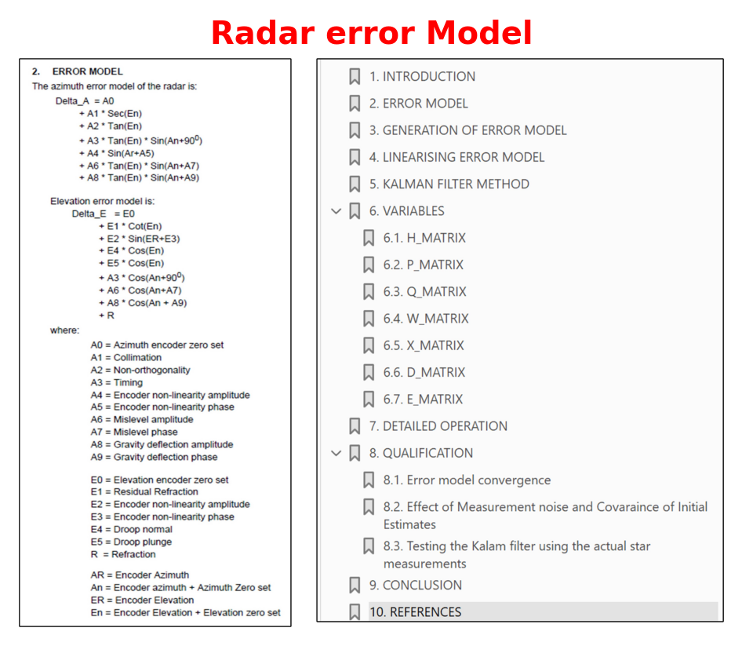
Kalman filter

Slide 34
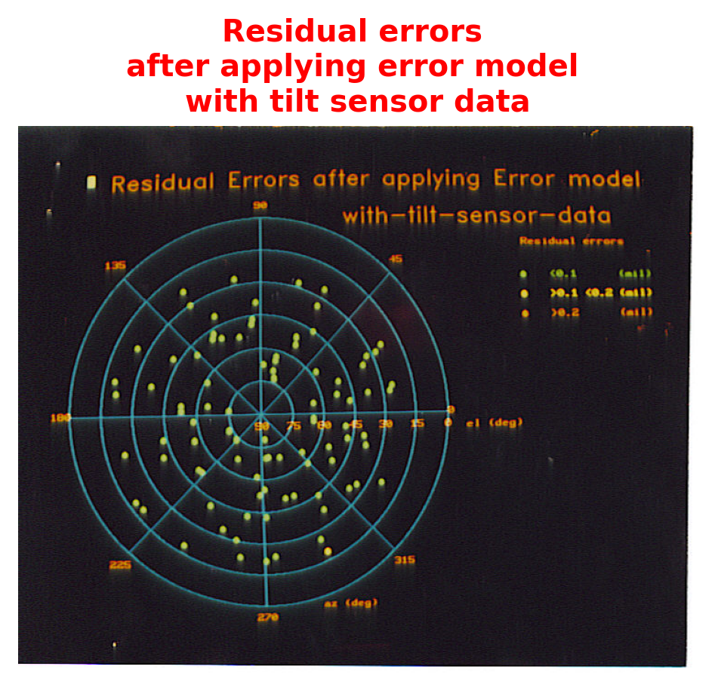
Kalman filter (contd.)

Slide 35
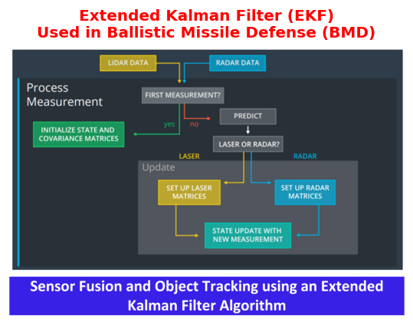
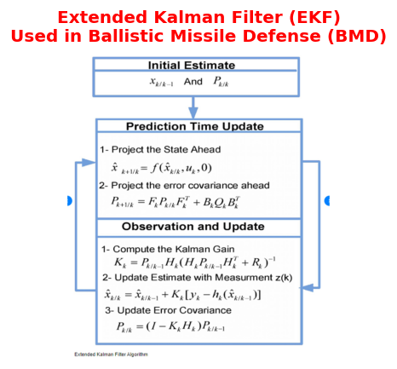
Extended Kalman Filter

Slide 36
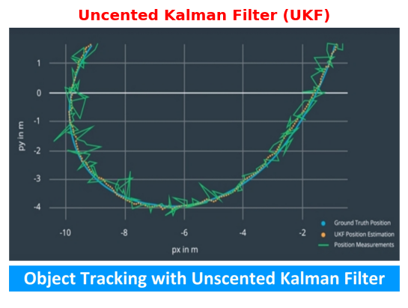
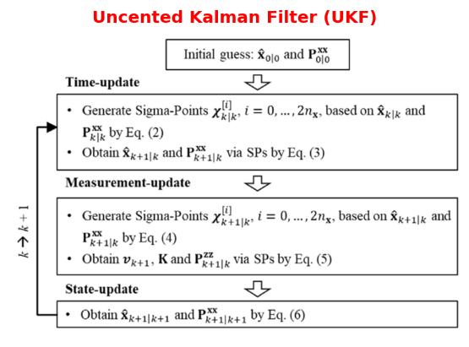
Unscented Kalman Filter (UKF)

Slide 37
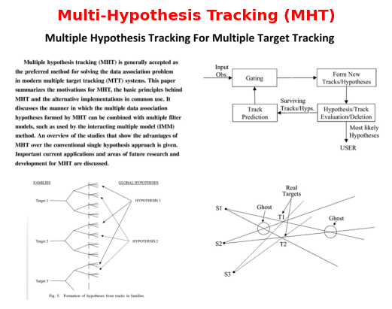
Multi-Hypothesis Tracking

Slide 38
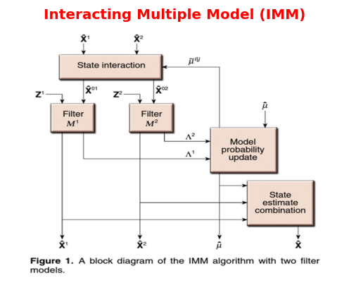
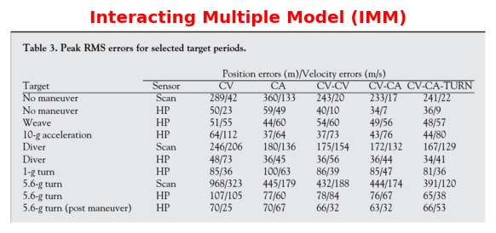
Interacting Multiple Model (IMM)

Slide 39
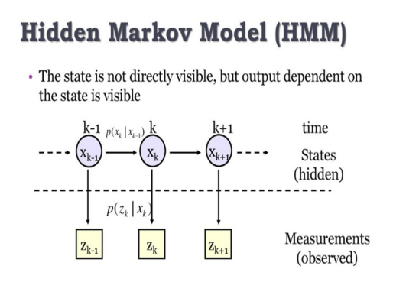
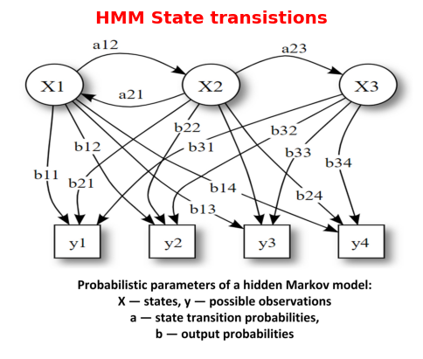
Hidden Markov Model (HMM)

Slide 40
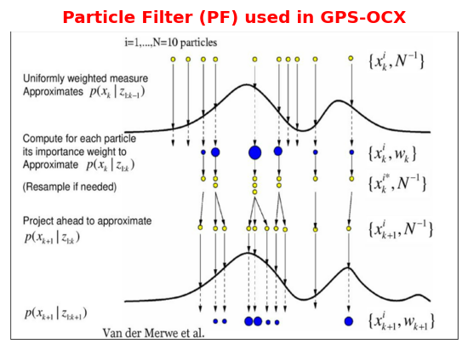
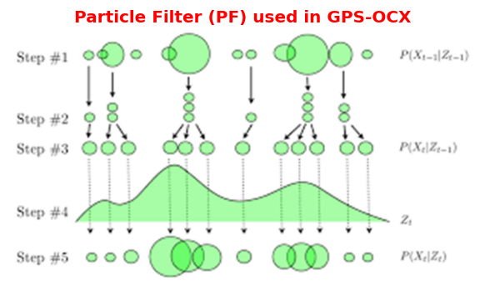
Particle Filter (PF)

Slide 41
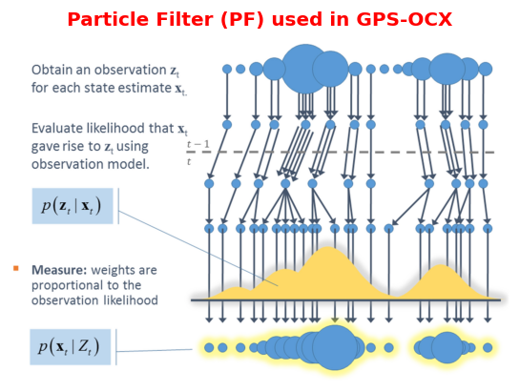
Particle Filter (PF) (contd.)

Slide 42
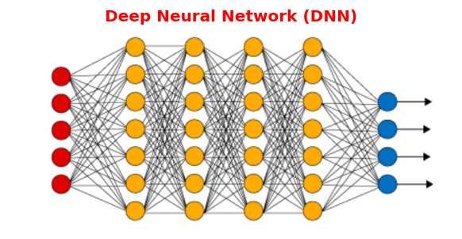
Deep Neural Network (DNN)

Slide 43
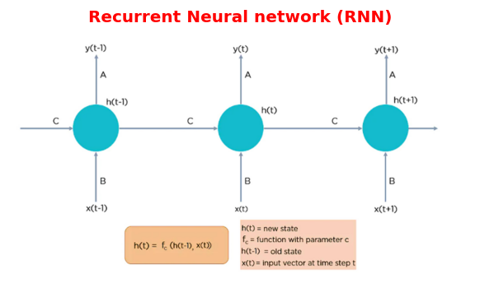
Recurrent Neural Network (RNN)

Slide 44
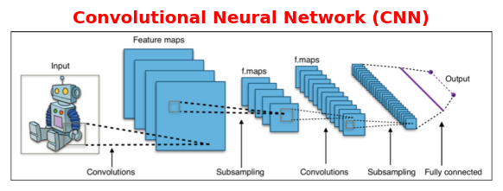
Convolutional Neural Network (CNN)

Slide 45
We don’t really need a Digital Twin
If we can play with the real system
However, the answer is almost always “NO”.
Some of the reasons:
  The real system is not yet built
  It may not be available for AOA (Analysis of Alternatives)
  It will be expensive
  The real system cannot be modified and experimented

Slide 46
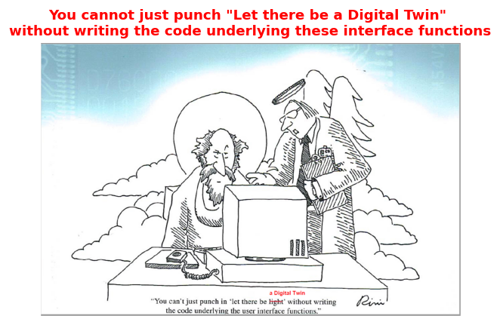
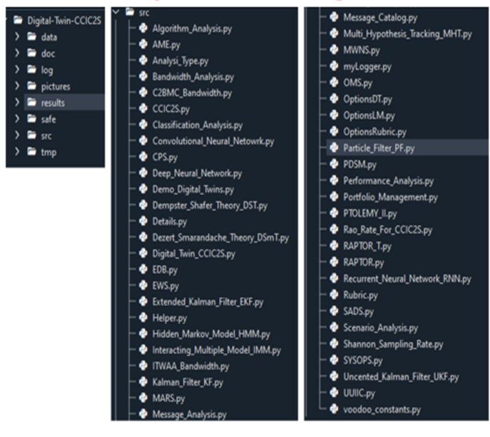
How to develop the Digital Twins?

Slide 47
How to develop the Digital Twins?
Develop incrementally
Optimum Fidelity, targeted to the questions to be answered
Don’t get hung up on tools. There are several commercial and open-source tools (Ptolemy-II, MATLAB, Simulink, Python, Spyder, Anaconda, Eclipse, Cameo, PTC Modeler, Rhapsody, IBM etc.)
Don’t buy into the hype created by tool vendors.
Follow the UNIX culture (listed in the previous slide)
Don’t end up on a dead-end which mostly happens if you use SysML tools.
Remember the “Flow Chart Curse” discussed by F.P.Brooks, the father of IBM-360 and the author of “The Mythical Man Month”
Your end goal is not drawing some static pictures but having executable models (“Digital Engineering is too important to be left alone to MBSE Practitioners”)
Also keep the round-trip engineering (Model → Code → Model) in mind
Always validate with the real system, whenever possible, and refine the model

Slide 48
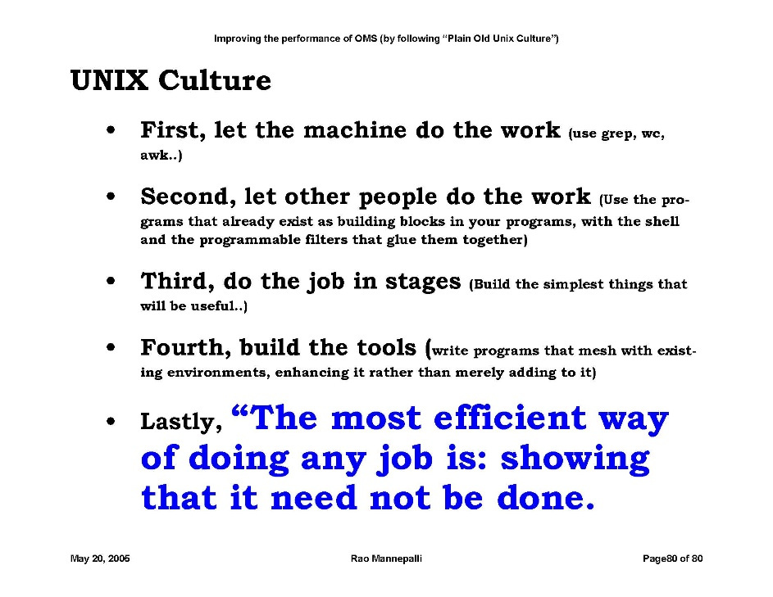




UNIX Culture
UNIX is an operating system developed by Ken Thompson and Dennis Ritche at Bell Labs
Bell Labs taught some important things. Some of them are:
  Almost anything can be done in any programming language. Only question: How much sweat?
  Research wants real egotists who seek their own pleasure and joy but find it in solving the puzzles of nature
  Don’t be humble. You are not that great

Slide 49
Evil Twin
How does a Digital Twin become an Evil Twin?
  Not understanding the problem completely
  Initial success
  Overselling by the developers
  Treating the Digital Twin as sacrosanct
How to prevent it?
  As they say in Instrumentation, “Good measurement always needs someone who is skeptical about it”. It applies for Digital Twins also
  Always be skeptical about it
  Don’t blindly believe the results
  It is where the feedback from real system comes into the picture
    NASA’s concept of Digital Twin (with close feedback from real physical system)
    Monitoring of the systems. Most important parameters are vibration & sound
    Using AI and ML (Analyzing logs, BITE data, Training (both supervised and unsupervised)
  Constantly refine the model based on the feedback

Slide 50
FAQs
I have read the following definition of Digital Twin. It seems to be universal. What is your take on this.
    “A digital twin is a dynamic, virtual representation of a physical object, system, or process. It differs from a standard 3D model by continuously syncing with its real-world counterpart using real-time data from IoT (Internet of Things) sensors, allowing users to simulate, monitor, and optimize without affecting reality”
  In my opinion this is a mistaken view. This is being pushed by the IOT crowd (in particular, tool vendors).
  Please remember one thing. We are building a “Digital Twin” not a “Digital Siamese Twin”)
As I stated earlier the Digital Twin is a replica of a system which can be used for what-if analysis of a real-system
  The real system may not have been built yet (like an Aircraft carrier)
  It cannot be accessed (like Nuclear stockpile)
I have a question for this school of thought: What do you call a Digital Twin if the real system is not yet developed (e.g. an aircraft Carrier)? Or cannot be connected (Nuclear stockpile)?

Slide 51
FAQs (contd.)
Evin twin: I understand making critical decisions based on the Digital Twin. Are there other cases?
  As they say in instrumentation “A healthy dose of skepticism is the cornerstone of reliable instrumentation and measurement. It ensures you validate sensors, account for environmental variables, and eliminate systematic biases to achieve true accuracy.” This applies to Digital Twins.
  There is a more serious and critical case of becoming an Evin Twin If we make it mandatory that a digital twin must always be linked to the real-system” it increases the attack surface for cybersecurity. In that case the Digital Twin becomes a real evil twin

Slide 52
FAQs (contd.)
You seem to be suggesting that Digital Twins are to be developed from scratch by engineers rather than using tools?
  Yes, there is a certain bias in what I stated. Probably that is because of my background (scientist/engineer at ISRO (Indian Space Research Organization), Bell Labs, Lockheed Martin, U.S. Navy, Raytheon, and Leidos). I like JPL’s statement “We like the systems engineers who can also writhe their own code”
  I have also worked on large and complex systems developed over years (or even decades)
  We need to select the tools or develop our own based on the cost, schedule, and available recourses. Follow the UNIX culture
  For example, if you are attempting to build a Digital Twin of a nation like Singapore, I would certainly use tools
  I recommend the book “The Mythical Man Month” by F. P. Brooks, in particular the chapter on why you need large teams to build complex systems like IBM-OS-360
  My experience is: Very few systems are in that class where IBM’s Watson Jr. bet the company’s future on it
In the book of corporate folklore, former IBM CEO Thomas J. Watson Jr. deserves a special spot. Specifically, the massive gamble he took in 1964 to introduce the System/360, which had the potential to undermine his own company's entire business model. Today on the show, an interview with author Marc Wortman on what Watson Jr.'s decision reveals about the fragile relationship between innovation and destruction. https://www.npr.org/2023/10/23/1197956188/the-indicator-watson-jr-ibm-big-gamble

Slide 53
FAQs (contd.)
Do you have any info on the commercial tools available to build Digital Twins?
  There are several commercial tools available
  Some details are given in the backup.
    Commercial Digital Twin Development Platforms
    How to Choose the Right Tool
    Pricing
    Quick Reference
  That is a topic for another lecture. If there is sufficient demand, I can give that lecture. Please contact the Systems Council

Slide 54

RESTORM Video
Play the file

Slide 55
Aegis shoots down an incoming ICBM (video)
Play the file

Slide 56
Acknowledgements
I want to acknowledge:
  F. P. Brooks the father of the IBM-360 and the author of the Mythical Man Month for his review of my technical report “How can we achieve Level-3 on SEI’s CMM with simple process improvements (that could save $640 Million/year add $0.32 to Lucent’s EPS”?
  M.S. Kodikal who first gave me the “The Mythical Man Month” book to read when I was at the Indian Space Research Organization (ISRO)
  Dr. Mike Griffin, former Administrator of NASA who reviewed several of my papers and engaged in a large number of thought-provoking discussions
  Mr. Norm Augustine, Dr. Paul Kamiski, Dr. John Tracy, Dr. Paul McManamon, Dr. Vint Cerf, Gen. (Retd.) Kenneth Todorov for their guidance and help

Slide 57

Rao Mannepalli
https://ieeesystemscouncil.org/contact/rao-mannepalli
Rao is currently working as the Chief Scientist of Leidos, USA. He has more than 25 years of international, multi-industry and multi-cultural experience as a Division Head, Program Manager, Chief Engineer, Chief Scientist, Chief Architect, and Principal Developer at Leidos, Raytheon, U.S. Navy, Lockheed Martin, Bell Labs, and Indian Space Research Organization (ISRO).
He has 24 inventions in the areas of routing in optical networks, capacity and performance improvements, ballistic missile defense, sensors, signal processing, solar power plant design, energy dispatch algorithms, better driving directions, preventing suicide car bombings, prevention of pandemics like H1N1, identity theft prevention, and others. He authored more than 180 papers. Presented keynote lectures at international conferences. Served as the Editor of IEEE’s Aerospace Electronics and Systems Magazine (Satellites, Modeling & Simulation, and Energy).
He is a Member of the Defense Acquisition Corps (DAC). “DAC is an elite group of highly qualified DoD acquisition professionals with skills and attributes required to fill Critical Acquisition Positions (CAP) and Key Leadership Positions (KLP) of Major Defense Acquisition Programs (MDAP) such as Program Manager of ACAT-ID, Chief Engineer, Chief Scientist, or Science & Technology Manager of ACAT-ID weapons programs.” He was interviewed at the Pentagon (finalist) for the job of Chief Systems Engineer of Army, Office of Chief Systems Engineer (OCSE) reporting to the Assistant Secretary of Army for Acquisition, Logistics, and Technology (ASN- ALT). He is a DoD certified Systems Engineer, Science and Technology Manager, and Program Manager.
One of his inventions is termed by George P. Sutton, Executive Director of Rocketdyne (during the Apollo Moon Landing Program), Chief Scientist of DARPA, Professor at MIT and Caltech, and the author of the most respected textbook ‘Rocket Propulsion Elements’ - which for more than 60 years has been regarded as the single most authoritative source book on rocket propulsion technology - as ‘An Original Contribution to Rocket Science’. Rao helped Sutton in bringing out the 9th edition of his iconic textbook. Two of Rao’s inventions (Rao’s Method and Chord-Midpoint Method for Burning Time Computation of Solid Rocket Motors) are references for this book.
He identified an error in the Guinness Book of Records regarding the highest sound level produced in the world (by NASA during the static firing of the Saturn-V Rocket first stage engines during the Apollo Moon landing program) and got it removed from the record book.

Slide 58
Rao Mannepalli (contd.)
At Bell Labs, he studied the software development process, identified the root causes, suggested improvements and documented them in “How can we achieve Level-3 on SEI’s CMM with simple process improvements that can save $640 million/year and add $0.32 to Lucent’s EPS”. It has become a classic (“Rao’s Mythical Man Month”). F. P. Brooks, the author of the ‘The Mythical Man Month’ and the father of IBM-360, termed them as “Exceedingly valuable to Lucent.” .
He is a quality evangelist and routinely offers $5/bug in the systems developed by him and his team (and never had to pay even once in 8 years). He is a champion of ZDD (Zero-Defect-Delivery). One of his favorite sayings is, “It is not Rocket Science -- even though I can do Rocket Science”
He is a Fellow of the International Society of Automation (ISA); British Computer Society; Royal Aeronautical Society; Royal Astronomical Society; Astronautical Society of India; Institution of Engineering and Technology; Council of Vibration Specialists; Institution of Engineers; Institution of Electronics and Telecommunication Engineers. Distinguished Scientist, ACM (‘for significant contributions to almost all the technologies that constitute Ballistic Missile Defense (BMD), including Rao’s Method an original contribution to Rocket Science’) and Chair of Distinguished Member selection committee; Associate Fellow AIAA, Eminent Engineer, Tau Beta Pi; Path Finder, Lucent Technologies; Chartered Engineer (CEng), Professional Engineer (PE).
He won the President of the USA Volunteer Service Award 8 times: Gold (>500 hours/year): 2010, 2011, 2019, 2020; Silver (>250 hours/year): 2009, 2018; Bronze (>100 Hours/year): 2008, 2017.
His education includes: M.S (Computer Science), B.E (Electronics), B.S (Physics) and Executive Education at MIT and Wharton Business School. He mentored a large number of engineers, scientists, and managers. Helped 11 team members to become first time inventors and 25, first time authors.

Slide 59


Slide 60
Extended Abstract
Weapon systems critical to national security are becoming increasingly complex and expensive. Most of the time, these are systems of systems. A study by Deloitte estimated the total cost overruns (in the U.S. alone) at $468 billion, making it the undisputed second-largest defense budget in the world.
To address these problems, the U.S. Department of Defense (DoD), under the leadership of Dr. Mike Griffin, Under Secretary of Defense for Acquisition, Technology, and Logistics (ATL), introduced the DoD’s Digital Engineering initiative in 2018. This far-reaching vision is intended to revolutionize the way DoD weapon systems are designed, built, tested, maintained, and sustained. It is expected to result in greater efficiency and improved quality across all acquisition activities.
The crux of Digital Engineering is the creation of computer-readable models to represent all aspects of a system and to support all activities related to the design, development, manufacture, and operation of the system throughout its lifecycle.
Digital Twins are an important part of Digital Engineering. Although the term “Digital Twin” is relatively recent and was popularized by NASA, the concept itself is not new. For example, the Partial Nuclear Test Ban Treaty signed on August 5, 1963, prohibited nuclear weapons tests and nuclear explosions underwater, in outer space, and in the atmosphere. Digital models developed by national laboratories such as Lawrence Livermore National Laboratory (LLNL) have been used to validate real weapons without resorting to actual testing. Highly complex systems of systems are analyzed through distributed simulation using independently developed models federated via the High Level Architecture (HLA) and Distributed Interactive Simulation (DIS).

Slide 61
Extended Abstract (contd.)
Some examples of Digital Twins include: Combatant Commanders Integrated Command and Control System (CCIC2S), Aegis Ballistic Missile Defense System (BMD), CVN-78 USS Ford (aircraft carrier), DDG-964 (U.S. destroyer), Gray Wolf Missile (U.S. AFRL), Solar Engineering Testbed (SolSTES), Solar Power Plant (RESTORM), city planning, Lanchester models of guerrilla engagements, next-generation warships, advanced gun systems, and healthcare (information fusion to generate a single integrated picture of the patient in the ICU), among others.
The author was involved in the development of several of these.
This paper presents his experiences, best practices, and lessons learned in developing Digital Twins with a light footprint and optimum fidelity, incrementally developed in an Agile cadence (delivering a Minimum Viable Product (MVP) every 13 weeks). It provides details, success stories, and recommendations.
It also lists steps for improving the efficiency and productivity of developing Digital Twins by following “Plain Old Unix Culture.” More importantly, this paper outlines precautions to prevent a “Digital Twin” from becoming an “Evil Twin.”

Slide 62


Thank you

Slide 63
Commercial Digital‑Twin Development Platforms (2026)
These tools cover the major commercial options currently available for building, deploying, and operating digital twins across a wide range of industries.
Pricing is fluid; contact the vendor sales teams for exact quotes tailored to your project's scale and feature set.

Slide 64
Commercial Digital‑Twin Development Platforms (2026)

Slide 65
How to Choose the Right Tool?

Slide 66
Quick Reference Cheat‑Sheet
All figures are approximate, based on publicly disclosed pricing, partner quotes, and typical enterprise contracts as of mid‑2026.
Most vendors use tiered licensing (by number of twins, devices, or concurrent users) and may offer volume discounts or specialty licenses for startups/academia.
Cloud‑native platforms (Azure, IBM, AWS‑based solutions) often charge per‑instance‑hour or per‑million‑messages; the yearly totals above assume a medium‑scale deployment (≈ 10 k‑50 k active twins).

Slide 67
Pricing

