Slide 1
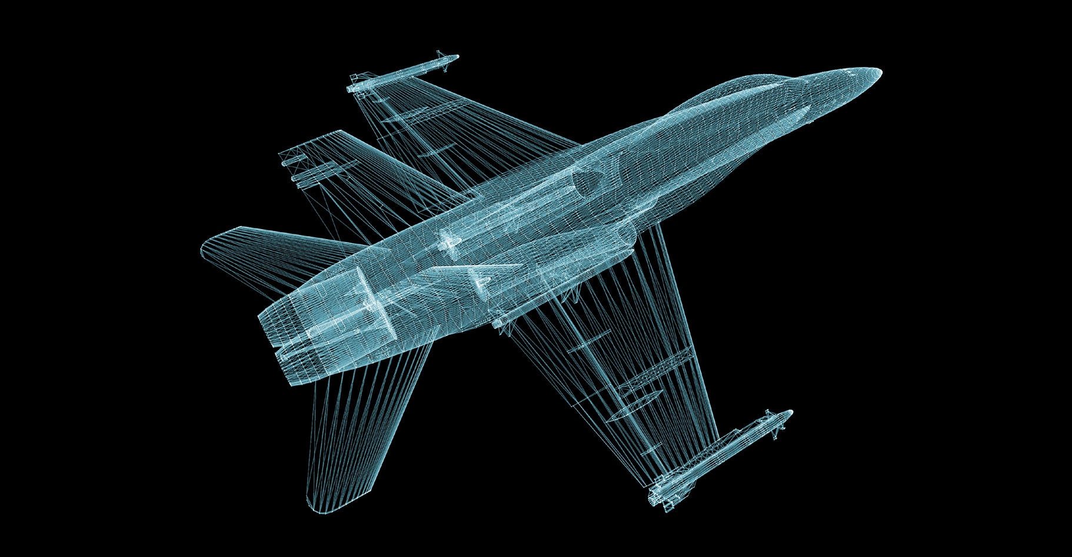
Systems Thinking
and
Digital Engineering
N.P. Whitehead, PhD
npw2w@virginia.edu
November 2024

Slide 2
Disclaimer
This presentation is strictly from
the perspective of N. Peter Whitehead, PhD.
It in no way reflects the perspective or opinions of any employers of Dr. Whitehead current or past, to include the RAND Corporation.
Please consider this perspective uniquely as such and do not draw any conclusions outside that scope.

Slide 3


In Memoriam
Bill Scherer, one of the great minds in systems engineering, my mentor, my friend, suffered an aneurism and passed away on October 30th.
“You can’t model your way out of thinking.” - WTS

Slide 4
Lecture Objectives
Suggest some outside the box aspects of systems engineering worthy of consideration
Provide new eyes for looking at digital engineering
and review a decision support framework
for evaluating the costs and benefits of digital engineering.
Report: https://www.rand.org/pubs/research_reports/RRA2418-1.html

Slide 5
A few key takeaways
Always distinguish: noise, metric, and index of performance – they are not the same
Information value
Who knows what? Information asymmetry
Not insignificant fraction of what good systems engineering is : to reduce information asymmetry in a program
Stakeholder analysis
Silicon Valley/VC hype versus critical thinking
Computer thinking versus systems thinking
left vs right brain
Coder brain versus reality brain
AI and its implication are a good manifestation
Supply chains – perspective, systems view
Understanding the DoD/USG mental model – above all policy predominates, not engineering

Slide 6
Digital Engineering Summary
DoD digital engineering is practiced in a complex environment with differing perspectives and approaches
The history shows that digital engineering is a policy, not an engineering approach. It is not goal driven in the systems engineering context.
We developed two frameworks for supporting resource decisions in leveraging Digital Engineering activities
  Cost-benefit Analysis
  Systems Engineering Evaluative Framework (SEEF)
Key takeaways:
  Definition and goal clarification are needed across practice
  Data collection will be engineering goal-based
  DoD absorptive capacity presents important risks
  DoD needs a better understanding of digital engineering risks

Slide 7
The Report
Background on digital engineering including literature survey
A DoD digital engineering cost-benefit analysis framework
A system engineering evaluative framework of digital engineering activity
A back-of-the-envelope case study using the mandatory sustainment KPP
Findings and recommendations

Slide 8
Background on Digital Engineering
Descriptive Scenario

Slide 9
History of Digital Engineering
UML – Universal Modeling Language - A failed graphical approach for developing software
  A tool (UML) in search of a purpose and a software perspective on systems
SysML – System Modeling Language - A dialect of UML
MBSE – A DoD policy circa 2007 to use SysML in acquisition
Digital engineering – A DoD policy circa 2018 where MBSE/SysML becomes the center of all DoD engineering

Slide 10
Key Findings from Literature Review of Costs & Benefits of Digital Engineering
Claimed benefits
  Knowledge transfer through communication and use of authoritative source of truth
  Quality of design via reduced error and improved testing
  Velocity and agility by reduced rework and earlier verification/validation
  Noise words: better, faster, cheaper
Evidence of benefits
  21 case studies of quantifiable metrics on cost and schedule illuminate the lack of counter-factual comparison to alternatives.
Inconsistent definitions of digital engineering across scholars and practitioners; further bogged by maturity differences
  Initial investments required to support digital engineering activities are in most cases still being made – 17 years after the MBSE policy, 7 years after the DE policy

Slide 11
Key Findings from Literature Review (2)
Lack of standardized practices for tracking digital engineering activities to their costs and benefits
  Costs often lumped in with costs of other program activities
  Benefits tend to be characterized as downstream, often difficult to link to specific Digital Engineering activities and arise in conjunction with other activities (e.g., agile acquisition approaches, use of open system architectures)
Proprietary nature of commercial costs structures inhibits disclosure of digital engineering costs
Pioneers of digital engineering may devote unequal time toward emphasizing benefits and neglect tracing costs
Once a metric becomes tracked, it may bias design in its favor

Slide 12
Digital Engineering Costs Rarely Specified in Literature
IT infrastructure required to support Digital Engineering | For maintenance model purposes alone, a single aircraft’s sensors would generate 10s–100s of terabytes of data per sortie (projected)ª A fully developed digital twin would require approximately 1 exaflop performance (projected)^{b}
Data, architecture | One MBSE system architecture demonstration exceeded $50M to establish (actual)^{c}
Models and tools | One project reported devoting a modeler to track the efforts of engineers and validate data during the transition to implement MBSE and migration from legacy practices (actual)^{d}
SOURCES: ª Light et al., 2022, p. 25; ^{b} West and Pyster, 2015; ^{c} Jacobs et al., 2021; ^{d} Cole et al., 2019, p. 208 NOTES: Costs not specified include bandwidth and connectivity (IT infrastructure); establishment of model access and traceability criteria, configuration management of models/data, and data rights/IP (standards, data, architectures); new digital deliverables, software (models and tools); labor required to develop and tailor digital models and tools to weapon system (workforce). See Light et al., 2022.

Slide 13
Digital Engineering Costs Rarely Specified in Literature pt. 2
Workforce | Digital Service Academy proposal: $800M up-front + $250K per student-year (projected)^{e} 23 other, less ambitious workforce development proposals combined: $500M per year (projected)^{e} Increasing DoD’s Digital Engineering workforce by 5% would cost approx. $500M per year (projected)^{e} Developing and operating high-fidelity digital twins and digital threads would require about 40,000 new graduates (about 25% of annual U.S. university throughput) (projected)
Total cost | Estimates can reach staggering proportions One study estimates that a high-fidelity DoD digital twin and digital thread collection would cost a total of $1–2 trillion (for digital twin) and $80–180 billion (for digital thread). Even at this level of investment, it would take a team of developers 1/3 the size of Microsoft’s about 250 years to complete^{f}
SOURCES: ^{e} Graham et al., 2022; ^{f} West and Blackburn, 2017
NOTES: Costs not specified include bandwidth and connectivity (IT infrastructure); establishment of model access and traceability criteria, configuration management of models/data, and data rights/IP (standards, data, architectures); new digital deliverables, software (models and tools); labor required to develop and tailor digital models and tools to weapon system (workforce). See Light et al., 2022.

Slide 14
Digital Engineering Discussions with Stakeholders
Discussions DoD | Discussions Non-DoD & Mixed
Naval Air Systems Command (NAVAIR) Naval Air Warfare Center Aircraft Division (NAWCAD) Systems Engineering Directorate, NRO Air Force Materiel Command Army Futures Command | Digital Engineering Communities of Practice Model-based Acquisition Community Defense Industry Non-Defense Industry Academia (e.g., Clemson, Iowa State) Professional associations (e.g., INCOSE)

Slide 15
Challenges Quantifying Digital Engineering Costs and Benefits
No two weapon system programs are the same
  Programs tailor their Digital Engineering approaches to address unique program needs
  Contractor and government responsibilities for Digital Engineering differ across programs
Limited empirical evidence of long-term benefits of Digital Engineering from DoD programs
  Digital Engineering literature paints a rosy picture of future benefits
SMEs emphasize Digital Engineering benefits to be concentrated in later lifecycle phases (e.g., sustainment)
  In one Digital Engineering pathfinder program, it was noted that Digital Engineering effort will increase program RDT&E costs, but help address schedule goals and program complexity
We never observe the counter-factual – better/worse than what exactly?

Slide 16
Challenges to Digital Engineering Assessment
No common definition of Digital Engineering across community
Digital Engineering costs not mapped to specific work break down structure (WBS) elements
Costs associated with Digital Engineering activities are rarely specified in program cost estimates, often merged with SETA and other costs
Digital Engineering benefits tend to be characterized as downstream and often difficult to link to specific Digital Engineering activities
The services are promoting the use of Digital Engineering broadly without requiring its application to weapon system goals or requiring data collection
  Air Force Instruction 63-101/20-101 (p. 68) states “The Program Manager utilizes Digital Engineering … to the maximum extent practicable.”
Lack of Digital Engineering risk awareness/analysis
  Modeling risks: availability heuristic, model aggregation, model assumptions
  Absorptive capacity

Slide 17
Our Digital Engineering Definition
Digitally provide Program Executive Offices, Program Managers, engineers and cost analysts with weapon system goal-focused information and decision support based on current, accurate design and system data. Leverage modeling and simulation according to good systems engineering practice and where cost effective to improve design and lifecycle operations and costs.
Navy: “An integrated, computation-based approach that uses authoritative sources of system data and models across disciplines to support lifecycle activities from concept through disposal.”ª
ª Naval-LIFT, "Naval Digital Engineering Body of Knowledge; Naval Digital EngineeringBoK - Naval-LIFT Wiki," 2023.
Weapon system is our shorthand for all programs where Digital Engineering is applied

Slide 18
Framework Part One:
A DoD Digital Engineering Cost-Benefit Analysis Framework

Slide 19
DoD Guidance for Cost-Benefit
DoD Instruction 7041.03, Economic Analysis for Decision-making, September 9, 2015 (Incorporating Change 1, October 2, 2017)
Air Force Instruction 65-501, Economic Analysis, October 29, 2018
U.S. Army, Cost Benefit Analysis Guide, 3rd Edition (V3.3), Updated as of: February 23, 2018
Department of the Navy, Economic Analysis Guide, 2013
Congressional Research Service, Cost-Benefit Analysis and Financial Regulator Rulemaking. Updated May 11, 2017
Military Cost-Benefit Analysis: Theory and Practice (Routledge Studies in Defence and Peace Economics), June 8, 2015 (by Francois Melese (Editor), Anke Richter (Editor), Binyam Solomon (Editor))
Defense Acquisition Guidebook – Trade Studies, September 21, 2022

Slide 20
Cost-Benefit Context
Two Contexts for Cost-Benefit Analysis (CBA)
Ex ante analysis: Considers the costs and benefits of proposed Digital Engineering activities to inform implementation decision | Ex post analysis: Evaluates how Digital Engineering activities performed (after the fact) using observed data on program outcome
SOME OBSERVATONS No formal ex post or ex ante assessments of Digital Engineering or MBSE implemented to date for DoD To conduct an ex ante analysis, one would hope to draw on findings from ex post assessment

Slide 21
DoD Instruction 7041.03
“A sound economic analysis recognizes that there are alternative ways to meet a given objective and that each alternative requires certain resources and produces certain results.”
  Assessment of the resources Digital Engineering requires and the alternatives
“The statement of the objective should clearly define and quantify (to the extent possible) the function to be accomplished. The statement of the objective should not assume a specific means of achieving the desired result.”
  Digital Engineering should not be a goal, but instead a means to a weapon system program goal
“Base economic analysis on facts and data whenever possible. Since economic analysis deals with costs and benefits occurring in the future, assumptions must be made to account for the uncertainties.”
  Digital Engineering costs and benefits should be based on empirical evidence; a range of possible outcomes should be acknowledged
“When quantification is not possible, the analyst should still attempt to document significant (qualitative) costs and benefits. Minimally, qualitative costs or benefits should be discussed in narrative format.”

Slide 22
Digital Engineering Cost-Benefit Analysis Steps
Understand the weapon system goals over its lifecycle and determine what type of analysis is needed
1
Identify and select specific Digital Engineering activities for analysis (e.g., develop and use of “digital models” for acquisition activities) and what would be done if Digital Engineering is not pursued
2
For each Digital Engineering activity, characterize what up front investments are required (e.g., investments in workforce, data rights, IT infrastructure, models/tools, etc.)
3
For each Digital Engineering activity (or for a set of Digital Engineering activities), characterize how they are expected to impact program cost, schedule, and performance/mission effectiveness over the weapon system’s lifecycle and any associated risk
4
Compare alternatives and document the results
5
Our approach recognized that many programs are in the process of implementing Digital Engineering,
but their costs and benefits are not likely to be fully understood at this point

Slide 23
Example Lifecycle Phase Digital Engineering Activities
Maturity Solution Analysis | Digital Engineering in analyses of alternatives Digital Engineering in requirement definition refinement
Technology Maturation and Risk Reduction | Model-based acquisition Digital Engineering in validation and verification planning RFP definition of digital deliverables
Engineering and Manufacturing Development | Digital platform for engineering decisions connecting government and contractor Digital milestone reviews Integration of Digital Engineering models & simulation into T&E flow Digital Contract Data Requirements Lists (CDRLs) Digital Engineering modeling and simulation in CPI protection

Slide 24
Example Lifecycle Phase Digital Engineering Activities (2)
Production and Deployment | Digital integration of design and manufacturing – Industry 4.0 Digital Engineering support for supply chain analysis & optimization Digital Engineering in operations and sustainment planning
Operations and Sustainment | Digital Engineering in multi-domain operations simulations of operations and logistics Digital Engineering in operator and maintainer training Digital Engineering applications in predictive maintenance
Retirement | Digital Engineering M&S support for recycling, re-use of weapon systems or components Digital Engineering M&S for optimizing destruction activities and disposal security

Slide 25
Cost Categories
IT Infrastructure Required to Support Digital Engineering Computing hardware Bandwidth and connectivity Cloud based services Physical infrastructure | Digital Engineering Standards, Data, Architectures Acquisition Reference Model, Government Reference Architecture, ASoT Simulation, models and data Configuration management of models, data Data rights and IP
Models and Tools Digital Engineering tools Workflow tools Engineering tools Translators, add-ons, graphics emulators, etc. | Workforce Systems engineering knowledge Labor required to develop and tailor digital models and tools to weapon system Workforce training on applicable software Workforce development plan

Slide 26
Identify and Assess Anticipated Benefits
Some literature citing empirical evidence of Digital Engineering benefits does not stand-up to scrutiny
Anecdotally: Digital models may reduce (but not eliminate) the need for costly physical prototypes
Anecdotally: Digital testing may reduce the iterations of physical testing needed, or refine the testing and evaluation plan more precisely, resulting in less spending on test and evaluation
Anecdotally: Digital Engineering efforts may allow greater optimization of requirements and manufacturing designs during production
Anecdotally: The systematic collection of weapon system data may aid in future maintenance and modification efforts and support competition
System complexity: Digital Engineering facilitates the engineering of highly complex systems
* Henderson and Salado, 2021.

Slide 27
Self-licking Ice Cream Come
A review of 847 published papers found that all but 2 papers report perceived benefits of Digital Engineering/MBSE without evidence and most noted benefits unrelated to cost.* This inspired us to develop a quantitative approach.

Slide 28
Framework Part Two:
A Systems Engineering Evaluative Framework
(SEEF) of Digital Engineering Activity

Slide 29

In the systems approach, concentration is on the analysis and design of the whole, as distinct from … the components or parts… The systems approach relates the technology to the need, the social to the technological aspects; it starts by insisting on a clear understanding of exactly what the problem is and the goal that should dominate solution[s] and lead to the criteria for evaluating alternative avenues… It provides for simulation and modeling so as to make possible predicting the performance before the entire system is brought into being. And it makes feasible the selection of the best approach from the many alternatives.
- Simon Ramo
SOURCE: Simon Ramo, Cure for Chaos; Fresh Solutions to Social Problems Through the Systems Approach, D. McKay Co., 1969.

Slide 30
Tenets of a Systems Approach
Concentrates on the whole system rather than components
Relates technology to need and social to technological aspects
Begins with a clear understanding of the goal
The goal should lead to the solution and evaluation criteria
Supports use of simulation and modeling to predict performance
Enables selection of best approach from alternatives
SOURCE: Simon Ramo, Cure for Chaos; Fresh Solutions to Social Problems Through the Systems Approach, D. McKay Co., 1969.

Slide 31
Framework Goals
Establish systems engineering goals for the use of Digital Engineering in a weapon system program
Leverage good systems engineering practice and the development of the systems engineering plan to empirically quantify the benefits, indices of performance (IoP)
1
Select Digital Engineering activities to achieve goals (contractor proprietary, Navy Digital Engineering Bok, other sources)
2
Translate goals into benefits
Logic model approach; associated risks (probabilistic costs)
3
Align costs to Digital Engineering activity per four established bins (hierarchical)
4
Map costs to benefits for decision support (NOT a CBA, more of a trade-study approach)
5

Slide 32
1. Establish systems engineering goals for the use of digital engineering in a weapon system program
Systems engineering goal definition approach
Joint Capabilities Integration and Development System (JCIDS) weapon system key performance parameter/key system attribute (KPP/KSA) approach
  Mandatory KPPs: Energy, System Survivability (Kinetic, Cyber, and EMS), Force Protection, Sustainment, Net-ready Performance Attribute
  System-specific KPPs such as modular open systems approach (MOSA)

Slide 33
KPPs and KSAs
KPPs provide empirical means to measure benefits from Digital Engineering
Example: Mandatory KPP Sustainment
  Material Availability
    Percentage
  Operational Availability, KSAs:
    Reliability (probability, 0.0-1.0)
    Maintainability (time)
    Total Ownership Cost ($)
Built from calculable metrics such as mean time between hard failures, mean time to repair, mean time between maintenance, and mean downtime
Associated Digital Engineering benefit metrics called Indices of Performance (IoP), e.g., percentage, dollars, days

Slide 34
2. Select Digital Engineering activities to achieve goals
Systems engineers working with design team engineers, manufacturing engineers, T&E, etc.
Lifecycle perspectives
Government-contractor engagement
  Spelled-out in RFP and contract
  Artifacts and models as CDRLs
Perhaps too many sources for tools
  Digital EngineeringBoK, NDigital EngineeringBoK, contractor proprietary, etc.

Slide 35
A Back-of-the-Envelope Case Study Using the Mandatory Sustainment KPP

Slide 36
3. Translate the goals into benefits: Material availability

Slide 37
3. Translate the goals into benefits: Operational availability
NOTE: reliability (R), maintainability (M), total ownership cost (C)

Slide 38
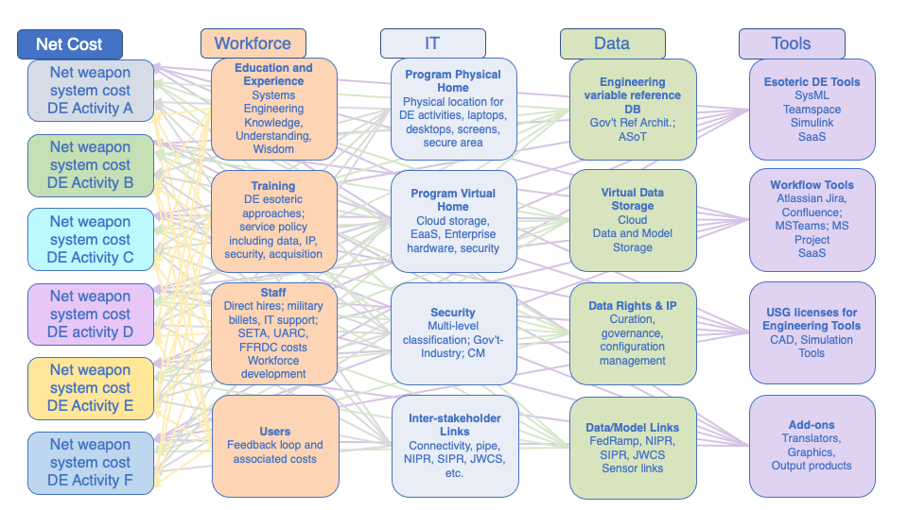
4. Align costs to Digital Engineering activity in four bins

Slide 39
5. Map costs to benefits for decision support

Slide 40
Findings and Recommendations

Slide 41
Our analysis resulted in two approaches to a Digital Engineering decision support framework
The two approaches evaluate the costs and benefits of Digital Engineering implementation over a weapon system lifecycle
  Cost-benefit analysis that can be used to consider costs and benefits of proposed Digital Engineering activities and/or to evaluate how well Digital Engineering activities performed after the fact
  Systems Engineering Evaluative Framework (SEEF) of Digital Engineering Activities, which makes it feasible to select the best approaches from many alternatives
These are first-pass approaches that would benefit from case study refinement, perhaps developing and using a facilitation tool

Slide 42
We identified numerous difficulties affecting
Digital Engineering decision support
Too many definitions
Not enough data and a need for DoD Digital Engineering data collection criteria
No counter-factual
Inconsistent and unreliable analysis: incorrect methods, marketing, pretending, and hubristic enthusiasm
Uncertain absorptive capacity—benefits not just a function of activities
Lack of understanding of Digital Engineering risks to costs and mission success—availability heuristic, model aggregation, communication of assumptions, and others

Slide 43
Backup

Slide 44
Systems Engineering Evaluative Framework
(SEEF) of Digital Engineering Activity
The Digital Engineering activities are selected for their ability to support the respective KPPs/KSAs
A logic model of the respective Digital Engineering activities shows the outcomes in support of the respective KPP/KSA. A risk column is added to correlate risks associated with the respective Digital Engineering activity
The outcomes of the Digital Engineering activity are described as benefits in achieving the respective KPP/KSA, thus linking the Digital Engineering activity to program performance. Associated risks may be added as probabilistic costs
Indices of Performance (IoPs) are delineated to track Digital Engineering activity benefits in terms of the respective KPPs/KSAs over the weapon system lifecycle
The weapon system lifecycle costs of the Digital Engineering activity are quantified in terms of 16 distinct bins and distributed across multiple KPPs/KSAs. Any probabilistic costs associated with risks may also be included as expected values if calculable
These data are gathered and analyzed to support Digital Engineering activity decisions over the weapon system lifecycle to retirement
SEEF makes feasible the selection of the best approaches from the many alternatives

Slide 45
Key Literature on Digital Engineering Implementation
Model-Based Systems Engineering
  Design management and reuse (Carrol and Malins, 2016)
  Architecture development and management (Zimmerman et al. 2019)
  Architecture modeling, simulation & evaluation (Soegaard 2016)
  Verification and Validation (Carrol and Malins, 2016)
  Provide a shared repository for capturing technical history, decisions, knowledge, etc. (Mitchel 2014, SWFTS)
Digital Twins
  Automated fabrication and labor assistance (Lockheed Martin)
  Scan parts to identify non-conformity (Boeing)
  Demonstrations to understand uncertainty in performance parameters (Air Force)
Digital Threads
  Support for manufacturing process for composite parts (Lockheed Martin)
MBSE, Digital Twins, and Digital Threads Combined
  Manage information through authoritative source of truth (SWFTS)
  Drive computer-aided machines with 3D models (Army Depot)
  Update training and repair manuals. (Army Depot)
  Planning and deconfliction of engineering details (Navy, Tactical Assault Light Operator Suit).

