Slide 1
Digital Engineering is too important to be left alone to MBSE Practitioners
Rao Mannepalli
Chief Scientist
Leidos, USA
Copyright © by Rao Mannepalli/Leidos
Published by the American Institute of Aeronautics and Astronautics, Inc., with permission.
doi of this presentation: 10.2514/6.2023-3772.vid
doi of full paper: 10.2514/6.2023-3772

Slide 2
Disclaimer
This paper does not discuss any specific details of any weapons system or program other than those published in the Government Accountability office (GAO) and Congressional Research Service (CRS) reports.

Slide 3
Motivation
Weapon systems are becoming more complex and expensive
Most of the time these are system-of-systems.
Cost overruns of the top 10 weapons systems alone make it the 3rd largest defense budget in the world.
The cost overruns of all the Major Defense Acquisition Program (MDAP) portfolio programs tops half-a-trillion dollars, making it the undisputed 2nd largest defense budget in the world.
We are still using some systems developed more than half-a-century ago (like PARCS radar, UWER radar, and B-52
Maintaining and sustaining these systems - designed with slide rules, pencils and paper - is becoming exceedingly expensive.
In the case of some systems like PARCS, where the documentation was partially destroyed as per the Anti-Ballistic Missile Treaty, the problem is even worse.
Hence something must be done.

Slide 4
Inadequate Systems Engineering
“Inadequate Systems Engineering” is almost always the critical factor in troubled programs.
Systems Engineering, since the days of Bell Labs where the word was first coined morphed several times to the current state where it has become tool centric and lost much of its original purpose of guiding the development of systems (in particular large and complex systems like 5ESS and Aegis BMD both are 100 million lines of code class).
If it does not adapt to the changing technologies, it will soon be relegated to history.

Slide 5
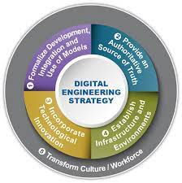
Digital Engineering
To solve some of these problems, in 2018 Digital Engineering strategy was unveiled
It has 5 elements/pillars
  Formalize the development, integration, and use of models to inform enterprise and program decision making.
  Provide an enduring, authoritative source of truth.
  Incorporate technological innovation to improve the engineering practice.
  Establish a supporting infrastructure and environment to perform activities, collaborate, and communicate across stakeholders.
  Transform the culture and workforce to adopt and support digital engineering across the life cycle.

Slide 6
Problems with the vision
I have two problems with this vision
  First: the name “Digital Engineering”
  Second: the concept of Model
The strategy/vision is laudable in terms of breadth & depth, and it goes much beyond “Engineering”
However, there is certain poverty of imagination (to borrow a term from AWK programming language which was named with the initial letters of its 3 creators (Aho, Kernighan and Weinberger of Bell Labs) in selecting the name.
There is no problem with the “Digital” part of it. Now a days everything is Digital and IT is called “Digital Technology”
It is the “Engineering” part I have trouble with
However, if we interpret “Engineering” as in “Engineering a political coup” rather than “Engineering in Mechanical/Electronics/Systems/Software Engineering.” It will solve the problem (i.e., It is a process of accomplishing some task)
I derived the inspiration from the creators of the UNIX operating system (Ritchie and Thompson) at Bell Labs.
In Bell Labs Technical Journal they wrote, “UNIX supports Free Text”. However, the term “Free” is more like “Free” in “Free Speech” rather than “Free” in “Free Beer”
The term “Free” is more like “Free” in “Free Speech” rather than “Free” in “Free Beer”
-- Ritchie & Thompson

Slide 7
Specialties needed for developing new weapons systems
Defense Acquisition Workforce Improvement Act (DAWIA) offers certification in the following areas:
      Auditing
      Business Cost Estimating
      Business Financial Management
      Contracting
      Facilities Engineering
      Industrial/Contract Property Management
      Information Technology
      Software
      Cybersecurity
      Life Cycle Logistics
      Production, Quality and Manufacturing
      Program Management
      Purchasing
      Small Business
      Systems Planning, Research, Development and Engineering.
      Program Systems Engineering
      Science and Technology Management
      Test and Evaluation
The certifications I need to get when I worked for SPAWAR, US Navy, DOD are highlighted in Yellow

Slide 8
Some of the Models
Specialty Engineering Models
Management Models
Cost Models
Design Models
Manufacturing Models
Verification and Validation Models
Digital System Models
Product Support Models
Acquisition Reference Models
Government Reference Models
Performance Models
Reliability Models
System Safety Models
Cybersecurity Models
Maintainability and Sustainability Models
Environment Models
Quality, Safety, and Mission Assurance Models
Human Performance Requirements Models.
The above list is NOT exhaustive

Slide 9
Current state of Digital Engineering
DOD’s Digital Engineering initiative requires all new acquisition programs include the language of Digital Engineering
Hence each DOD component came up with its own vision of Digital Engineering.
Some of their requirements are so broad, deep, and ambitious that trying to develop these digital system models for all the systems, including legacy systems, will not only make Norm Augustine’s XVI Law a reality but probably will move the target date from the predicted 2054 to 2044.
Hence most of the Defense and Aerospace companies are in a quandary.
Moving to wholescale Digital Engineering does not justify the ROI and mostly cannot be funded. But DOD requirements mandate Digital Engineering.

Slide 10
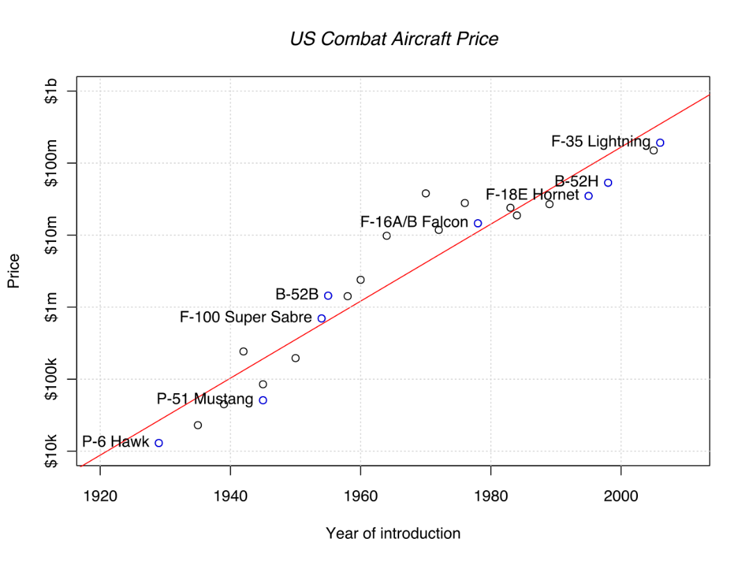
Augustine’s Law# XVI
Norm’s most cited law is number 16, which shows that defense budgets grow linearly but the unit cost of a new military aircraft grows exponentially:
“In the year 2054, the entire defense budget will purchase just one tactical aircraft. This aircraft will have to be shared by the Air Force and Navy 3½ days each per week except for leap year, when it will be made available to the Marines for the extra day”

Slide 11
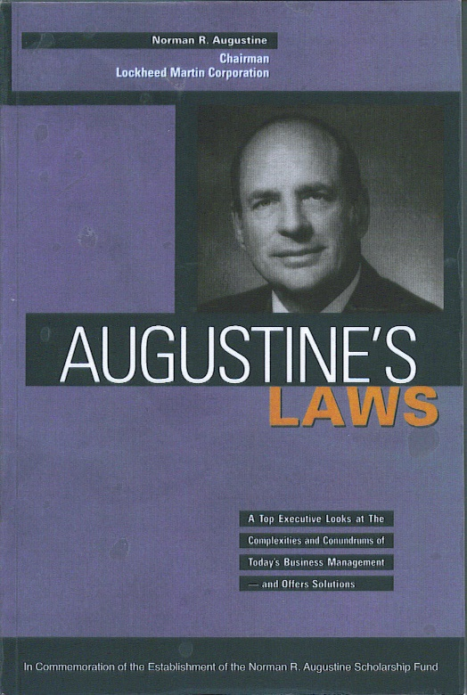
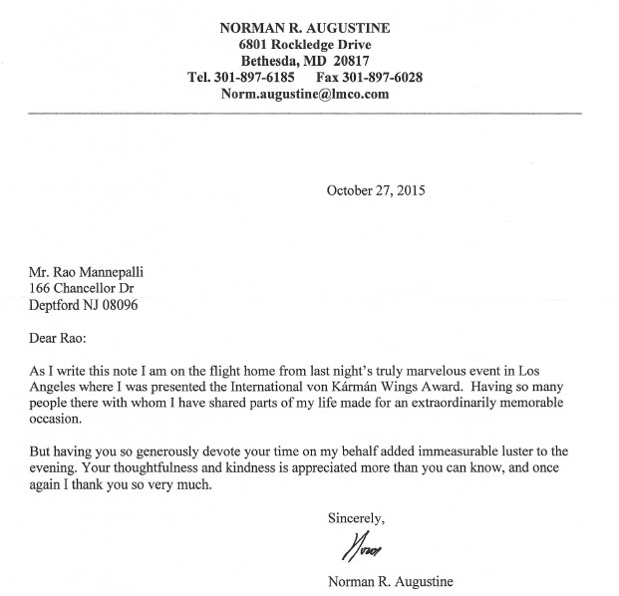
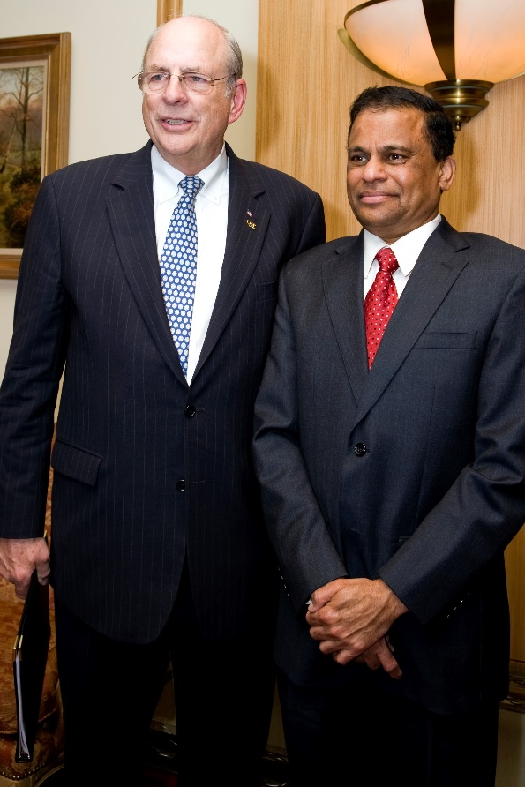
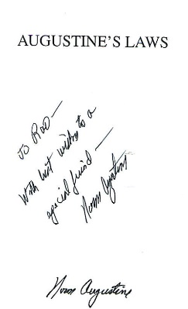
Norm Augustine

Slide 12
Augustine’s Law# XVII (Software)
“Software is like entropy. It is difficult to grasp, weighs nothing, and obeys the Second Law of Thermodynamics; i.e., it always increases”
Interesting anecdote: When Norm was presenting his Law# XVI to the USAF top brass, a general remarked, “Norm it is also true that the cost is increasing exponentially. At the same time the fighter planes are getting smaller every decade. If you extrapolate, soon a fighter plane will cost infinity and weigh nothing. Is it not contrary to the laws of physics?”. For this Norm replied, “Software accomplishes that seemingly impossible feat”

Slide 13
Aerospace Industry is in a Quandary
Hence most of the Defense and Aerospace companies are in a quandary.
Moving to whole scale Digital Engineering does not justify the ROI and mostly cannot be funded.
But DOD requirements mandate Digital Engineering.
The systems engineers found a solution.
They stretched the definition of MBSE and equated it to Digital Engineering.
Hence, whenever and wherever the government requests Digital Engineering, MBSE is used as the answer
However, MBSE is a small part in Systems Engineering which is a small part in Engineering which is a small part in the scope Digital Engineering
This is similar to the switching from 4G to LTE by AT&T
“AT&T flipped a switch and converted their entire network to LTE. Interestingly the flipped switch was not in their Engineering department but in their marketing department”

Slide 14
Why this undermines the spirit of Digital Engineering?
Most of the output/work products of of MBSE is a collection of mostly static SysML drawings
This is similar to the “Flowchart Curse” Brooks described in his “Mythical Man Month”.
During this process, the spirit of Digital Engineering is lost.
Only systems engineers are concerned with it.
Even though most major aerospace companies have been using models encompassing all the domains enumerated in the DOD’s vision, there is no coordination among these development efforts and the synergies are not optimized.
Their efforts are not considered as a part of Digital Engineering.
Flow chart curse: “The flow chart is a most thoroughly oversold piece of program documentation. Many programs don't need flow charts at all; few programs need more than a one-page flow chart”
- F. P. Brooks in “Mythical Man Month”

Slide 15
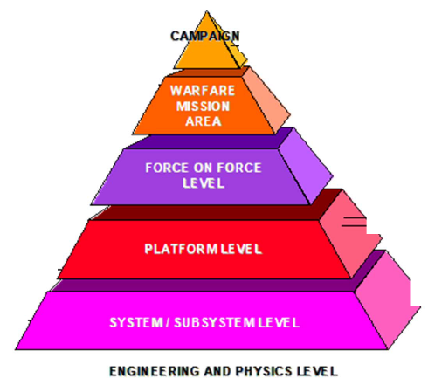
Models an in Modeling & Simulation (M&S)
Before the dawn of Digital Engineering, (and even MBSE) the most popular use of the models was in the M&S community.
Models are used to produce real and tangible results that cannot be obtained by modifying and experimenting on an existing system.
They can also be used to obtain such results at lower cost, in a more repeatable way.
M&S played a major role in the development and analysis of military systems.
These models are developed at different levels (commonly known as the M&S pyramid) with varying levels of fidelity and sophistication.
Highly complex systems-of-systems are analyzed by distributed simulation using independently developed models federated using High Level Architecture (HLA) and Distributed Interactive Simulation (DIS)
M&S is mostly the domain of designers and operational analysts.

Slide 16
MBSE (from INCOSE)
MBSE supports the systems engineering activities of requirements, architecture, design, verification, and validation.
These models have to be connected to the physics-based models used by other engineering disciplines such as mechanical and electrical engineering to be useful.
One challenge remaining for Digital Engineering is the integration of MBSE with physics-based models.
Even though the term “MBSE” first appeared in the book “Model-Based Systems Engineering" in 1993 it came into prominence during the early 2000s when it became associated with Systems Modeling Language (SysML) and championed by INCOSE.
Due to the composition of INCOSE membership (mostly systems engineers) and the prevailing problems with the document-based systems engineering methods used at that time, systems engineers embraced it. Tool vendors pushed it as the “Silver Bullet” for improving engineering efficiency and lowering development costs. Technology, in particular in software and systems domains, is no stranger to Silver Bullets. These are discussed in more detail later.
Models are not new concepts. Even before the advent of MBSE, there were Model Based Engineering (MBE), Model-Driven Engineering (MDE) and Model-Driven Development (MDD)

Slide 17
Origin of the word “Model”
The term originally denoted the plans of a building in late 16th-century English and derived via French and Italian ultimately from Latin modulus, a measure.
Models can be divided into physical models (e.g., a model plane) and abstract models (e.g., mathematical expressions describing behavioral patterns)

Slide 18
What is a Model in MBSE?
The systems engineering community stretched the definition of the Model.
With the advent of tools like Cameo and Rhapsody, creating static pictures/drawings became very popular.
They started defining the SysML artifacts as “Models” although they are mostly static pictures, not executable models, and cannot answer difficult questions like the ones shown later (Aegis Ballistic Missile Defense System, Solar power plant and others).
Some MBSE practitioners started calling anything and everything a “Model”.
For example, system requirements uploaded to a DOORS database became a “Model”.
Some even started calling the original text document a “Descriptive Model”.
Such an informal, permissive and imprecise definitions are like performing surgery with blunt tools. Everyone suffers.
There are already too many “CAC cards ” and “A2/ADs” in our business and they are not helping the cause.
Even DODAF jumped on the Model bandwagon and started calling almost everything a Model and UAF is not far behind
The real Digital Engineering effort is greatly harmed by these lax definitions of “Models”.
When everything is a “Model” there is no need or motivation to develop real Digital Models that are useful.
Moreover, developing real models that can answer difficult questions (like those shown in the examples later) needs effort, thought, and concentration in addition to resources (experts, time, and money).
For example, a weather map displayed on the TV during weather bulletins is not a “Model”.
The real weather model runs on high performance computers. The blueprint of a house is not a Model. The real 3-D model generated using CAD software is the real model.

Slide 19
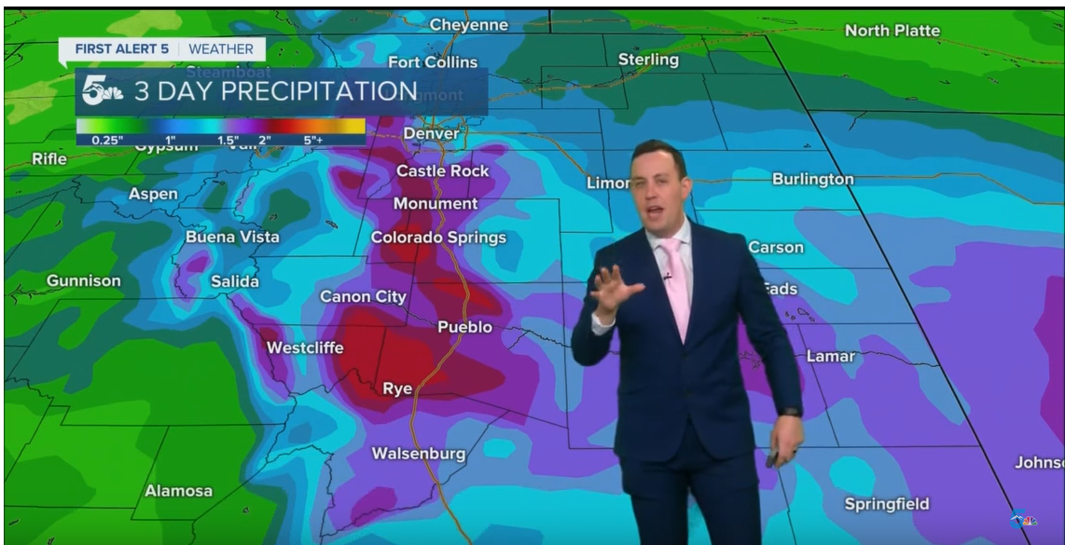
Climate : Weather Map is NOT a Model
High-impact storm with heavy rain, flooding, and at least a foot of snow above 7,000 feet

Slide 20
Climate Model (Real Model)
Manipulating the vast datasets and performing the complex calculations necessary to modern numerical weather prediction requires some of the most powerful supercomputers in the world.
Even with the increasing power of supercomputers, the forecast skill of numerical weather models extends to only about six days.
Factors affecting the accuracy of numerical predictions include the density and quality of observations used as input to the forecasts, along with deficiencies in the numerical models themselves.

Slide 21
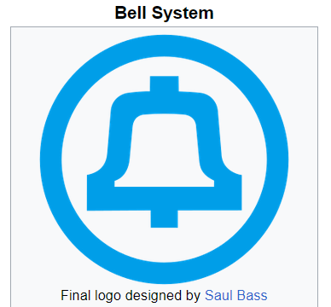
Who is an Original Systems Engineer at Bell System?
The term “Systems Engineering” originated at Bell Labs
It is not the omnipotent role that is being made of now.
In those days, the telephone system was called the “Bell System”.
The folklore is: There is a charge code for every major technology (e.g., Area-11 (fundamental research), electronics, switching, amplification, transmission, billing, etc.)
There is one even for IEEE
There are some people who work on improving the system in general without any specific specialty. Those people are called systems engineers (people who work, in general, on Bell System without an identifiable specialty).

Slide 22
MBSE is no Silver Bullet, and in fact “There is no Silver Bullet”
Contrary to popular belief ,MBSE is no silver bullet. In fact, there are no Silver Bullets in any discipline
However, from time immemorial people have always touted silver bullets . Some of them are:
  Structured Programming
  “GOTO” statement considered harmful
  Structured programming with GOTO statements
  Literate Programming
  ALGOL programming language
  Simple and systematic programming languages
  Proving programs to be correct (“I have not tested this program. Only proved it to be correct”)
  Beauty is our Business
  Software Engineering (“Software Engineering: An Idea Whose Time Has Come and Gone”, “Software engineering should be known as ‘The Doomed Discipline’, and aimed to guide people who can't program”)
  Object Oriented Programming (OOP) (“An exceptionally bad idea which could only have originated in California.”)
  CORBA (Common Object Request Broker Architecture)
  CMM, CMMI, and CIMM
  Agile (“Agile is no silver bullet “)
  UML (“Death by UML Fever: Self-diagnosis and early treatment are crucial in the fight against UML Fever”)
  Flowcharts (Flowchart curse)
  The Waterfall method of software development was an innovation when it was introduced in the 1950s during SAGE development
  Artificial Intelligence (AI) (“AI had a long and glorious history. It started in 1956 and ended on Oct 24, 2011”, Grandmother hack of ChatGPT
Interesting observation: Two waterfalls (much maligned in the Software world) when put back-to-back become a respected “V” of systems Engineering

Slide 23
Digital Twin
A Digital Twin is a related yet distinct concept to Digital Engineering.
The Digital Twin is a high-fidelity model of the system which can be used to emulate the actual system.
Modeling and Simulation (M&S) is very closely related to Digital Twins
There is a lot of confusion in what constitutes a Digital Twin.
The simplest and most practical definition is: It is a computer program which can answer the questions about the real physical system without the need to modify and experiment with the real system.
More often than not, the real system is either not available, not yet built, cannot be experimented with, and prohibitively expensive in terms of cost, schedule, and complexity.
The best example is the software model developed by Lawrence Livermore Labs to check the effectiveness of nuclear warhead stockpiles.
Real testing of them is no longer possible due to the Comprehensive Nuclear-Test-Ban Treaty (CTBT)
A general rule of thumb: Unless there are equations (often complex equations) it is either not a Digital twin or a useful twin.

Slide 24
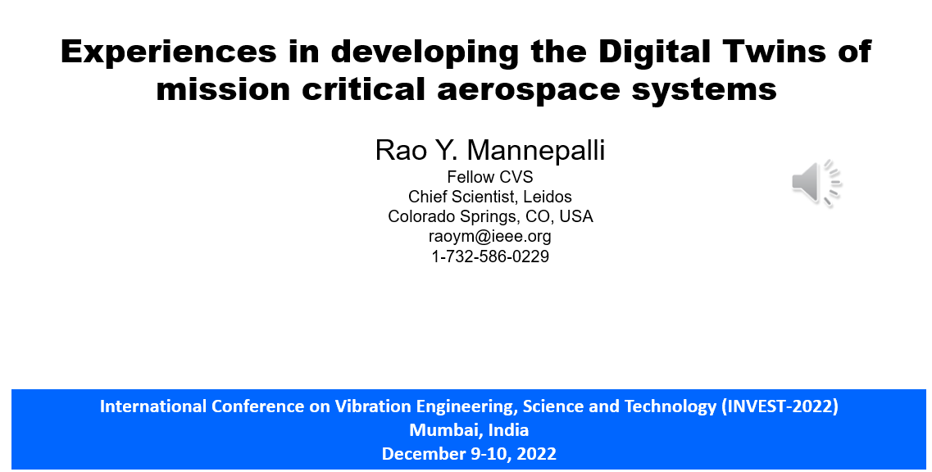

Slide 25
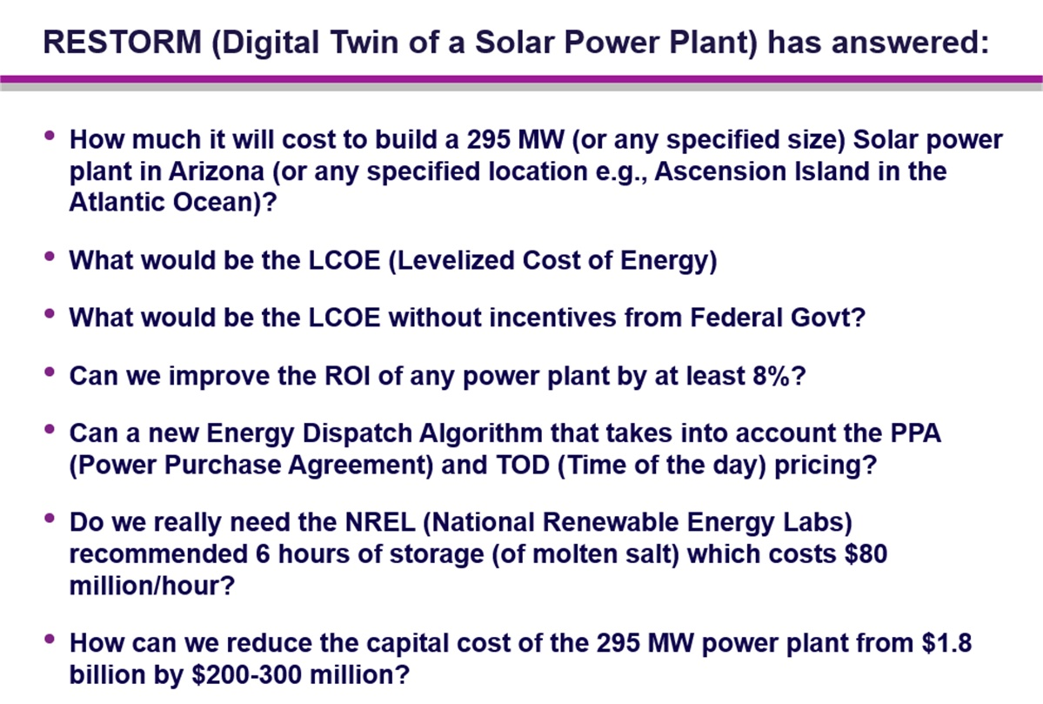
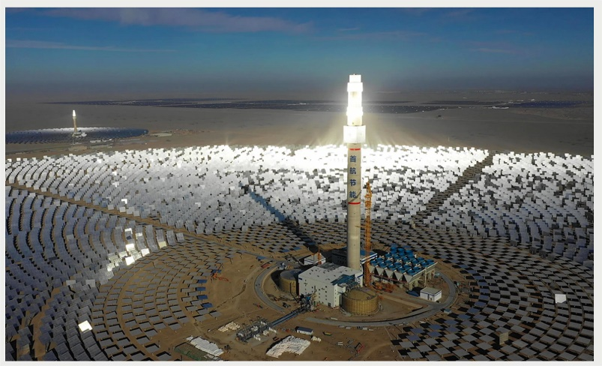
Some examples of Digital Twins

Slide 26
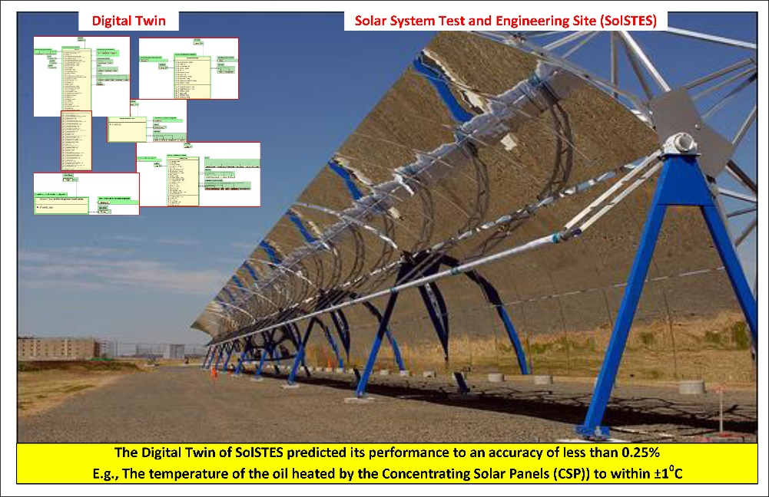
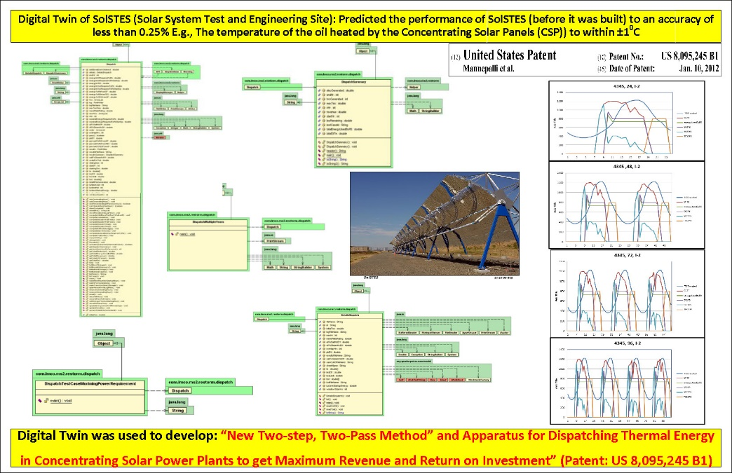
SolSTES

Slide 27
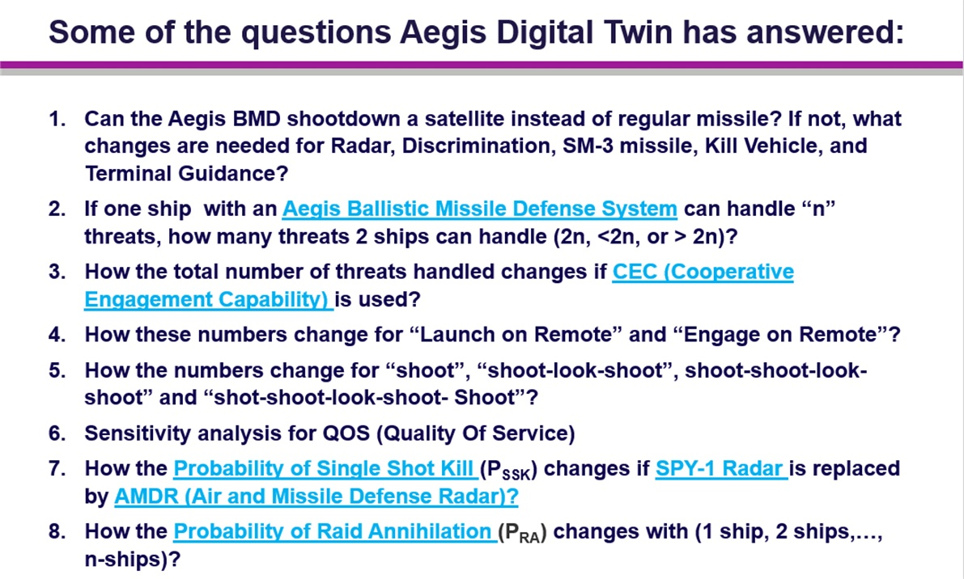
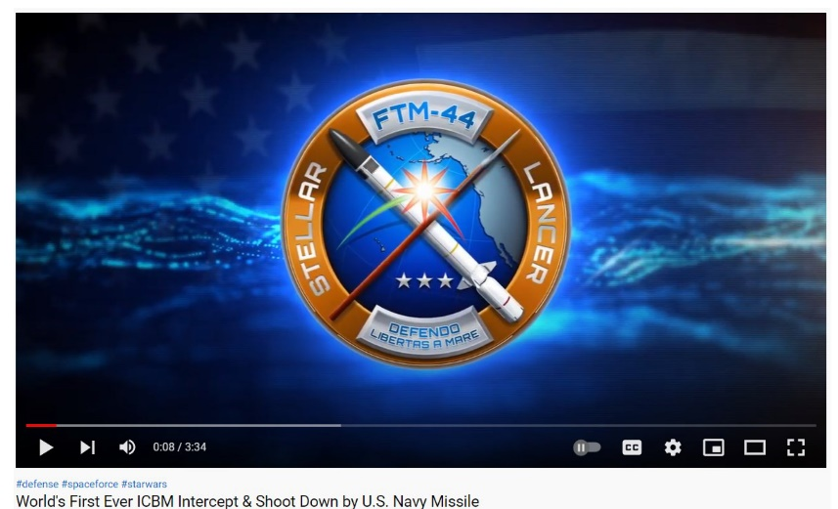
Aegis Shots down an ICBM (FTM-44)

Slide 28
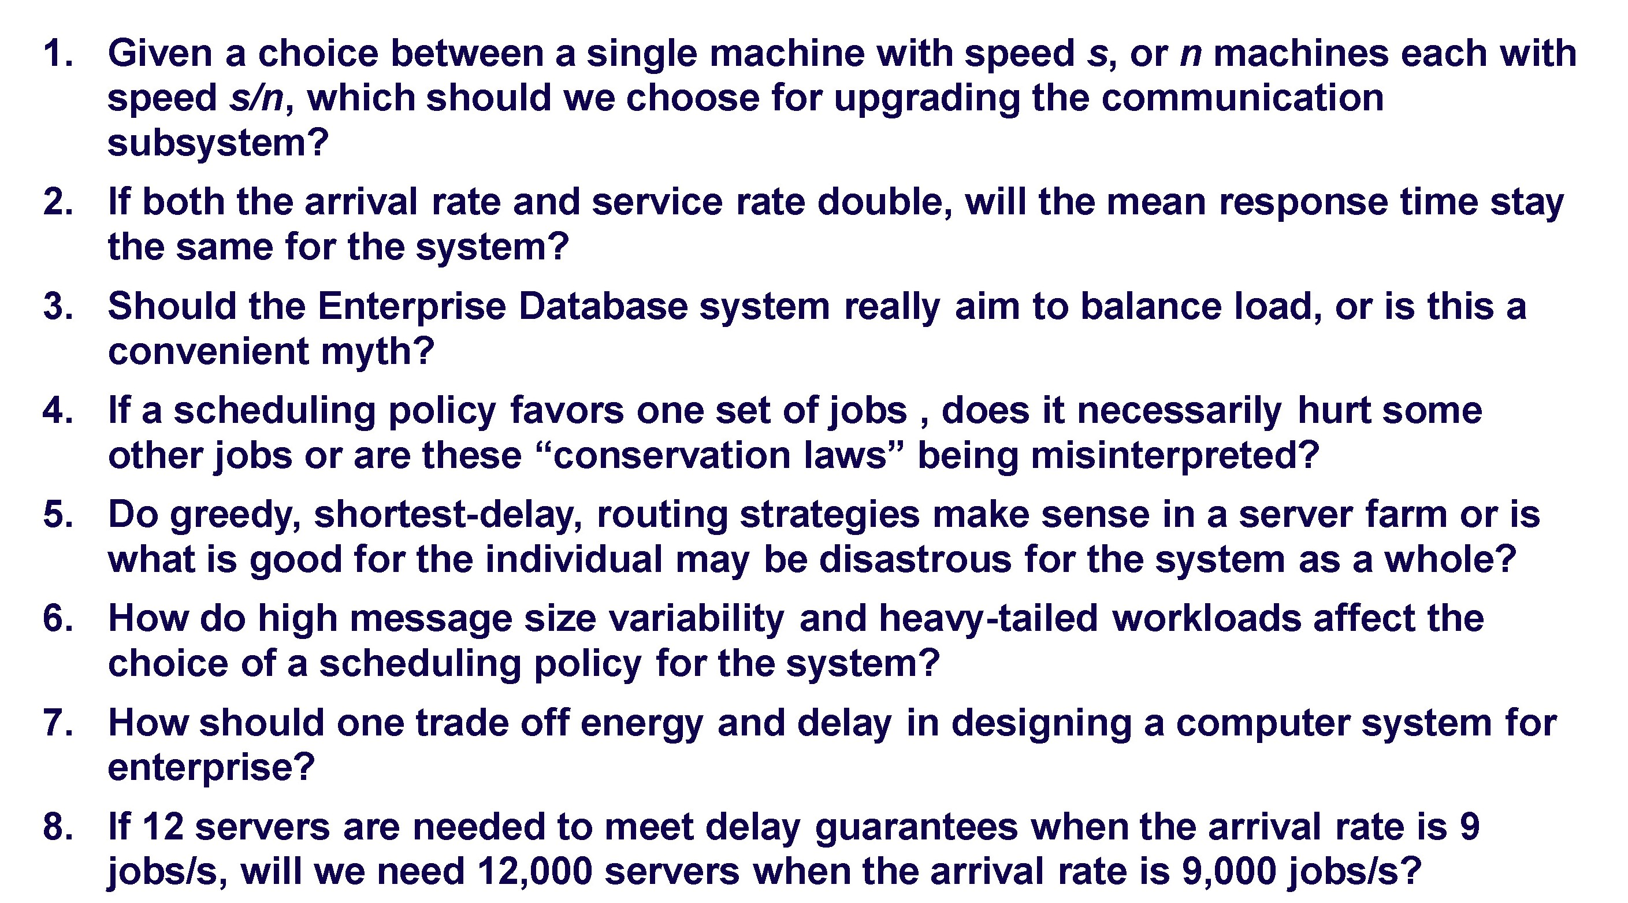
The Digital Twin of a Communication Processing system has answered:

Slide 29
Multi-Mission Analysis Tool (MMAT) for DD(X) developed entirely using only UML
Throughout my professional life I have seen only one example where the requirements taken from the documents were used to create the UML artifacts using Rational Rose which were then enhanced using Rational Rose Real-time [which are used to generate the executable code.
The lessons learned are:
  The effort required is not less. In fact, in some cases, it is much more than the normal methods
  The code generated is not human readable
  In spite of recent advantages in compiler optimizations, the efficiency of generated code is suboptimal both in terms of space and time

Slide 30
Best Practices for developing Digital Twins
Don’t get hung up on the tools (in particular vendor promoted Silver Bullets”
Do it incrementally, optimum fidelity to answer the questions
Do not generate dead-end artifacts (e.g., static pictures which cannot be used in the next phase of development (e.g., Automatic code generation, Automatic text script generation)
Follow Unix culture. The last bullet is most important. If we can eliminate any step by using technological advances (pillar-3 of the Digital Engineering vision) eliminate it. If ChatGPT can generate the code from the documents (or even emails, voice memos) then use it.
Keep “Model Developer’s Dilemma” in mind

Slide 31
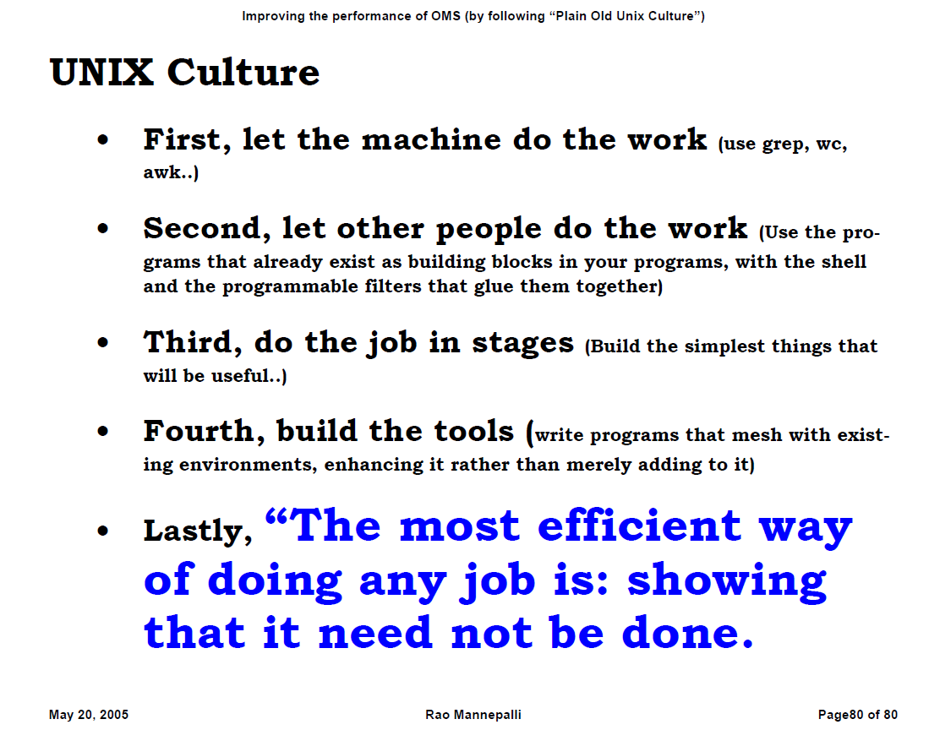
UNIX culture

Slide 32
Preventing the Digital Twins from becoming Evil Twins
Digital Twins are very useful in finding the answers which could not be obtained easily using the real systems (Physical Twins).
However, after some initial successes people tend to trust them blindly and take critical decisions based on their results.
This is where the Digital Twin becomes an evil twin
Some of the steps to guard against this are:
  Be skeptical about the results
  Remember the worlds of Aristotle
  Try to cross check the results from a system of lesser fidelity (if available)
  If possible, use the data obtained from the real system to periodically update the underlying model
  If the system is really critical (like validating the effectiveness of nuclear weapons) use the method used for Space Shuttle Avionics System

Slide 33
Incorporating technological innovations
This is the 3rd and probably most important initiative in the Digital Engineering vision.
A number of disruptive technological innovations are coming onto the scene.
They will revolutionize the way systems are designed and developed.
For example, the field of Computer Science is headed for a major upheaval with the rise of large AI models such as ChatGPT that are capable of performing general-purpose reasoning and problem solving
We are headed for a future in which it will no longer be necessary to write computer programs.
These technologies can fuse Unstructured, Uncertain, Incomplete, Imprecise, and even Contradictory (UUIIC) information from all sources (documents, audio, video, web, emails, hidden web etc.) and generate the final systems probably using 3-D printing .
This will make the current processes obsolete, including the systems engineering

Slide 34
What are the main problems?
By concentrating almost exclusively on the tools like Cameo and UML/SysML artifacts which more often than not are dead ends and not seamlessly integrated into the Systems Development Life Cycle, we are wasting valuable resources.
Increasingly Systems Engineering is being lumped with Testing (Systems Engineering, Integration and Testing (SEIT)).
It is interesting to note that almost always System Engineering, in particular MBSE (Model based Systems Engineering) is touted as a great improvement on the document-based processes.
However, almost always, the idea for a new system or capability starts with a Capability Development Document (CDD).
I am yet to see where the requirements form the user starts with SysML artifacts.

Slide 35
Software Development is moving ahead
Software development a.k.a computer programming also went through its own tool centric mania
However, with the advent of A.I, LLMs, ChatGPT and Copilot the software development is witnessing huge gains in productivity and quality
Programmers are not spending their time and energy in creating UML diagrams.
The LLMs can directly take the requirements from Unstructured, Uncertain, Incomplete, Imprecise, and even Contradictory (UUIIC) information from all sources (documents, audio, video, web, emails, hidden web, etc.) and generate the final systems probably using 3-D printing.
This will make the current processes obsolete, including Systems Engineering and computer programming.
Even though this is not yet perfect and ready for prime time, they are progressing in the right direction.

Slide 36
Why Systems Engineering needs to change?
In this changing landscape, unless Systems Engineering jettisons its marbles (Cameo, SysML, Models, etc.) and try to become an integral part of the system development life cycle, soon Systems Engineers will be extinct like the office typists and stenographers of yester years.
By concentrating almost exclusively on MBSE to the detriment of Modeling, Simulation and Analysis (M&SA) which is a valuable tool for the designing the system and conducting the Analysis Of Alternatives (AOA), Systems Engineering will lose its relevance.

Slide 37
One example
Any major weapons system needs to estimate the cost and schedule (before it gets approved and funded)
SEER-SYS and SEER-SEM are generally used for estimating the effort for Systems Engineering and Software Development
COCOMO (Constructive Cost Bodel) by Prof. Bary Boehm is the path breaker

Slide 38
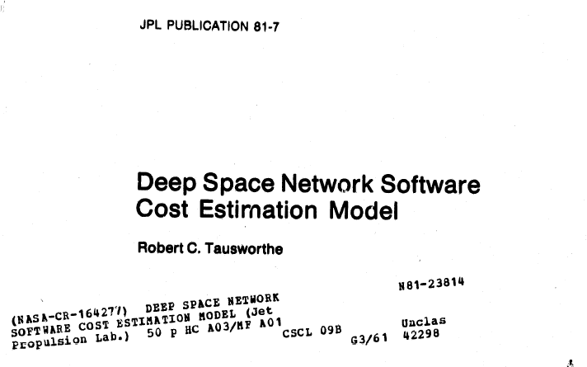
How was this done during the stone age (1960s)?

Slide 39
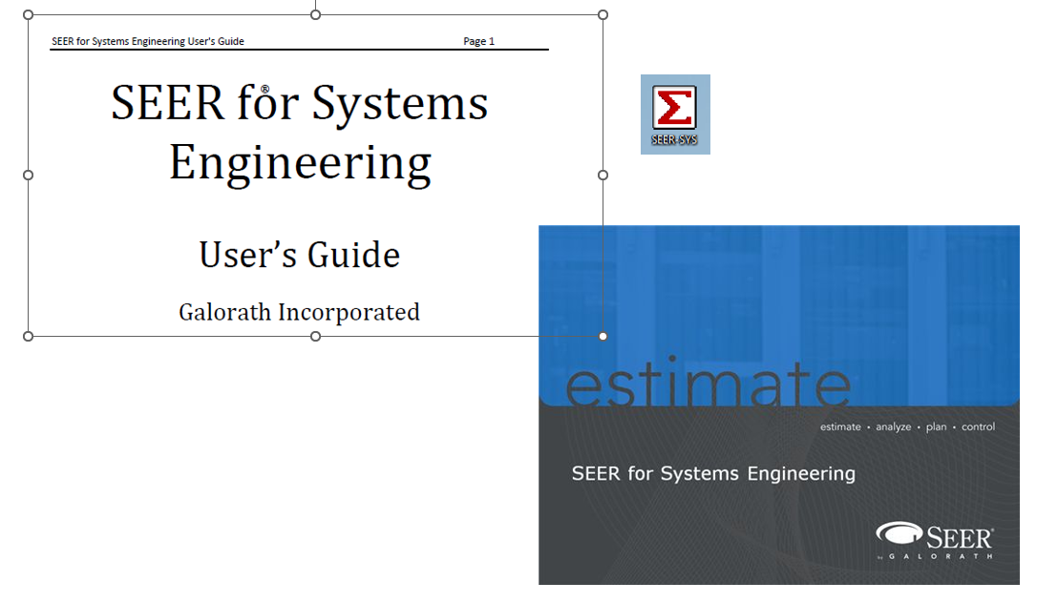
SEER-SYS

Slide 40
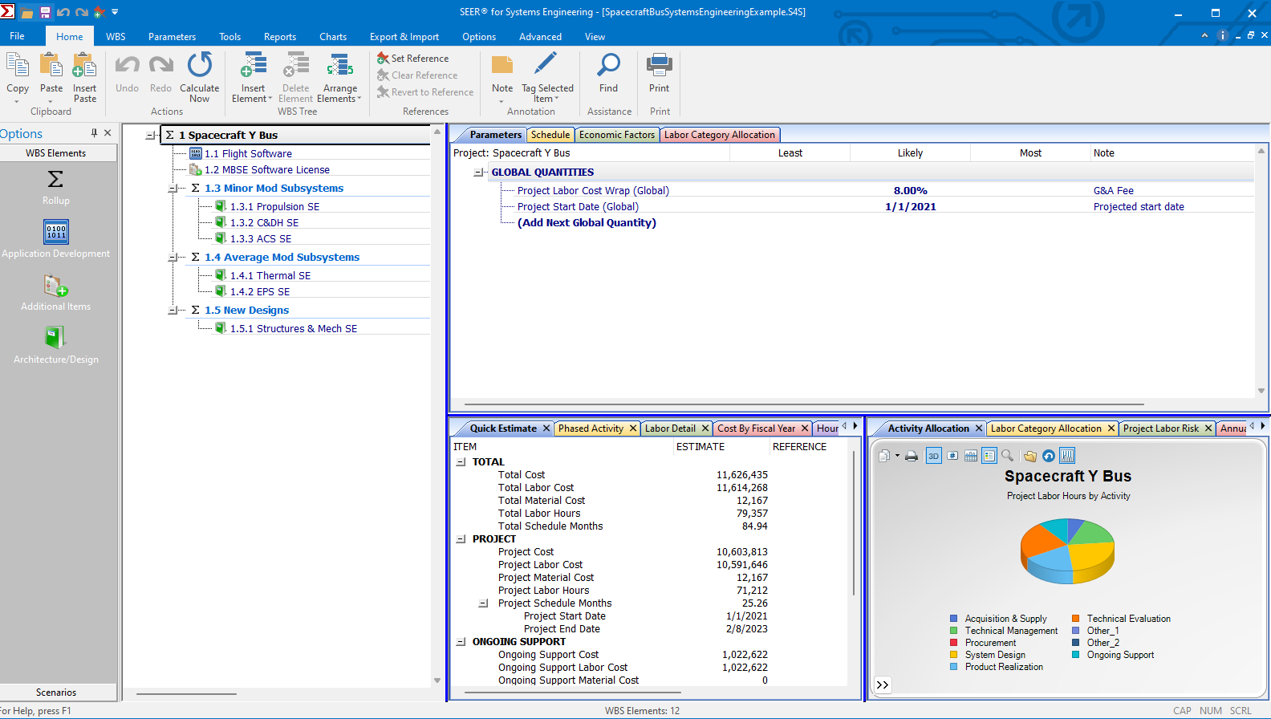
Example project( Spacecraft Bus Systems Engineering)
Problems
Tedious
Labor intensive
Error Prone
Needs specialized Knowledge

Slide 41
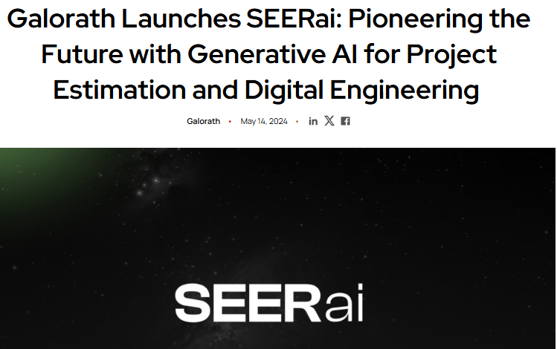
SEERai

Slide 42
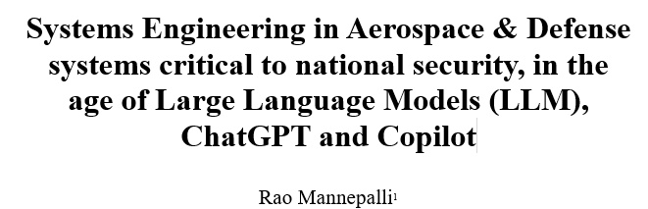
My vision for systems engineering

Slide 43

Conclusion
Digital Engineering is a misnomer and there is certain poverty of imagination in choosing that name.
It is not specific to Engineering (much less systems engineering) but encompasses all the specialties involved.
Engineering is a small part of it and System Engineering is a small part of Engineering.
We need to come up with a new name for it which all disciplines can relate to.
At present only systems engineers are paying any attention to it and unfortunately, they are equating to MBSE.
This way we will fail to realize the full potential.
We should refrain from calling everything a “Model”.
MBSE should not be equated to Digital Engineering, as currently being done in the Govt, Industry and Academia. The main motivation or justification for MBSE is “Document based process is bad.”.
However, I am yet to see a program where the original requirements are in any form other than documents.
If AI can parse those documents and generate the requirements or even final executable software, we don’t need Systems engineering, MBSE or even Software Engineering.
We must not flip a switch ,like AT&T did in its marketing department, and make MBSE the Digital Engineering.
There is no Royal Road to Digital Engineering.
Model
Model

Slide 44
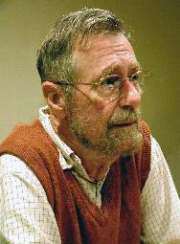
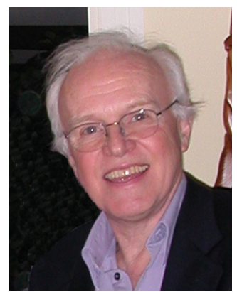

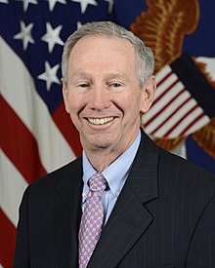
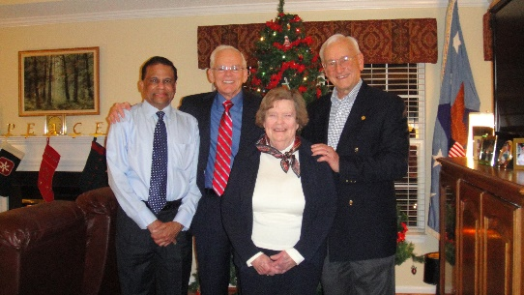
Acknowledgments
I want to acknowledge the inspiration derived from
  Alex Bell's “Death by UML fever”,
  Tom Demarco's “Software engineering an idea whose time has come and gone” and
  Dijkstra’s “Software engineering should be known as ‘The Doomed Discipline’ and should have its charter ‘How to program if you cannot’.".
I also want to express my sincere thanks to Mr. Norm Augustine, Dr. Paul Kaminski, and Dr. Mike Griffin who reviewed the draft and provided valuable comments.

Slide 45
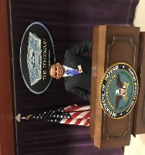
Rao Mannepalli
Rao is currently working as the Chief Scientist of Leidos, USA. He has more than 30 years of international, multi-industry and multi-cultural experience as Division Head, Program Manager, Chief Engineer, Chief Scientist, Chief Architect, and Principal Developer at Leidos, Raytheon, US Navy, Lockheed Martin, Bell Labs, and Indian Space Research Organization (ISRO). He was a member of high-level Senior Executive Service (SES) that needs the approval of the Federal Cabinet of Ministers.
He has 24 inventions in the areas of routing in optical networks, capacity and performance improvements, ballistic missile defense, sensors, signal processing, solar power plant design, energy dispatch algorithms, better driving directions, preventing suicide car bombings, prevention of pandemics like H1N1, identity theft prevention, and others. He authored more than 180 papers. Presented keynote lectures at international conferences. Served as the Editor of IEEE’s Aerospace Electronics and Systems Magazine (Satellites, Modelling & Simulation, and Energy)
He is a Member of the Defense Acquisition Corps (DAC). “DAC is an elite group of highly qualified DOD acquisition professionals with skills and attributes required to fill Critical Acquisition Positions (CAP) and Key Leadership Positions (KLP) of Major Defense Acquisition Programs (MDAP) like Program Manager of ACAT-ID, Chief Engineer, Chief Scientist, or Science & Technology Manager of ACAT-ID Weapons programs.” He was interviewed at Pentagon (finalist) for the job of Chief Systems Engineer of Army, Office of Chief Systems Engineer (OCSE) reporting to Assistant Secretary of Army for Acquisition, Logistics, and Technology (ASN-ALT). He is a DOD certified Systems Engineer, Science and Technology Manager, and Program Manager.
One of his inventions is termed by Mr. George P. Sutton, Executive Director of Rocketdyne (during Apollo Moon Landing Program), Chief Scientist of DARPA, Professor at MIT and Caltech, and the author of the most respected textbook ‘Rocket Propulsion Elements‘ - which for more than 60 years has been regarded as the single most authoritative source book on rocket propulsion technology - as ‘An Original Contribution to Rocket Science’. Rao helped Mr. Sutton in bringing out the 9th edition of his iconic textbook. Two of Rao’s inventions (Rao’s method and Chord-midpoint method) are references for this book.
He identified an error in the Guinness book of records regarding the highest sound level produced in the world (by NASA during the static firing of Saturn-V Rocket first stage engines during the Apollo Moon landing program) and got it removed from the record book.
Notes:
About me

Slide 46
Rao Mannepalli (contd.)
At Bell Labs, he studied the software development process, identified the root causes, suggested improvements and documented them in “How can we achieve Level-3 on SEI’s CMM with simple process improvements that can save $640 million/year and add $0.32 to Lucent’s EPS”. It has become a classic (“Rao’s Mythical Man Month”). F. P. Brooks, the author of the ‘Mythical Man Month’ and the father of IBM-360, termed them as “Exceedingly valuable to Lucent.” ”. It starts with “Improving quality in Bell Labs is like going to Heaven. Everyone is interested. But nobody is in a hurry” and ends with “Maturity is the ability to do the right thing at the right time, whether you like it or not”.
He is a quality evangelist and routinely offers $5/bug in the systems developed by him and his team (and never had to pay even once in 8 years). He is a champion of ZDD (Zero-Defect-Delivery) which is not a Rocket Science (even though he is a Rocket Scientist)
He is a Fellow of Royal Aeronautical Society, Royal Astronomical Society, Astronautical Society of India, Institution of Engineering and Technology, Council of Vibration Professionals, British Computer Society; Institution of Engineers; Institution of Electronics and Telecommunication Engineers; Distinguished Scientist, ACM (‘for significant contributions to almost all the technologies that constitute Ballistic Missile Defense (BMD), including Rao’s Method an original contribution to Rocket Science’) and Chair of Distinguished Member selection committee; Associate Fellow AIAA, Eminent Engineer, Tau Beta Pi; Path Finder, Lucent Technologies; Chartered Engineer (CEng), Professional Engineer (PE); US President Volunteer Service Awards: Gold (2020, 2019, 2011, 2010), Silver (2018, 2009), and Bronze (2017, 2008)
His education includes: M.S (Computer Science: Major Artificial Intelligence), B.E (Electronics), B.S (Physics) and Executive Education at MIT and Wharton Business School. He mentored a large number of engineers, scientists, and managers. Helped 11 team members to become first time inventors and 25, first time authors.
Notes:
About me

Slide 47


Slide 48
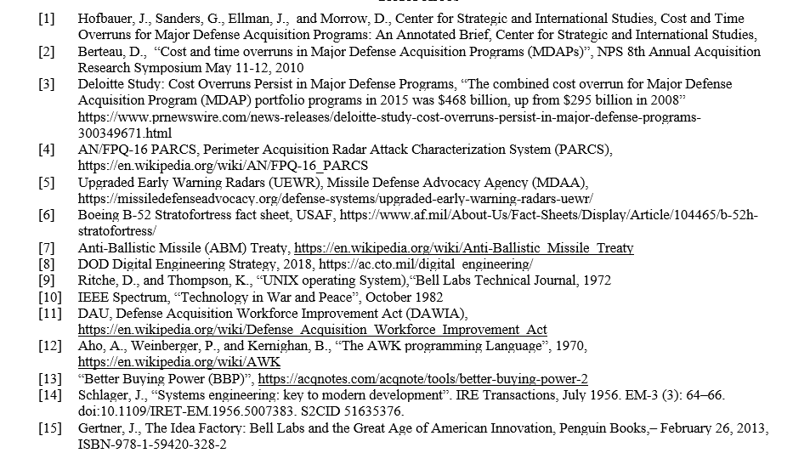
References
Notes:
About me

Slide 49
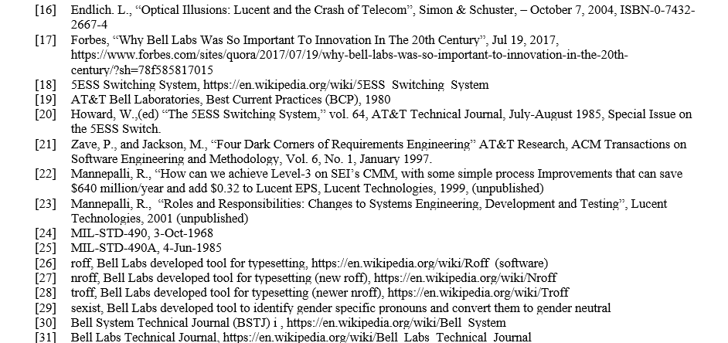
References (contd.)
Notes:
About me

Slide 50
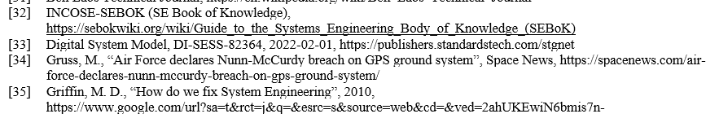
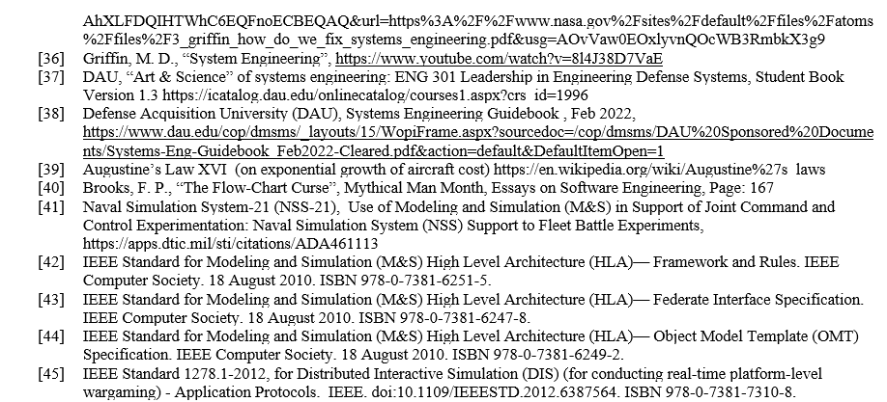
References (contd.)
Notes:
About me

Slide 51
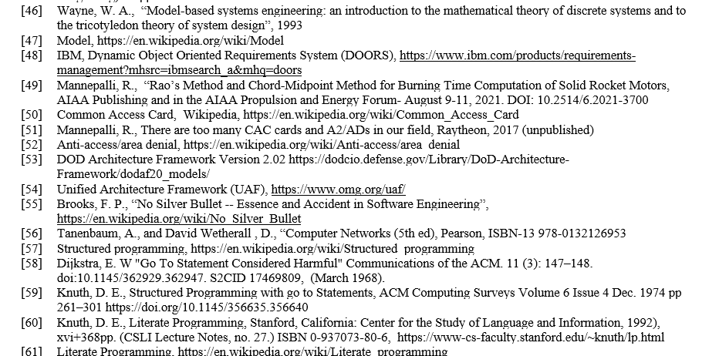
References (contd.)
Notes:
About me

Slide 52
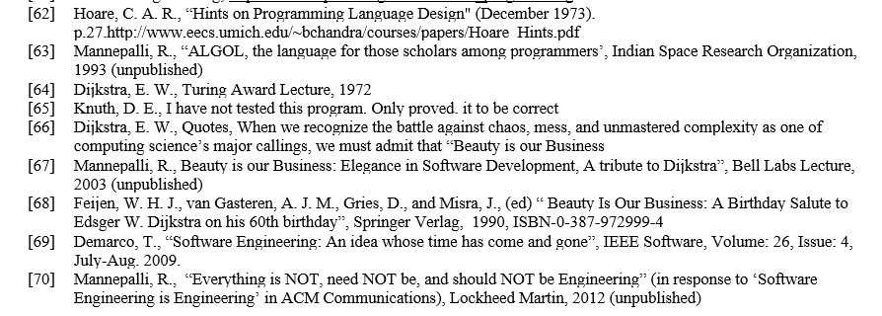
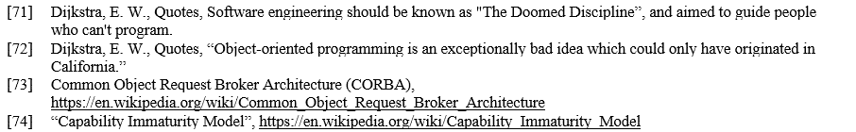
References (contd.)
Notes:
About me

Slide 53
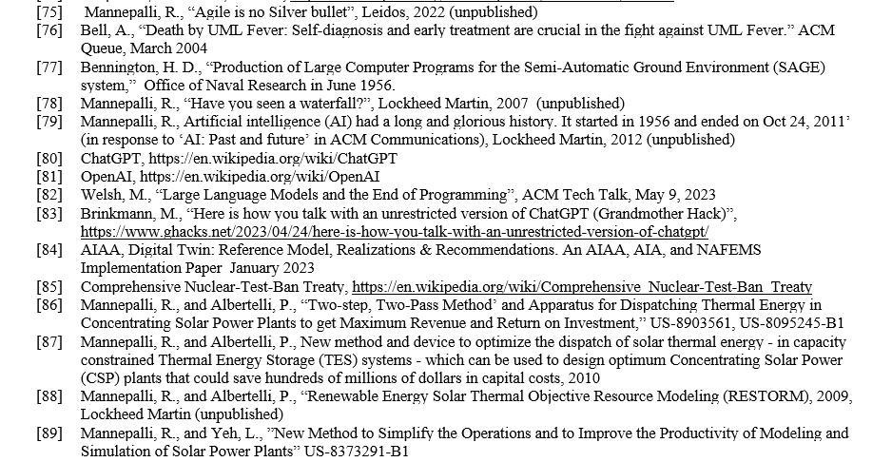
References (contd.)
Notes:
About me

Slide 54
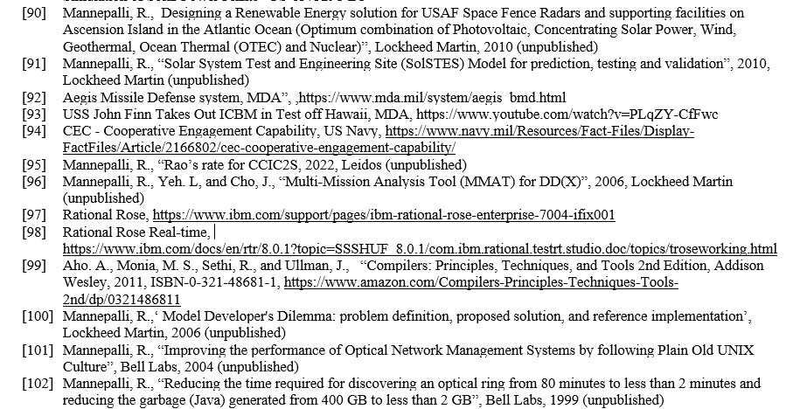
References (contd.)
Notes:
About me

Slide 55
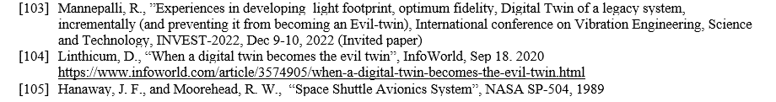
References (contd.)
Notes:
About me

Slide 56
Abstract
Weapon systems critical to national security are increasingly becoming more complex and expensive. The cost overruns alone are estimated to be about half-a-trillion Dollars, making it the second largest defense budget in the world. To address this problem, DOD introduced the Digital Engineering initiative in 2018. Even though its vision and scope are laudable, not all the areas/disciplines involved in realizing these weapon systems are excited. There is a certain poverty of imagination in naming the vision as “Digital Engineering.” Most people misunderstood it to be an engineering initiative (in particular Systems Engineering). This paper redefines the term “Engineering” in Digital Engineering as a process (e.g., engineering a political coup rather than like Mechanical/ Electrical/Systems Engineering), which then addresses all the five pillars of Digital Engineering. Another disturbing trend noticed by the author is that the Systems Engineering community equated Model Based Systems Engineering (MBSE) to Digital Engineering. This prevents new thinking and thereby limits or negates the vision of Digital Engineering. This paper also touches upon the origins of Systems Engineering at Bell Labs, obsession with the term “Model” to mean anything and everything, including a text document or a static picture, and Digital Twins. It gives practical and useful definitions of “Model” and “Digital Twin” and provides examples and some best practices followed in developing them. It also lists some of the disruptive technologies like ChatGPT which could potentially even eliminate the need to write computer programs. These systems can fuse Unstructured, Uncertain, Incomplete, Imprecise, and even Contradictory (UUIIC) information from all sources. This will make the current processes obsolete, including Systems Engineering. Finally, it presents the lessons learned and makes some recommendations for the near-term, including how to prevent Digital Twins from becoming “Evil Twins.”

Slide 57
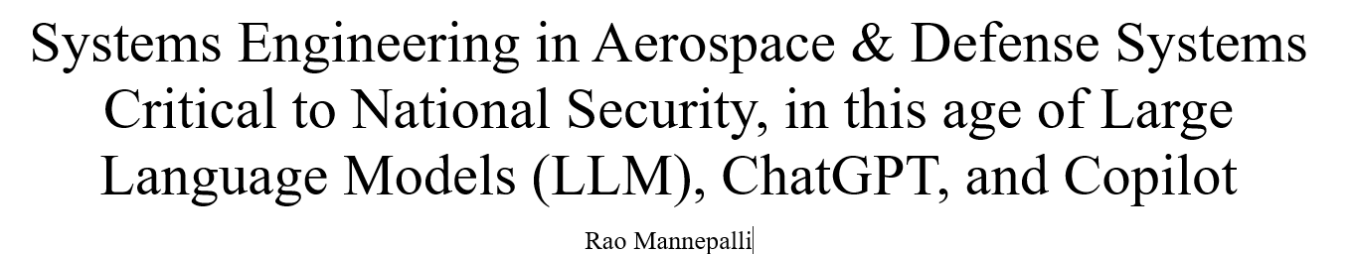
Upcoming Paper

Slide 58

Thank you

