Slide 1
Systems Engineering and Data Science Session Overview
Introduction
Objectives/Goals Envisioned:
Encourage participation in this area.
Obtain a list of individuals who want to participate
Develop recommendations for topics that are of interest
brainstorm session
If time permits, flesh out preliminary description of topics and prioritize by value and time to perform.

Slide 2
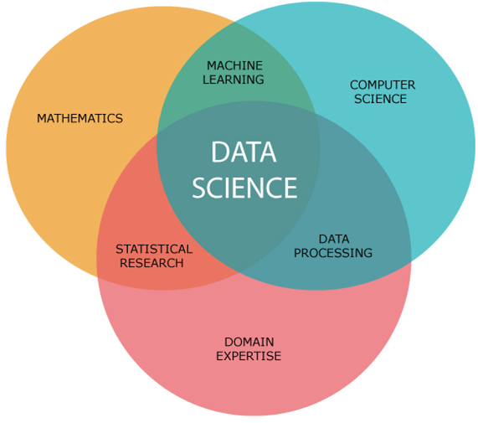
Data Science Overview
Definition of Data Science: Data science – Wikipedia
Data science is an interdisciplinary academic field ^{[1]} that uses statistics, scientific computing, scientific methods, processes, algorithms and systems to extract or extrapolate knowledge and insights from noisy, structured, and unstructured data.^{[2]}
It is interdisciplinary
Source: data-science-components2.png (571×505) (javatpoint.com)

Slide 3
Some Data Science Activities and Enablers
The foundation for Artificial Intelligence (AI) and Machine Learning (ML)
Access and manage large amount of data source
Data extraction
Expertise of domain specific data
Data source authentication
Data source pedigree
Data preparation
Data analysis
Data transformation
Data security
Etc.

