Slide 1

IEEE Systems Council
VP-Publications
Paolo Carbone
Perugia, Italy
With support by Vincenzo Piuri and John Schmalzel

Slide 2
Current Status & Achievements
IEEE Systems Journal
IEEE J-MASS -Journal on Miniaturization for Air and Space Systems
Sponsored publications

Slide 3
IEEE Systems Journal – EiC Amir G. Aghdam
Year | Submitted | Published | Rejected | Withdrawn | In-process
2007 | 140 | 63 | 72 | 5 | 0
2008 | 65 | 35 | 29 | 1 | 0
2009 | 180 | 57 | 111 | 12 | 0
2010 | 268 | 115 | 146 | 7 | 0
2011 | 417 | 90 | 309 | 18 | 0
2012 | 505 | 62 | 420 | 13 | 0
2013 | 537 | 160 | 356 | 21 | 0
2014 | 970 | 310 | 634 | 26 | 0
2015 | 840 | 204 | 617 | 19 | 0
2016 | 781 | 185 | 570 | 26 | 0
2017 | 785 | 261 | 506 | 18 | 0
2018 | 1142 | 433 | 669 | 28 | 12
2019 | 1489 | 394 | 877 | 27 | 191
2020 | 544 | 10 | 182 | 8 | 344

Slide 4
IEEE Systems Journal – processing times
Average time from submission to first decision (days): 62 (67-77-66-80-65-49-42-43-59-47)
Average reviewer-turnaround time (days): 16 (18-19-19-18-20-20-19-18-17-18)
Average time from submission to final decision (days): 83 (91-97-85-90-75-56-50-50-77-55)
ISJ: Citation Metrics
Year Impact Factor Eigenfactor Article Influence | 2018 4.463 0.00867 0.878 | 2017 4.337 0.00786 1.047 | 2016 3.882 0.00660 0.987 | 2015 2.114 0.00444 0.773 | 2014 1.980 0.00336 0.691 | 2013 1.746 0.00272 0.592 | 2012 1.270 0.00173 0.592

Slide 5
Open access
ISJ: about 5-7 papers per year in the past few years - not enough to sustain a new open-access journal (at least 20 per year are required)
Special Section in IEEE Access: feasible, but the review process does not include innovation
Open-access journal across multiple S/Cs: not enough actual interest – S/Cs are still waiting to see how the situation evolves or choosing Special Section in IEEE Access

Slide 6
IEEE Systems Journal
Additional information
All papers submitted by the end of 2018 have been included in issues by the second 2020 issue.
Current page limits (apply to papers submitted from 1 Jan 2015): 8 complimentary pages for regular papers; up to 12 pages, with overlength page charge of US$150 per page. No complaints received from authors.
Backlog of papers accepted and posted as advance posting (about 4,500 pages ready for inclusion in issues in 2020, about 3,000 pages available in 2020 issues; about 4,000 pages accepted by the end of 2020 ready for inclusion in 2021; the cost of IEEE page production is about US$56 per page).
No publicity since beginning of 2015 to limit the increase of the backlog of accepted papers
No special issues approved since the last quarter of 2014 to limit the increase of the backlog of accepted papers. One exception in 2019 to support the IEEE Brain Initiative
Page budget: 4,500 pages in 2019 - 4,500 pages in 2020 – 5,000 pages in 2021
Add 500 pages in 2020 (total 5,000) – about 27,500 US$
Manuscript assistant to support the EIC in 2021: US$10K to be added to the 2021 budget

Slide 7
Motion I
To add 500 pages to the page budget in 2020 (total 5,000 pages)
Pros:
  Sustain the increased number of submission and keep publication times under control
Cons:
  Financial implications as below noted
Financial Implications: about 27,500USD

Slide 8
Motion II
To add US$ 10,000 to the 2021 budget for a manuscript assistant to support the EIC in 2021
Pros:
  support the journal and the EiC
Cons:
  Financial implications
Financial Implications: 10,000 USD

Slide 9
Publications Report: J-MASS
John L. Schmalzel
EIC, J-MASS

Slide 10
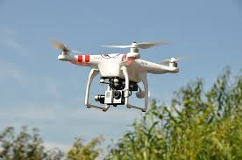
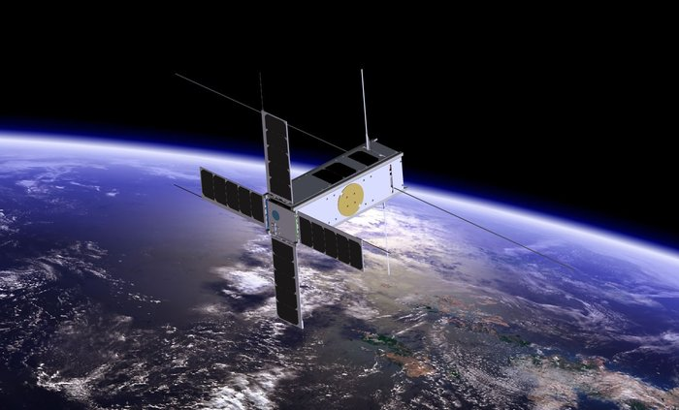

J-MASS
The Plan
Journal on Miniaturization for Air and Space Systems (J-MASS)
Financial sponsors
  IEEE Systems Council: 35%
  IEEE Geospatial & Remote Sensing: 25%
  IEEE Sensors Council: 25%
  IEEE Instrumentation & Measurement Society: 10%
  IEEE Aerospace & Electronic Systems Society: 5%
Launch: 2019
4 Issues per year, electronic only, available to all IEEE members, and non-members
Annual page count (Overlength > 8 pages)
  Year 1 (2019): 300
  Year 2 (2020): 450
  Year 3 (2021): 600

Slide 11
J-MASS
The Reality
To Date: 17 Decisions; 5 New in Queue
Minor Rev
First Issue Pending
EIC Reject
Reject
Major Rev

Slide 12
J-MASS
EiC - John Schmalzel
  A subcommittee on Revitalization/Termination (R/T) of the IEEE TAB Periodical Committee is chartered to check the progress of this publication
  Effort are being spent by the EIC who proposed an Action Plan to revitalize the journal
  As part of this activity the steering committee chaired by Bill Emery met recently twice to talk about possible strategies

Slide 13
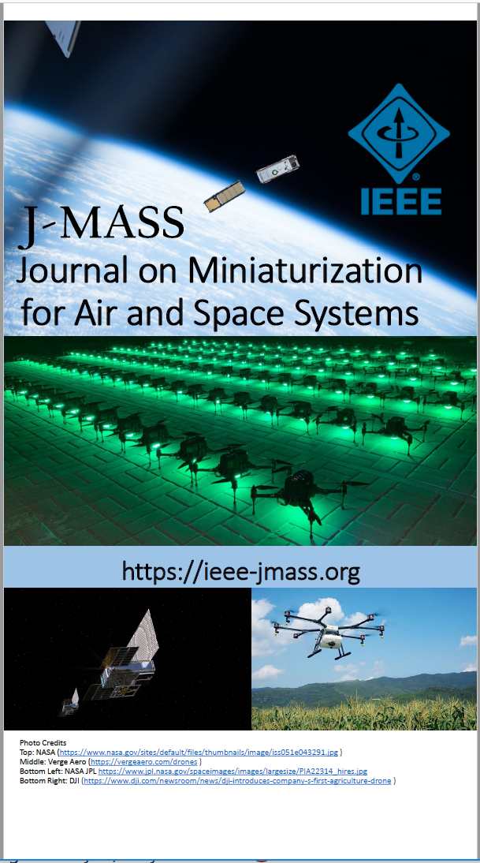
Turning the J-MASS Corner
Steering Committee (W. Emery, Chair)
  NEW Assoc EICs
    S. Dyer
    K. Fowler
  Special Issues (See ieee-jmass.org)
    NEW “Advanced Processing of Remotely Sensed Data Collected by Unmanned Aerial Vehicles (UAVs)” (A. Plaza)
    “From Payload to Uses” (E. Kerstel)
    “Innovative Approaches for Measurements in Small Aerospace Platforms” (P. Daponte)
    “2020 Federated Satellite Systems Workshop” (A. Golkar)
    “2019 MetroAeroSpace Workshop” (P. Daponte)

Slide 14
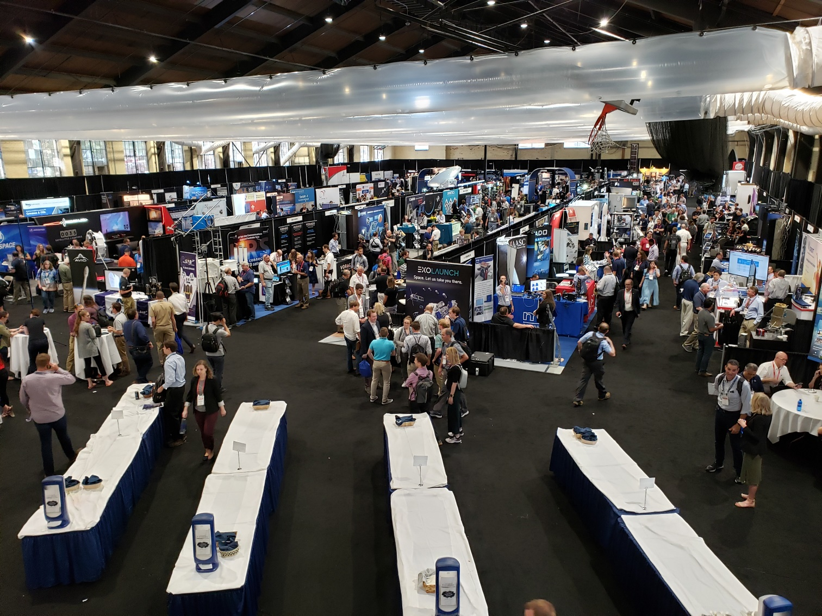
J-MASS Marketing: Small Sat
Have booth for 2020
2019 Stats (Aug 2019)
  3460 Participants
    1100 Organizations
    45 Countries
    383 Students
  Exhibitors
    235 Commercial
    20 University
  Presentations
    134 Poster
    150 Oral

Slide 15
J-MASS Challenges & Actions Ongoing
Additional AEs
  Broader representation of Member Councils/Societies
  Expanded map to scope—e.g., UAS
Special Issues: Best short-term way to get papers
Marketing
  Directed mailers
  Help from Member Councils/Societies

Slide 16
Sponsored publications
IEEE Transactions on Cloud Computing: financial cosponsorhip
  Computer Society
  Communications Society
  Systems Council (7%)
  Power and Energy Society
  Consumer Electronics Society
IEEE Transactions on Big Data: financial cosponsorhip
  Computer Society
  Communications Society
  Computational Intelligence Society
  Sensors Council
  Signal Processing Society
  Systems, Man, and Cybernetics Society
  Systems Council (5%)
  Vehicular Technology Society

Slide 17
THANK YOU

