Slide 1
IEEE Systems Council Remote Meeting Apr 2020 VP Member Services
Marco Parvis
April 24th, 2020
Torino, ITALY

Slide 2
Current Status & Achievements
The situation is good!. Four units in 2019 and 2 new units in 2020. One new student chapter and one new chapter in 2020 for a total of 19 chapters
Two vacant chapters which might disappear
Chairs contacted to get data regarding their activity
World reasonably covered with a prevalence of USA

Slide 3
Current Status
Nine system council only chapters
Chapter | Chair | Position Start
Coastal Los Angeles Section Chapter | Yeh | 06-May-09
Italy Section Chapter | Moschitta | 02-Sep-15
Mohawk Valley Section Chapter | Riley | 01-Sep-16
Long Island Section Chapter | White | 30-Dec-16
United Kingdom and Ireland Section Chapter | Hessami | 28-Mar-17
Israel Section Chapter | Mordecai | 02-Oct-18
Long Island Section Chapter | Lanzisero | 01-Jan-19
Tunisia Section Chapter | Baklouti | 01-Jan-19
Egypt Section Chapter | El Saeed | 01-Feb-20

Slide 4
Current Status
Five joint chapters
Chapter | Chair | Position Start
Shanghai | Tong | 01-Aug-16
Mexico | Velazquez Vazquez | 31-Jul-17
Toronto Section | Tirandazian | 01-Jan-18
Washington | Douglass | 01-Jan-18
Galveston Bay | Taqvi | 28-Aug-18

Slide 5
Current Status
Three student branches, all started in 2019 and later all from regions 9 and 10
Student branch | Chair | Position Start | Country | Region | Section
Malaviya Natl Inst of Tech | sharma | 15-Mar-19 | India | R10 | Delhi Section
Universidad del Magdalena | Carpio | 09-Oct-19 | Colombia | R9 | Colombian Caribbean Section
Adi Shankara Inst of Eng &Tech | ABHIJITH | 24-Jan-20 | India | R10 | Kerala Section

Slide 6
Current Status
Two chapters without chair, all joint chapters. Might disappear in future, no way of having them re-vitalized
China Council Jt. Chapter, SEN39/SYSC45
Madras Section Jt. Chapter, BT02/SYS45

Slide 7
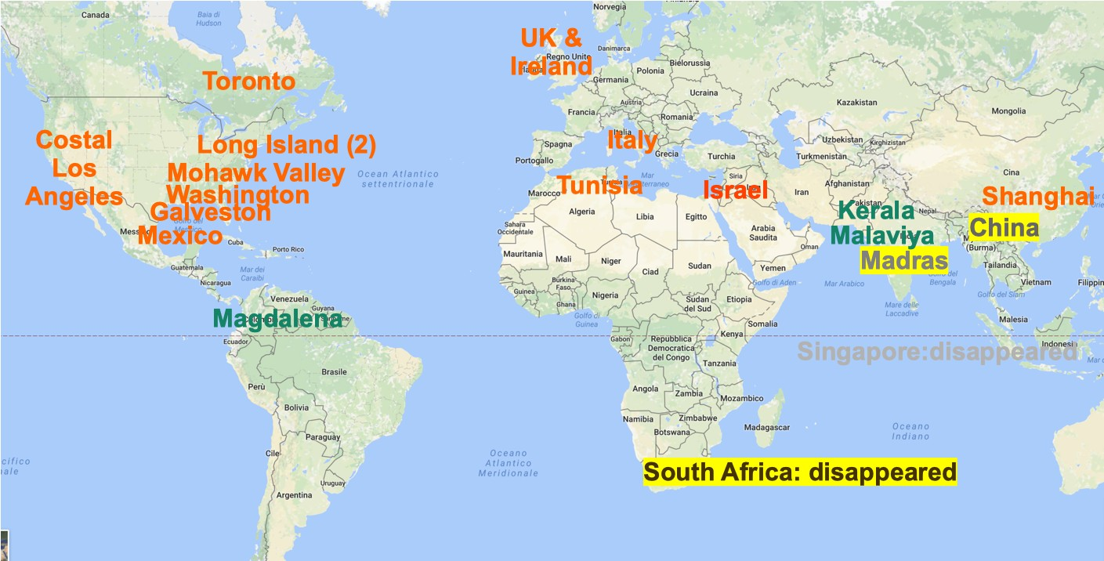
Current Status
We are missing south America, south Africa and partially far east. We have three (almost new) student branches (in green), two from India (?!).

Slide 8
Challenges and Actions
Difficult to ‘push’ any ‘new’ chapter, it is reasonably easy to find 12 members signing the petition, much more difficult to have the new chapter organizing events (especially in this time)
Assist any person willing to start a new chapter (and work for the System council)
Might contact again the chairs and tell them of the new ‘remote’ opportunities (which have a small cost, even though also a small impact…)
The system council is not so visible, we might try to increase our visibility going social, but we need help from our sponsoring societies.
Should we set apart money for recording videos?

Slide 9
Motion #1
Ask all supporting society to provide 30-60 s videos by the fall AdCom which content related to the system council without audio, and to provide a text to be read by a professional who will put together the different videos in a 3-5 min overall video
Pros:
If the support society send all data we may decide in the fall AdCom to create a video to increase the System Council visibility
Cons:
Require all supporting societies to provide some material
No Financial Implication now

Slide 10
Motion #2
In the Fall AdCom discuss if we can set apart 5k$ to arrange a video to be put on You Tube and other social networks to increase the system council visibility
Pros:
Will increase the System Council visibility
Cons:
We spend part of our money we could spend as an example in more pages on journals
Financial Implications: nothing now, about 5k$ if we decide in the fall AdCom to start the video

