Slide 1
IEEE Systems Council Remote Meeting Aug 2020 VP Member Services
Marco Parvis
August 8th, 2020
Torino, ITALY

Slide 2
Current Status & Achievements
Checked the nominal situation on Aug. 7. The situation is still good with 9 chapters, 6 joint chapters and 4 student branches.
Only one vacant chapter (which might disappear), which is a joint chapter. This means only about 5% of vacancies
World reasonably covered with a prevalence of USA
Interest from Russia, but without any concrete action after receiving all material

Slide 3
Current Status
Nine system council only chapters
Chapter | Chair | Position Start
Coastal Los Angeles Section Chapter | Yeh | 06-May-09
Italy Section Chapter | Moschitta | 02-Sep-15
Mohawk Valley Section Chapter | Riley | 01-Sep-16
Long Island Section Chapter | White | 30-Dec-16
United Kingdom and Ireland Section Chapter | Hessami | 28-Mar-17
Israel Section Chapter | Mordecai | 02-Oct-18
Long Island Section Chapter | Lanzisero | 01-Jan-19
Tunisia Section Chapter | Baklouti | 01-Jan-19
Egypt Section Chapter | El Saeed | 01-Feb-20

Slide 4
Current Status
Six joint chapters, China (which was without chair) reappeared
Chapter | Chair | Position Start
Shanghai | Tong | 01-Aug-16
Mexico | Velazquez Vazquez | 31-Jul-17
Toronto Section | Tirandazian | 01-Jan-18
Washington | Douglass | 01-Jan-18
Galveston Bay | Taqvi | 28-Aug-18
China | Chen | 09-Dec-19

Slide 5
Current Status
Four student branches, all started in 2019 and later all from regions 9 and 10. Two branches from Delhi section
Student branch | Chair | Position Start | Country | Region | Section
Malaviya Natl Inst of Tech | Sharma | 15-Mar-19 | India | R10 | Delhi Section
Universidad del Magdalena | Carpio | 09-Oct-19 | Colombia | R9 | Colombian Caribbean Section
Adi Shankara Inst of Eng &Tech | Augustine | 02-Aug-20 | India | R10 | Kerala Section
Jamia Millia Islamia | Alam | 12-Jou-20 | India | R10 | Delhi Section

Slide 6
Current Status
South Africa disappeared in the past. Actually only one (joint) chapter without chair which might disappear in future
Madras Section Jt. Chapter, BT02/SYS45

Slide 7
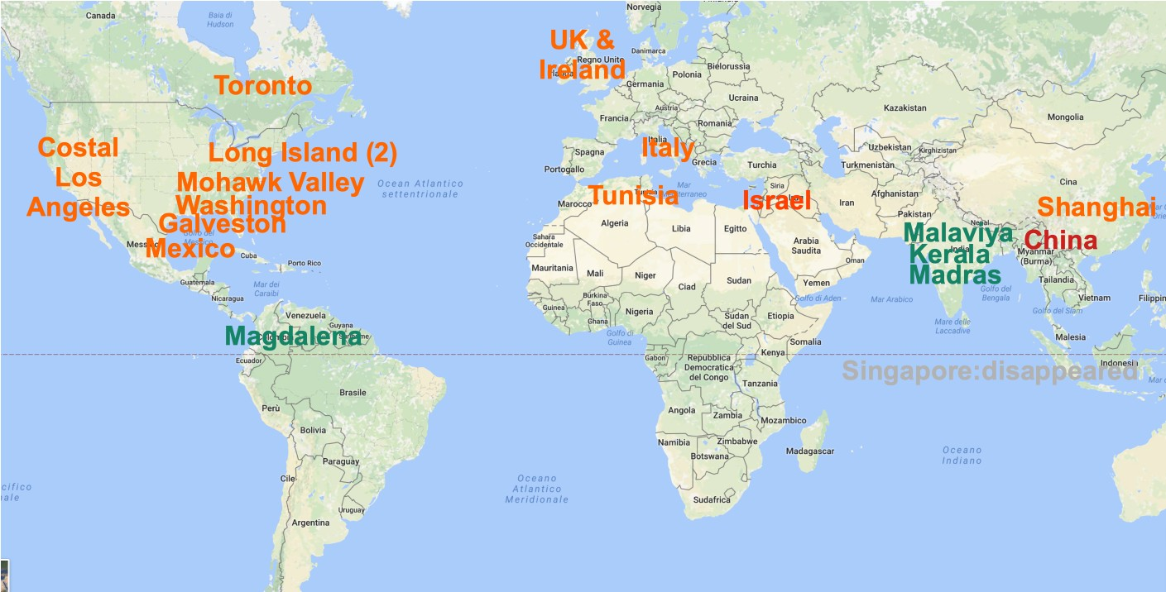
Current Status
We are missing south America, south Africa and partially far east. We have four student branches (in green), three from India (!).

Slide 8
Challenges and Actions
Just as in past difficult to ‘push’ any ‘new’ chapter, easy to find 12 members signing the petition, much mode difficult to have the new chapter organizing events (especially in the Covid time)
Assist any person willing to start a new chapter (and work for the System council)
Might contact again the chairs and tell them of the new ‘remote’ opportunities (which have a small cost, even though also a small impact…)
The system council is not so visible, we might try to increase our visibility going social, but we need help from our sponsoring societies.
Tried to have recorded videos without success..
This is the reason of no specific motions for the AdCom. If supporting societies are not willing to produce the videos there is no reason to allocate money!

