Slide 1
IEEE Systems Council Ice Breaker Exercise
Technical Interest Profiles (TIPS)
Walt Downing
20 April 2023

Slide 2
IEEE Systems Council Ice Breaker Exercise
SysC does not have a TIPS list.
Which TIPS best represent SysC?
AdHoc Committee to create the list?

Slide 3
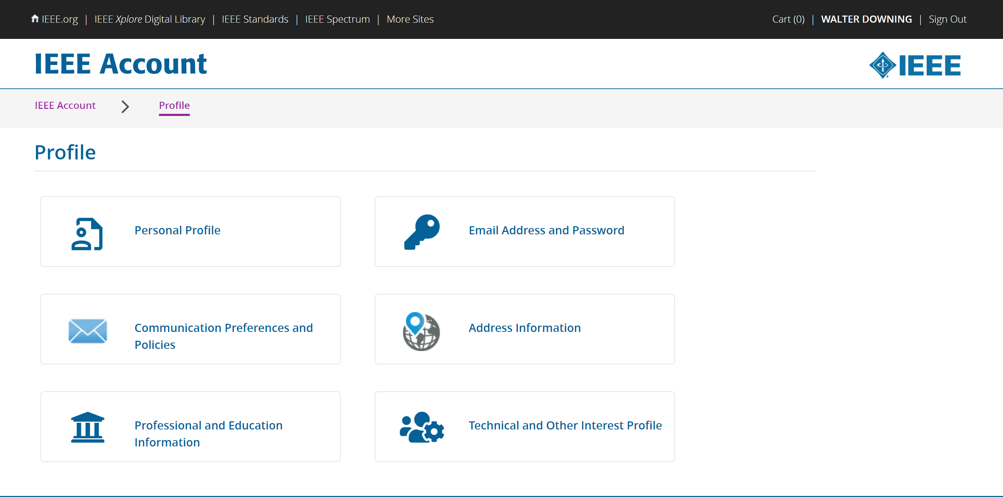
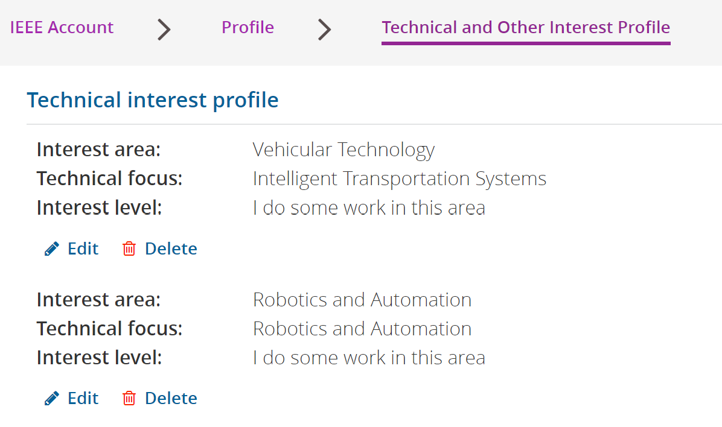
Technical Interest Profiles (TIPS)

Slide 4
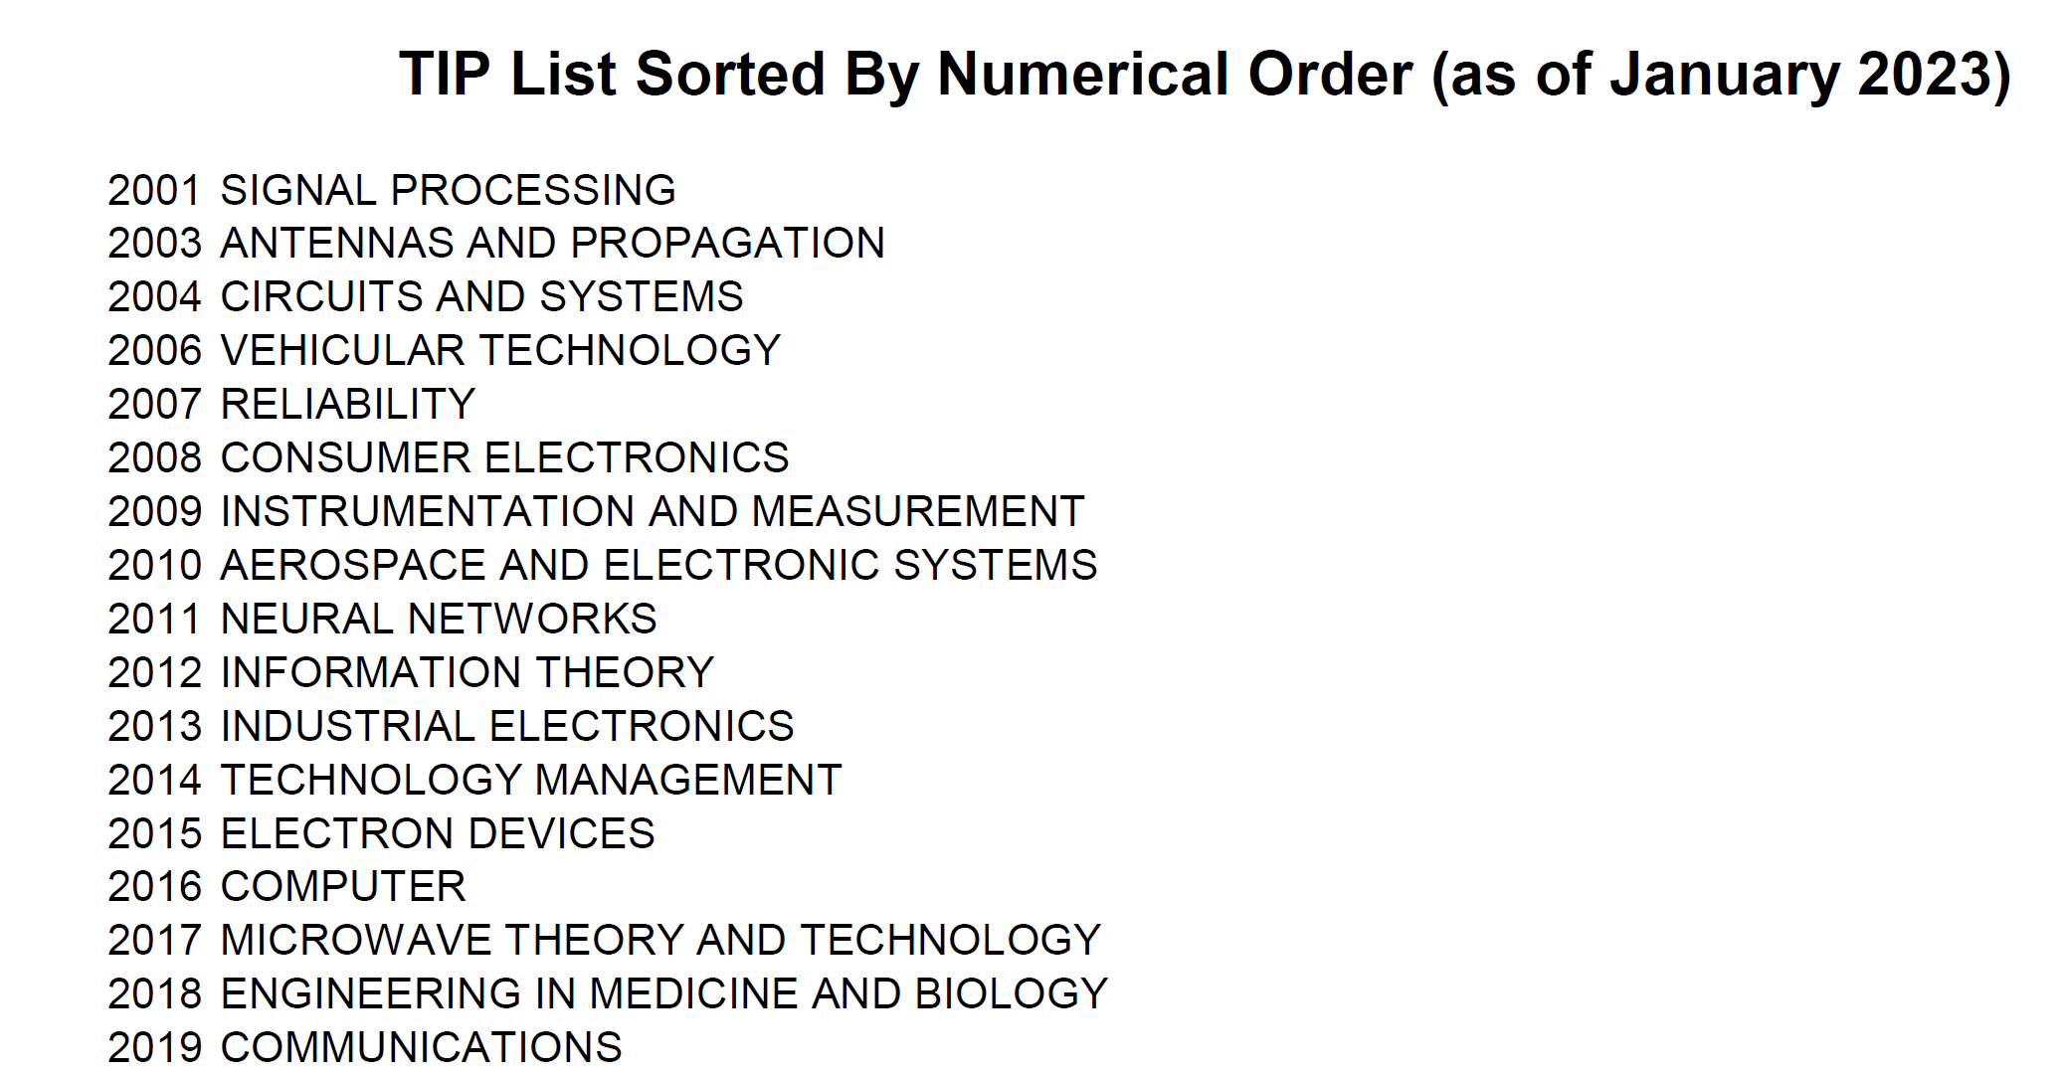
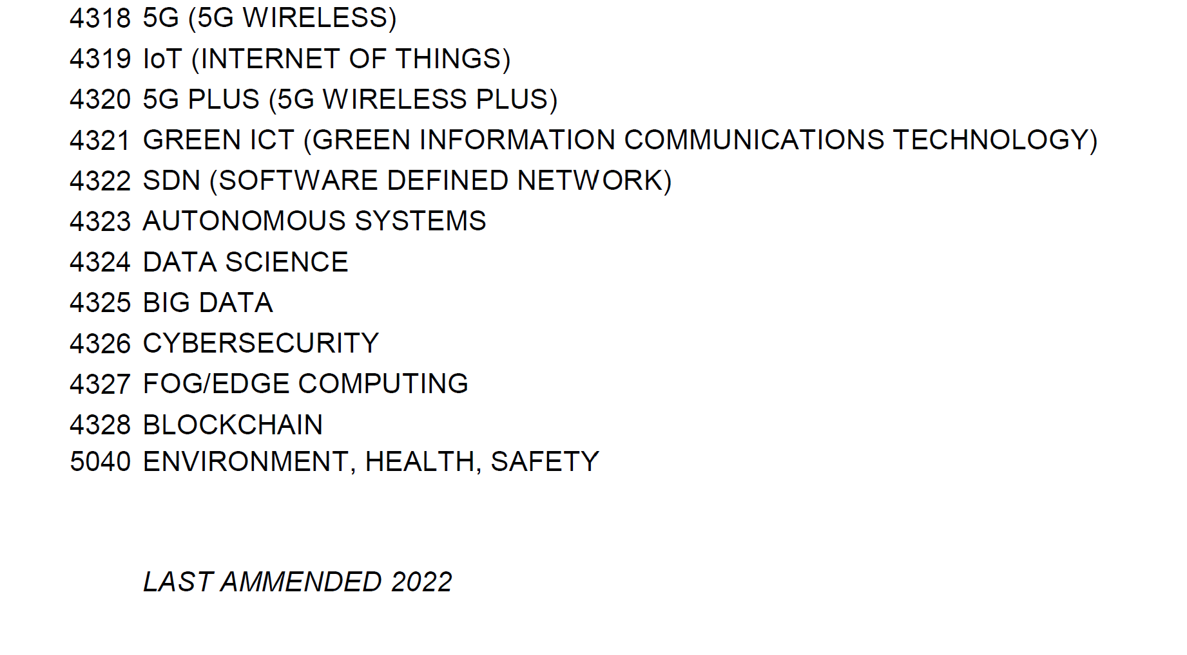
Higher numbers were most recently added.
There are over 400 TIPS.
Lower numbers are the oldest.

Slide 5
There are 77 TIPS Containing “Systems” (Partial List Shown Below)
2004 - CIRCUITS AND SYSTEMS
2010 - AEROSPACE AND ELECTRONIC SYSTEMS
2028 - SYSTEMS, MAN, AND CYBERNETICS
3002 - ADAPTIVE SYSTEMS
3011 - ATE TEST AND MEASUREMENT SYSTEMS
3020 - CABLE SYSTEMS
3021 - CIRCUITS AND SYSTEMS THEORY, DESIGN, AND IMPLEMENTATION
3023 - COMMUNICATION SYSTEMS INTEGRATION AND MODELING
3030 - COMPUTER AIDED NETWORKS AND SYSTEMS DESIGN
3031 - COMPUTER AIDED CONTROL SYSTEMS DESIGN
3036 - COMPUTER COMMUNICATIONS, SYSTEMS AND PROTOCOLS
3045 - CONTROL OF POWER SYSTEMS
3046 - CONTROL SYSTEMS
4310 - THERAPEUTIC AND DIAGNOSTIC SYSTEMS, DEVICES AND TECHNOLOGIES, AND CLINICAL ENGINEERING
4311 - HEALTHCARE INFORMATION SYSTEMS AND TELEMEDICINE
4313 - TRACKING SYSTEMS
4314 - GUIDANCE SYSTEMS
4315 - NAVIGATION SYSTEMS
4323 - AUTONOMOUS SYSTEMS

Slide 6
Most Common TIPS of Systems Council Member Societies
(Number of TIPS range from 8 to 112)
TIP Description | TIP # | AES010 | CAS004 | COM019 | C016 | CT008 | CS023 | IA034 | IE013 | IT012 | IM009 | MTT017 | PEL035 | PSE043 | RA024 | RL007 | SIT030 | SMC028 | TM014 | VT006 | Frequency
MAN-MACHINE SYSTEMS | 3132 | 3132 | 3132 |  | 3132 |  | 3132 | 3132 |  |  |  |  |  |  | 3132 | 3132 |  | 3132 |  | 3132 | 9
COMPUTER CONTROL SOFTWARE, HARDWARE, AND INTERFACES | 3037 |  |  |  | 3037 |  | 3037 | 3037 | 3037 |  |  | 3037 |  |  |  |  | 3037 | 3037 |  |  | 7
EMBEDDED CONTROLLERS | 3075 | 3075 |  |  | 3075 |  | 3075 | 3075 | 3075 |  |  | 3075 |  |  |  |  |  | 3075 |  |  | 7
INTELLIGENT CONTROL | 3118 |  |  |  | 3118 |  | 3118 | 3118 |  |  |  |  | 3118 |  | 3118 |  |  | 3118 |  | 3118 | 7
MICRO/NANO ELECTRO-MECHANICAL SYSTEMS AND ROBOTS | 3143 | 3143 | 3143 |  | 3143 |  | 3143 | 3143 |  |  |  |  |  |  | 3143 |  |  | 3143 |  |  | 7
SIMULATION | 3211 | 3211 | 3211 |  | 3211 |  | 3211 | 3211 |  |  |  |  |  |  |  |  | 3211 | 3211 |  |  | 7
SYSTEM DESIGN | 3227 | 3227 | 3227 |  | 3227 |  | 3227 | 3227 |  |  |  |  |  | 3227 |  |  |  | 3227 |  |  | 7
SIGNAL PROCESSING | 2001 | 2001 | 2001 |  |  |  |  | 2001 |  | 2001 | 2001 |  |  |  |  |  |  | 2001 |  |  | 6
ENGINEERING IN MEDICINE AND BIOLOGY | 2018 |  | 2018 |  | 2018 |  | 2018 | 2018 |  |  |  |  |  |  |  |  | 2018 | 2018 |  |  | 6
ADAPTIVE SYSTEMS | 3002 | 3002 | 3002 |  |  |  | 3002 |  |  |  |  | 3002 |  |  |  |  | 3002 | 3002 |  |  | 6
ARTIFICIAL NEURAL NETWORKS | 3009 |  | 3009 |  | 3009 |  | 3009 | 3009 |  |  |  | 3009 |  |  |  |  |  | 3009 |  |  | 6
COMMUNICATION SYSTEMS INTEGRATION AND MODELING | 3023 |  | 3023 | 3023 | 3023 |  |  |  |  |  |  | 3023 |  |  |  |  |  | 3023 |  | 3023 | 6
DIGITAL SIGNAL PROCESSING | 3058 | 3058 | 3058 |  | 3058 |  |  |  |  | 3058 | 3058 |  |  |  |  |  |  | 3058 |  |  | 6
EDUCATIONAL AND PROFESSIONAL DEVELOPMENT | 3062 | 3062 |  |  | 3062 |  | 3062 | 3062 |  |  |  | 3062 |  |  |  |  | 3062 |  |  |  | 6
INFORMATION TECHNOLOGY/SYSTEMS | 3111 |  | 3111 |  | 3111 |  | 3111 |  |  |  |  |  |  |  |  |  | 3111 | 3111 |  | 3111 | 6
INTERDISCIPLINARY AND NEW ACTIVITIES | 3120 | 3120 | 3120 |  | 3120 |  | 3120 |  |  |  |  |  |  |  |  |  | 3120 | 3120 |  |  | 6
INTERNET ARCHITECTURE, TECHNOLOGY APPLICATIONS | 3121 |  | 3121 | 3121 | 3121 |  |  |  |  |  |  |  |  |  |  |  | 3121 | 3121 |  | 3121 | 6
KINEMATICS, DYNAMICS, AND CONTROL | 3123 | 3123 | 3123 |  |  |  | 3123 |  |  |  |  |  |  |  | 3123 |  | 3123 | 3123 |  |  | 6
MODELING, SIMULATION AND DATABASES | 3148 | 3148 | 3148 |  | 3148 |  | 3148 | 3148 |  |  |  |  |  |  |  |  |  | 3148 |  |  | 6
MOTOR DRIVERS & MOTION CONTROL | 3150 | 3150 |  |  |  |  | 3150 | 3150 |  |  |  |  | 3150 |  |  |  |  | 3150 |  | 3150 | 6
NEURAL NETWORK APPLICATION AND IMPLEMENTATION | 3151 |  | 3151 |  | 3151 |  | 3151 | 3151 |  |  |  |  |  |  |  |  |  | 3151 |  | 3151 | 6
REAL TIME CONTROL COMPUTING AND SIGNAL PROCESSING | 3195 | 3195 | 3195 |  | 3195 |  | 3195 | 3195 |  |  |  |  |  |  |  |  |  | 3195 |  |  | 6
REAL TIME SYSTEMS | 3196 | 3196 |  |  | 3196 |  | 3196 | 3196 |  |  |  |  |  |  |  |  |  | 3196 |  | 3196 | 6
ROBOTICS AND AUTOMATION | 3200 | 3200 |  |  | 3200 |  | 3200 |  |  |  |  |  |  |  | 3200 |  |  | 3200 |  | 3200 | 6
SYSTEMS ANALYSIS AND DECISION ANALYSIS | 3229 | 3229 |  |  | 3229 |  | 3229 | 3229 |  |  |  |  |  |  |  |  | 3229 | 3229 |  |  | 6
WIRELESS COMMUNICATIONS | 3252 | 3252 | 3252 | 3252 | 3252 |  |  |  |  | 3252 |  |  |  |  |  |  |  |  |  | 3252 | 6

Slide 7
IEEE Systems Council Ice Breaker Exercise
SysC does not have a TIPS list.
Which TIPS best represent SysC?
AdHoc Committee to create the list?

