Slide 1
IEEE Systems Council
Education Committee
Stephen M. Holt, Educational Chair
March 26, 2021
AdCom Meeting, Virtual

Slide 2
IEEE Education and Resource Center Status
Develop pricing structure/policy for tutorials
Asking Member Societies what their pricing policy for their resource centers about educational materials in their repositories are
Cost is basic $3,000 (USD) per year for hosting and this amount (plus maintenance and advertising) after that. Profits flow back to the owning Society or Council. (This amount approved last August, 2020 AdCom via a Motion)
Approval of Zoom Expense - $400/year for 100 attendees
Developed Budget for 2021 - $10,000 approved for 2021
Develop process for review and approval of tutorial topics and materials; finalize Intro slide and PPT template
Develop process and instructions for approving final mp4 videos
IEEE Consent and Copyright Forms (working now with IEEE Legal)
Emails and Letters developed (Request, Responded, Non-Responded, Topic Selection, Technical Requirements, and Acceptance)

Slide 3
IEEE Education Portal Next Steps
Continue working all of the issues raised on the previous slide.
Continue working with IEEE Resource Center to transition import of tutorial presentations into their system.
Continue to reach out to potential presenters from previous IEEE SC conferences to gain their support in working with us.
Come up with a timeline of when we would hope to achieve important milestones for our action items.
Try to have one or two prototype presentations we find acceptable for posting on our educational portal.
Determine what tutorials might be free and which we would charge a fee.
Determine what kind of tutorials we would want on our site over the next few years.

Slide 4
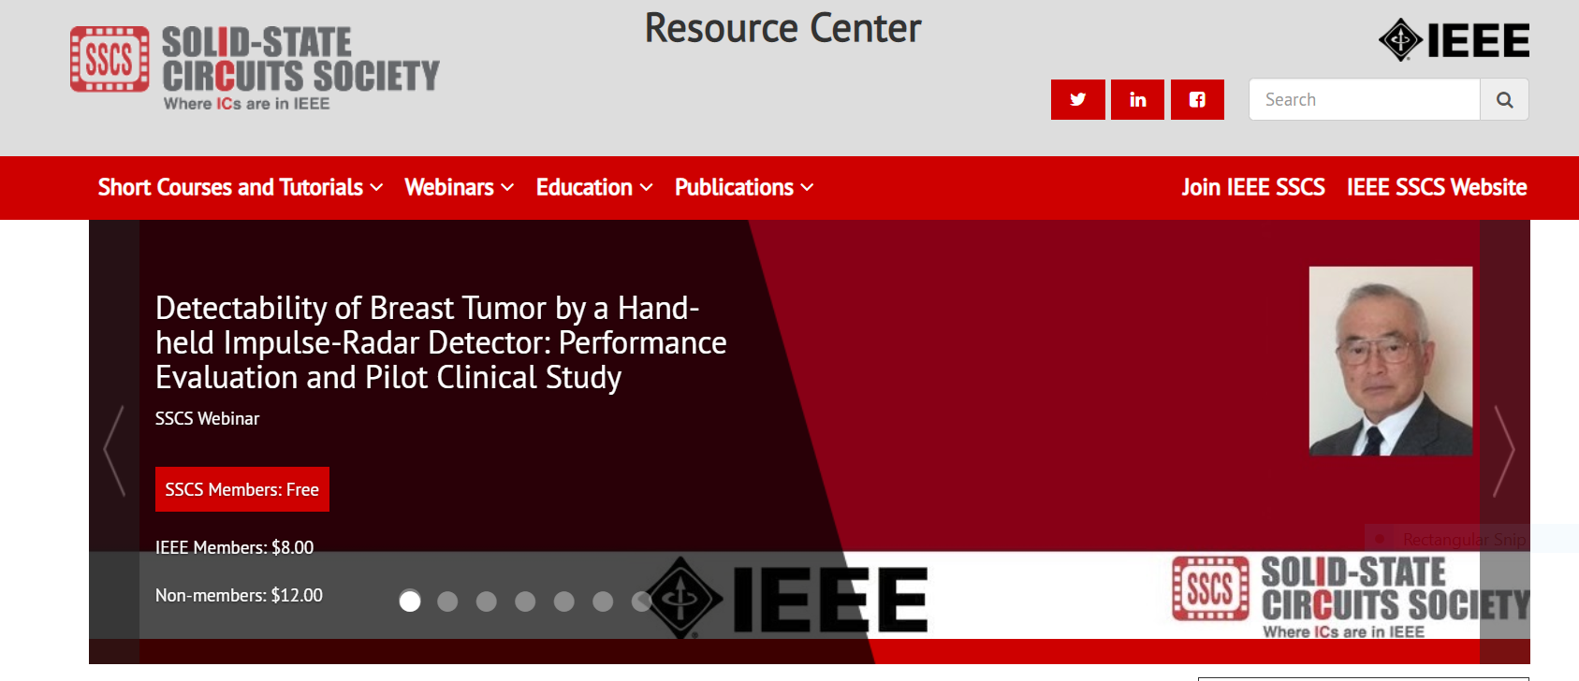

Slide 5
Questions?
Ideas for the future?

