Slide 1
IEEE Systems Council President’s Report
Vincenzo Piuri
24 April 2020
2020 SYSC Spring AdCom

Slide 2
Welcome!
Our Mission:
Foster advancement of knowledge and innovation in science, technology, and applications of systems engineering, especially in complex systems and systems-of-systems, for the benefit of humanity
Promote the activities of and cooperate with the SYSC Member Societies in the area of interest of the Council.

Slide 3
2020 SYSC Member Society & Representatives
Society | Rep(s)
AESS - Aerospace and Electronic Systems Society | Robert Lyons and Michael Cardinale
CASS – Circuits and Systems Society | Rajiv Joshi
ComSoc – Communications Society | Nelson Fonseca
CS – Computer Society | Cecilia Metra
CE Soc* – Consumer Electronics Society | Chih-Peng Fan and Lucio Ciabattoni
IAS* – Industrial Applications Society | Georges Zissis and David Eng
IES – Industrial Electronics Society | Okyay Kaynak and Armando Walter Colombo
IMS – Instrumentation and Measurement Society | John Schmalzel and Ruth Dyer
MTT-S – Microwave Theory and Technology Society | Nils Pohl and Amir Mortazawi
PES – Power and Energy Society | Ernie Parker and Jian Sun
PSES** – Product Safety Engineering Society
RAS** - Robotics and Automation Society | Josè Contreras-Vidal
SMCS – Systems, Man, and Cybernetics Society | Adrian Stoica and Ferial El-Hawary
*New Society in 2020 ** Has not yet signed 2020-2021 MoU

Slide 4
2020 Systems Council Officers
Position | Name
President | Vincenzo Piuri
Past President | Stephanie White
VP Conferences | Robert Rassa
VP Finance | Jeffrey Rubin
VP Members Services | Marco Parvis
VP Publications | Paolo Carbone
VP Technical Operations | Steve Holt
Secretary | Richard Hochberg
Treasurer | Robert Rassa

Slide 5
2020 Systems Council Committee Chairs
Position | Chair
Constitution & Bylaws | Richard Hochberg
Distinguished Lecturer Committee | Stephanie White
Fellows Evaluation Committee | John Schmalzel
Finance Committee | Jeffrey Rubin
Meetings Committee | Robert Rassa
Member Services Committee | Marco Parvis
Nominations & Appointments | Stephanie White
Publications Committee | Paolo Carbone
Standards Committee | Steve Holt
Young Professional Representative | James Ritchie
AdHoc Awards Committee | Stephen Dyer
AdHoc Women in Systems Engineering | Stephanie White

Slide 6
2020 Systems Council Representatives in Other Committees
Position | Appointment
BKCASE Governing Board | Stephanie White & Robert Rassa
IEEE Transportation Electrification Community | Robert Lyons
IEEE-USA Committee on Transportation and Aerospace Policy | Robert Rassa
IEEE-USA Research & Development Policy Committee | Robert Lyons
IEEE-USA Artificial Intelligence and Autonomous Systems Policy Committee | Adrian Stoica
IEEE-USA Energy Policy Committee | Ernie Parker
IEEE European Public Policy Committee: Modeling Energy Futures | Bruno Meyer & Gérald Sanchis
IEEE WIE | Stephanie White

Slide 7
2020 Systems Council Representatives in Other Committees (cont’d)
Position | Appointment
IEEE European Public Policy Committee (EPPC): Position Statement on Power-To-Gas | Franco Cotana & Federico Rossi
IEEE Transactions on Big Data (TBD) Representative | Paolo Carbone
IEEE Future Directions Committee | Adrian Stoica
IEEE Division X N&A Committee | Stephanie White
TAB Finance Committee | Robert Rassa
TAB Strategic Planning Committee | Robert Rassa & Vincenzo Piuri
TAB Periodicals Committee | Paolo Carbone
TAB Awards and Recognition Committee | Okyay Kaynak
TAB/PSPB Products and Services Committee | Adrian Stoica

Slide 8
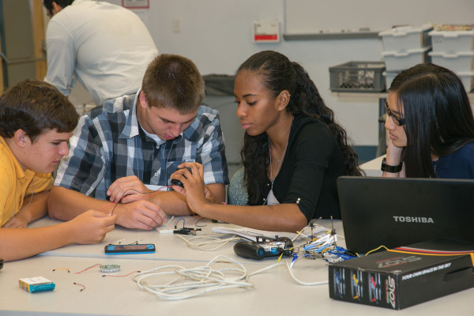
Strategic Directions for 2020 and 2021
Continuing Education
Adhoc Education Committee
SYSC Educational Program
SYSC in the IEEE Learning Library
Cooperation with SYSC Member Societies and other institutions
Technical Activities
Expand the technical committees to involve more volunteers worldwide
Add new technical committees in the field of interest of SYSC Member Societies
Add new technical committees in interdisciplinary areas relevant to researchers and industry professionals in the field of interest of SYSC

Slide 9
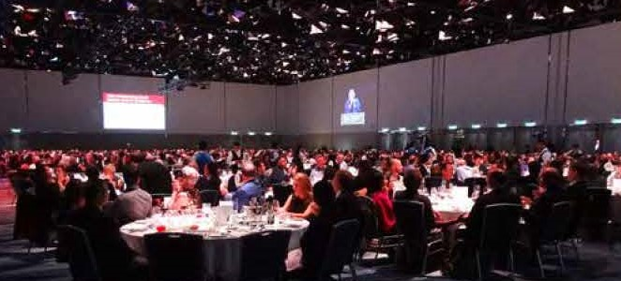
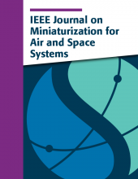
Strategic Directions for 2020 and 2021 (cont’d)
Conferences
New conferences to address emerging technical needs
New conferences to address needs in new geographical areas
Publications
Support and publicize the IEEE Systems Journal
Special issues in the IEEE Systems Journal
Promote the IEEE Journal on Miniaturization for Air and Space Systems

Slide 10
Strategic Directions for 2020 and 2021 (cont’d)
Members Services
Promoting Chapters and Students Chapters
Local activities in Chapters
New services: mentoring, meetups, internships, …
Listen industry professionals and industries
Awards and Recognitions
Cooperation with SYSC Member Societies and other institutions
Promote Diversities
Expanding SYSC global coverage worldwide
Africa, Asia, Latin America
WISE – Women in Systems Engineering Cmte
SYSC Young Professionals Committee
Promote diversity in the workspace
Cooperation with SYSC Member Societies and other institutions

