Slide 1
IEEE Systems Council
Women in Systems Engineering (WiSE)
Holly A. H. Handley, PhD, PE
April 29, 2022
Focus on promoting women systems engineers and systems scientists,
and inspiring others to pursue a systems-centric career.

Slide 2
WiSE Leadership
Chair: Holly Handley, Old Dominion University, Norfolk, VA USA
Advisory Board:
  Stephanie White, Long Island University – Post Campus, USA
  Kanika Singh, American Bureau of Shipping, South Korea
  Bozenna Pasik-Duncan, University of Kansas, USA
  Rosa Delgado, President, IPv6 Council Peru, Peru

Slide 3
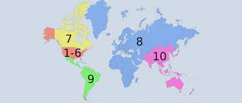
Membership
Regions 1–7 (USA & Canada) - 36
Region 8 (Africa, Europe, Middle East) - 19
Region 9 (Latin America) - 7
Region 10 (Asia and Pacific) - 46
IEEE System Council members interested in participating in the WiSE Community.

Slide 4





WiSE Charter Highlights
Build a database of women interested in WiSE
Nominate WiSE women for IEEE awards
Build WiSE networks at IEEE conferences
Participate with Local Chapters & Students
Participate in IEEE WIE Events
Encourage publication in Journals

Slide 5
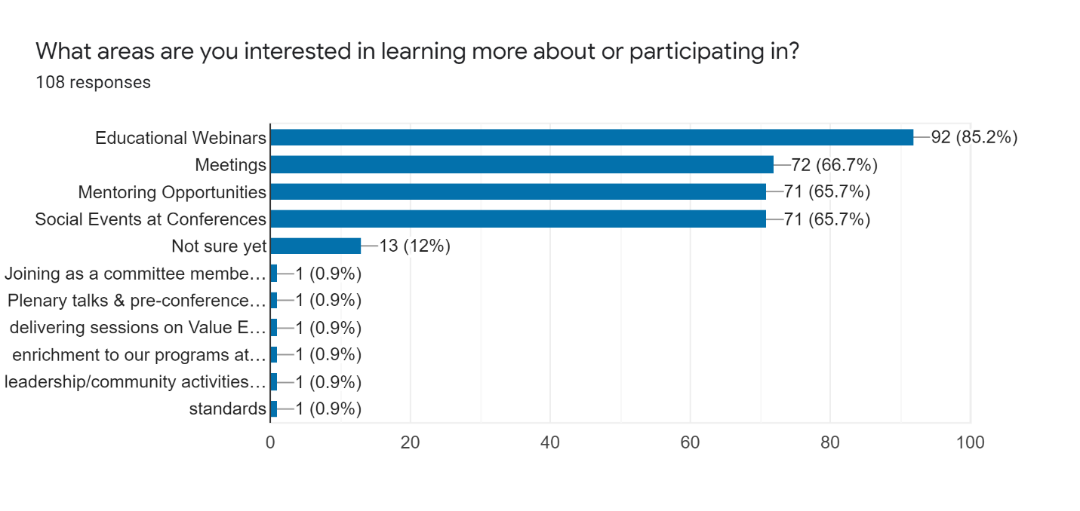
Activity Interest Area
Strengthen our WiSE network and provide educational and mentoring opportunities.

Slide 6
2022 - Women in Systems Engineering (WiSE)
Calendar | Date | Event | Speaker | Title
1st Quarter | Wed, Feb 23 11am ET | Welcome | Saminah Chaudhry, Systems Engineer at Texas Instruments | Functions of a Systems Engineer in the Semiconductor industry
2nd Quarter | Wed, April 27 11am ET | SYSCON Conference | Shamsnaz Bhada, Worchester Polytechnic Institute | A Model Centric Framework and Approach for Complex Systems Policy
3rd Quarter | Fri, Sept 16 TBD https://wie.ieee.org/ wie25seminarseries/ | WIE Extraordinary Women Series | Holly Handley, Old Dominion University | From Human Views to Human Readiness Levels
4th Quarter | Wed Oct 26 11AM ET | ISSE Conference | Cynthia Burham, University of Texas | Women and Intellectual Property (tentative title)

