Slide 1
IEEE Systems Council VP-Publications
Paolo Carbone
Spring 2022 ADCOM meeting
SUMMARY
IEEE Systems Journal
IEEE J-MASS - Journal on Miniaturization for Air and Space Systems
IEEE Open Access Journal on Systems Engineering
Sponsored journals
New initiatives

Slide 2
IEEE Systems Journal – EiC Amir G. Aghdam
Year | Submitted | Published | Rejected | Withdrawn | In-process
2007 | 140 | 63 | 72 | 5 | 0
2008 | 65 | 35 | 29 | 1 | 0
2009 | 180 | 57 | 111 | 12 | 0
2010 | 268 | 115 | 146 | 7 | 0
2011 | 417 | 90 | 309 | 18 | 0
2012 | 505 | 62 | 420 | 13 | 0
2013 | 537 | 160 | 356 | 21 | 0
2014 | 970 | 310 | 634 | 26 | 0
2015 | 840 | 204 | 617 | 19 | 0
2016 | 781 | 185 | 570 | 26 | 0
2017 | 785 | 261 | 506 | 18 | 0
2018 | 1142 | 433 | 670 | 29 | 0
2019 | 1489 | 542 | 897 | 29 | 0
2020 | 2165 | 715 | 1421 | 27 | 2
2021 | 2000 | 459 | 1448 | 13 | 168
2022 | 483 | 51 | 171 | 3 | 298

Slide 3
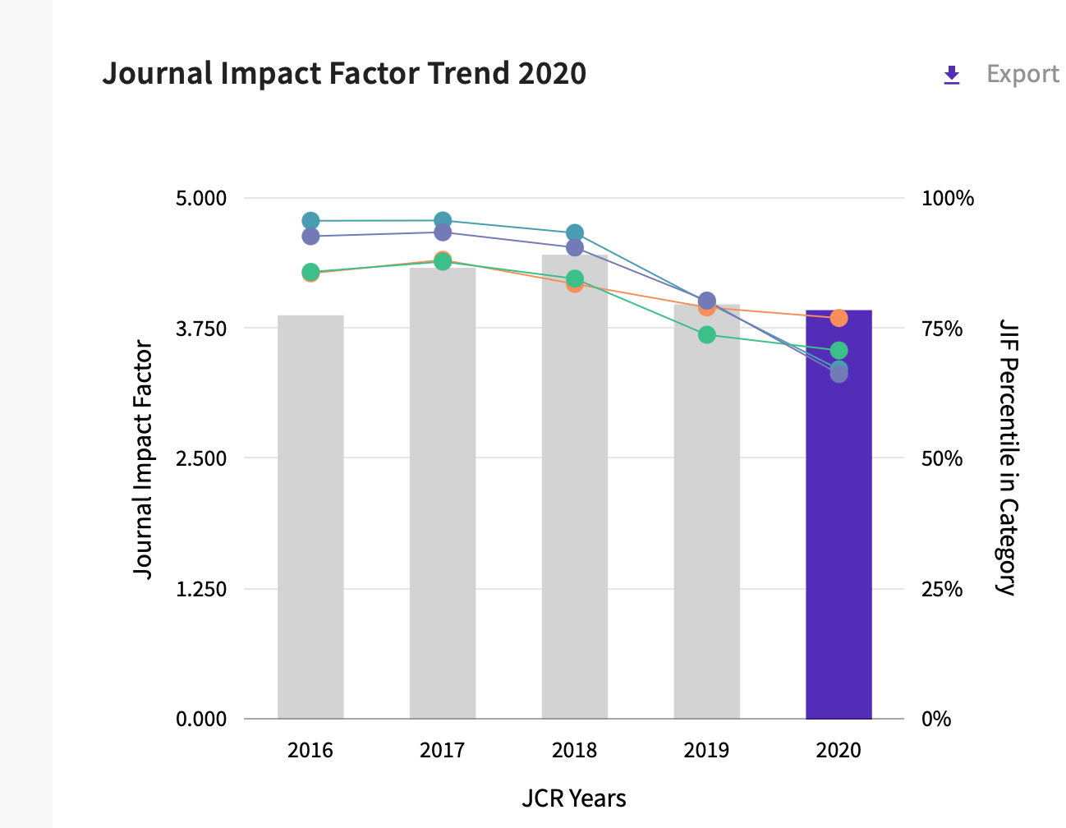
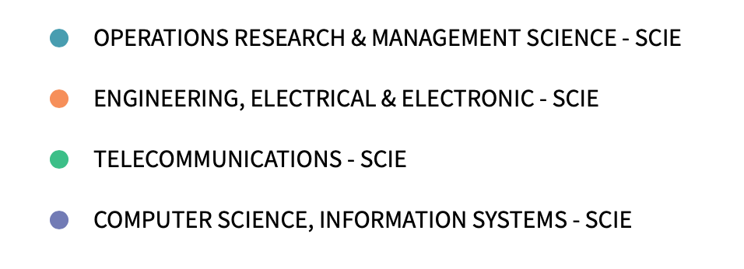
Citation metrics

Slide 4
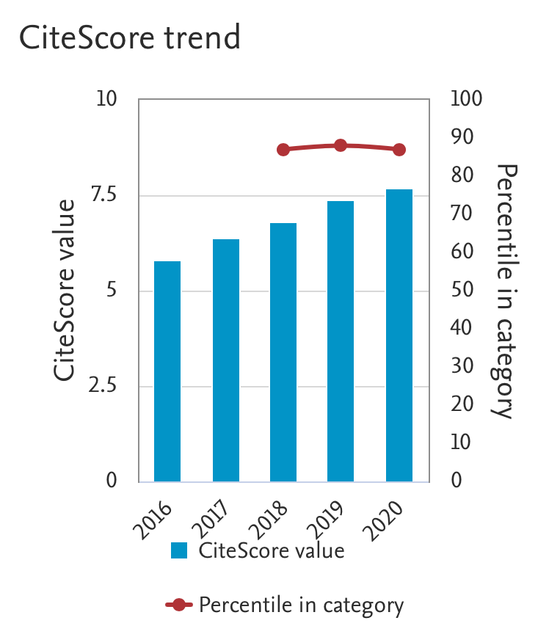
Journal is listed in several categories: in all of them Citescore is above 75% percentile, meaning Q1

Slide 5
SYSJ usage statistics

Slide 6
Additional information
All papers submitted by the end of 2018 have been included in issues by the second 2020 issue.
Current page limits (apply to papers submitted from 1 Jan 2015): 8 complimentary pages for regular papers; up to 12 pages, with overlength page charge of US$150 per page. No complaints received from authors.
No publicity since beginning of 2015 to limit the increase of the backlog of accepted papers.
Page budget: 6,000 pages in 2022 – 6,250 pages in 2023
IEEE Computer Society is proposing a new Gold OA periodical called the IEEE Transactions on Privacy. The LOI was submitted last November and the Phase 1 proposal is to be submitted in June, with a projected launch of 2023 Q1. I am the lead proposer for this periodical.

Slide 7
Other: SYSC newsletter
Newsletter recipients
2022
Q1 – 18,017
2021 -
Q1- 14,006 Q2 - 14,861 Q3 - 15,322
Q4 - 16,660
2020 Q1 - 10,720 Q2 - 11,434 Q3 - 11,925 Q4 - 12,721 2019 Q3 - 8,967 Q4 - 9,608

Slide 8
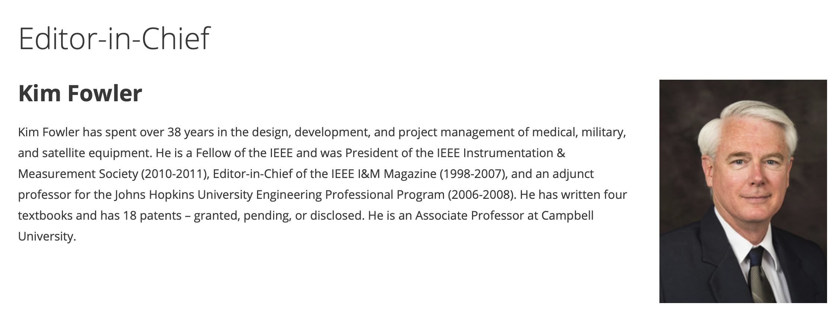
J-MASS
EiC:
Approved new special issues, several tied to major conferences
Appointed 20 new Associate Editors
Journal delisted from IEEE watch list
Starting July 1st, new EiC, new assistant Ms. Greeley Hibbard

Slide 9
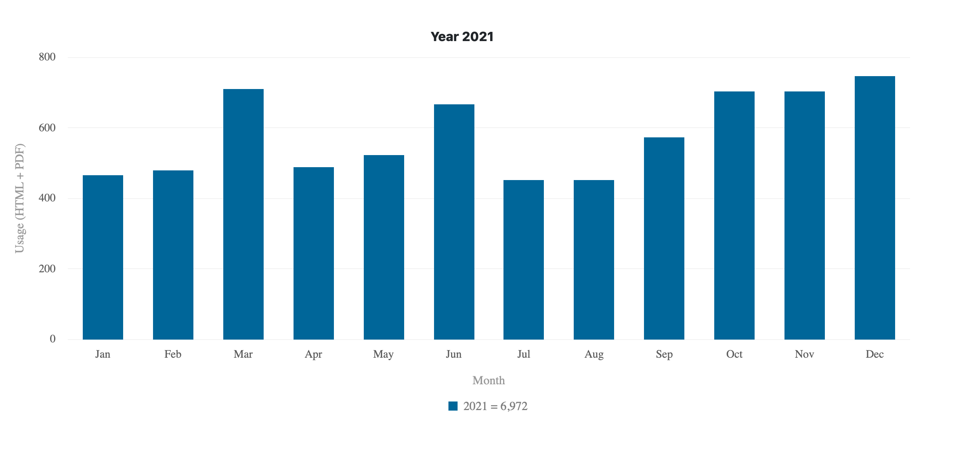
J-MASS usage statistics

Slide 10
Open Journal of Systems Engineering (OJSE)
PROJECTED LAUNCH YEAR & MONTH: 2023 – 4th Quarter
Sponsorship
IEEE Systems Council (40%)
IEEE Systems, Man and Cybernetics Society (40%)
IEEE Aerospace & Electronic Systems Society (20%)
Establishing an open-access journal, will provide a venue for addressing the growing need for open-access publications, steered by several funding agencies around the world. This new journal will benefit the IEEE, reinforcing its leading role in science and engineering of systems and systems-of-systems.

Slide 11
OJSE: Editorial Board
Editor-In-Chief
W. Dale Blair, Principal Research Engineer, IEEE Fellow
Georgia Tech Research Institute
Georgia Institute of Technology
Associate EIC
Ljiljana Trajkovic, Professor, IEEE Fellow
School of Engineering Science
Simon Fraser University
Associate Editors
Peter Willett, Professor, IEEE Fellow, University of Connecticut
James Lambert, Professor, IEEE Fellow, University of Virginia
Donald Brown, Professor, IEEE Fellow, University of Virginia
Dongrui Wu, Professor, Senior Member IEEE, Huazhong University of Science and Technology
Vincenzo Piuri, Full Professor, IEEE Fellow, University of Milan, Italy

Slide 12
OJSE: Status
Promotional Flyer completed
Announcements in Newsletters from AESS, SMC and SYSC.
Manuscript Central setup completed
IEEE Xplore setup completed
Established policy on discounting APC fees for the first three years
Four free publications to authors of international preeminence in systems engineering
50% discount to all authors
Two special issues are in progress
Special Issue on Front-end Need Analysis
Special Issue on Artificial Intelligence and Systems Engineering

Slide 13
OJSE Flyer

Slide 14
Sponsored publications
IEEE Transactions on Cloud Computing: financial cosponsorhip (Q1)
Computer Society
Communications Society
Systems Council (7%)
Power and Energy Society
Consumer Electronics Society
IEEE Transactions on Big Data: financial cosponsorhip
Computer Society
Communications Society
Computational Intelligence Society
Sensors Council
Signal Processing Society
Systems, Man, and Cybernetics Society
Systems Council (5%)
Vehicular Technology Society

Slide 15
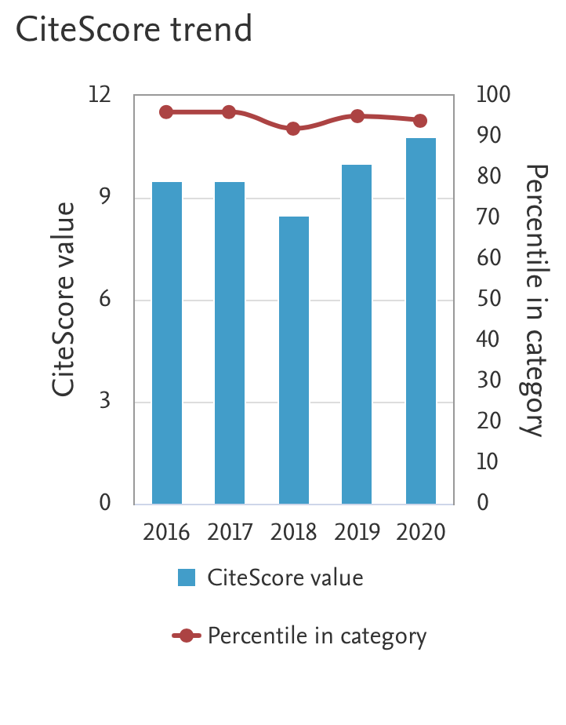
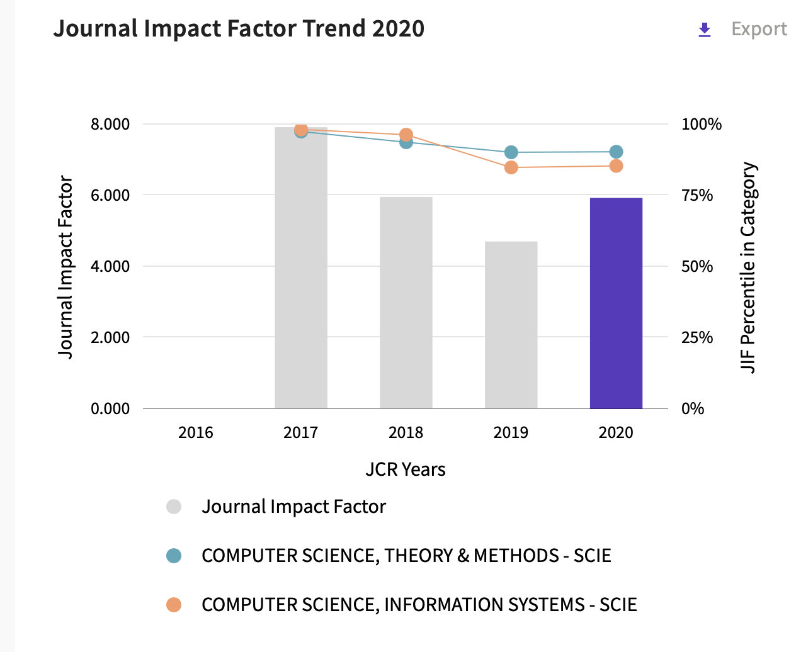
TCC

Slide 16
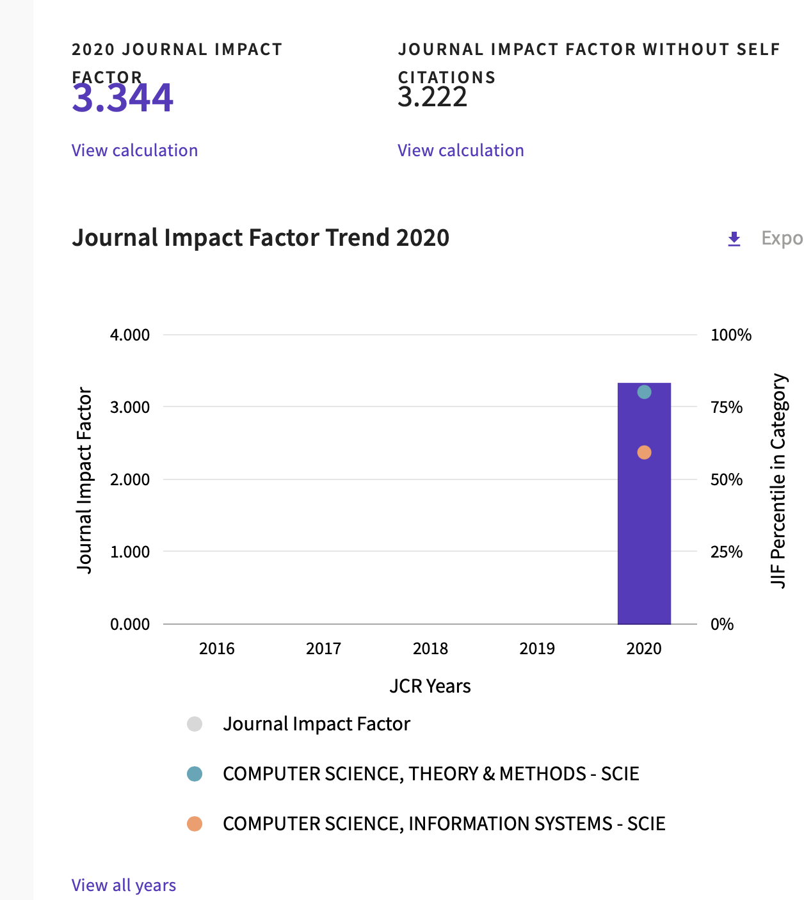
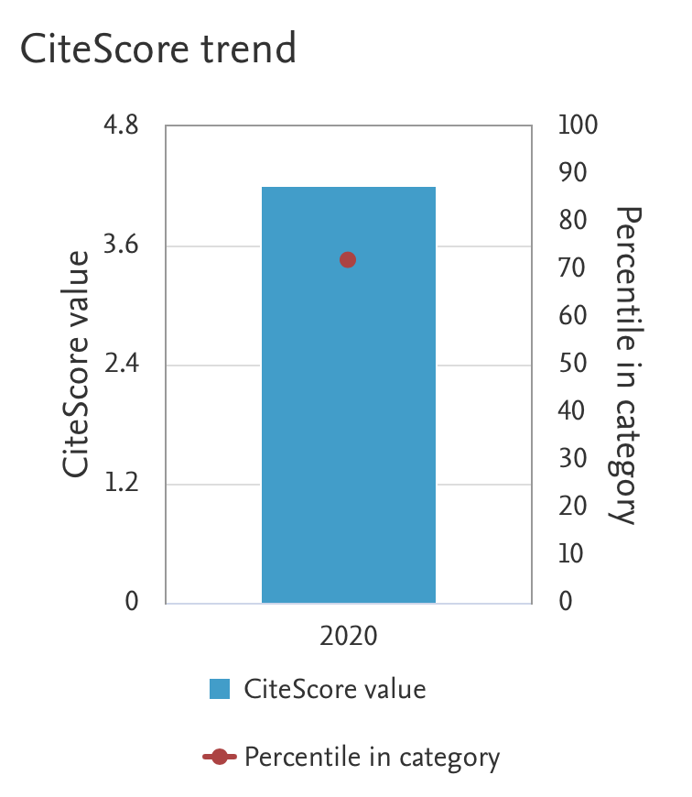
TBD

Slide 17
Conference publications IEEE SYSCON & ISSE: total number of paper downloads

Slide 18
New initiatives
Jaideep Vaidya, CS:
IEEE Computer Society is proposing a new Gold OA periodical called the IEEE Transactions on Privacy. The LOI was submitted last November and the Phase 1 proposal is to be submitted in June, with a projected launch of 2023 Q1. I am the lead proposer for this periodical.
The Transactions on Privacy aims to provide a multidisciplinary forum for theoretical, methodological, engineering, and applications aspects of privacy and data protection, including specification, design, implementation, testing, and validation. The transactions will publish articles reporting significant advances in theoretical models and formalization as well as engineering tools supporting the above activities, design frameworks and languages, architectures, infrastructures, model-based approaches, study cases, and standards.

Slide 19
Motion
MOTION: Paolo Carbone moves to accept the proposal by the IEEE Computer Society to have the IEEE Systems Council act as a technical co-sponsor of the newly proposed journal IEEE Transactions on Privacy.
Pros:
Widen the portfolio of technically sponsored journals that are coherent with the mission of the IEEE Systems Council
Cons:
None
Financial Implications:
None

Slide 20
Thank you for your attention!

