Slide 1
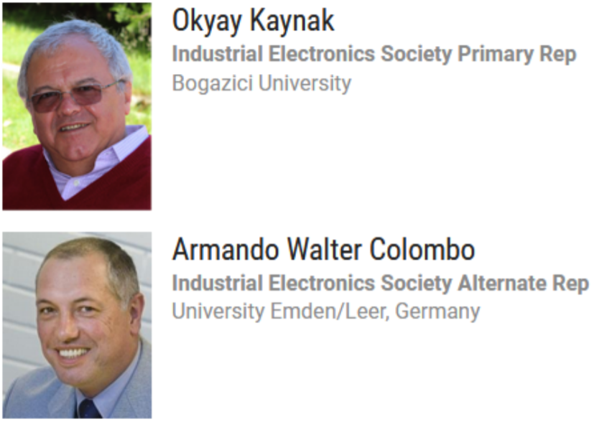
IEEE Systems Council
Industrial Electronics Society - Report
April 24th 2020
Prof. Armando Walter Colombo

Slide 2
Contents
Industrial Electronics Society (IES) – Actualized data (#3-#10)
Collaborative Activities initiated between IES and IEEE Systems Council (#11-#15)
A Strategic Roadmap Initiative Proposal (#16-#23)
1 Motion (#24)
Annex: Roadmap Initiative Proposal (full description – 4 pages)

Slide 3
IES Constitution
The IES strives for the advancement of the theory and practice of electrical engineering and of the allied arts and sciences, and the maintenance of a high professional standing among its members
The Field of Interest confined to the theory and applications of electronics, controls, communications, instrumentation and computational intelligence to industrial and manufacturing systems and processes

Slide 4
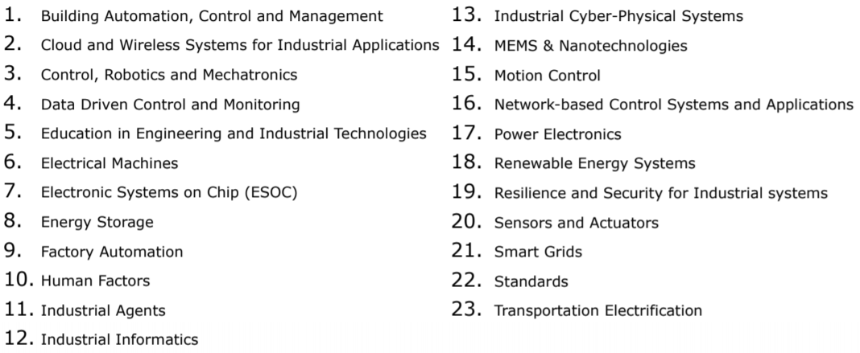
Technical Activities
The Industrial Electronics Society through its members encompasses a diverse range of technical activities devoted to the application of electronics and electrical sciences for the enhancement of industrial and manufacturing processes. These technical activities address the latest developments in intelligent and computer control systems, robotics, factory communications and automation, flexible manufacturing, data acquisition and signal processing, vision systems, and power electronics. The Society continually updates its program of technical activities to meet the needs of modern industry.

Slide 5
Membership Activities
The Industrial Electronics Society (IES) was established in February 1951.
As one of the oldest IEEE societies it has been the engine propelling numerous technological advances and innovations.
IES is very attractive to professionals; its membership has constantly increased since 2013 at an annual rate of 3%-5%.
Very versatile technological society, now with more than 7,000 members in over 100 countries worldwide.
Truly international, with three quarters of its members outside USA, IES keeps abreast of innovations and opportunities in the ever-expanding field of Industrial Electronics.

Slide 6
Membership Activities - offers
Distinguished Lecturer Program http://vps.ieeeies.org/members/lecturers
  18 Lecturers available to IES Chapters
Student Activities http://vps.ieee-ies.org/iestudents.shtml
  70 student paper travel awards (up to $2,000 each) to participate in IES major conferences each year
  Student Forum, every year within ISIE and/or IECON -Two Student Forum paper travel awards (up to $750 each)
Chapters: 60 chapters and 8 student chapters worldwide
  Best Chapter Award & Best Student Branch Chapter Award
  Support for Local Chapter’s Activities (SLCA) 5 x $1,000
  Chapter Chairs Meeting held every 2-3 years at IECON.

Slide 7
Membership Activities - Chapters
IES is very attractive to professionals; its membership has constantly increased since 2013 at an annual rate 3%-5%.
The number of Chapters has recently increased, reaching now 60:
  Europe, Africa, Middle East, Russia: 28
  Asia, Australia: 14
  North America: 12
  South America: 6
Typical Chapter activities: technical events/seminars, host Distinguished Lecturer presentations, industry visits, life skills events /younger member activities, specialist symposia.
To form a new Chapter, or for other membership initiatives, contact:
  VP Membership activities, Prof. Yousef Ibrahim (vp-membership@ieee-ies.org)
  IES Membership Champion, Dr. Kim-Fung Tsang (ee330015@cityu.edu.hk)
Guidance for Chapter formation: http://www.ieee.org/societies_communities/geo_activities/chapters/creating_a_chapter.html

Slide 8
IES Pubications
IES sponsors/cosponsors several peer-reviewed journals ranked at the top level in electrical and electronic engineering areas
IEEE Industrial Electronics Magazine
IEEE Transactions on Industrial Electronics
IEEE Transactions on Industrial Informatics
IEEE/ASME Transactions on Mechatronics
Starting in 2020, IES sponsors two new journals
  IEEE Opean Journal of the Industrial Electronics Society (OJIES). http://www.ieee-ies.org/pubs/ojies
  IEEE Journal of Emerging and Selected Topics in Industrial Electronics. http://www.ieee-ies.org/pubs/jestie
Several other journals on micromechanical systems, sensors, nanotechnology, image processing, sustainable energy and smart grid technologies, as well as the IES free on-line publications: “the IE Technology News (ITeN)” and “the Industrial Electronics Technology Transfer News (IETTN)”.

Slide 9
IES Conferences
Fully peer-reviewed content, indexed in IEEE Xplore, Conference Proceedings Citation Index – Science (CPCI-S) and EI Compendex
7 sponsored conferences cover the full spectrum of Society interests
5 sponsored focused workshops
4 co-sponsored conferences in robotics and energy conversion fields
20+ technically co-sponsored events
Industry Forum
Student & Young Professional Forum
Event calendar at: http://ieee-ies.org/conferences/

Slide 10
IES Officers for 2020
President: Prof. Terry Martin, USA
President Elect: Prof. Mariusz Malinowski, Poland
VP Technical Activities: Prof. Roberto Oboe, Italy
VP Conferences: Prof. Juan Jose Rodriguez-Andina, Spain
VP Workshops: Prof. Kiyoshi Onishi, Japan
VP Publications: Prof. Thilo Sauter, Austria
VP Membership: Prof. Yousef Ibrahim, Australia
VP Planning & Dev.: Prof. Makoto Iwasaki, Japan
Treasurer: Prof. Milos Manic, USA
Secretary: Prof. Lucia Lo-Bello, Italy
Junior Past President: Prof. Xinghuo Yu, Australia
Senior Past President: Prof. Kamal Al-Haddad, Canada

Slide 11


Slide 12
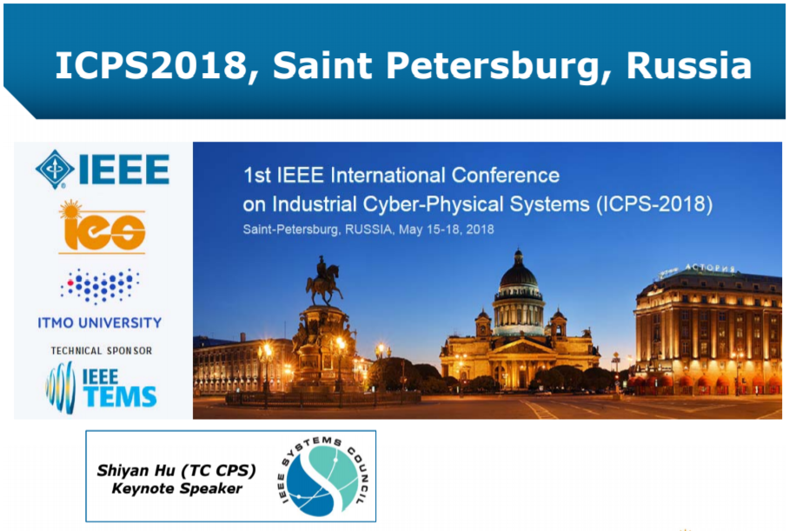

Slide 13
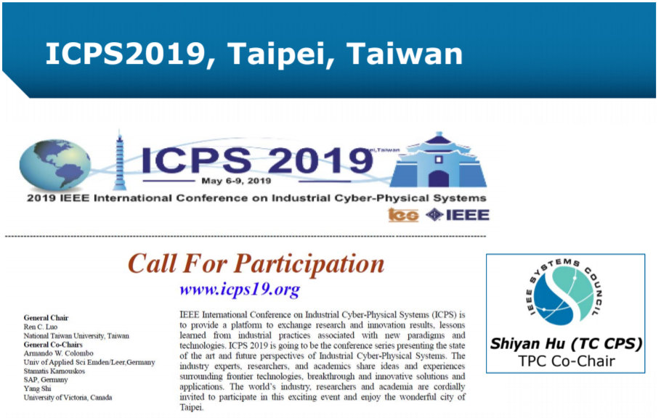

Slide 14

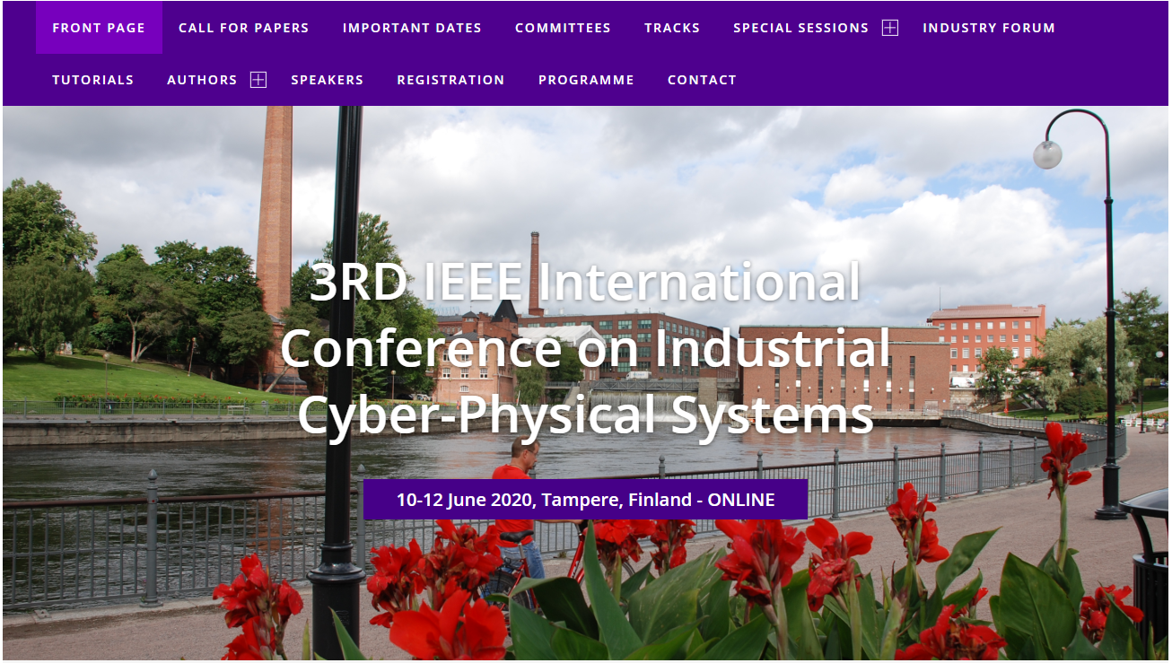


Slide 15
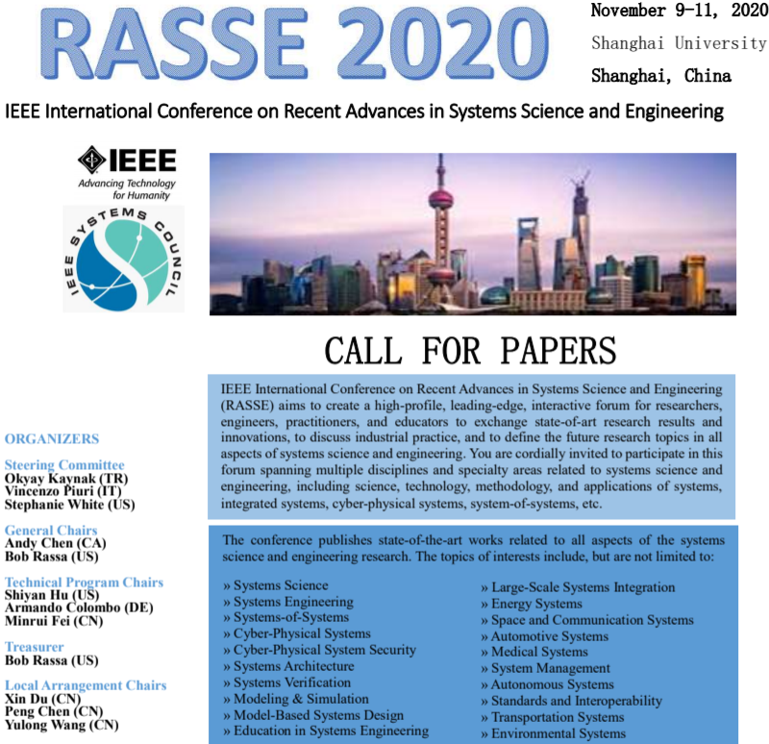

Date to be confirmed

Slide 16
A Strategic / Technical Initiative Proposal
Strategic Roadmap Initiative: Engineering of “Systems of Cyber-Physical Systems (ESoCPS)”
(See Motion on Slide #24)

Slide 17
Roadmap Initiative Proposal
Engineering Systems of Cyber-Physical Systems (ESoCPS)
Complementary Information

Slide 18
Systems Engineering: Evolving Technologies
FROM
  20th Century: (1) Industrial Components
  20th Century: (2) Integration of Components (building blocks) –architectural principles
  20th Century: (3) Algorithmic trying to fulfill behavioral requirements
  System analysis and validation for (1), (2)
  20th Century: Algorithms trying to fulfill behavioral requirements of the components and the result of the integration addressed in (2)
  20th Century: Analysis Methods and Tools
  20th Century: System analysis (Algorithms, Methodologies, Tools, Technologies)
TO
  21st Century: Industrial Solutions that are Systems-of-Cyber-Physical Systems
  21st Century: Synthesis of Systems (instead of Analysis) following clear Principles as e.g. Maier´s Principles
  21st Century: Systems-of-Cyber Physical Systems (structurally evolvable, behavioral with emergence, geographical distributed, independently managed and organized) in all industrial (but not only "industrial") domains.
  21st Century: AI-based decision making capabilities within systems -> intelligence embedded into systems

Slide 19
Engineering SoS
Principles and Key Research and Innovation Aspects related to SoS
ISO/IEC/IEEE 15288:2015
  A system of systems (SoS) brings together a set of systems for a task that none of the systems can accomplish on its own. Each constituent system keeps its own management, goals, and resources while coordinating within the SoS and adapting to meet SoS goals.
Maier’s Principles: Five key characteristics are evident in SoS.
  operational independence of component systems,
  managerial independence of component systems,
  geographical distribution,
  emergent behavior, and
  evolutionary development processes
  [Note: Lack of operational or managerial independence –> this is not a SoS]

Slide 20

Engineering SoCPS
core technologies
~30% domain
specific
domain specific extensions
~70% common
base
Standardization and cross-industry
Tool Development Strategy
Strategy behind SoS
Discussed in 2010 with the EU DG Connect (ICT).

Slide 21
IEEE Example Activities so far
Based on the experience (2004-2018) by key EU projects e.g. CONET, I*PROMS, T-AREA, Road2CPS
2009 INDIN: Keynote on Systems of Systems (SoS) Engineering, Prof. Jamshidi, following I*PROMS
2010 – 2012: Consultation Activities EU/IEEE SoS
2012 INCOSE: Panel on SoS Engineering representing IEEE views.
2014-2018: Collaboration EU-USA(NSF) on SoCPS, including Roadmaps and future activities.
2015-… Selected Theme within the scope of IES TC-ICPS
2018-… Thematic area within the technical programs of the IEEE Conferences on ICPS (2018, 2019, 2020, …)
2020-… Thematic area within the technical program of the IEEE Conference RASSE (2020, …)

Slide 22
Proposal Aims and Significance
Within the CPS community are three aspects of key importance for research and innovate:
How to address the challenges inherent to Systems of CPS (SoCPS), mainly how to build SoCPS meeting given structural and behavioral requirements, from a given set of symbiotic autonomous system´s components, encompassing Heterogeneity and achieving Constructivity?
How to apply Artificial Intelligence and Data Science within different phases of the Life Cycle of SoCPS and associated Digital Thread, e.g., creating digital-/cyber-shadows of physical systems in such a way that become a seamless extension of our body and mind and an integral part of our life?
  for managing Evolvability (e.g. capabilities to learn and adapt) and Emergency (e.g., capabilities for creating new secure behaviors)
  for Monitoring, Controlling, Diagnosticing, Prognosticing, Operating, Supervising SoCPS
How to Engineer safe and secure SoCPS, especially large-scale ones?
The combination of these three aspects, is seen as pivotal towards the creation of flexible and usable future SoCPS Infrastructures, in industry (e.g. production systems, smart grids etc.), as well as public infrastructure (e.g. a Smart City, a Smart Health, a Smart Transportation, etc.).
The primary goal of this initiative is to provide an IEEE Systems Council supported international platform with the aiming to carry out a systematic process that will identify (i) Key Enabling Technologies (KETs) and (ii) Key Enabling Features (KEFs) that are relevant for Engineering SoCPS. A balanced approach is targeted where KETs are coupled with KEFs in order to properly assess impacts, success criteria and other socio-technical dimensions of SoCPS. Subsequently, an analysis can be carried out, which will lead to a Strategic Roadmap (SRM) and associated Research and Innovation Agenda (RIA).
Remark: Due to the nature of this activity, the involvement of different stakeholders from academia and industry is imperative, as well as the involvement of key experts from the various technology and application domains as these are reflected e.g. in the various IEEE Systems Council and IEEE TCs.

Slide 23
Proposal Summary
Aim: Plan and carry out a Roadmaping activity focusing on the Engineering of “Systems-of-Cyber-Physical Systems!
Results: A Strategic Road Map plus Research and Innovation Agenda (SRIA)
Content:
  Key Enabling Features (KEF)
  Key Enabling Technologies (KET)
  Roadmaps for KEF + KET
  Built on existing SRIAs from different areas with focus on large-scale SoCPS Engineering
How:
  Coordinated multi-society effort
  Expert meetings (online/offline), step-wise yearly advances
Administrative:
  Approval at Systems Council AdComs in 2020
  Kick-start in Q3/Q4 2020 [ongoing WiP]
  Duration: Jan 2021 – Dec 2023 (3 years)
  The estimated cost is approx. U$D 49,2k for the total of 3 years ($16,4k / year)

Slide 24
Motion(s)
Provide precise text that AdCom is voting on.
Strategic Roadmap Initiative Proposal for 2021-2023 (3 years)
Engineering of “Systems of Cyber-Physical Systems (ESoCPS)”
Motion: To support the Strategic Roadmap Initiative: Engineering of “Systems of Cyber-Physical Systems”.
Pros: (i) Technical contributions and guidance for IEEE via the Strategic Roadmap creation, (ii) Collaboration of several TCs on the cross-cutting issues of ESoCPS, (iii) Networking benefits via the sync with other societies and international initiatives within IEEE (e.g. systems Council / TConCPS) as well as other organizations (e.g. European Commission, NSF (USA), ARC (Australia) etc.), (iv) Creation of new content-driven interaction between academia and industry, (v) Creation of publications in IEEE-journals, -conferences and –magazines, (vi) Support and expand the newly created IES conference on ICPS (initiated in 2018) and IEEE Systems Council RASSE (to be initiated in 2020), (vii) Increase of IEEE Membership via the technical activity participation as well as planned events and increase the Industrial Engagement in IEEE by involving Industrial Experts in the Initiative, (viii) Increase IEEE members by offering bringing future-oriented strategy in a very pertinent issue that has good innovation opportunities both in academia and in industry.
Cons: Due to the nature of the road mapping work, and the necessary interactions with other Societies / Councils / Technical Committees, the expected impacts will start being visible the latest by Year 2 of the work, once the initial results, such Strategic Research and Innovation Agendas, are present and the implications shown in different events / publications / reports.
Financial Implications: Amount in U$D
The estimated cost is approx. U$D 49,2k for the total of 3 years (U$D16,4k/year)
Duration: Jan 2021 – Dec 2023 (3 years)
Remark: For more information please see the complementary information in the attached document (Full Proposal (4 pages) in Annex)

Slide 25
Thank you for your Attention!

