Slide 1
IEEE Systems Council Report on IEEE Future Directions Committee
Adrian Stoica, Liaison to IEEE Future Directions Committee
Aug 28, 2020
Systems Council AdCom Meeting – Fall 2020 - Online

Slide 2
IEEE Future Directions Committee - Charter
* The following are from the Technical Activities Board Operations Manual, Jan. 2020
Charter
General: The IEEE Future Directions Committee (FDC) reports to, and is a Committee of, the TAB Management Committee.
Scope: The principal mission of the FDC is to anticipate and determine the direction of existing, new and emerging technologies, and related issues, and to spearhead their investigation and development by IEEE in association with Societies/Councils (S/C’s). The emphasis is on new, emerging technical areas either not adequately covered by existing (S/C’s), or which overlap the fields of interest of the existing S/C's, taking a collaborative view that would often involve other constituencies.
Functions (selection):
Seek out future technologies and related issues of potential interest to IEEE TAB and encourage the investigation of emerging technologies. The proactive support of the Societies and Councils is expected and ensured through reporting and discussions in conjunction with the Technical Activities Board (TAB) and S/C meetings
Foster cooperation among existing S/Cs to develop new products and services in new or emerging topics. The proactive support of Societies and Councils is therefore expected.
…

Slide 3
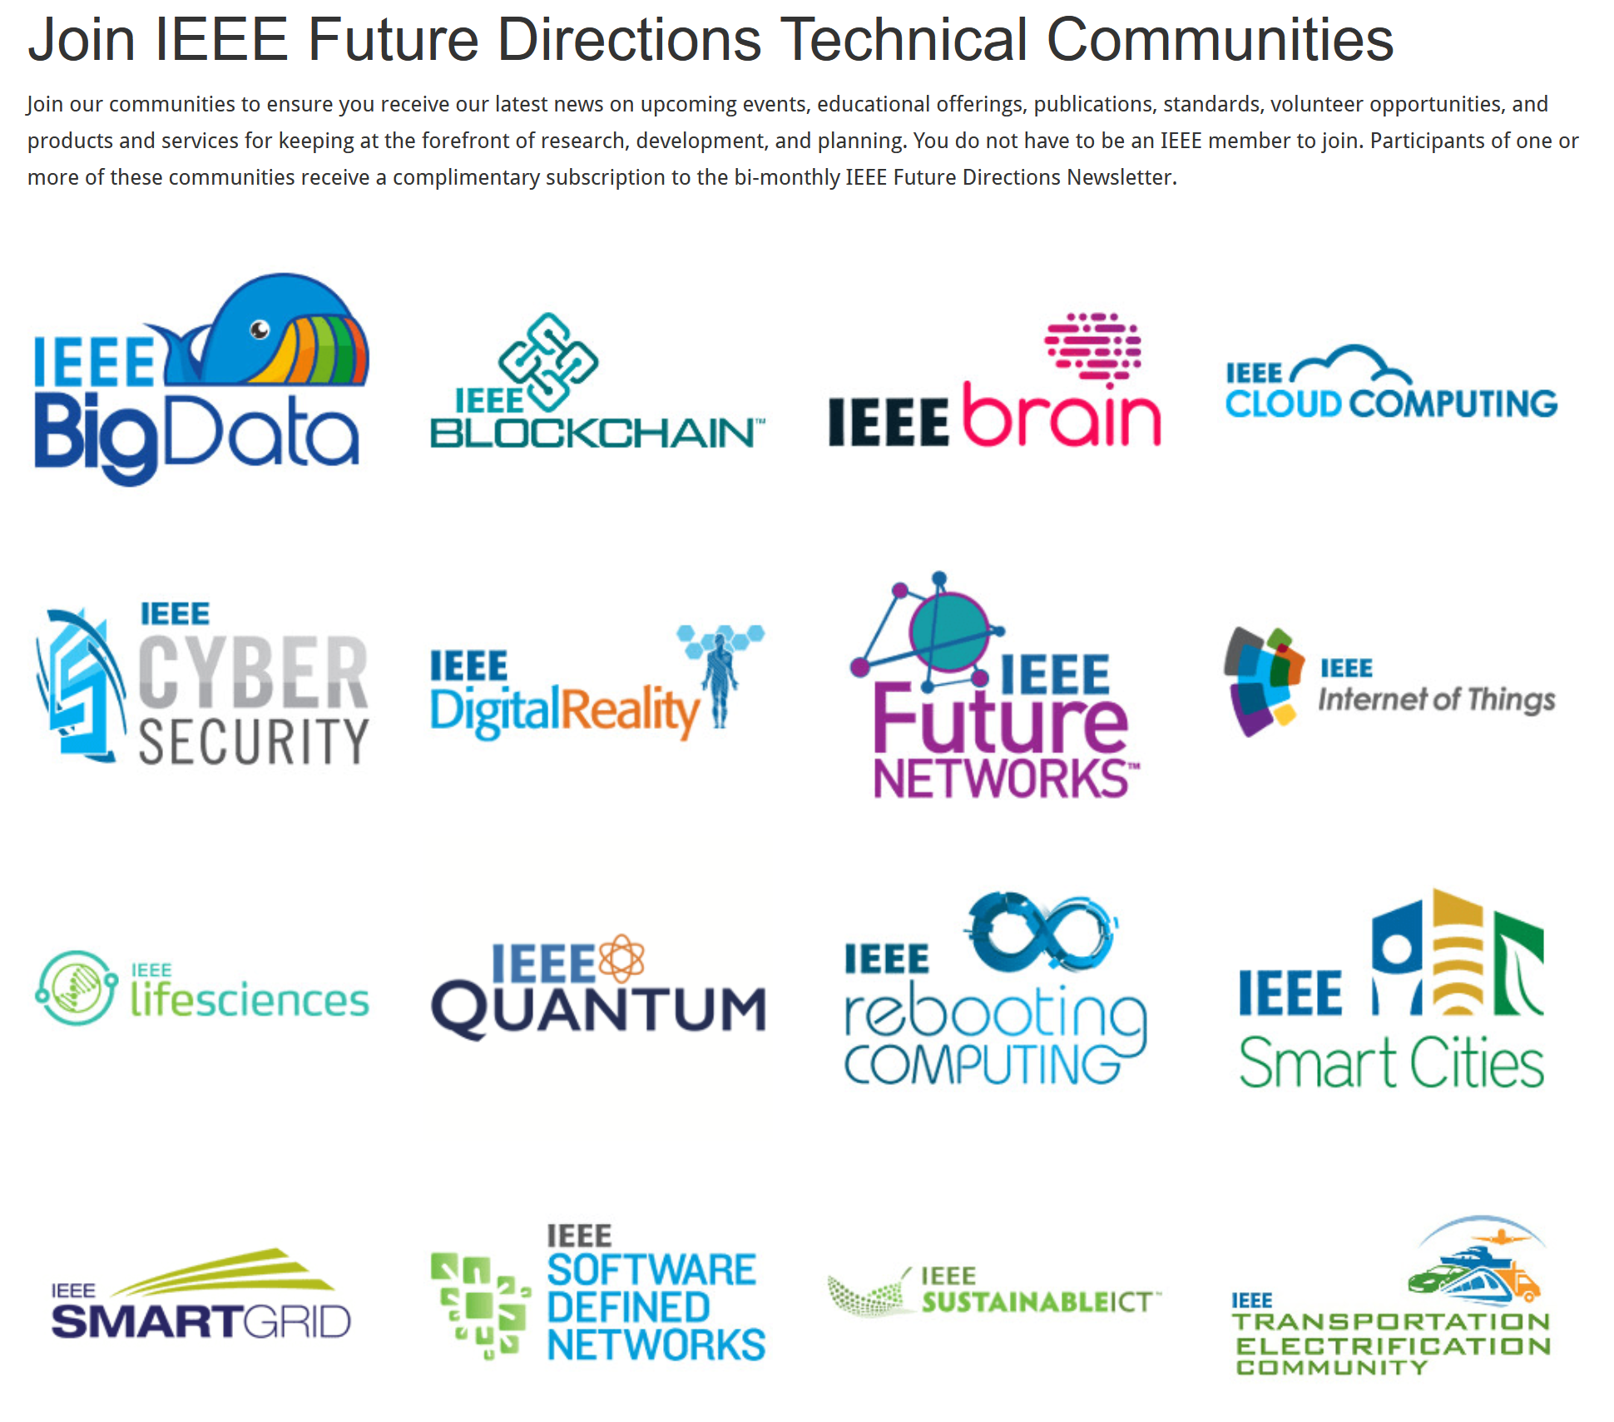
IEEE Future Directions Technical Communities

Slide 4
Activities – Initiatives – Brain

Slide 5
Activities – Initiatives – Rebooting Computing

Slide 6
Activities - Roadmaps
Available Roadmaps
Heterogeneous Integration Roadmap (HIR)
IEEE International Network Generations Roadmap (INGR)
IEEE SA Neurotechnologies for Brain-Machine Interfacing
International Roadmap for Devices and Systems (IRDS)
International Technology Roadmap on Wide Bandgap Semiconductors (ITRW)
About ITRW
Download ITRW
Roadmap Activities Under Development
Future Neural Therapeutics: Closed-Loop Control of Neural Activity - White Paper
IEEE Robotics and Autmation Society (RAS) Roadmaps
The IEEE Roadmaps Strategy and Governance Ad Hoc Committee (IRSG) was created in 2018. Overseen by the IEEE Technical Activities Board (TAB) and supported by IEEE Future Directions, IRSG is working to provide guidance and infrastructure to support technology roadmap activities across the IEEE.
The growing interest in technology roadmaps spans a wide range of IEEE organizational units. IRSG seeks to enable the success of IEEE’s roadmap activities by leveraging the expertise of experienced roadmap developers to create tools and templates and document a high level roadmap development process to assist new roadmaps.
IRSG transitioned to the IEEE Roadmaps Committee (IRC) on 01 January 2020
Rakesh Kumar – Roadmaps Chair

Slide 7
Projects & Collaboration Opportunities
Involvement in Initatives and Roadmaps
IEEE FDC Funding Opportunities
Seed Funding: Offered for new and innovative projects that have not been formerly funded by IEEE FDC, up to $50,000 USD for fiscal year of proposal
Graduated Initiative Funding: For former IEEE Future Directions Initiatives that have graduated and are seeking additional funding support, up to $50,000 for fiscal year of proposal.
Past Successful Projects Funded by IEEE FDC:
IEEE Low-Power Image Recognition Challenge (LPIRC):
IEEE Technology Roadmaps Committee (ITRC):
Fog World Congress (FWC):
IEEE International Forum on Smart Grids for Smart Cities:

Slide 8
IEEE Future Directions Committee - Composition
Composition
Voting members: Chair, Vice-Chair, Ind Advisory Board (IAB) Chair, Up to sixteen (16) Members-at-Large, no more than four (4) serving as current TAB members. Four (4) member positions include one member representing each of the following: Educational Activities (EA), Member and Geographic Activities (MGA), Standards Activities (SA) and IEEE-USA.
Non-voting members: Eight (8) additional members, who shall serve on the Industry Advisory Board, a subcommittee of the FDC.
Appointments and terms of office
Chair: The Committee Chair shall be appointed by the Vice President-Elect, Technical Activities, and shall begin their two-year term on 1 January when the Vice President-Elect becomes Vice President.
Vice-Chair: The Chair may appoint a Vice-Chair for the current year.

Slide 9
IEEE FDC – Adrian Stoica’s Contributions (in addition to involvement in discussion and voting)
Participated in "Ideation" for Next Future Directions Technology Initiatives and/or Small Projects
Prepared/ presented 2 materials (decks of slides) in the June 2020 meeting, supporting ideation in:
Telepresence
AI Hypersphere

Slide 10
IEEE Future Directions Committee - People
Sample attendance list of last meeting. Voting members in bold in first column.
Steve Diamond - Chair | Ashutosh Dutta (FN) | William Tonti (All)
Wanda Reder - Vice Chair | Bruce Kraemer (RC) | Andrea Sadlowski (FD, Roadmaps)
Roberto Saracco - IAB | Candace Culhane (Quantum) | Brad Kloza (FN)
Rakesh Kumar - Roadmaps | Dejan Milojicic (RC) | Chris Franzino (FD)
Yahia MM Antar | Elie Track (RC) | Julie Bernicker (FD)
Braham Ferreira | Erik DeBenedictis (Quantum) | Kathy Grise (FD, DR)
Jill I Gostin | Hausi Muller (Quantum) | Randi Sumner
Samina Husain | Jacob Robinson (Brain) | Sin Kuen Hawkins (Brain)
James Irvine | Jason Rupe (Blockchain) | Terence Martinez (RC, Quantum)
Okyay Kaynak | Jose M. Carmena (Brain) | Tim Kostyk (Blockchain)
Witold Kinsner | Paul Sajda (Brain) | Patrick Mccarren
Christine Miyachi | Raj Tivari (DR)
John Nelson | Ramesh Ramadoss (Blockchain)
Jeewika C Ranaweera | Roberto Saracco (DR)
Grayson Randall | Steve Dukes (DR)
Adrian Stoica | Timothy Lee (FN)
Mehmet Ulema | Travis Humble (Quantum)
Anding Zhu
Doug Zuckerman | Rob Fish
Kathy Grise - staff, non-voting | Samar Saha
William Tonti - staff, non-voting | Georges Zissis - IAS President
Bill Tonti, Senior Director and Kathy L. Grise, Senior Program Director
Future Directions IEEE Technical Activities

Slide 11
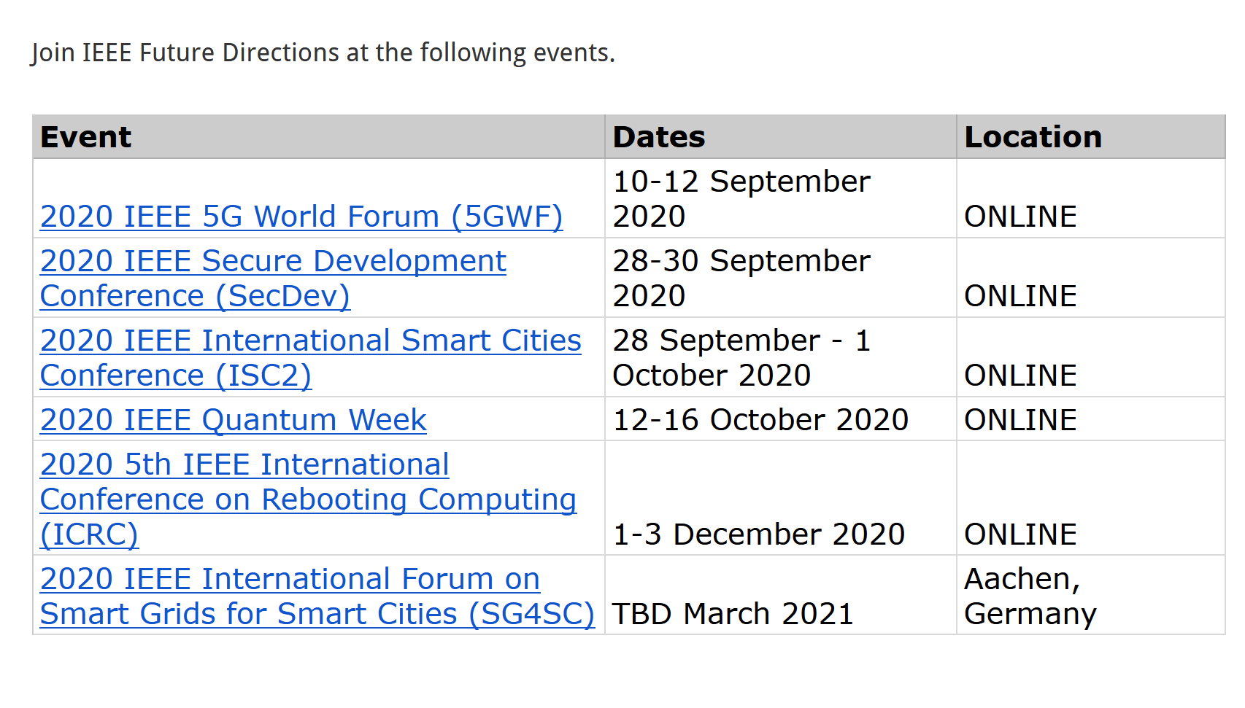
IEEE Future Directions Committee Meetings
And FDC EVENTS
2020 FDC Meeting Schedule
January 27, 2020 | Teleconference
February 12-13, 2020 | In Person, Hilton Orlando Lake Buena Vista, Florida
March 23, 2020 | Teleconference
April 27, 2020 | Teleconference
June 1, 2020 | Teleconference
June 15, 2020 June 24-25, 2020 | Virtual In Person, Sheraton Grand, Chicago, Illinois
July 27, 2020 | Teleconference
August 24, 2020 | Teleconference
September 28, 2020 | Teleconference
October 26, 2020 | Teleconference
November 18-19, 2020 | In Person, Hyatt Regency Bellevue, Bellevue, Washington

