Slide 1
IEEE Systems Council Industry Applications Society (IAS)
Prof. Georges Zissis, IAS President
April 24th, 2020
Toulouse, France

Slide 2
Industry Applications Society Vision, Mission & FoI
IAS Vision Statement
IEEE Industry Applications Society will be a world leader in the advancement of science and technology linking theory and practice in the application of electrical and electronic systems for the benefit of humanity.
IAS Mission Statement
IEEE Industry Applications Society enables the advancement of theory and practice in the design, development, manufacturing and application of safe, sustainable, reliable, smart electrical systems, equipment and services.
Field of Interest
The Society, as a transnational organization, is interested in advancement of the theory and practice of electrical and electronic engineering in the development, design, manufacture and application of electrical systems, apparatus, devices and controls to the processes and equipment of industry and commerce; promotion of safe, reliable and economic installations; industry leadership in energy conservation and environmental, health, and safety issues; creation of voluntary engineering standards and recommended practices; and the professional development of its membership.
Linking Research to Practice

Slide 3
Attributes of Industry Applications Society
IAS was formed in 1965, two years after the creation of IEEE
But, many of its committees have a much longer history
Two committees were formed before 1910
14 of the original 23 committees still exist
5th IEEE Society in membership size
15,000 members (51% industry sector) 3,500 students
Over 450 Chapters – many joint with other Societies like PELS, PES, IES
Student branch chapters in 30+ countries and technical chapters in 67 countries
Financial or Technical Sponsor of almost 50 Conferences per year
68 IEEE Standards (out of 1200 in IEEE)
IAS is a core member of IEEE Transportation Electrification Community
IAS supports Smart Grid
IAS supports Smart Cities
IAS supports Systems Council
IAS supports International Smart Village

Slide 4
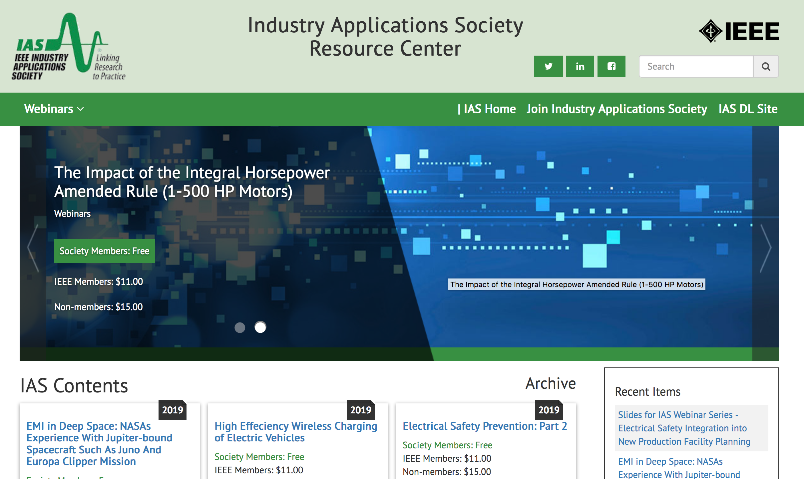
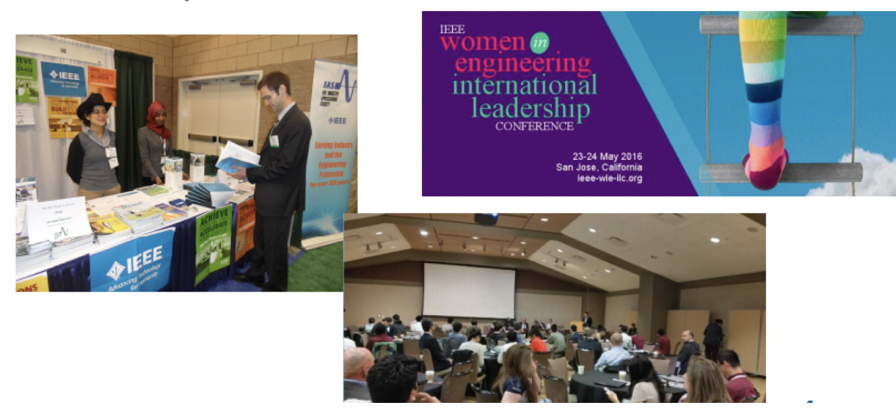
Society’s Main Activities
7 Rank-A peer Review Journals; more than 10 conference proceedings/year
Tutorials, Webinars and IAS Resource center
Women In Engineering Travel awards
Myron Zucker Student-Faculty Research Grant Program
Sponsoring two research projects annually.
The project must be designed to produce Myron Zucker Student-Faculty Research Grant Program publishable results in one year.
Maximum funding $25,000 per project.
Student Travel Awards
Approx. 370 travel awards for students (all levels)
Student contests & Awards
Thesis
Demonstrations & projects
Chapter Activity
Humanitarian
IEEE Open Journal of Industry Applications
Gold Open-Access Journal is now accepting papers.
IAS started a YP
mentoring program in 2019

