Slide 1
IEEE Systems Council VP-Publications
Paolo Carbone
Fall 2021 ADCOM meeting

Slide 2
Current Status & Achievements
IEEE Systems Journal
Other publications
IEEE J-MASS - Journal on Miniaturization for Air and Space Systems
NEW Open Access Journal on Systems Engineering

Slide 3
IEEE Systems Journal – EiC Amir G. Aghdam
Year | Submitted | Published | Rejected | Withdrawn | In-process
2007 | 140 | 63 | 72 | 5 | 0
2008 | 65 | 35 | 29 | 1 | 0
2009 | 180 | 57 | 111 | 12 | 0
2010 | 268 | 115 | 146 | 7 | 0
2011 | 417 | 90 | 309 | 18 | 0
2012 | 505 | 62 | 420 | 13 | 0
2013 | 537 | 160 | 356 | 21 | 0
2014 | 970 | 310 | 634 | 26 | 0
2015 | 840 | 204 | 617 | 19 | 0
2016 | 781 | 185 | 570 | 26 | 0
2017 | 785 | 261 | 506 | 18 | 0
2018 | 1142 | 433 | 670 | 29 | 10
2019 | 1489 | 542 | 897 | 29 | 21
2020 | 2174 | 590 | 1442 | 27 | 115
2021 | 1519 | 26 | 626 | 8 | 859

Slide 4
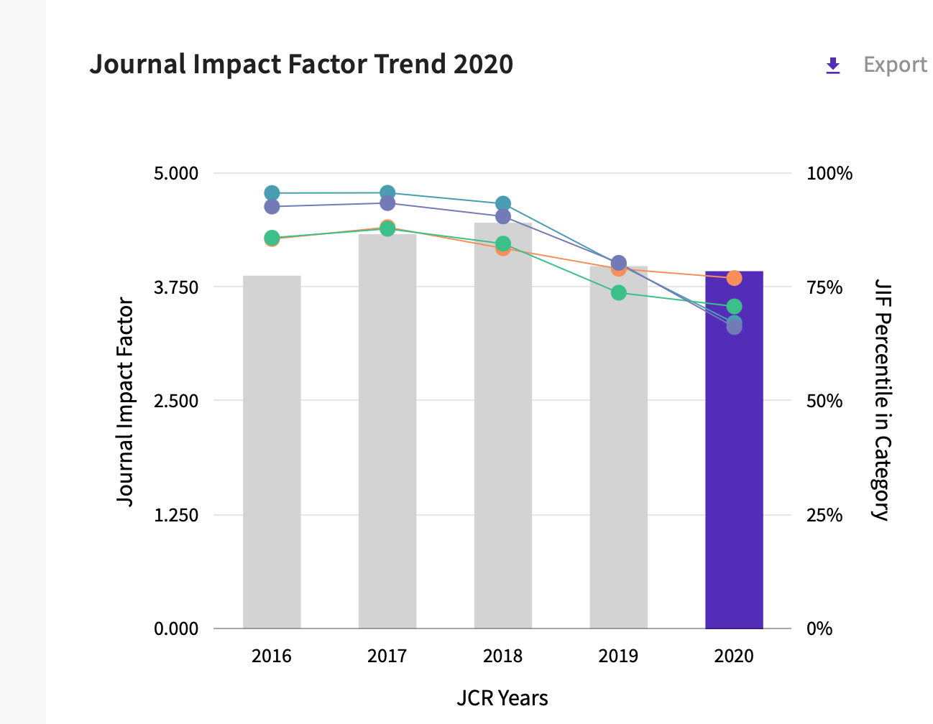
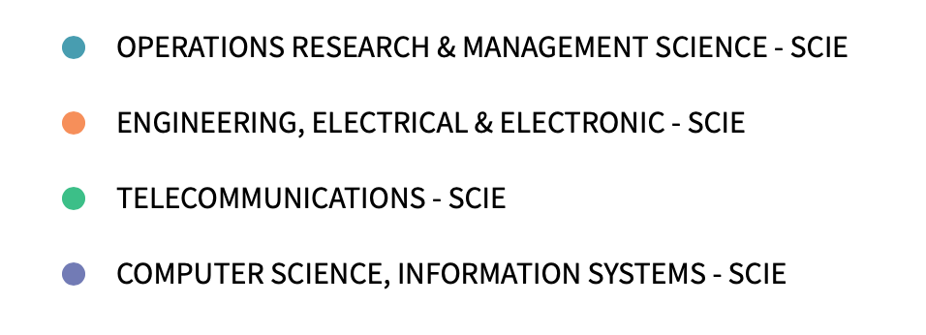
Citation metrics

Slide 5
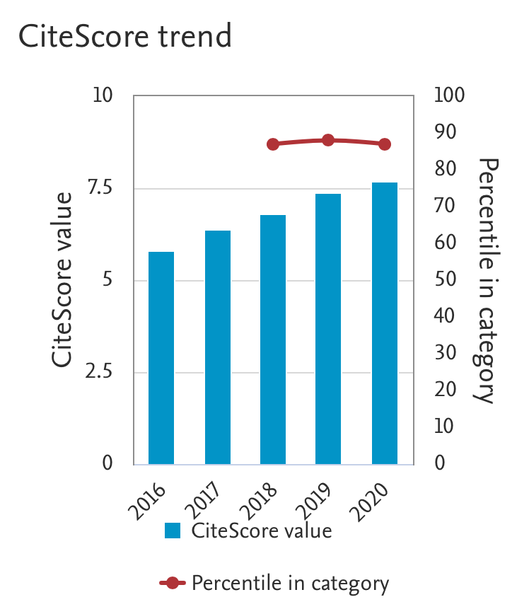
Journal is listed in several categories: in all of them Citescore is above 75% percentile, meaning Q1

Slide 6
Additional information
All papers submitted by the end of 2018 have been included in issues by the second 2020 issue.
Current page limits (apply to papers submitted from 1 Jan 2015): 8 complimentary pages for regular papers; up to 12 pages, with overlength page charge of US$150 per page. No complaints received from authors.
No publicity since beginning of 2015 to limit the increase of the backlog of accepted papers.
No special issues approved since the last quarter of 2014 to limit the increase of the backlog of accepted papers. One exception in 2019 to support the IEEE Brain Initiative.
Page budget: 5,750 pages in 2021 – 6,000 pages in 2022

Slide 7
Motion I
To add 750 pages to the page budget in 2021 (total 6,500 pages)
Pros:
Sustain the increased number of submissions and keep publication times under control
Cons:
Financial implications as below noted
Financial Implications: about 23,505 USD

Slide 8
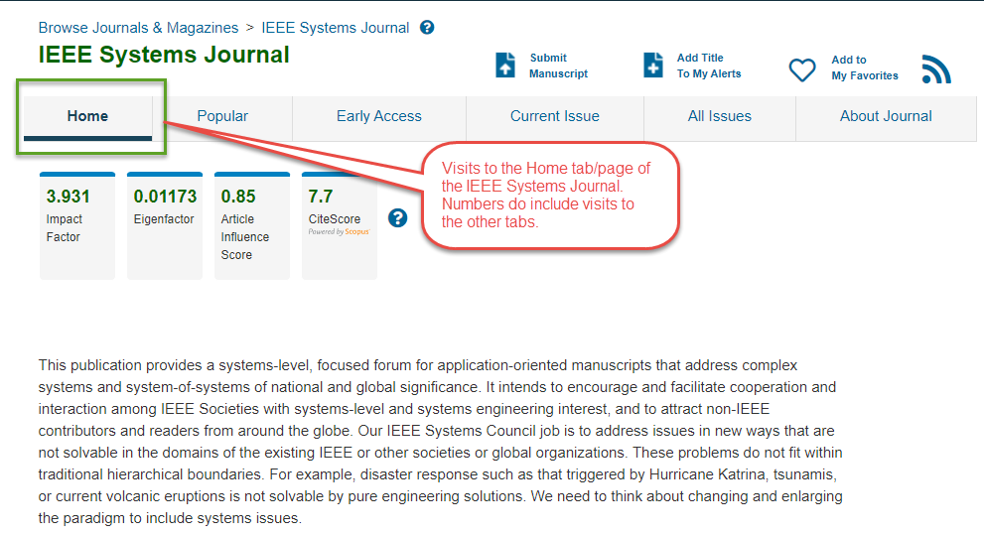
Other: IEEEXplore SJ website visits
Year | Total | % Chg YoY
2018 | 30.259
2019 | 30.205 | -0,2%
2020 | 15.688 | -48,1%
2021 | 23.977 | 52,8%

Slide 9
Other: SYSC website visits
Newsletter recipients
2021 -
Q1- 14,006 Q2 - 14,861 Q3 - 15,322
2020 Q1 - 10,720 Q2 - 11,434 Q3 - 11,925 Q4 - 12,721 2019 Q3 - 8,967 Q4 - 9,608

Slide 10
IEEE SYSCON: total number of paper downloads in 2019 and 2020

Slide 11
IEEE ISSE: total number of paper downloads in 2019 and 2020

Slide 12
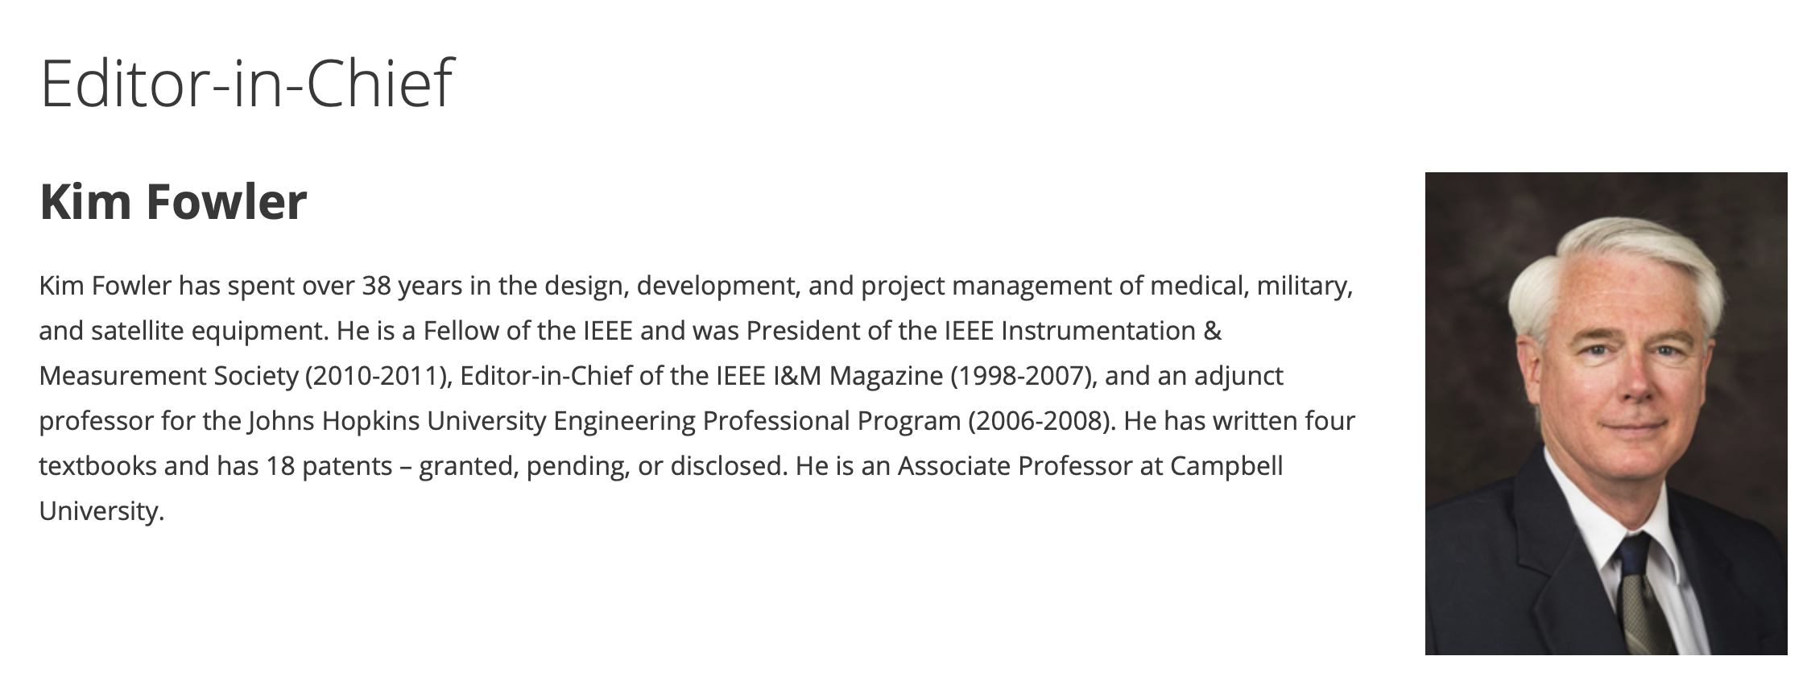
J-MASS
After appointment of new EiC, Prof. Antonio Plaza with support by Kim Fowler:
Significantly improved J-MASS Web site and author templates
Approved new special issues, several tied to major conferences
Appointed 20 new Associate Editors
Journal delisted from IEEE watch list
Starting July 1st, new EiC, new assistant Ms. Greeley Hibbard

Slide 13
Open Access Journal on Systems Engineering
PERIODICAL TITLE: IEEE Open Journal on Systems Engineering
PROJECTED LAUNCH YEAR & MONTH: 2023 – 4th Quarter
Current approved sponsorship is:
IEEE Systems Council (40%)
IEEE Systems, Man and Cybernetics Society (40%)
IEEE Aerospace & Electronic Systems Society (20%)
Establishing an open-access journal, will provide a venue for addressing the growing need for open-access publications, steered by several funding agencies around the world. This new journal will benefit the IEEE, reinforcing its leading role in science and engineering of systems and systems-of-systems.

Slide 14
New initiatives: Open Access Journal on Systems Engineering
Phase I proposal passed at June TAB
Phase II to be discussed by Nov TAB (Bob leading the drafting activity), documents submitted before the deadline, Sept. 1st
Second quarter survey report outcomes are positive
EiC: Dr. Dale Blair (Georgia Tech research Institute)

Slide 15
Sponsored publications
IEEE Transactions on Cloud Computing: financial cosponsorhip (Q1)
Computer Society
Communications Society
Systems Council (7%)
Power and Energy Society
Consumer Electronics Society
IEEE Transactions on Big Data: financial cosponsorhip
Computer Society
Communications Society
Computational Intelligence Society
Sensors Council
Signal Processing Society
Systems, Man, and Cybernetics Society
Systems Council (5%)
Vehicular Technology Society

Slide 16
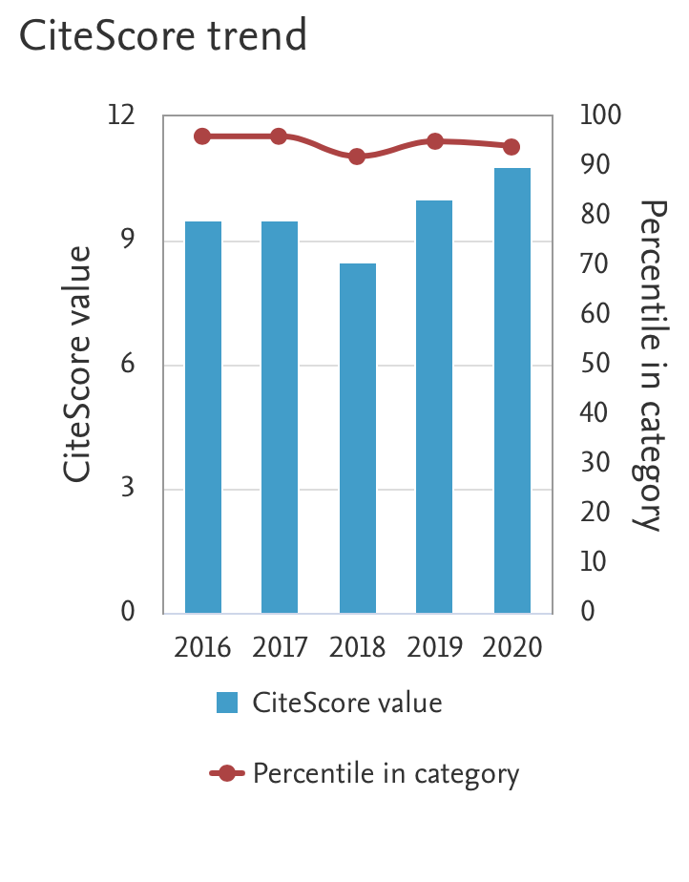
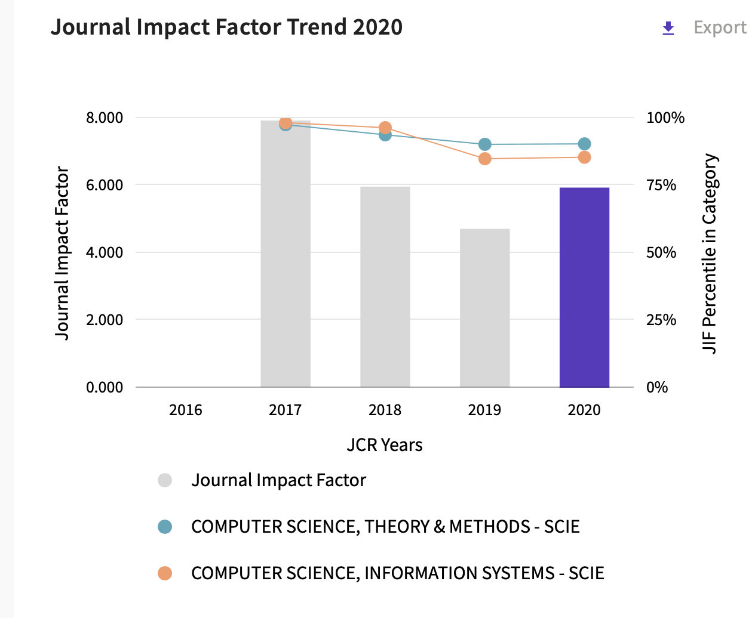
TCC

Slide 17
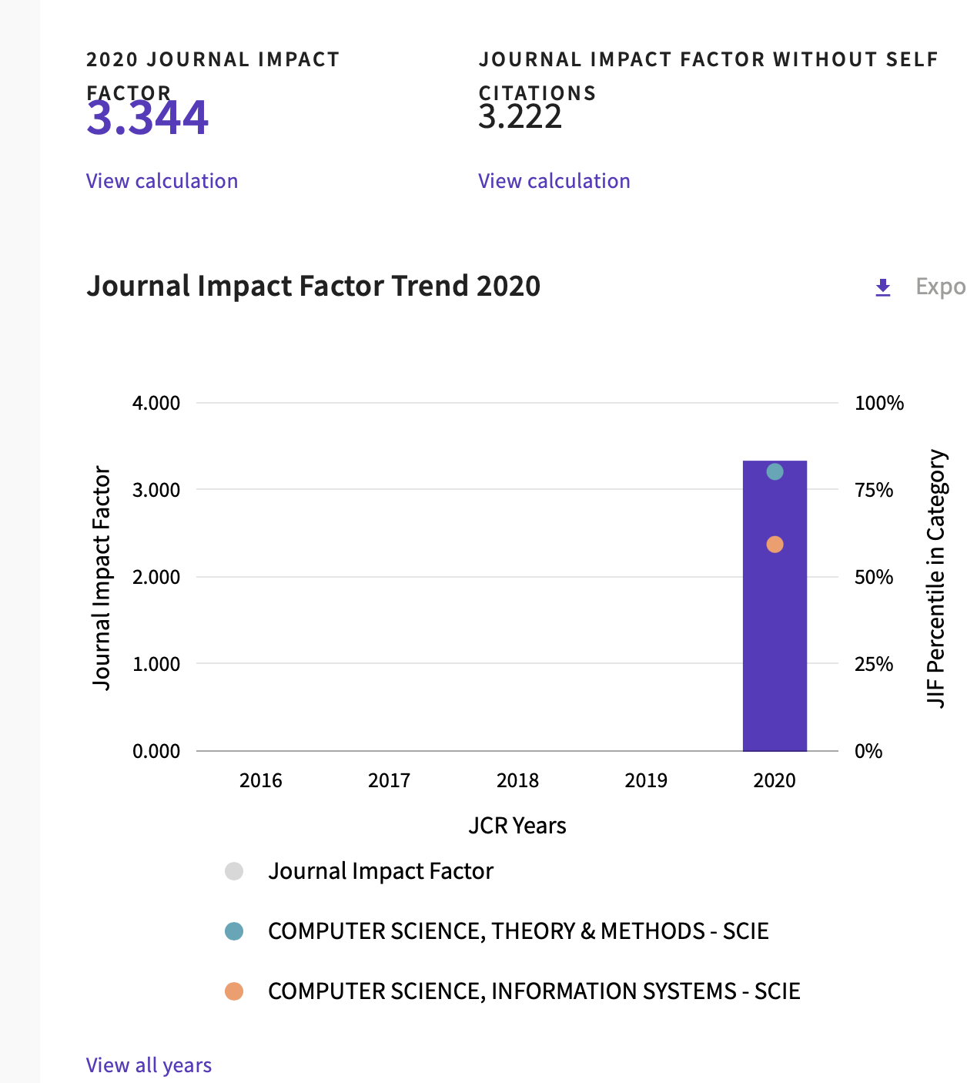
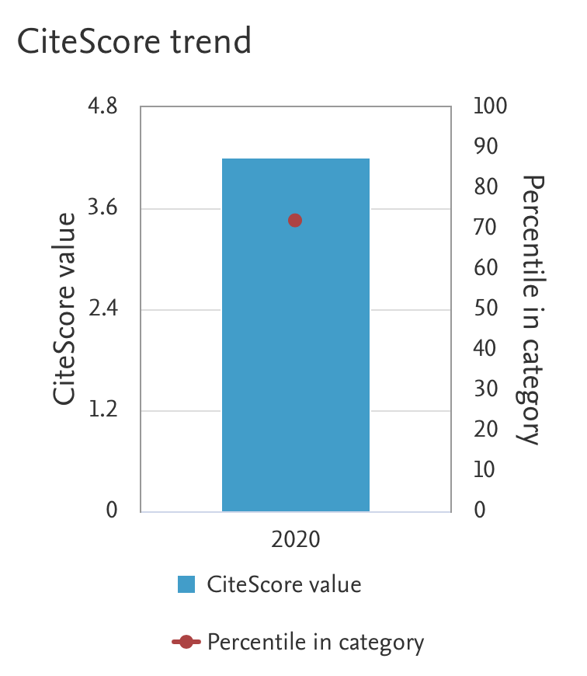
TBD

