Slide 1
IEEE Systems Council President’s Report
Vincenzo Piuri
3 September 2021
2021 SYSC Fall AdCom

Slide 2
Welcome!
Our Mission:
Foster advancement of knowledge and innovation in science, technology, and applications of systems engineering, especially in complex systems and systems-of-systems, for the benefit of humanity
Promote the activities of and cooperate with the SYSC Member Societies in the area of interest of the Council

Slide 3
2021 SYSC Member Society & Representatives
Society | Rep(s)
AESS – Aerospace and Electronic Systems Society | Michael Cardinale and Walt Downing
CASS – Circuits and Systems Society | Rajiv Joshi
ComSoc – Communications Society | Nelson Fonseca and Michele Nogueira
CS – Computer Society | Cecilia Metra and Jyotika Athavale
CTSoC – Consumer Technology Society (formerly CESoc) | Chih-Peng Fan and Lucio Ciabattoni
CSS – Control Systems Society | Amir G. Aghdam
IAS – Industrial Applications Society | Georges Zissis and David Eng
IES – Industrial Electronics Society | Okyay Kaynak and Armando Walter Colombo
ITS – Information Theory | Aylin Yener
IMS – Instrumentation and Measurement Society | Shreekanth Mandayam and Ruth A. Dyer
MTT-S – Microwave Theory and Technology Society | Amir Mortazawi and Nils Pohl
PELS – Power Electronics Society | Ernie Parker and Jian Sun
PSES – Product Safety Engineering Society | Stefan Mozar and Kim Fung Tsang
RAS – Robotics and Automation Society | Josè Contreras-Vidal
SSIT – Society on Social Implications of Technology | Bozenna Pasik-Duncan and Prasanta Ghosh
SMC – Systems, Man, and Cybernetics Society | Thomas Strasser and Adrian Stoica
TEMS – Technology and Engineering Management Society | Mark Wehde and Shiyan Hu
VTS – Vehicular Technology Society | Fabrice Labeau and Alexander Wyglinski

Slide 4
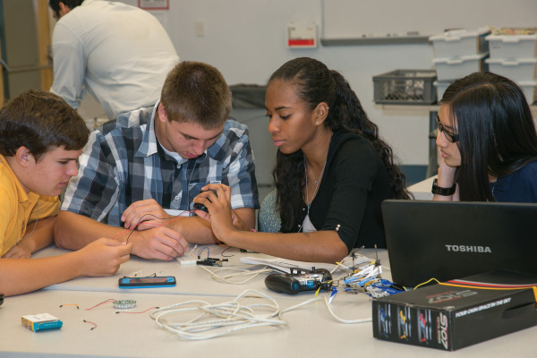
Strategic Directions for 2021
Continuing Education
Adhoc Education Committee → to be transformed in Standing Committee
SYSC Educational Program
→ define policy and platform
Cooperation with SYSC Member Societies and other institutions
Cooperation with SYSC Member Societies and other institutions
Technical Activities
Expand the technical committees to involve more volunteers worldwide
New technical committees in the field of interest of SYSC Member Societies
New technical committees in interdisciplinary areas relevant to researchers and industry professionals in the field of interest of SYSC

Slide 5
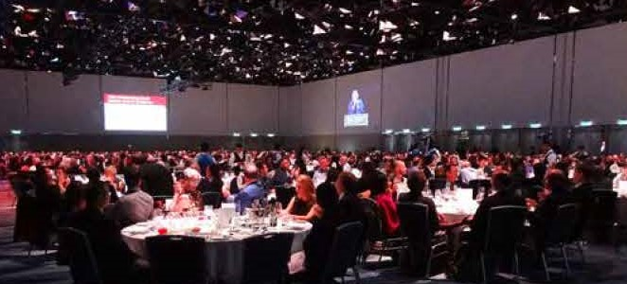
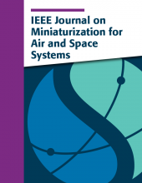
Strategic Directions for 2021 (cont’d)
Conferences
New conferences to address emerging technical needs
New conferences to address needs in new geographical areas
More cooperation with technical committee for special sessions and tutorials
Publications
Support and publicize the IEEE Systems Journal
Enhance the operation of the IEEE Systems Journal bringing it into the future
Promote the IEEE Journal on Miniaturization for Air and Space Systems
Promote creation of the IEEE Open Journal on Systems Engineering (Phase II)

Slide 6
Strategic Directions for 2021 (cont’d)
Members Services
Restructure the Committee involving more volunteers with more focused activities
Promoting Chapters and Students Chapters
Expand the Distinguished Lecturers Program
Promoting and funding local activities in Chapters
New services: mentoring, meetups, internships, …
Listen industry professionals and industries
Awards and Recognitions → transform the AdHoc Cmte in Standing Committee
Cooperation with SYSC Member Societies and other institutions
Promote Diversities
Expanding SYSC global coverage worldwide
Africa, Asia, Latin America
WISE – Women in Systems Engineering Cmte
→ transform in Standing Committee
Establish a subcommittee on Diversity and Inclusion with the Member Services Committee
SYSC Young Professionals Committee
→ establish a group and create an AdHoc Committee
Promote diversity in the workspace
Cooperation with SYSC Member Societies and other institutions

Slide 7
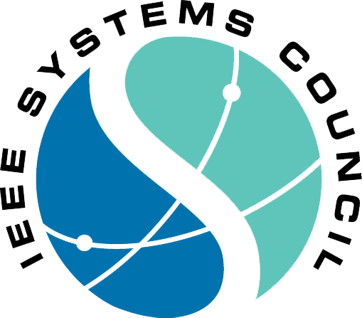
Strategic Directions for 2021 (cont’d)
Organizational Structure
Distribute the workload
Structure each Committee with appropriate Sub-Committees focused on specific activities
Recruit more volunteers for Sub-Committees
Ensure diversity in Sub-Committees to better understand and address the needs of our scientific and professional community

