Slide 1
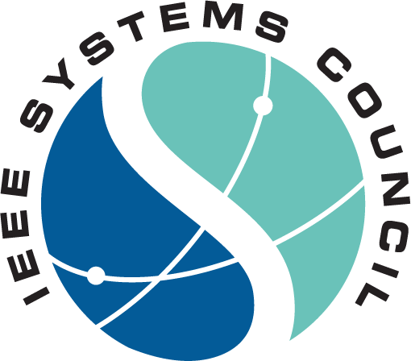
IEEE Entities Cooperation Committee
Aylin Yener
IEEESYSTEMSCOUNCIL.ORG

Slide 2
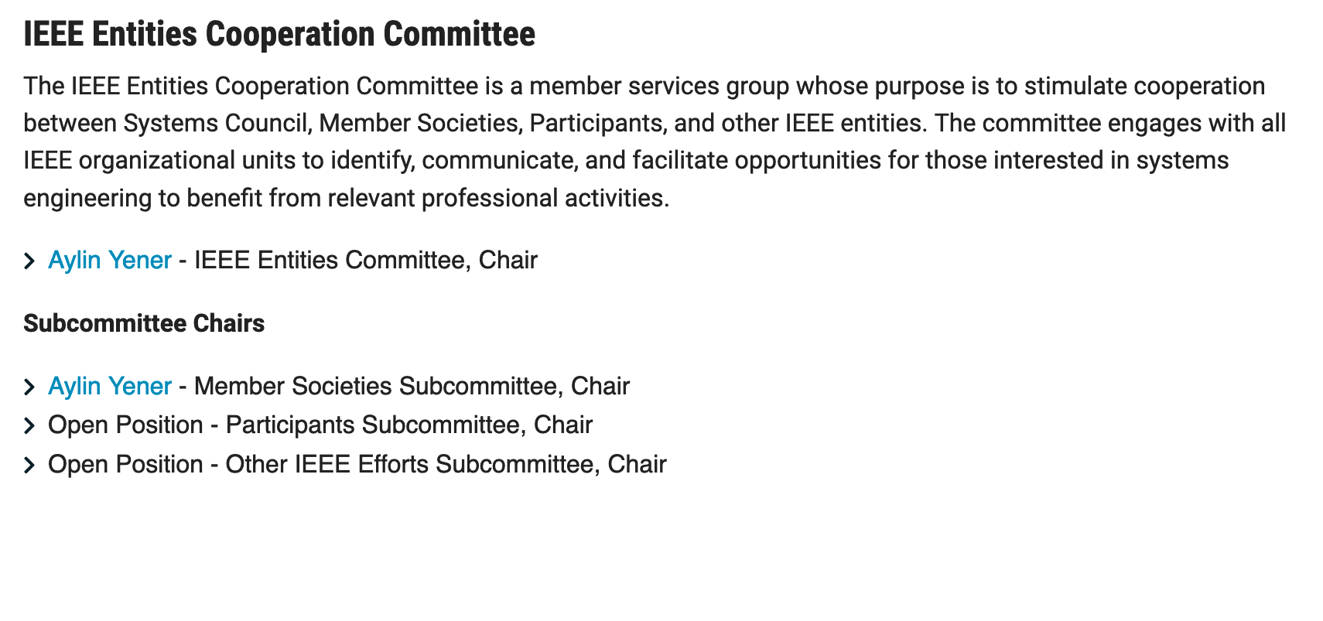
IEEE Entities Cooperation Committee
In its early stages still; has envisioned to have three subcommittees
https://ieeesystemscouncil.org/cooperation-committee
IEEESYSTEMSCOUNCIL.ORG/ABOUT

Slide 3
IEEE Entities Cooperation Committee Charter
Enable and act on avenues of cooperation with member societies, and all other IEEE regional and technical activities, including but not limited to technical committees, standards, regional meetings where Systems Engineering should have a voice.
Timeline: Call for volunteers in Aug 2022 to all member societies reps for Member Societies Subcommittee.
IEEESYSTEMSCOUNCIL.ORG/ABOUT

Slide 4
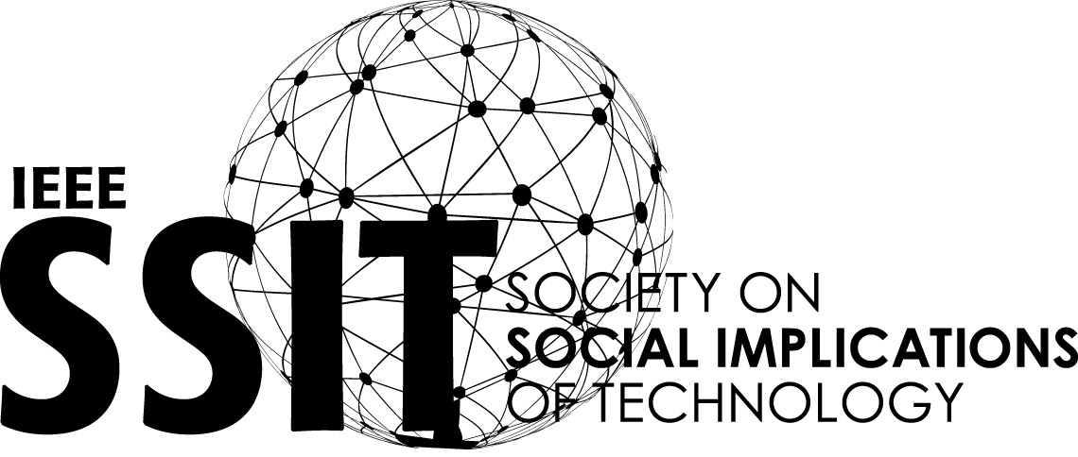
Member Societies
Aerospace and Electronic Systems Circuits and Systems Communications Computer Consumer Technology Control Systems Industry Applications Industrial Electronics Information Theory Instrumentation and Measurement Microwave Theory and Techniques Power Electronics Product Safety Engineering
Reliability Robotics and Automation Social Implications of Technology Systems, Man, and Cybernetics Technology and Engineering Management Vehicular Technology
IEEESYSTEMSCOUNCIL.ORG/MEMBER-SOCIETIES

Slide 5
IEEE Member Societies Cooperation Subcommittee
First meeting: April 2023
Aylin Yener (ITSoc): Region2
Luke Rosenberg (): Region 9
Thomas Strasser (): Region 8
Chun Sing Lai (): Region 8
Antonio J Marques Cardoso (PELS): Region 8
Amir Mortazawi (): Region 4
Rajiv V. Joshi (CAS): Region 1
Wei-Jen Lee (IAS): Region 5
Stamatis Karnouskos (IES): Region 8
Stephanie White (): Region 1
IEEESYSTEMSCOUNCIL.ORG/ABOUT

Slide 6
2022-2023 Member Society Representatives
ITS |
MTT-S |
PELS |
PSES |
RAS |
RS |
SSIT |
SMC |
TEMS |
VTS |
Aylin Yener and Lingxi Li
Greg Lyons
Antonio J. Marques Cardoso and Ernie Parker
Stefan Mozar and Kim Fung Tsang
Emanuele Menegatti
Jason Rupe and Wei Zhang
Bozenna Pasik-Duncan and Prasanta Ghosh
Mingcong Deng and Ming Hour
Mark Wehde and Shiyan Hu
Fabrice Labeau and Alexander Wyglinski
AESS |
CASS |
COMSOC |
CS |
CTSOC |
CSS |
IAS |
IES |
IMS |
Bob Rassa and Michael Cardinale
Rajiv Joshi and Yoshifumi Nishio
Michele Nogueira and Ruidong Li
Andre Obler and Jyotika Athavale
Chih-Peng Fan and Lucio Ciabattoni
Amir G. Aghdam and Rifat Sipahi
Wei-Jen Lee and Andy Knight
Stamatis Karnouskos and Yang Shi
Shreekanth Mandayam and Vincenzo Piuri
IEEESYSTEMSCOUNCIL.ORG/MEMBER-SOCIETY-REPS

Slide 7
Ideas from April 2023 Meeting
Industry participation is a common point most (all?) member societies care about.
IAS: Series of talks emphasizing the societal impact of technology
Liaise with CPS/ other technical committees
System Engineering + X (X= PES, AES, CAS, IT, CSS,…)
Action items:
1.Talk series on societal impact of what we do (collectively)
2. Survey out to member reps / adcom: What is needed?
IEEESYSTEMSCOUNCIL.ORG/ABOUT

Slide 8
How to Get Involved
Become a Systems participant
For free on the IEEE website
Subscribe to Systems Council Mailing List
Conferences and Events
Organize a meeting, workshop or conference
Review for Systems conferences and Journals
Get involved with local chapters and volunteer to organize activities
Volunteer to Serve on Systems Committees
Calls are announced on the website and social media
Distinguished Lecturers Program
Request a DL at your next event Apply to become a DL

Slide 9
Website
ieeesystemscouncil.org
Facebook
facebook.com/IEEESystemsCouncil
Twitter
Stay up to date on all Systems news and events!
@SystemsCouncil
LinkedIn
linkedin.com/company/ieee-systems-council
IEEESYSTEMSCOUNCIL.ORG/MARKETING-REQUESTS

