Slide 1
IEEE Systems Council VP-Publications
Paolo Carbone
Fall 2022 ADCOM meeting
SUMMARY
IEEE Systems Journal
IEEE J-MASS - Journal on Miniaturization for Air and Space Systems
IEEE Open Access Journal on Systems Engineering
Sponsored journals

Slide 2
IEEE Systems Journal – EiC Amir G. Aghdam
Year | Submitted | Published | Rejected | Withdrawn | In-process
2007 | 140 | 63 | 72 | 5 | 0
2008 | 65 | 35 | 29 | 1 | 0
2009 | 180 | 57 | 111 | 12 | 0
2010 | 268 | 115 | 146 | 7 | 0
2011 | 417 | 90 | 309 | 18 | 0
2012 | 505 | 62 | 420 | 13 | 0
2013 | 537 | 160 | 356 | 21 | 0
2014 | 970 | 310 | 634 | 26 | 0
2015 | 840 | 204 | 617 | 19 | 0
2016 | 781 | 185 | 570 | 26 | 0
2017 | 785 | 261 | 506 | 18 | 0
2018 | 1142 | 433 | 670 | 29 | 0
2019 | 1489 | 542 | 897 | 29 | 0
2020 | 2165 | 715 | 1421 | 29 | 0
2021 | 2012 | 467 | 1470 | 14 | 61
2022 | 1304 | 202 | 644 | 6 | 452

Slide 3
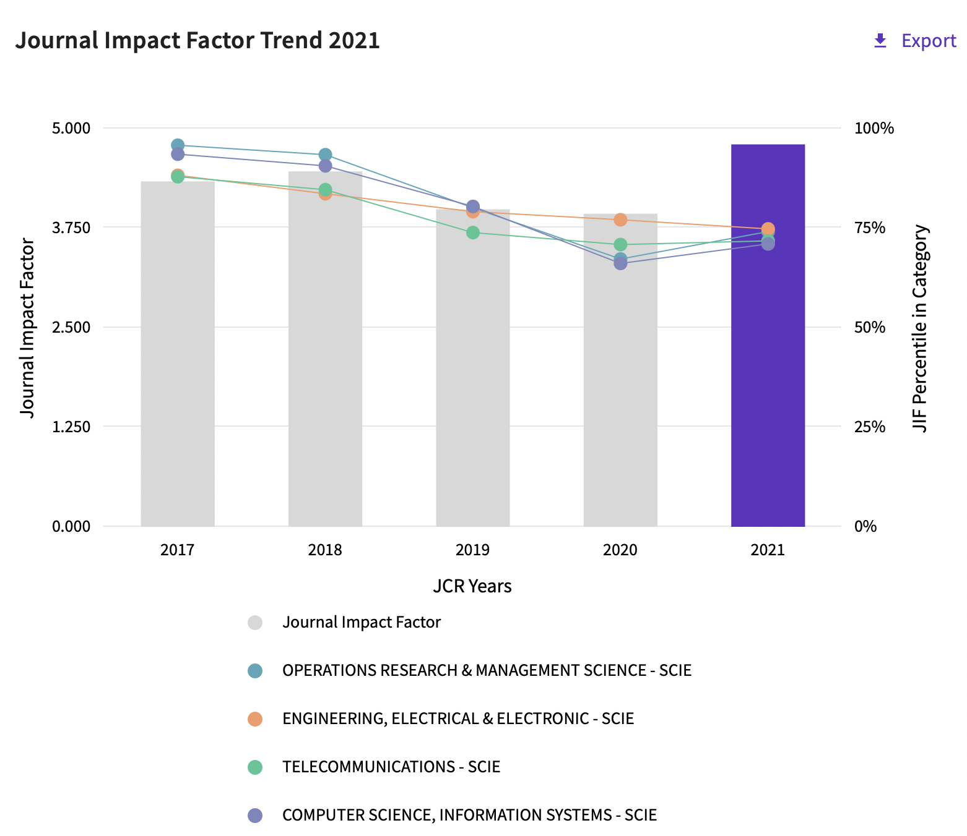
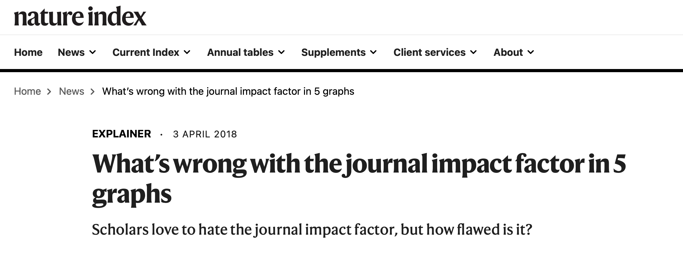
Citation metrics
Q2 in all 4 categories

Slide 4
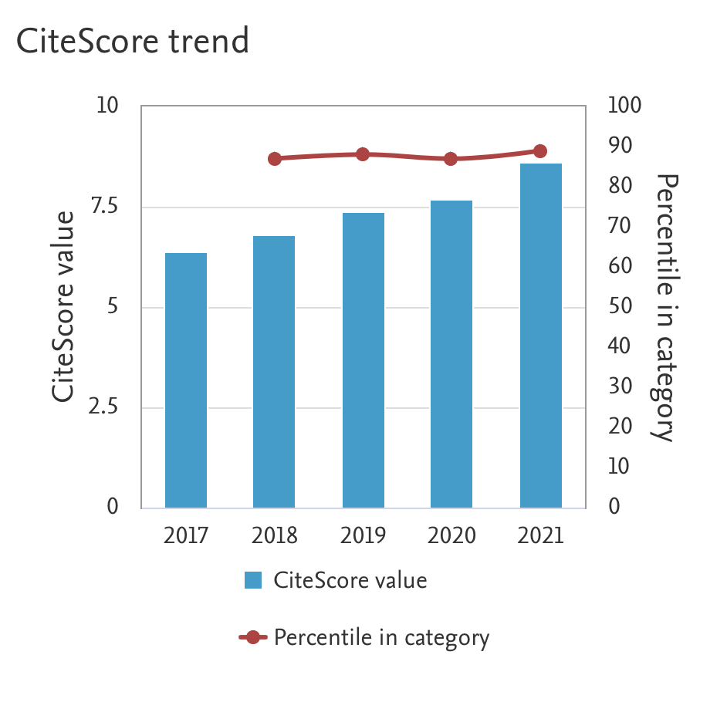
Journal is listed in several categories: in all of them Citescore is above 85% percentile, meaning Q1

Slide 5
SYSJ usage statistics

Slide 6
Additional information
Current page limits (apply to papers submitted from 1 Jan 2015): 8 complimentary pages for regular papers; up to 12 pages, with overlength page charge of US$150 per page. No complaints received from authors.
No publicity since beginning of 2015 to limit the increase of the backlog of accepted papers.
Page budget: 6,750 pages in 2022 –
Proposal of 6,750 pages in 2023
Previous MOTION 2211: The Publications Committee moves to add 500 pages to the page budget in 2022 for a total of 6,750 pages.

Slide 7
Other: SYSC newsletter
Newsletter recipients
2022
Q2 – 18,296
Q1 – 18,017
2021 -
Q1- 14,006 Q2 - 14,861 Q3 - 15,322
2020 Q1 - 10,720 Q2 - 11,434 Q3 - 11,925 Q4 - 12,721 2019 Q3 - 8,967 Q4 - 9,608

Slide 8
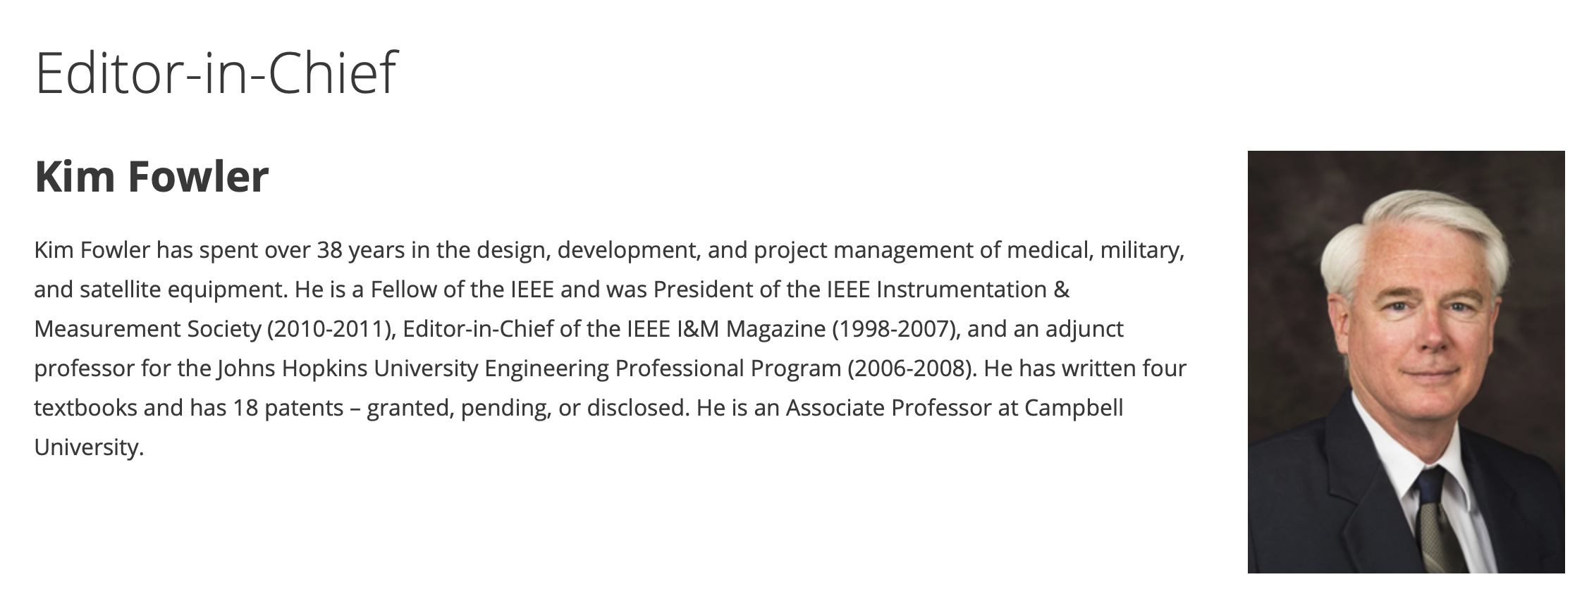
J-MASS
Received 32 new submissions so far in 2022 (it is highly possible that J-MASS will publish more than 20 papers by the end of Oct).
Appointed 4 new Associate Editors.
One special issues “Miniaturization for SAR” is in preparation.
Starting June 25st, new EiC Prof. Hanwen Yu, new EiC assistant Ms. Taoli Yang.

Slide 9
Sponsoring societies/councils
IEEE Journal of Miniaturization for Air and Space Systems: financial cosponsorhip
Geoscience and Remote Sensing Society (25%)
Sensors Council (25%)
Aerospace and Electronic Systems Society (5%)
Instrumentation and Measurement Society (10%)
Systems Council (35%)

Slide 10
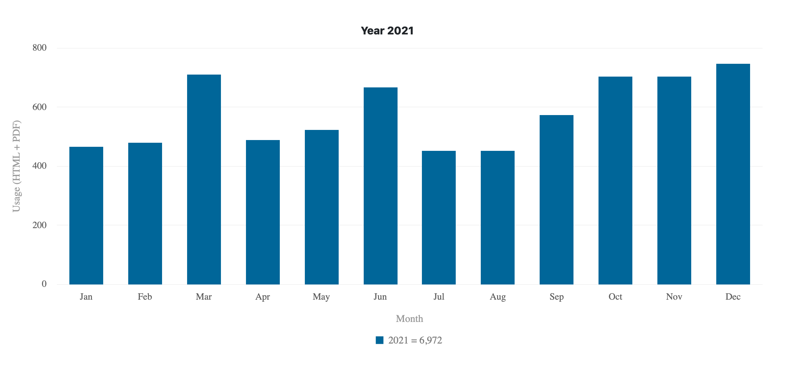
J-MASS usage statistics

Slide 11
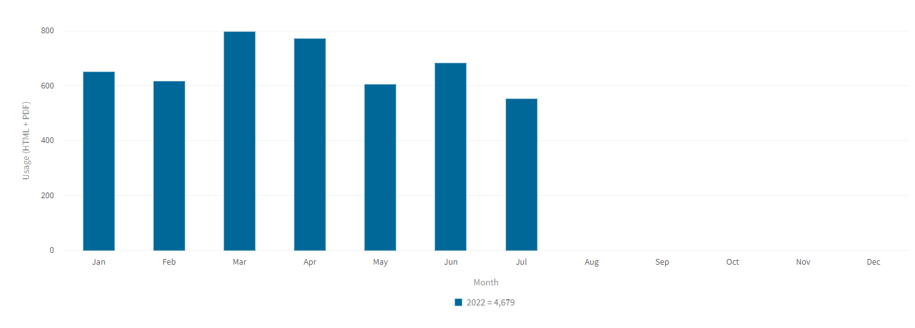
J-MASS usage statistics
Year 2022

Slide 12
Latest information From 2022 Jan to Aug, J-MASS has received 40 new submissions. It is highly possible that J-MASS could publish 30 papers by end of this Oct (so far 12 papers have been published), which will be more than that of 2021!
One more thing, according to the scientometric analysis of Exaly (https://exaly.com/journal/45953/ieee-journal-on-miniaturization-for-air-and-space-systems), it seems that JMASS will have its first IF: 1.5.

Slide 13
Open Journal of Systems Engineering (OJSE)
PROJECTED LAUNCH YEAR & MONTH: 2023 – 4th Quarter
Sponsorship
IEEE Systems Council (40%)
IEEE Systems, Man and Cybernetics Society (40%)
IEEE Aerospace & Electronic Systems Society (20%)
Establishing an open-access journal, will provide a venue for addressing the growing need for open-access publications, steered by several funding agencies around the world. This new journal will benefit the IEEE, reinforcing its leading role in science and engineering of systems and systems-of-systems.

Slide 14
OJSE: Editorial Board
Editor-In-Chief
W. Dale Blair, Principal Research Engineer, IEEE Fellow
Georgia Tech Research Institute
Georgia Institute of Technology
Associate EIC
Ljiljana Trajkovic, Professor, IEEE Fellow
School of Engineering Science
Simon Fraser University
Associate Editors
Peter Willett, Professor, IEEE Fellow, University of Connecticut
James Lambert, Professor, IEEE Fellow, University of Virginia
Donald Brown, Professor, IEEE Fellow, University of Virginia
Dongrui Wu, Professor, Senior Member IEEE, Huazhong University of Science and Technology
Vincenzo Piuri, Full Professor, IEEE Fellow, University of Milan, Italy

Slide 15
OJSE: Status
Promotional Flyer completed
Web pages established on AESS and SYSC web sites.
Announcements in Newsletters from AESS, SMC and SYSC.
Manuscript Central setup completed
IEEE Xplore setup completed
Established policy on discounting APC fees for the first three years
Four free publications to authors of international preeminence in systems engineering
50% discount to all authors
Three special issues are in progress
Special Issue on Front-end Need Analysis
Special Issue on Artificial Intelligence and Systems Engineering (four submissions)
Special Issue on Resilience in Systems Engineering
Six manuscripts submitted with one decision of major revision required.

Slide 16
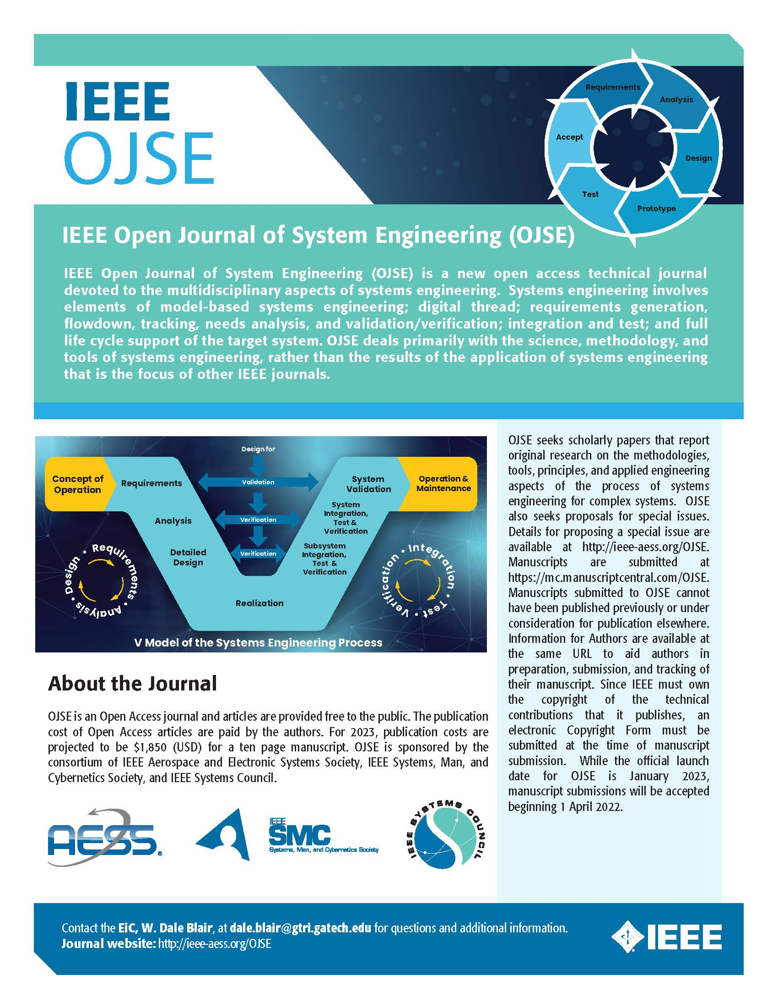
OJSE Flyer

Slide 17
Sponsored publications
IEEE Transactions on Cloud Computing: financial cosponsorhip (Q1)
Computer Society
Communications Society
Systems Council (7%)
Power and Energy Society
Consumer Electronics Society
IEEE Transactions on Big Data: financial cosponsorhip
Computer Society
Communications Society
Computational Intelligence Society
Sensors Council
Signal Processing Society
Systems, Man, and Cybernetics Society
Systems Council (5%)
Vehicular Technology Society

Slide 18
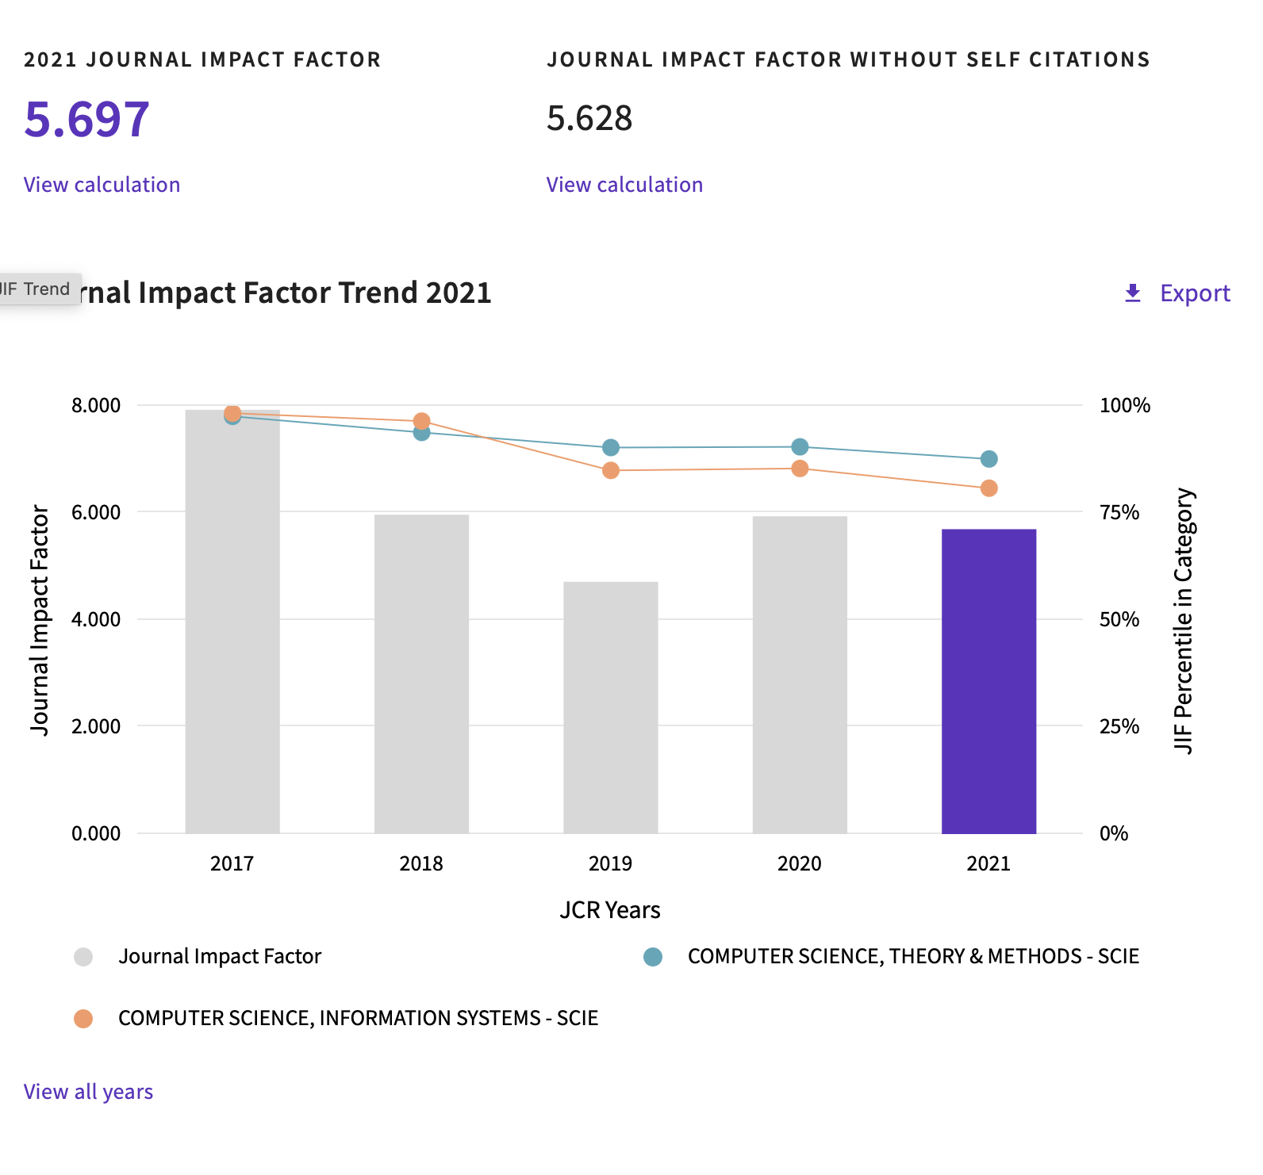
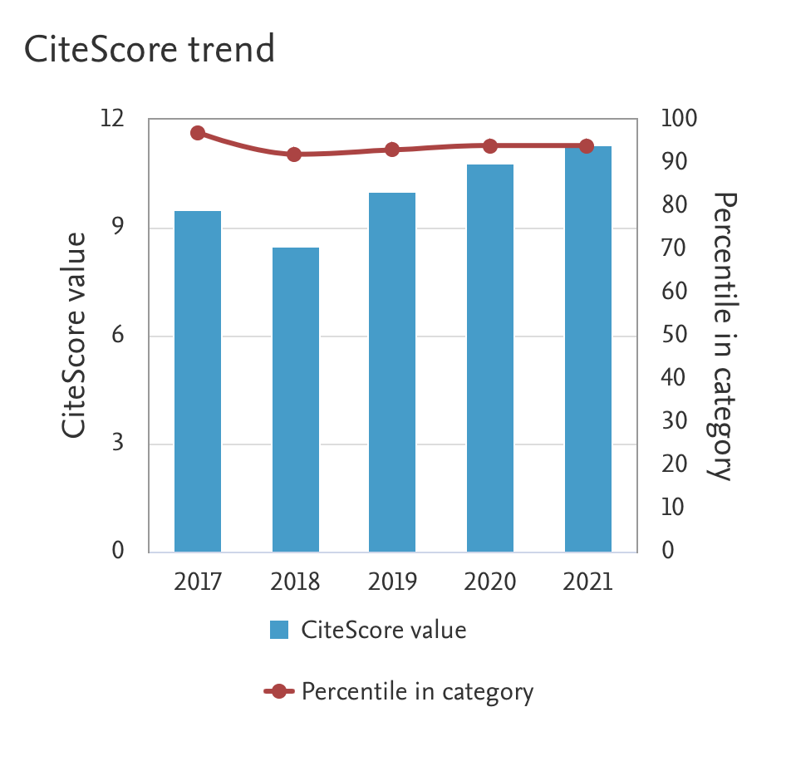
TCC

Slide 19
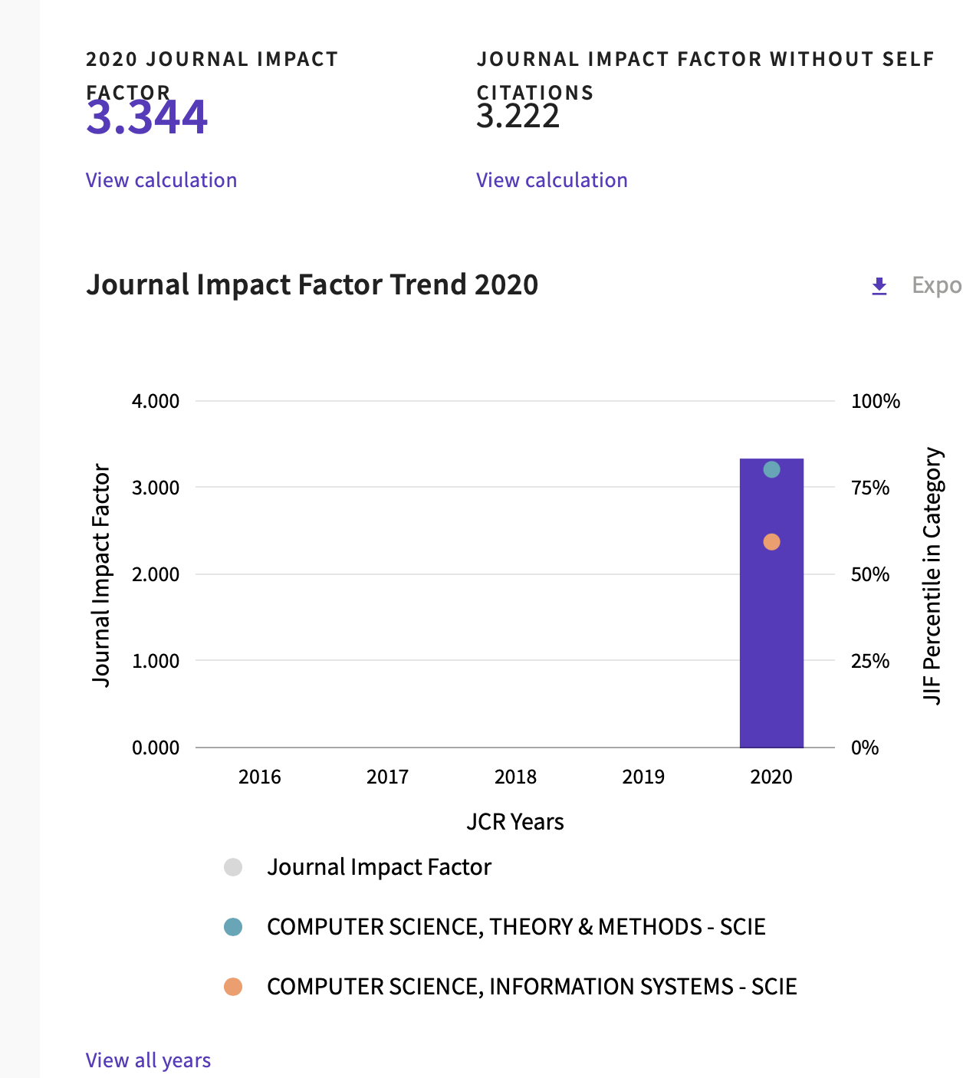
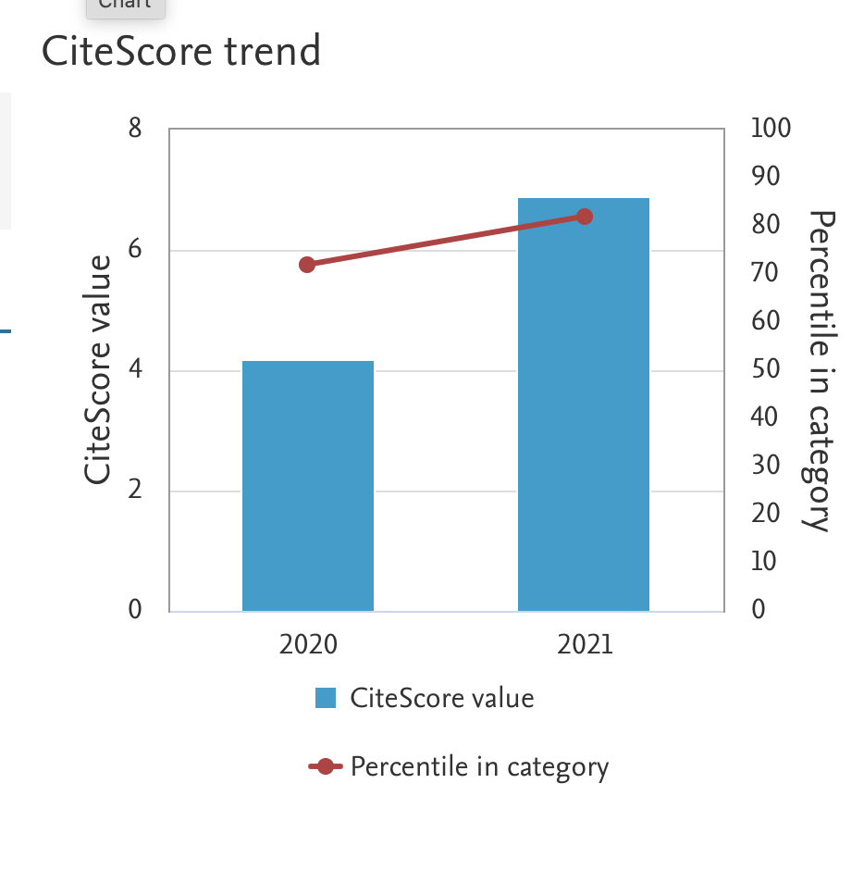
TBD

Slide 20
Conference proceedings net distribution 2020 data, total: $114.116,05
SYSCON
ISSE

Slide 21
Thank you for your attention!

