Slide 1
IEEE Systems Council Meetings and Conferences Committee
Andy Chen
AdCom Meeting
September 2, 2022

Slide 2
Current Status & Achievements
Please summarize your committee’s achievements here
2022 Conferences Planning
SYSCON
92 Registrations totaling $51, 075.00 in income to date
106 Accepted Papers
ISSE 2022
57 Accepted Papers to Date
13 Active Papers still waiting review
This will be an onsite conference
RASSE
57 Submission to Date

Slide 3
SCRC Recommendations for Conferences
Improve the industrial engagement, as well as YP and WIE.
For Industry Engagement, the new conference series in R10 will feature an Industry Forum. The Industry Forum is a new integration for IEEE Systems Council’s conferences. It is designed to help facilitate a bridge between research and industry. The Industry Forum will feature industry speakers and panels that discuss the technical directions of industry and, most importantly, its challenges. Conceptually, the attending research community may be studying or wish to study the challenges discussed.
Have the complete list of conferences be provided through SYSC’ website.
We have an extensive conference section to display all conference activities. The Conference Listing and Conference Calendar can both be used to find all IEEE System Council conferences.
Further use of new technologies/formats etc at conferences.
We have currently executed 7 virtual conferences utilizing a new virtual platform provided by our professional conference organizer (PCO), By executing these conferences virtually, the council has been able to reach over 500 attendees and continue hosting our conferences without interruption.

Slide 4
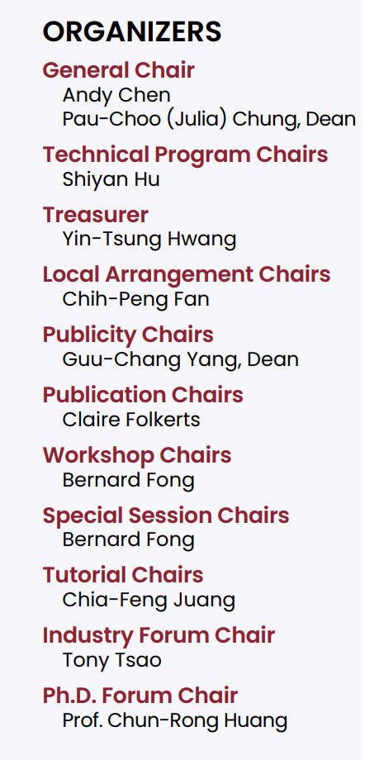
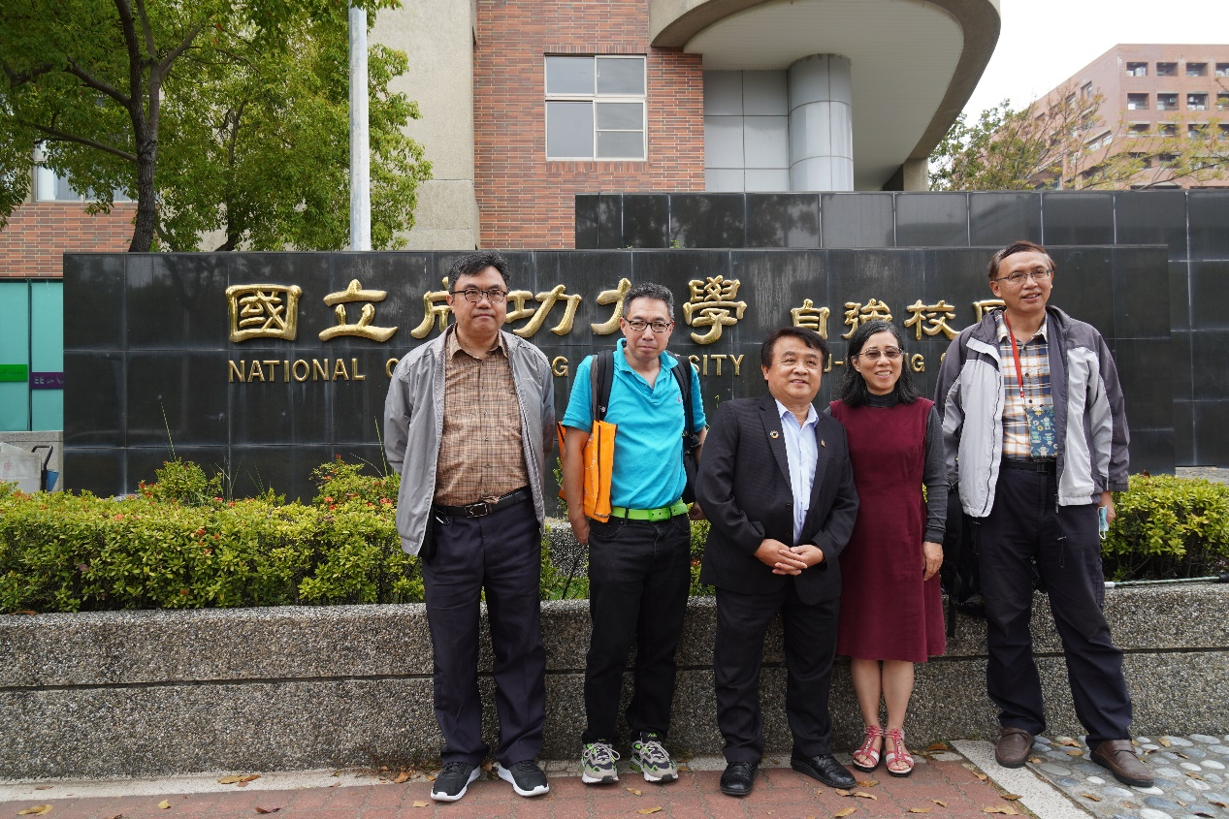
RASSE 2022 Planning

Slide 5
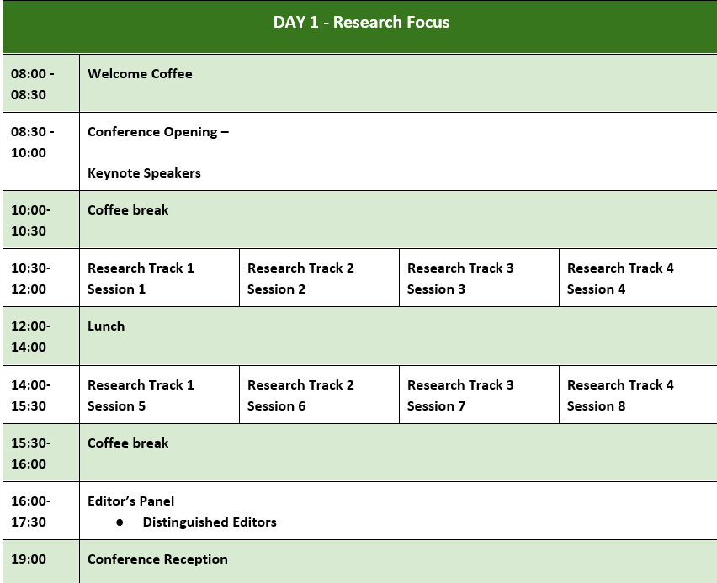
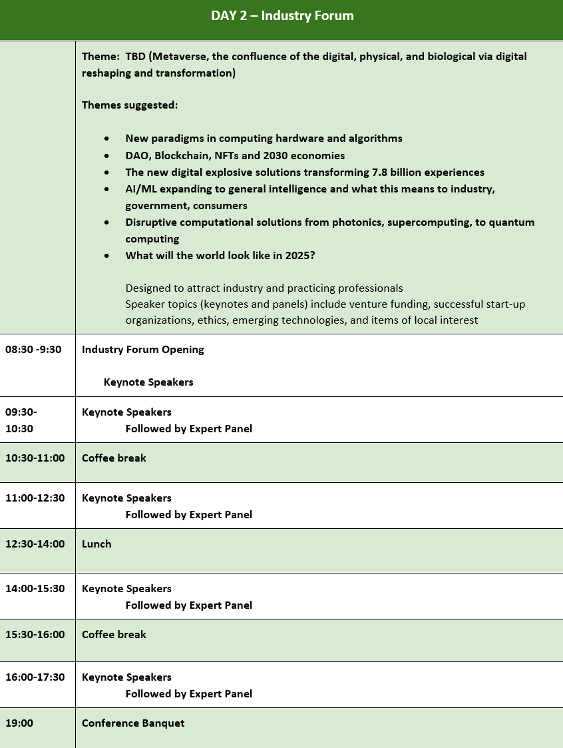
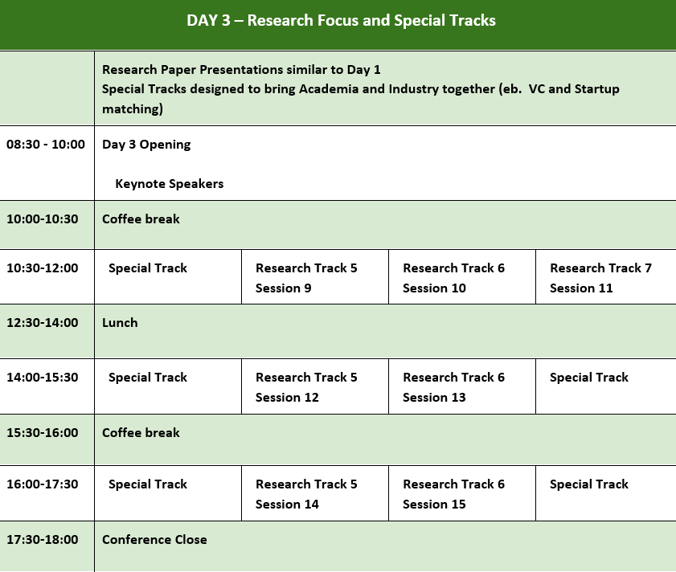
RASSE Program Overview

Slide 6
New in RASSE 2022
To address the SCRC recommendation of increase the industry participation, Day 2 of the conference is dedicated to an Industry Forum with 20 industry leaders confirmed to contribute the forum as speakers and expert panelists.
Appoint an Industry Forum Chair to invite and organize the speakers and pan3lists.
Engage local Professional Conference Organizers to organize and promote locally and seek local government agency support.
A grant from Ministry of Science was approved.
A grant from City of Tainan is forthcoming.
NCKU to host the conference proceedings in their International Conference facilities.
Intel Asia Pacific and Japan agreed to be the platinum sponsor for the conference.
Appoint a Conference Treasurer and a Local Arrangement Chair
Opened a local conference bank account for local expenses which will be closed after the completion of the conference.

Slide 7
Challenges and Opportunities
ISSE 2023
Conference chair recommended we should skip 2023 for ISSE due to low turnout and attendance
New Middle East Conference in 2023
Hosting organization: Dubai University, Dubai
Date: Q4 2022
Met with the President and Provost of Dubai University and confirmed their interest in hosting the conference
Joint conference with IEEE TEMS
Technical sponsor confirmed by VP Conference TEMS
Appoint VP Marketing and Communications TEMS as the local chair
Will host the Industry Forum on Day 2 of the conference

