Slide 1
Zero-Defect-Delivery (ZDD): Is it really possible - in particular - while delivering updates to decades old legacy mission critical systems? Or is it Rocket Science, a Beautiful Myth, or Snake Oil?
Rao Mannepalli
Chief Scientist, Leidos
2023 AIAA Aviation Forum, 12–16 June 2023, San Diego, CA
Copyright © by Rao Mannepalli/Leidos
Published by the American Institute of Aeronautics and Astronautics, Inc., with permission.

Slide 2
Survey Questions
Have you worked on a major mission-critical weapons/aerospace system?
How many defects were found after you first delivered the system?
Are you familiar with the “Work until it Works” paradigm?
Are you a Systems Engineer?
Are you a Software Engineer?
Are you a Systems Software Engineer?
Have you ever heard of Prof. Donald Knuth of Stanford University?
Have you read his “The Art of Computer Programming” book series?
Are you aware that he offers $2.56 for any mistake in his books including a typo?
Are you aware that he doubled the reward for his TeX program every year (the last known number is $20.48 in 1985?
Are you familiar with 6-Sigma (and its accuracy rate of 99.99966%)?
Have you read “3M’s experience with 6-sigma implementation?

Slide 3
Introduction
What is your first reaction to seeing the title: “Zero-Defect-Delivery (ZDD)?
Do you think it is attainable?
Have you done any Zero-Defect-Delivery?
What role does Systems Engineering play (if any) in ZDD?

Slide 4
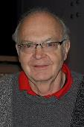


Inspiration
Inspired by Prof. Donald Knuth of Stanford University
He is the author of the textbook series “The Art of Computer Programming”
They are often mentioned in lists of the most influential books ever written, sometimes alongside works like the Magna Carta.
He won the “Turing award” at the age of 36 (youngest ever)
Knuth used to pay $2.56 for any mistake, including typographical errors discovered in his books.
According to an article in the Massachusetts Institute of Technology's Technology Review, these Knuth reward checks are "among computerdom's most prized trophies“
He once warned a correspondent, "Beware of bugs in the above code; “I have only proved it correct, not tried it.”
I have done it (offering $5/bug) at Bell Labs and never had to pay out even once in 8 years. Details are given later

Slide 5
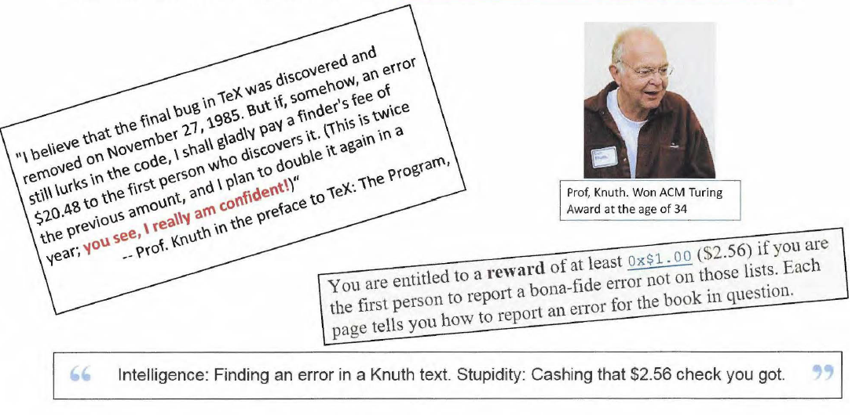
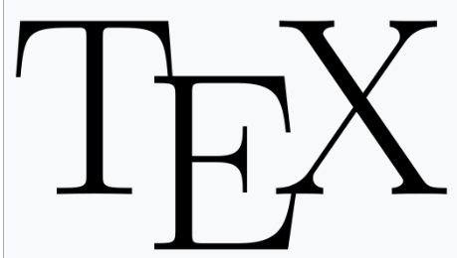
He doubled the reward for his TeX program every year

Slide 6
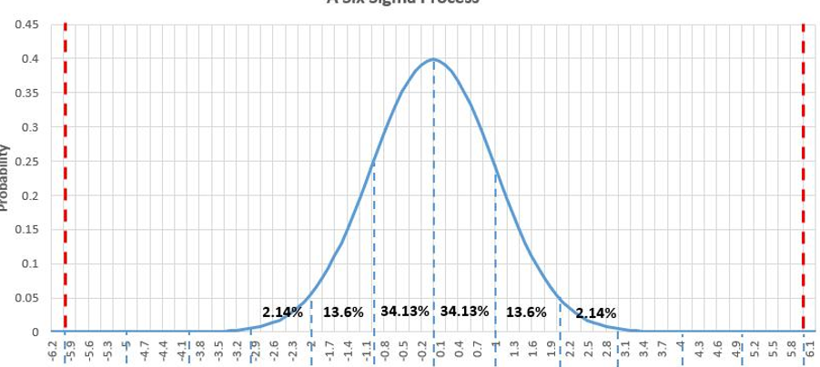
Defining ZDD in our context
We are familiar with 6-sigma** initiative
What ZDD is not:
  Not 6-Sigma
  Not a statistical quality control tool.
  Not a Bug-bounty
It is a mind-set and culture change
** Of 58 large companies that have announced Six Sigma programs, 91% have trailed the S&P 500 since.
— Fortune, citing Charles Holland (Qualpro), 2006

Slide 7
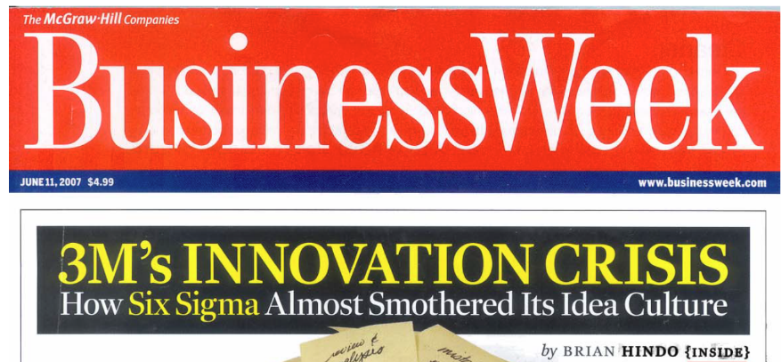
6-sigma at 3M

Slide 8
Defining ZDD in a practical context
I served as the Deputy Chief Engineer of GPS-OCX (Next generation control system for the GPS constellation).
I joined the program (and Raytheon) in 2017 after it critically breached Nunn-McCurdy in 2016
It was termed as “The most troubled program” in the entire DoD
Factors that led to the critical Nunn-McCurdy breach include:
  Inadequate systems engineering at program inception
  Block-0 software with high defect rates and
  Block-1 designs requiring significant rework
Immediately after joining Raytheon, I asked a hypothetical question:
  ‘If someone from Raytheon’s GPS-OCX needs to stand in front of the customer and say ‘Requirement-xxx is delivered. If anyone can find a bug in that, I will gladly pay $5 for each bug, who would be that person? Do you think it can be done?’
Almost all the answers I received were “It is impossible. It cannot be done”.

Slide 9
Defining ZDD in a practical context (contd.)
Prof. Donald Knuth of Stanford University did it.
I have done it routinely at Bell Labs on a project that is much more challenging than GPS-OCX
In other words, we are NOT attempting the impossible.
Spoiler alert:
  I changed the conversation from being reactive and defensive to one of proactive, positive, confident, and assertive with professional pride, innovation and measured risk taking.
  Introduced the terms like ‘Zero-Defect-Development (ZDD)’, ‘Offering $5 for each bug’, ‘Feature Driven Development (FDD)’, ‘Accountability’, ‘Personal Warranty/Guarantee’ to the vocabulary of GPS-OCX.
  Presented them to the Vice President who led the root cause analysis to identify systemic problems for “Why so many programs in Aurora, Colorado are Red” and to the program Manager of GPS-OCX. The Vice President commented, “Had Rao been here from the beginning, GPS-OCX would not have breached the Nunn-McCurdy.”
Popular putdown at Bell Labs in its halcyon days: “Don’t be humble. You are not that great”

Slide 10
You are delivering with Zero-Defects, if:
You (Chief Engineer, Systems Engineer, Responsible Engineer, or any other title) stand in front of your customer (internal or external) and declare that you just delivered this capability, feature, or functionality and if anyone finds a defect or bug, you will gladly pay $5/bug
If any of you have done it, congratulations, you are delivering with zero-defects, and you can skip the rest of this presentation

Slide 11
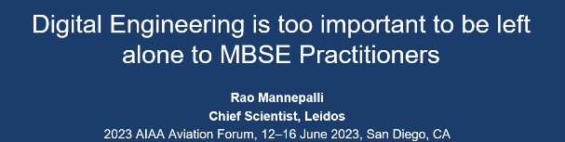
Why we need ZDD?
Weapon systems are becoming more complex and expensive
Most of the time these are system of systems.
Cost overruns of the top 10 weapons systems alone make this the 3rd largest defense budget in the world.
The cost overruns of all the Major Defense Acquisition Program (MDAP) portfolio programs top half-a-trillion dollars, making it the undisputed 2nd largest defense budget in the world.
We are still using some systems developed more than half-a-century ago (like PARCS radar, UWER radar, and B-52)
Maintaining and sustaining these systems - designed with slide rules, pencils and paper - is becoming exceedingly expensive.
In the case of some systems like PARCS, where the documentation was partially destroyed as per the Anti-Ballistic Missile Treaty the problem is even worse.

Slide 12
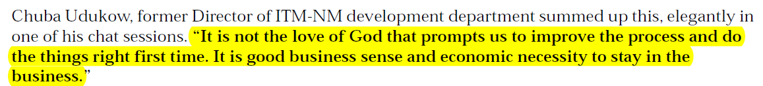
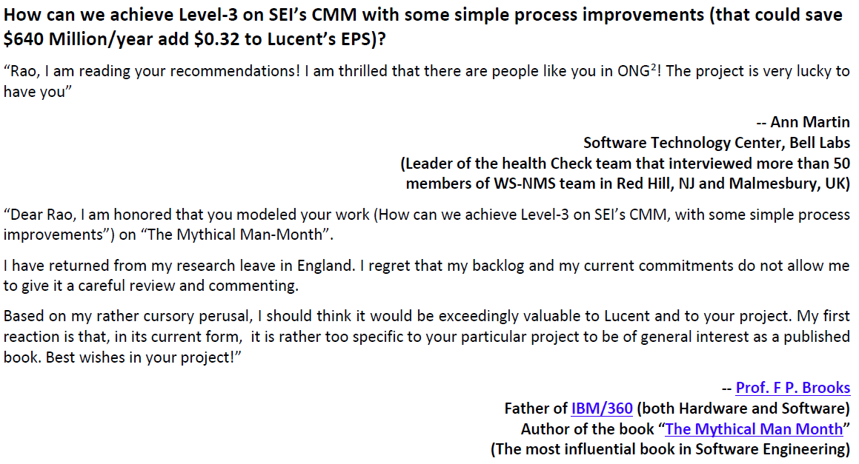
Why we need ZDD? (contd.)

Slide 13
Why the systems we deliver have defects?
If we look at the root cause analysis of troubled programs (in DOD programs, they breach Nunn-McCurdy thresholds)
They are two types of breaches:
  Significant Breaches (15%–25% current, or 30%–50% original baseline increase)
  Critical Breaches (25%+ current, or 50%+ original baseline increase), with critical requiring certification to avoid program termination.
“Inadequate Systems Engineering at the inception of the program” is the most frequent root cause
“If you have the word ‘Systems’ in your job title, then you are responsible for the system.”
— Michael D. Griffin, former NASA Administrator

Slide 14
Multiple Nunn-McCurdy breaches
The Space-Based Infrared System (SBIRS) High program experienced four separate Nunn-McCurdy breaches between 2001 and 2011, driven by massive cost overruns, technical failures, and mismanagement.
Total program costs grew roughly 260% from $5.6 billion in 1996 to over $20 billion, with 9-year delays due to immature technology, software issues, and inefficient, unstable funding
We used to call them jokingly: Nunn-McCurdy, 1-McCurdy, 2-McCurdy, 3-McCurdy

Slide 15


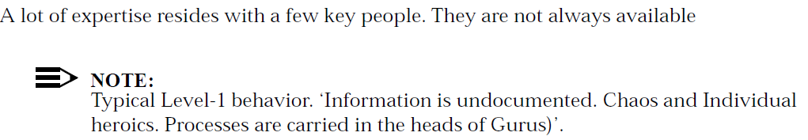

Why do we need help?

Slide 16
Why do we need help? (contd.)

Slide 17
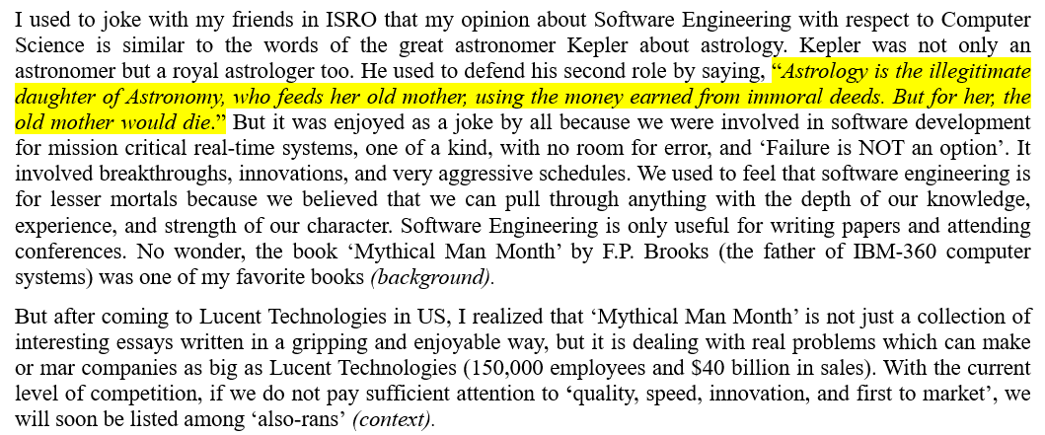
Leading Change

Slide 18
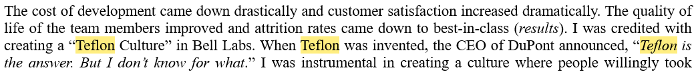
Teflon Culture

Slide 19
Designing, Developing, and Delivering with Zero Defects

Slide 20
Feature Driven Development (FDD)
Feature-driven development (FDD)
  It is an iterative and incremental software development process. It is a lightweight or Agile method for developing software. It blends a number of industry-recognized best practices into a cohesive whole. These practices are all driven from a client-valued functionality (feature) perspective. Its main purpose is to deliver tangible, working software repeatedly in a timely manner.
Feature Design Document (FDD)
  It is the High-Level Design Document. It is the output of the high-level design process, generally performed by a small group of individuals ( A virtual architecture/Design team comprising of the owners of t he subsystems). A Feature Engineer owns that feature and delivers it to the customers (internal/external) that involves a demo and hand-off. It starts with the user's request (RFC, Use case etc.). It considers all the other requirements (non-functional, derived( standards, laws and regulations). The customer can review it and understand what he/ she is getting very early during the development life cycle. It also serves as the reference for feature testing

Slide 21
Feature Driven Development (contd.)
Subsystem Design Document (SDD)
  It is the Detailed Design Document. There will be one for each impacted subsystem. The only input required is the Feature Design Document (FDD). Code can and will be written from the SDD. It serves as the reference for code walk-throughs and unit testing.
Feature Engineer (FE)
  A person who owns the feature. Delivers the feature to the customers. Accepts the developed subsystems. Shows a demo to the stakeholders during hand-off
Unit Testing (UT)
  Conducted by the individual developer to make sure that the code meets the requirements described in the SDD

Slide 22
Feature Driven Development (contd.)
Subsystem Testing (SST)
  Conducted by the Subsystem Engineer. Tests all the components (for the given feature) together. Executes all the test cases listed in the SDD
Feature Testing (FT)
  Conducted by the Feature Engineer. Tests all the subsystems (for the given feature) together, which makes sure that the code meets the requirements described in the FDD
Feature Pack (FP)
  A collection of features delivered for a given program increment (generally 13 weeks).

Slide 23
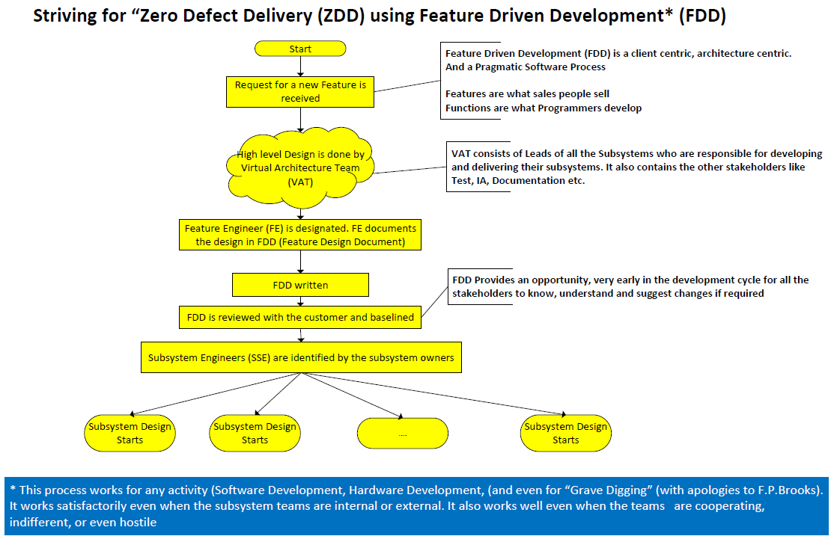
Feature Design

Slide 24
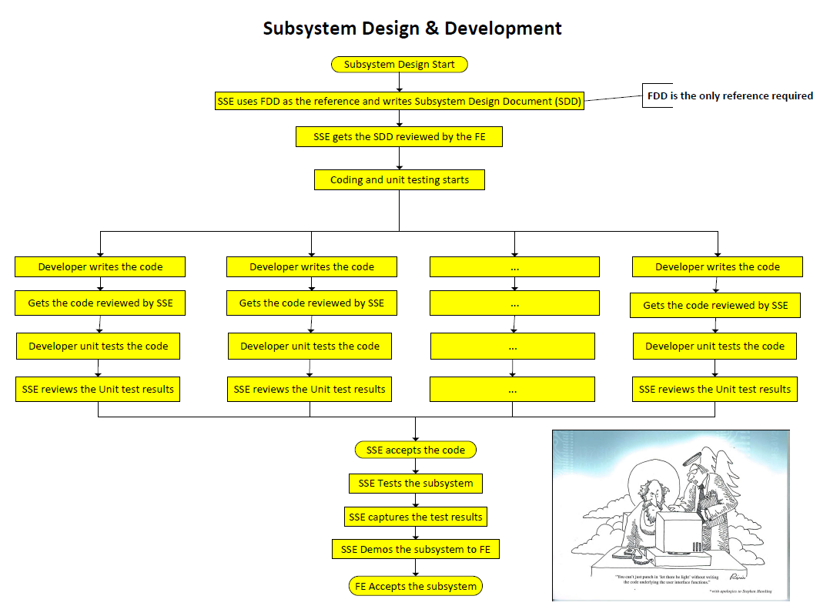
Subsystem Design & Development

Slide 25
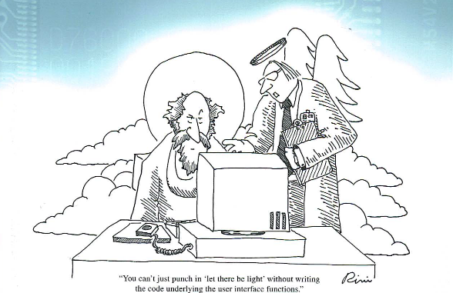
“You cannot just punch ‘Let there be light’ without writing the code underlying the user interface functions”
from: IEEE’s “A Brief History of Computer Time”
60 years of Computer Technology and the people who helped make it happen

Slide 26
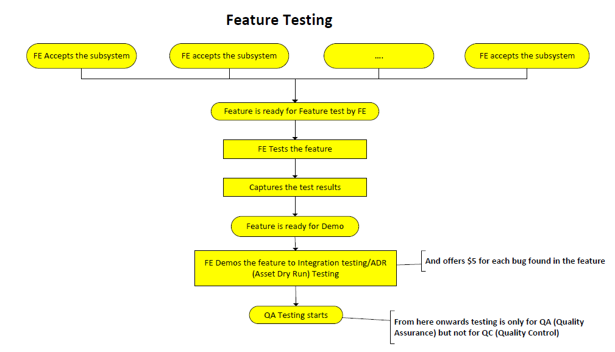
Feature Testing

Slide 27
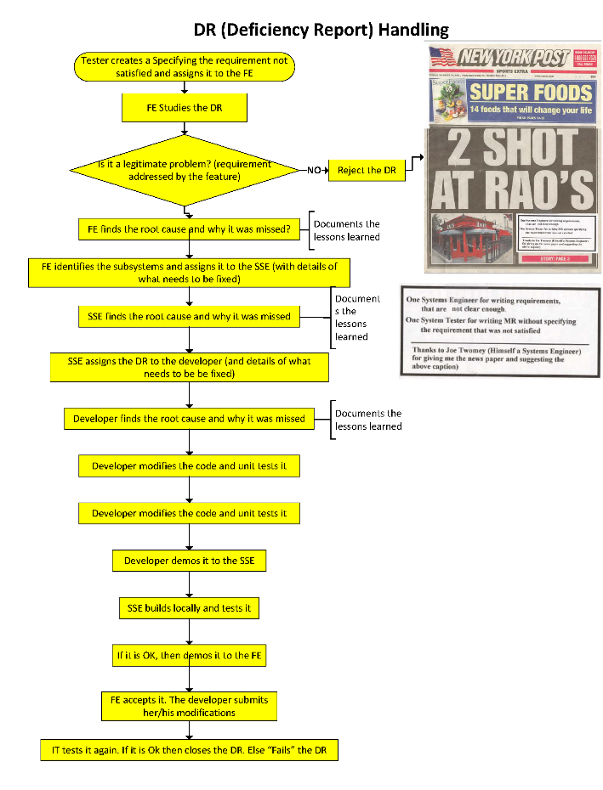
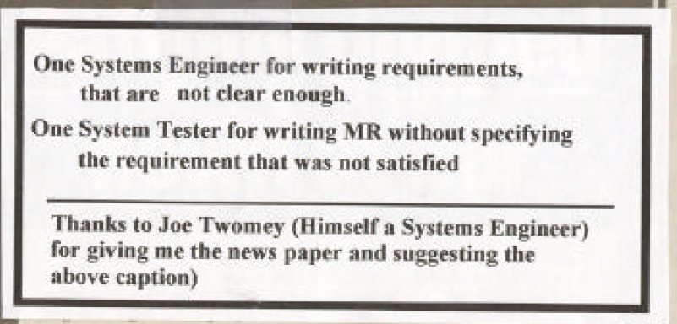
DR (Deficiency Report) Handling

Slide 28
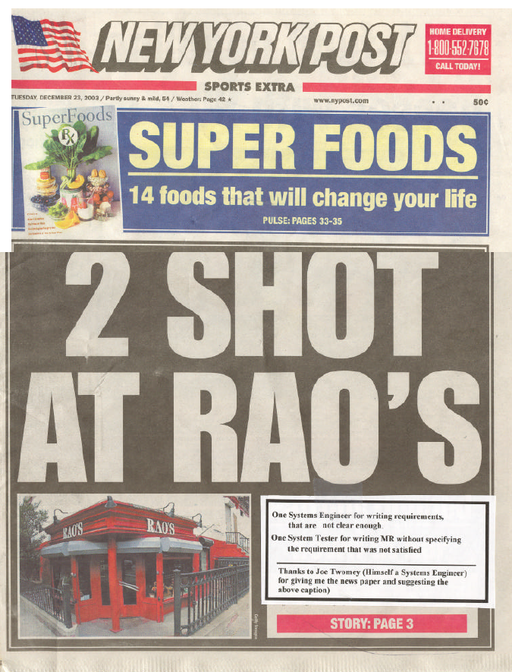
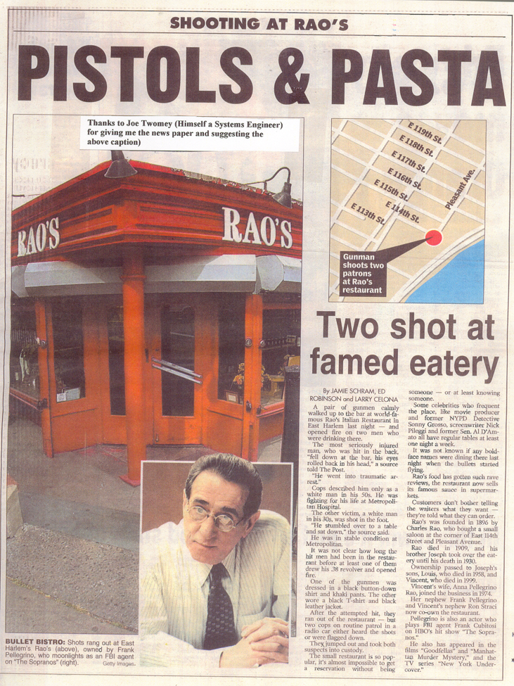

Slide 29
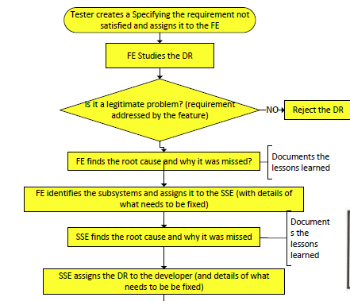
DR (Deficiency Report) Handling

Slide 30
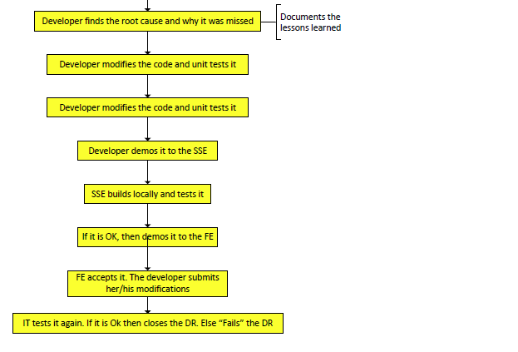
Dr Handling (contd.)

Slide 31
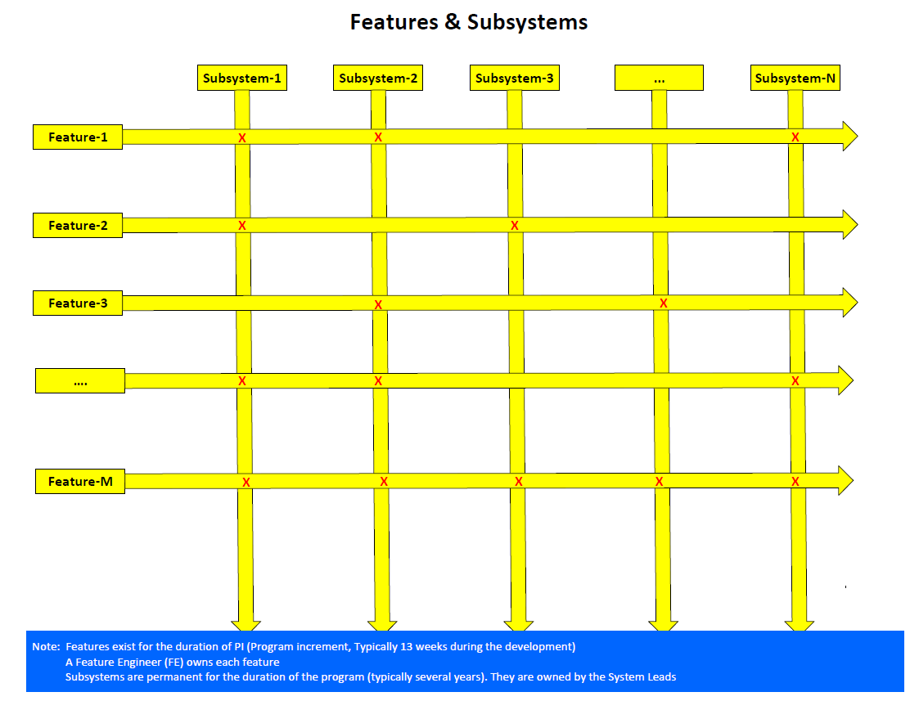
Features & Subsystems

Slide 32
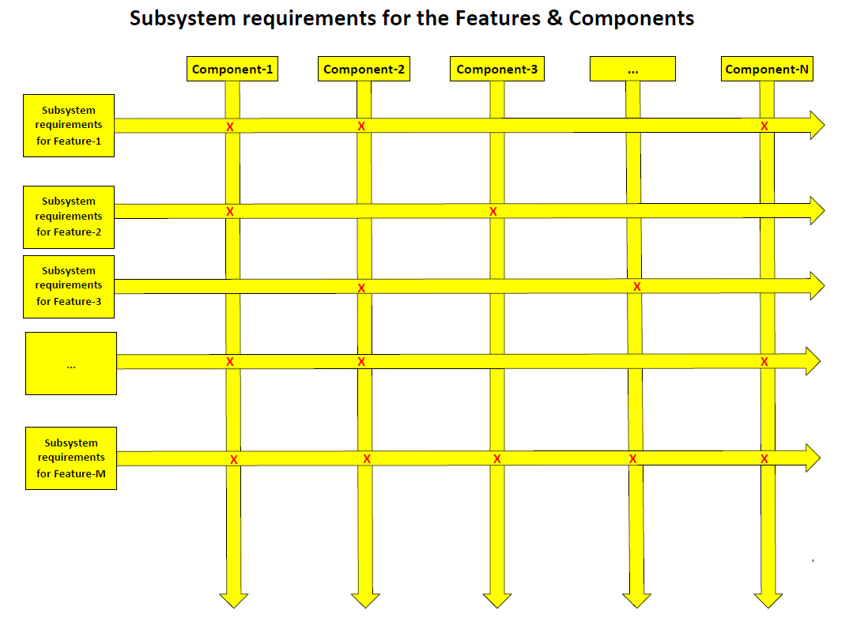
Subsystem requirements for the Features & Components

Slide 33
Design steps
Design is divided into 2 steps
  High-Level Design/Feature Design
  Detailed Design/Subsystem Design

Slide 34
High-Level Design
It is also called Feature Design
The input for this comprises of: Use cases, non-functional requirements, derived requirements, standards, Architectural tenets, etc.
The output of this process is a High-level design document (Feature design document)). Its contents are:
  How the customer uses this feature/functionality
  Requirements satisfied (list of)
  Test cases that need to be run to certify the feature. A subset of them are demonstrated as part of the acceptance/hand-off to the customer (internal/external)
  List of subsystems impacted by this new feature
  Requirements for each impacted subsystem (this includes Middleware, COTS, Hardware and others)

Slide 35
High-Level Design (Contd.)
A template is provided in a later slide
Customer Review
  FDD is reviewed by the customer. It provides him/her an opportunity very early in the development life cycle to understand what he/she is getting and suggest required changes.
Single point of reference for Detailed Design
  FDD serves as the single point of reference for the detailed design of subsystems involved.
  It also serves as the single point of reference for developing feature test cases

Slide 36
Feature Design Document (FDD) Template
Feature Id:
  Feature Name
  Feature-ID (Internal)
  Feature ID (External/customer ID)
Requirements satisfied (list all)
How the customer uses this feature
Test cases that need to be run to certify the feature. A subset of them are demonstrated as part of acceptance/hand-off to the customer (internal/external)
List of the subsystems impacted by this new feature
Requirements for each impacted subsystem. This includes Middleware, COTS, Hardware and others
7. For each impacted subsystem, the following details are provided in a table
  Input received
  Output to be produced
  Processing required
  Errors and Exceptions
  Logging/Tracing
  Changes to the Database schema
  Database Access
  Database upgrade/Data migration
  Performance
  Scalability
  Limitations
  Improvements that can be done
  Information Assurance (IA)
  Changes to Documentation
  Site preparation
  Installation
  Operation
  Maintenance
  List of test cases (the subsystem needs to pass and show as a part of the hand-off/acceptance
  Open issues (if any) (e.g., Clarifications required from the customer)

Slide 37
Conceptual Integrity of the System
"Conceptual integrity is the most important consideration in system design. It is better to have a system omit certain anomalous features and improvements but to reflect one set of design ideas than to have one that contains many good but independent and uncoordinated ideas.”
Conceptual integrity in turn dictates that the design must proceed from one mind, or from a very small number of agreeing resonant minds
-- F. P. Brooks in his “The Mythical Man Month"

Slide 38
High-Level Design: Performance Considerations
  "How do processes get in trouble with performance? The problem is often due to a fundamental misunderstanding of how to achieve performance objectives. The approach is frequently "First, let us make it run; then we'll make it run fast.” The idea is to get the functionality right and then tune the performance. Unfortunately, by the time the architecture and design are selected, it is already too late to achieve adequate performance by tuning. It is a mistake to treat the potential performance problem as if it were the same complexity as a coding error. Coding errors are relatively easy to fix, where as performance problems may require extensive changes to code"
      -- Smith & Williams,
      Performance Solutions: A practical Guide to Creating Responsive, Scalable Software

Slide 39
Detailed Design/Sub-system Design
The FDD is used as the one and only reference for the next level of refinement (i.e., Detailed Design by the Subsystem)
Each impacted subsystem does its own design to satisfy the requirements listed in the FDD
The output is a SDD (Subsystem Design Document)
Generally, each table in the FDD is expanded
Each row becomes a heading in the SDD
The Subsystem design is done by the leader of the subsystem with the help of the component leads
No other persons are involved (particularly the developers are not involved)
The only person that needs to review and approve the SDD is the Feature Engineer (FE)
No other person is involved in the review
The SDD lists the test cases that need to pass (and be demonstrated)

Slide 40
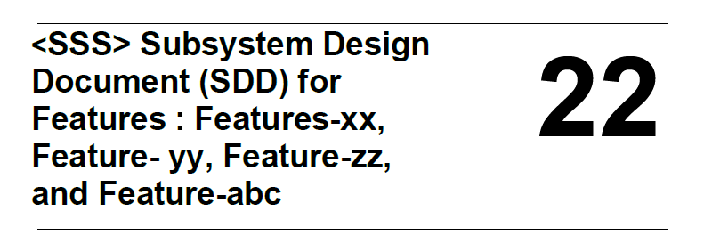
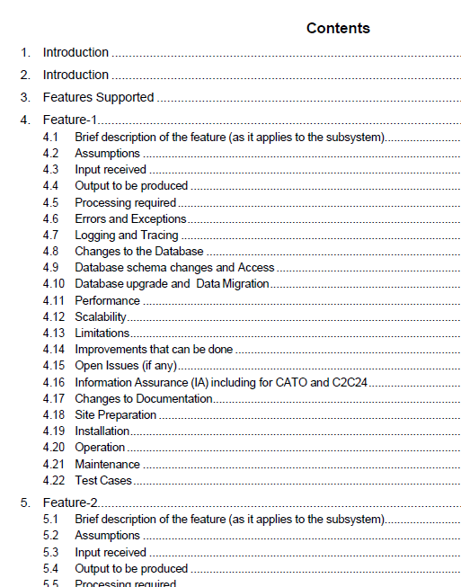
Template for Subsystem Design Document (SDD)

Slide 41
Coding & Unit Testing
The developer takes the SDD (as the one and only reference) to write the code and unit test plan
Writes/modifies the code
Writes the testing functions/classes to test and qualify the newly developed code
Conducts unit testing
Captures the unit test results and stores them to serve as evidence for future audits like CMMI assessments
Reviews the code and unit test results with the subsystem leader.
Demonstrates the unit test cases to the subsystem leader
The subsystem leader accepts the code
Once it is accepted, the developer moves to other tasks. Ideally, he/she should never have to look at this code again (zero defects)
Apart from CMMI there is CIMM (Capability Immaturity Model)

Slide 42
Subsystem Testing
Once all developers hand off their code to the subsystem leader, the subsystem leader conducts the subsystem testing.
Ideally all the test cases should pass. (Please note: There is no separate "Integration,, phase. If the design is done properly, all the components should work, the right first time.)
The subsystem leader captures the test results (and stores them to serve as evidence for future audits like CMMI assessments)
Demonstrates his/her subsystem to the FE
FE accepts the subsystem
The subsystem leader moves on to other tasks

Slide 43
Feature Testing & Demonstration
Once all the subsystem leaders hand off their subsystems, the Feature Engineer conducts the feature testing.
Ideally all the test cases should pass. (Please note: There is no separate "Integration" step. If the design is done properly, all the components should work, the right first time.)
The FE captures the test results (and stores them to serve as evidence for future audits like CMMI assessments)
Demonstrates the feature to his customers (mostly internal customers like Testing, Documentation, and others)
The testing group writes their test cases based on the Feature Design Document and executes them
At this point, the testing should serve as "Quality Assurance (QA)" only and not as “Quality Control (QC)”.
No bugs should be found at this phase

Slide 44
DR Handling
Tester creates a DR (specifying the requirement not satisfied) and assigns to the FE
FE studies the DR
If it is not a legitimate problem (requirement addressed by the feature, not a “In my opinion the system should behave” issue, or an “enhancement”) the FE rejects the DR
Else:
  FE finds the root cause and why it was missed
  Identifies the subsystem that needs to fix be fixed
  Assigns the DR to the SSE
  Documents the lessons learned

Slide 45
DR Handling (contd.)
  SSE finds the root cause and why it was missed
  Identifies the developer that needs to fix it.
  Documents the lessons learned
  The developer modifies the code and unit tests it
  Developer demos the fix to the SSE
  SSE builds locally and tests it.
  If it is OK, then demos to the FE
  If the FE accepts it the developer submits his/her modifications
  The tester tests again. If it is OK, then closes the DR. Else “fails” the DR

Slide 46
Salient points
Software development is organized into subsystems
Feature Driven Development (FDD) is used. FDD is a natural fit for DevSecOps.
Each Feature is owned by a Feature Engineer (FE) a.k.a Responsible Engineer (RE)
Each subsystem is led by a senior engineer. He/she owns the subsystem.
Each subsystem lead has a deputy. He/she is the alter ego of the Subsystem Lead
Each subsystem is organized into Components
Each component is led by a Component Lead
Each component has a deputy, and he/she is the alter ego of the lead
Each component has software developers assigned to it

Slide 47
Subsystem Leads
The subsystem leads form the “Virtual Architecture Team” (VAT)
Collectively they provide the “Intellectual Fire Power”.
Collectively they are the custodians of the “Conceptual Integrity”
VAT also participates in the Program Increment (PI) planning
VAT analyzes the Features in the PI, does the High-Level Design and writes the Feature Design Document (FDD).
FDD provides the complete requirements of the feature.
A template for the FDD is given
Once the FDD is reviewed with the customer and baselined, a Feature Engineer (FE) is assigned for each feature
FDD is the only reference for the Subsystem Design (Detailed Design) and Development
The Subsystem lead selects a SSE (subsystem engineer) for each feature to be developed by the subsystem (similar to the FE at the Feature level)

Slide 48
Subsystem Leads (contd.)
The subsystem lead, with the help of component leads, takes the relevant sections (tables) from the FDD and amplifies them so that a developer can write, and unit test the code.
This document is called SDD (Subsystem Design Document/Detailed Design Document)
SDD contains complete requirements for each component.
A template is provided
The component leads assign the software developers
The developer develops and unit tests
The developer demonstrates the test cases to the SSE

Slide 49
Subsystem Leads (contd.)
Once the SSE accepts the component, then the accountability is transferred from the software developer to the SSE
Once all the components are accepted by the SSE, then the SSE tests the subsystem (using the test cases listed in the SDD)
The SSE demonstrates the subsystem to the FE
Once the FE accepts the Subsystem, the accountability is transferred to the FE
Once the FE accepts all the subsystems, the FE tests the feature, captures the test results and demonstrates it to the customer (ADR testing/IT/ST)

Slide 50
Answers to the original questions?
Is it possible to deliver complex systems with zero defects?
Is it a beautiful myth?
Is it rocket science?
Is it snake oil?
How Systems Engineering play a role?

Slide 51
1. Is it possible to deliver complex systems with Zero defects?
Yes.
Some examples are given in the next slides

Slide 52
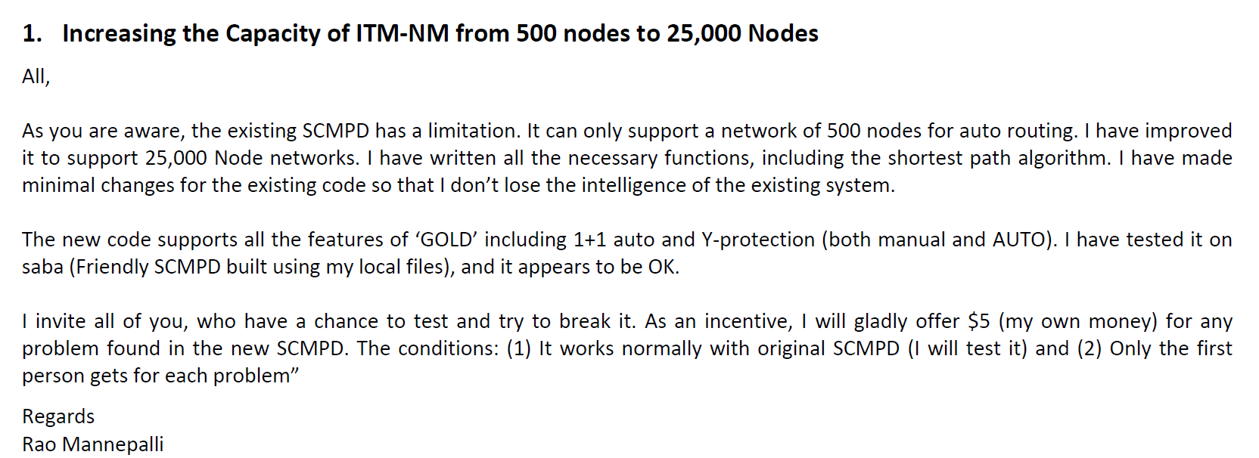

Offering $5 for each bug in the software¹ (Bell Labs)

Slide 53
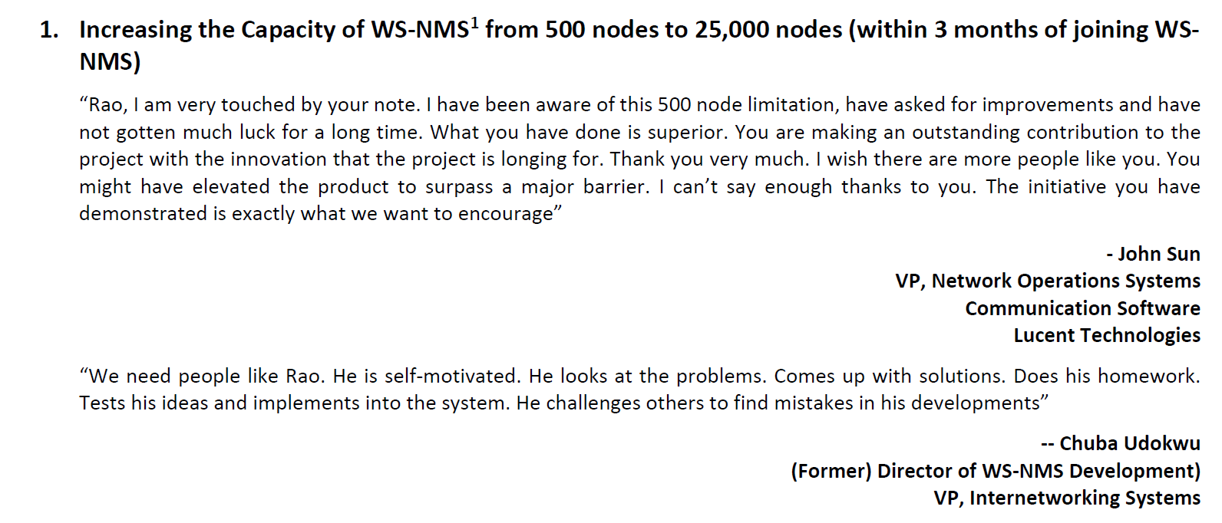

Slide 54
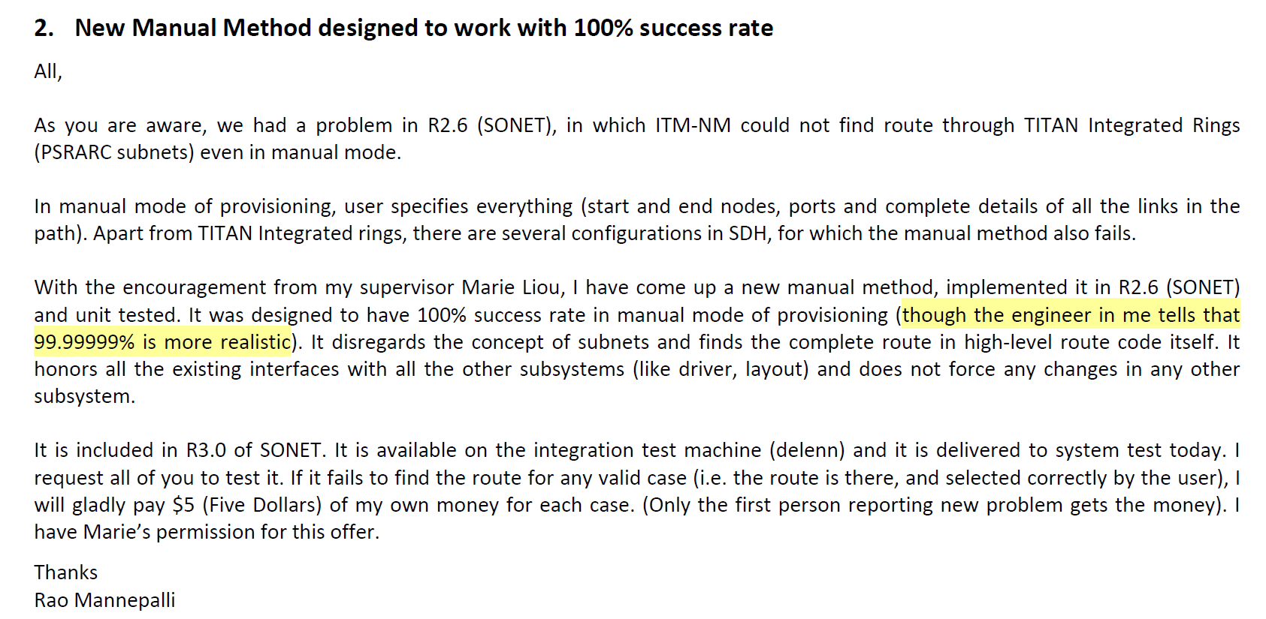
2. New Manual Method designed to work with 100% success rate (Bell Labs)

Slide 55
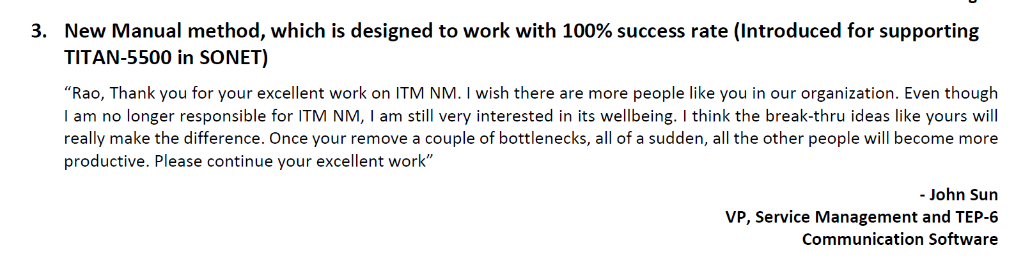
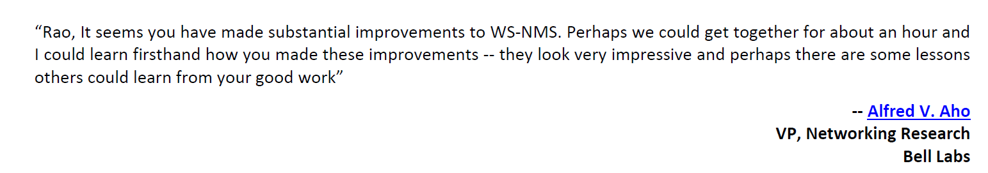

Slide 56
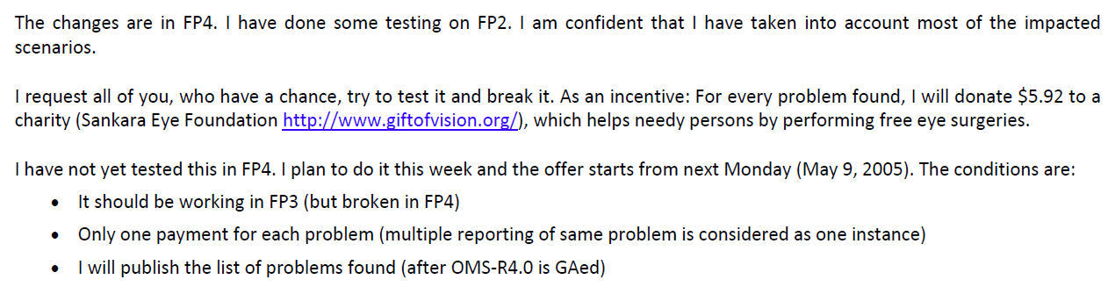
3. I have reduced the garbage in OMS (jvm3) from 400 GB to 2 GB and I will pay $5.92 (Bell Labs)

Slide 57
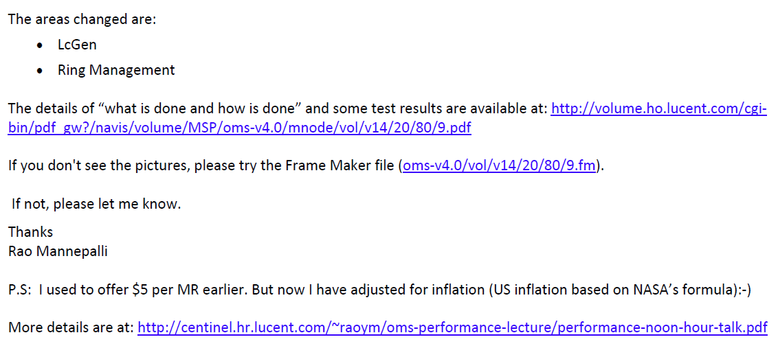
3. (Contd.)

Slide 58
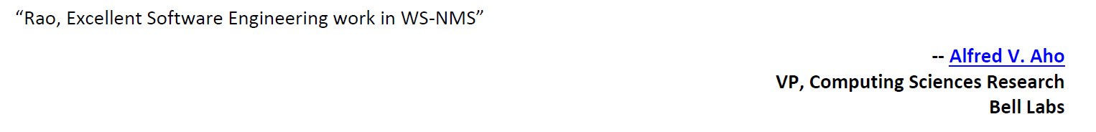
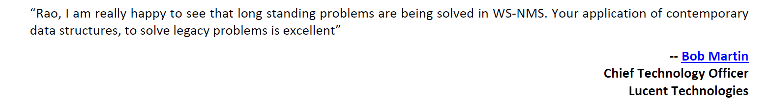
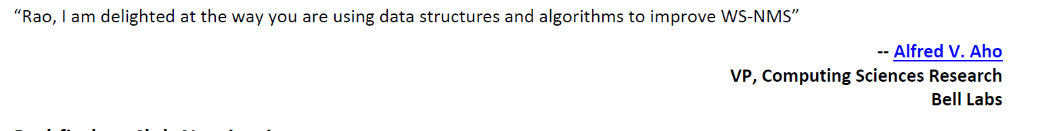

Slide 59
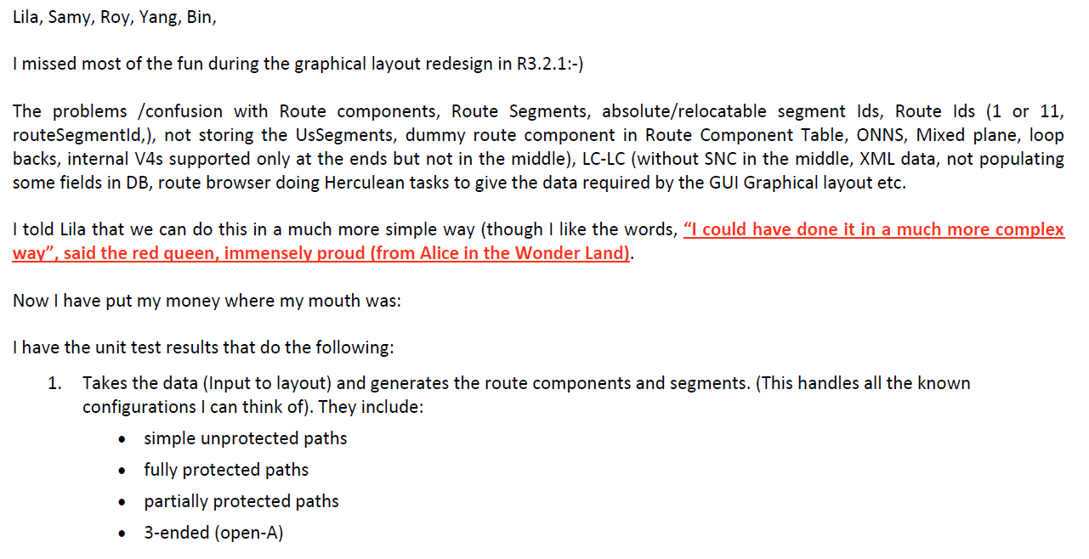
4. Graphical Layout Redesign (Bell Labs)

Slide 60
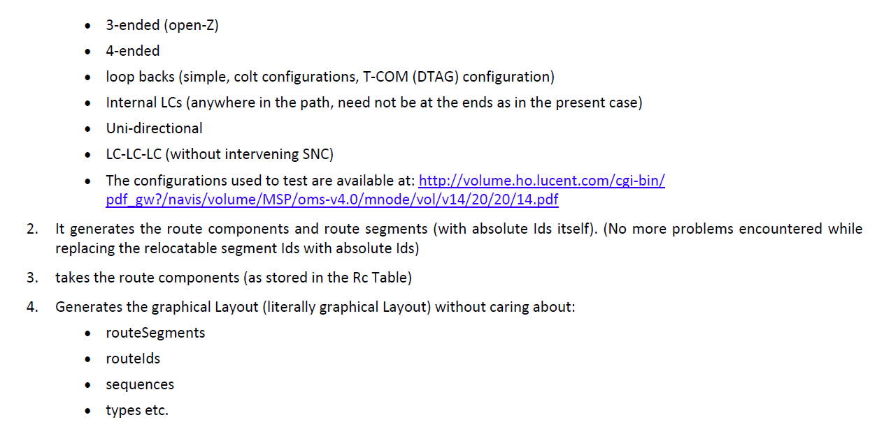
4. (Contd.)

Slide 61
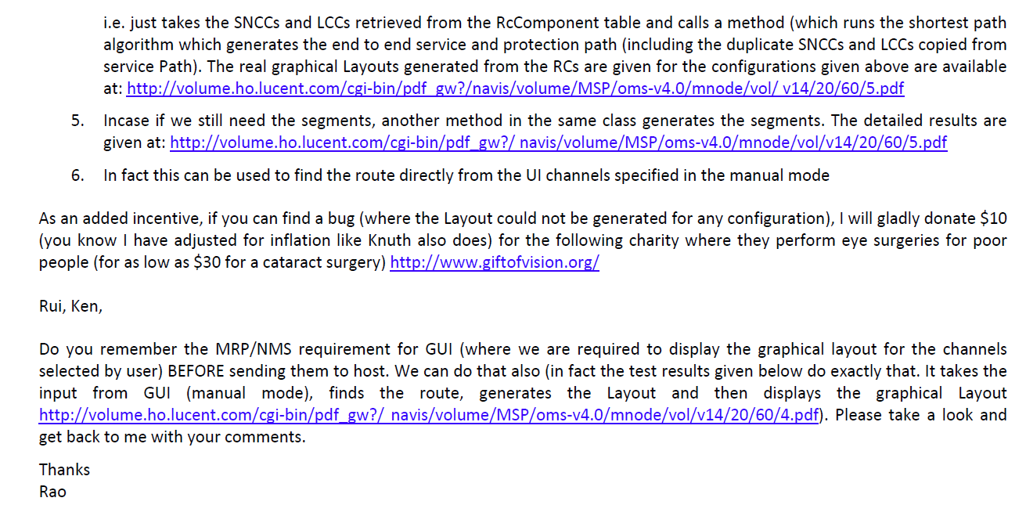
4. (Contd.)

Slide 62
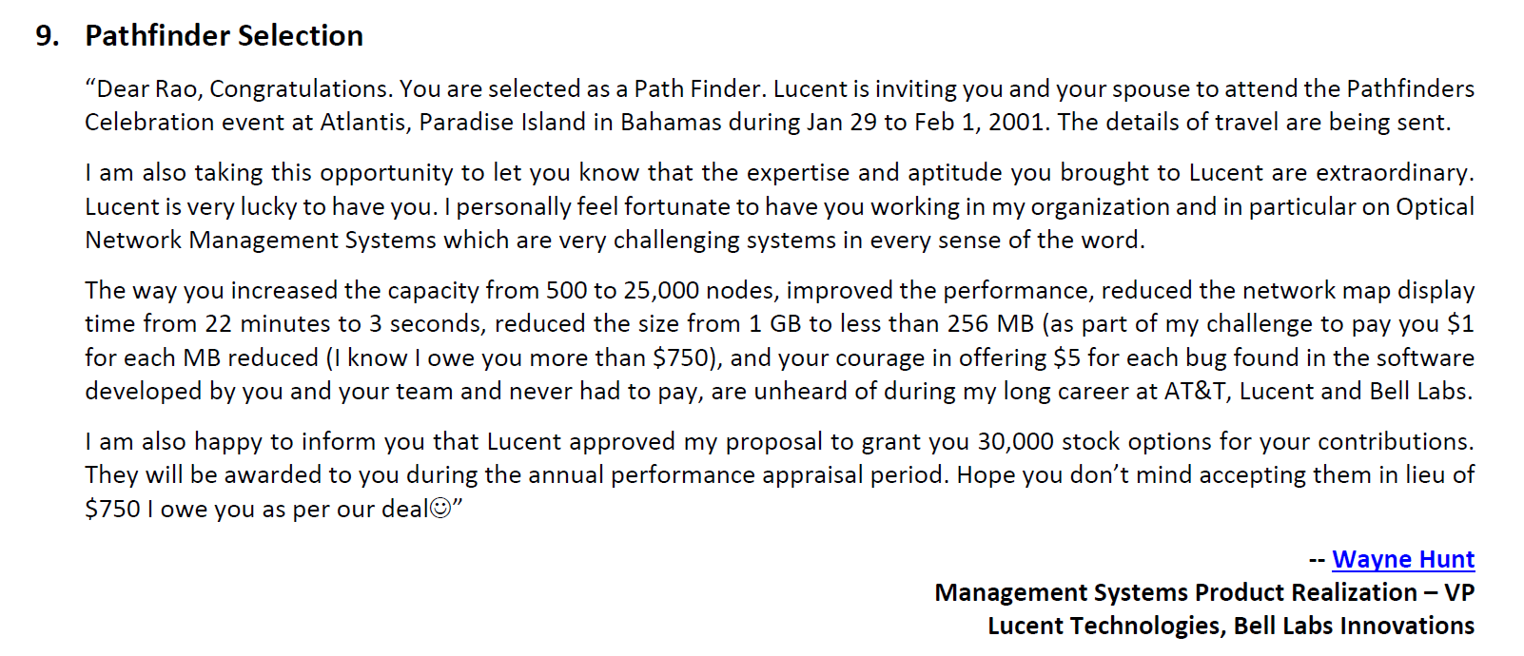

Slide 63

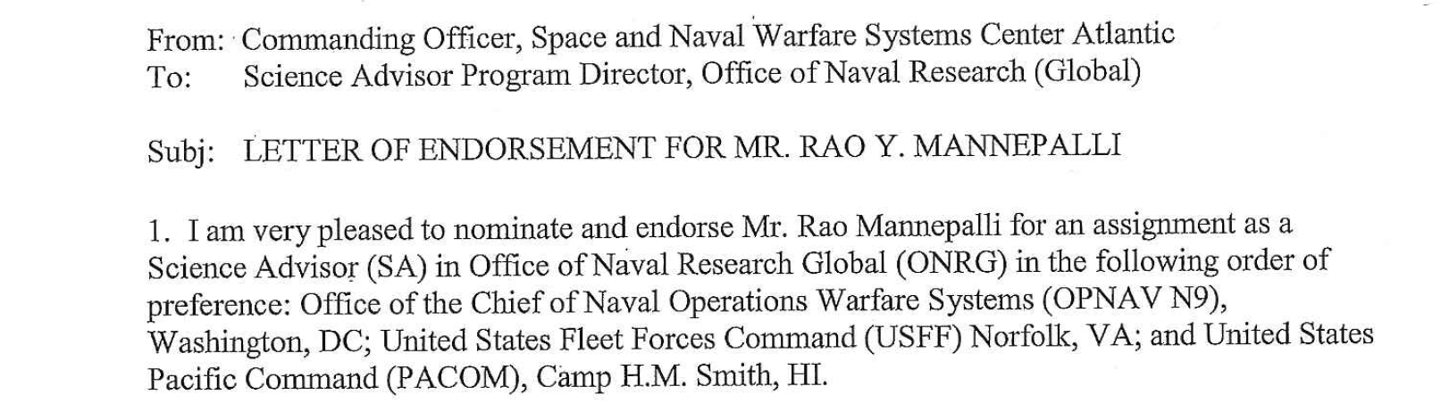
Science Advisor to the Fleet (US Navy)

Slide 64
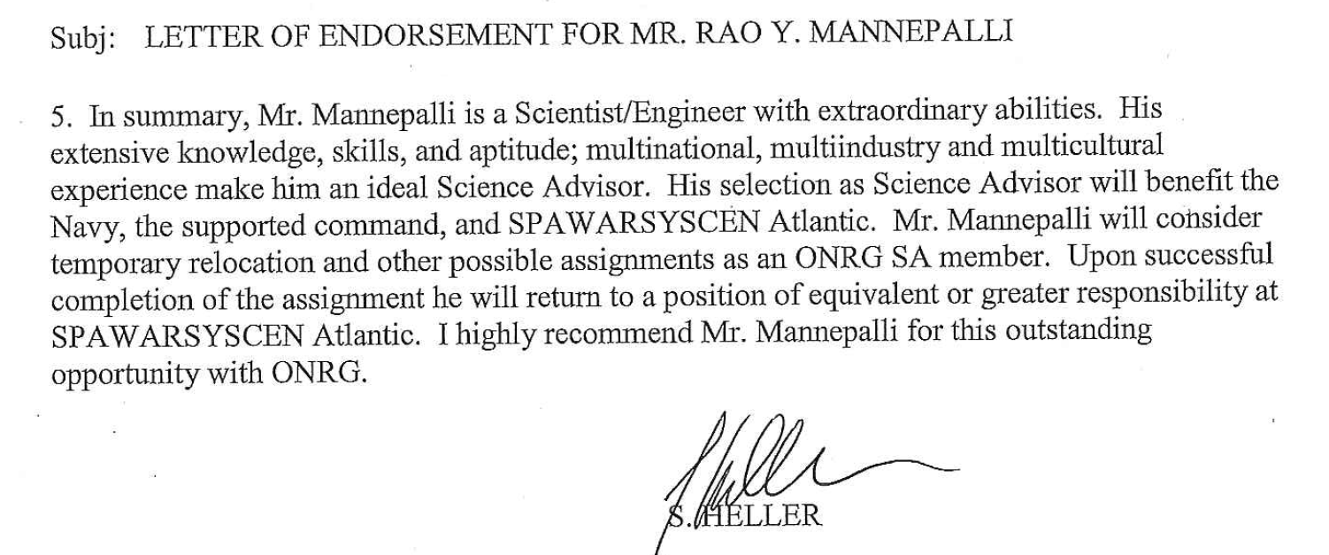
Science Advisor to the Fleet (contd.)

Slide 65
2. Is it a beautiful myth?
No. This has been done long before. For example, when I was at ISRO, in the early 1990s, I developed the Star Calibration Software for PCMC (Precision Coherent Monopulse C-band) Radar
It is more than 100,000 lines of C code (115,634 lines to be exact). Its output is just 17 coefficients for the mathematical model of the radar
For every function, a testing function was developed (except for the main function)
It is self-validating system. Some details are given in the next slides

Slide 66
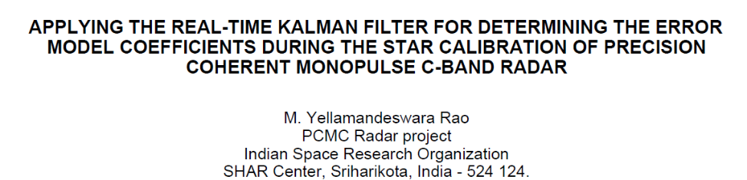
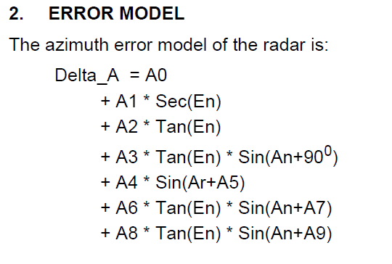
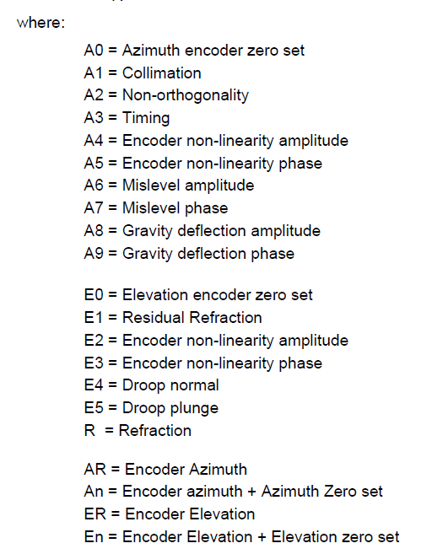
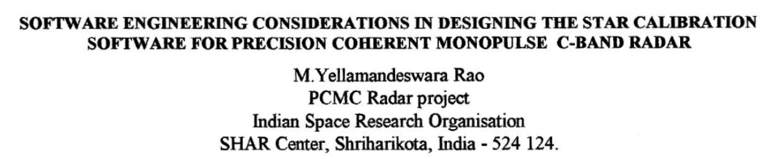
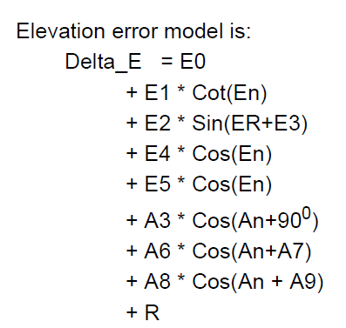
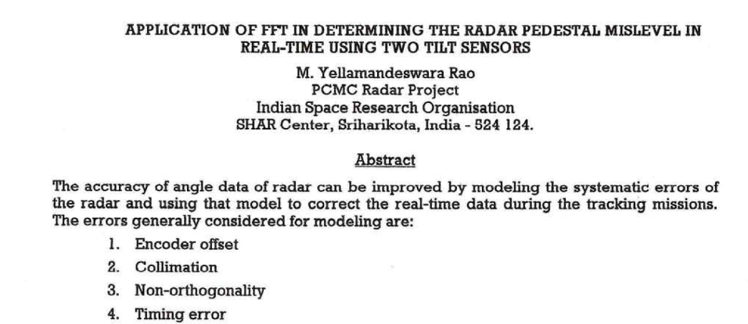
Star Calibration Software Subsystem

Slide 67
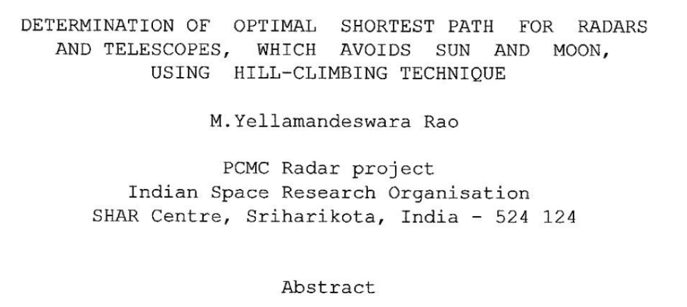

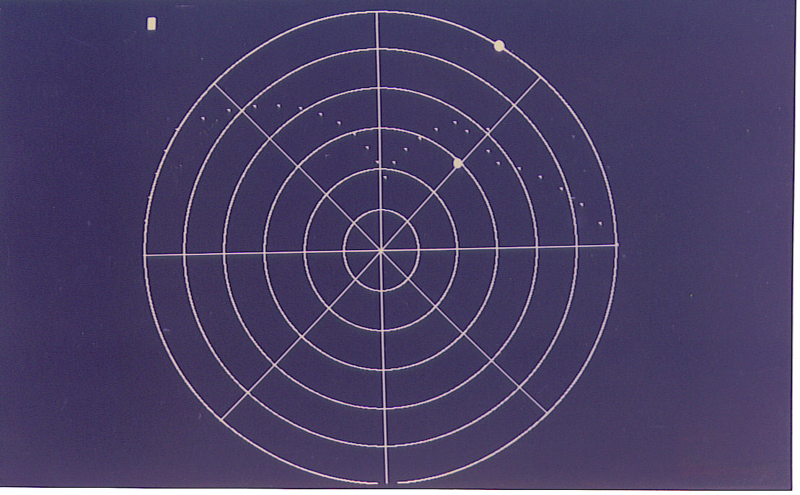
Optimal Shortest Path for Radars and Telescopes using Hill-Climbing Technique

Slide 68
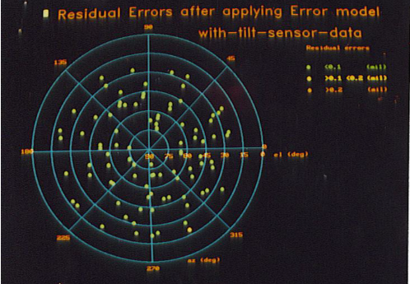




Star Calibration of Precision Radar

Slide 69
3. Is it Rocket Science?
No. Anyone can do it
As Jensen Huang stated, “It is the application of first principles to solve complex problems.”
My favorite quote: “It is not rocket science, even though I can do rocket science”

Slide 70

4. Is it snake oil?
No. I am not peddling any tool or silver bullet.
Contrary to the popular belief ,MBSE is no silver bullet. In fact, there are no silver bullets in any discipline (from my paper: “Digital Engineering is too important to be left alone to MBSE Practitioners
However, from time immemorial people have always touted silver bullets . Some of them are:
  Structured Programming
  “GOTO” statement considered harmful
  Structured programming with GOTO statements
  Literate Programming
  ALGOL programming language
  Simple and systematic programming languages
  Proving programs to be correct (“I have not tested this program. Only proved. it to be correct” [65])
  Beauty is our Business
  Software Engineering (“Software Engineering: An Idea Whose Time Has Come and Gone, Software engineering should be known as ‘The Doomed Discipline’, and aimed to guide people who can't program”)
  Object Oriented Programming (OOP) (An exceptionally bad idea which could only have originated in California.”
  CORBA (Common Object Request Broker Architecture)
  CMM, CMMI, and CIMM
  Agile (“Agile is no silver bullet. It is a cargo-cult culture)“)
  UML (“Death by UML Fever: Self-diagnosis and early treatment are crucial in the fight against UML Fever”)
  Flow charts
  The Waterfall method of software development was an innovation when it was introduced in the 1950s during SAGE development
  Artificial Intelligence (AI) (“AI had a long and glorious history. It started in 1956 and ended on Oct 24”,
  Grandmother hack of ChatGPT

Slide 71

5. How does Systems Engineering play a role?
As Jensen Huang, founder of NVIDIA and IEEE Medal of Honor-2026 recipient said during the announcement (see the video starting from 15:30)
  “Ultimately Engineering is about applying the first principles in Science and Math to break down incredibly challenging problems into solvable parts and solving the problems which were nearly impossible”
Systems engineering is a structured, end-to-end way to handle problems that are both complex and risky—like large defense programs, aerospace systems, by:
  Breaking Down Complexity (Decomposition): Instead of tackling a huge system all at once, systems engineering breaks it into smaller subsystems, defines clear roles and interfaces
  Keeping the “Big Picture” (Holistic View): While breaking things down, it ensures all parts work together and avoids “local optimization” problems
  Manages Requirements Clearly: Systems engineering, Captures stakeholder needs early; Converts them into measurable requirements; Maintains traceability
An example of local optimization vs. global optimization problem is given later

Slide 72
FDD at its core is about:
  Understanding the stakeholders’ requirements clearly, documenting them and getting their buy-in,
  Designing the system (output of the Feature Design is the clear and detailed requirements for each involved subsystem)
  Breaking down the subsystem requirements into requirements for the involved components (sub-sub-systems),
  Clearly defining the acceptance criteria at every step, transferring the accountability at every step if the deliverable meets the acceptance criteria
  Finally offering $5/bug by the Feature Engineer

Slide 73




Local optimization vs. global optimization (example)

Slide 74


Local Optimizations vs. Global Optimization (contd.)

Slide 75


Slide 76
FAQs
Someone asked me whether this is specific to software or does it apply to hardware
  My favorite answer: It applies for hardware, software and even for grave digging (inspired by F.P.Brooks’ “The Mythical Man Month” book: “3 things are always done at night: System software debugging, astronomy, and grave digging”)
Does it apply to cooperating teams only?
  No. It works for cooperating, indifferent or even hostile teams
At the end you may feel “There is nothing new in this. This is all common sense.”
  My first boss told me “Common sense is not that common and commonest sense is nonsense”
  I want to ask you one thing. If this is just common sense, have you ever delivered a large system with zero-defects? If yes, Congratulations. If no,which prevented/is preventing, you from ZDD
  Have you ever in your professional life put your reputation on the line and declared like Professor Knuth and challenged your customers? If not, why?
It applies to software, hardware, and even for grave digging

Slide 77
FAQs (contd.)
Most large and complex systems (and system of systems) suffer from problems during integration (often called “Integration Hell”). How that problem is addressed?
    As emphasized throughout this presentation, there is no separate “Integration Phase”. We address all the requirements, including interface requirements, during Feature Design, Subsystem Design, and lower levels. At every stage there is testing and demonstration that these interface requirements are honored. Hence “Integration” is automatic.
    What is the role/need of Integration Testing or even System Testing
    As mentioned, they serve the purpose of “Quality Assurance (QA)” but not “Quality Control (QC)”
Have you used it on any real system?
    Yes, at ISRO, Bell Labs, Lockheed Martin, US Navy, Raytheon, and Leidos

Slide 78
Closing thought
If you leave with one thought, that large, complex aerospace and weapons systems need not follow the “Work until it works” paradigm, I consider myself successful

Slide 79

FDD is not a new concept. It is an integral part of DevSecOps

Slide 80
Agile Planning is ''Feature-Based''
Agile projects plan and execute in accordance with established EVMS policies, procedures and guidelines
Agile Planning is value driven: the value of the Features to the customer drives the order of work
Therefore, Agile Planning is Feature-Based rather than Activity-Based
  Feature examples: shoot-down a missile, track a target, establish communication circuit
  Activity examples: write requirements , update design, write code, run unit tests
Agile Planning Terms:
  Capability: customer-required ability of the system that provides value to the warfighter
  Feature: part of a capability which can be completed within an incremental release (e.g. 3 months)
  Story: part of a Feature which can be completed within one iteration (2-4 weeks)

Slide 81
Does ZDD really mean Zero-defects?
ZDD is a mind-set and culture change. An example from my Bell Labs days (circa 1998)
0g Trans Fat (Labeling): FDA regulations permit manufacturers to state "0g“ of trans fat if the product contains less than 0.5 grams per serving

Slide 82
Acknowledgements
I want to acknowledge:
  The inspiration (for offering $5/bug (later adjusted for inflation) developed by my team and never had to pay in 8 years) derived from Prof. Donald Knuth of Stanford University.
  F. P. Brooks the father of the IBM-360 and the author of the Mythical Man Month for his review of my technical report “How can we achieve Level-3 on SEI’s CMM with simple process improvements (that could save $640 Million/year add $0.32 to Lucent’s EPS”?
  M.S. Kodikal who first gave me the “The Mythical Man Month” book to read when I was at the Indian Space Research Organization
  My Bell Labs colleagues and mentors: John Sun, Chuba Udokwu, Ravi Sethi, Rod Alferness, Alfred V. Aho, Ann Martin, Hans Teder, Norman Sinowitz, Francois Morvan, J D Ou, Steve Kingscott, Bob Martin, Wayne Hunt, and Dan McCurdy who reviewed my improvements and provided comments and feedback
  Joe Towmey who gave me the New York Post’s news article “2 Shot at Rao’s” and suggested the two possible people”
  Dr. Mike Griffin, former Administrator of NASA who reviewed several of my papers and engaged in a large number of thought-provoking discussions
  Mr. Norm Augustine, Dr. Paul Kamiski, Dr. John Tracy, Dr. Paul McManamon, Dr. Vint Cerf, Gen. (Retd.) Kenneth Todorov for their guidance and help
  My wife Usha Mannepalli who tested my software changes at Bell Labs to the ITM-NM (Integrated Transport Management-Network Management, when I increased the capacity of the system from 500 nodes to 25,000 nodes

Slide 83

Rao Mannepalli
https://ieeesystemscouncil.org/contact/rao-mannepalli
Rao is currently working as the Chief Scientist of Leidos, USA. He has more than 25 years of international, multi-industry and multi-cultural experience as Division Head, Program Manager, Chief Engineer, Chief Scientist, Chief Architect, and Principal Developer at Leidos, Raytheon, US Navy, Lockheed Martin, Bell Labs, and Indian Space Research Organization ( ISRO).
He has 24 inventions in the areas of routing in optical networks, capacity and performance improvements, ballistic missile defense, sensors, signal processing, solar power plant design, energy dispatch algorithms, better driving directions, preventing suicide car bombings, prevention of pandemics like H1N1, identity theft prevention, and others. He has authored more than 180 papers., presented keynote lectures at international conferences. Served as the Editor of IEEE’s Aerospace Electronics and Systems Magazine (Satellites, Modelling & Simulation, and Energy).
He is a Member of the Defense Acquisition Corps (DAC). “DAC is an elite group of highly qualified DOD acquisition professionals with skills and attributes required to fill Critical Acquisition Positions (CAP) and Key Leadership Positions (KLP) of Major Defense Acquisition Programs (MDAP) like Program Manager of ACAT-ID, Chief Engineer, Chief Scientist, or Science & Technology Manager of ACAT-ID Weapons programs.” He was interviewed at Pentagon (finalist) for the job of Chief Systems Engineer of Army, Office of Chief Systems Engineer (OCSE) reporting to Assistant Secretary of Army for Acquisition, Logistics, and Technology (ASN- ALT). He is a DOD certified Systems Engineer, Science and Technology Manager and Program Manager.
One of his inventions is termed by Mr. George P. Sutton, Executive Director of Rocketdyne (during Apollo Moon Landing Program), Chief Scientist of DARPA, Professor at MIT and Caltech, and the author of the most respected textbook ‘Rocket Propulsion Elements’ - which for more than 60 years has been regarded as the single most authoritative source book on rocket propulsion technology - as ‘An Original Contribution to Rocket Science’. Rao helped Mr. Sutton in bringing out the 9th edition of his iconic textbook. Two of Rao’s inventions (Rao’s method and Chord-midpoint method) are references for this book.
He identified an error in the Guinness book of records regarding the highest sound level produced in the world (by NASA during the static firing of Saturn-V Rocket first stage engines during the Apollo Moon landing program) and got it removed from the record book.

Slide 84
Rao Mannepalli (contd.)
At Bell Labs, he studied the software development process, identified the root causes, suggested improvements and documented them in “How can we achieve Level-3 on SEI’s CMM with simple process improvements that can save $640 million/year and add $0.32 to Lucent’s EPS”. It has become a classic (“Rao’s Mythical Man Month”). F. P. Brooks, the author of the ‘The Mythical Man Month’ and the father of IBM-360, termed them as “Exceedingly valuable to Lucent.” .
He is a quality evangelist and routinely offers $5/bug in the systems developed by him and his team (and never had to pay even once in 8 years). He is a champion of ZDD (Zero-Defect-Delivery). One of his favorite sayings is, “It is not Rocket Science -- even though I can do Rocket Science”
He is a Fellow of International Society of Automation (ISA); British Computer Society; Royal Aeronautical Society; Royal Astronomical Society; Astronautical Society of India; Institution of Engineering and Technology; Council of Vibration Specialists; Institution of Engineers; Institution of Electronics and Telecommunication Engineers. Distinguished Scientist, ACM (‘for significant contributions to almost all the technologies that constitute Ballistic Missile Defense (BMD), including Rao’s Method an original contribution to Rocket Science’) and Chair of Distinguished Member selection committee; Associate Fellow AIAA, Eminent Engineer, Tau Beta Pi; Path Finder, Lucent Technologies; Chartered Engineer (CEng), Professional Engineer (PE). He won the President of the USA Volunteer Service Award 8 times: Gold (>500 hours/year): 2010, 2011, 2019, 2020; Silver (>250 hours/year): 2009, 2018; Bronze (>100 Hours/year): 2008, 2017.
His education includes: M.S (Computer Science), B.E (Electronics), B.S (Physics) and Executive Education at MIT and Wharton Business School. He mentored a large number of engineers, scientists, and managers. Helped 11 team members to become first time inventors and 25, first time authors.

Slide 85


Slide 86
Extended Abstract
Weapon systems critical to national security are increasingly becoming more complex and expensive. The cost overruns alone are estimated to be about half-a-trillion dollars, making it the second-largest defense budget in the world. In the USA, several weapon system programs have breached Nunn-McCurdy thresholds for cost and schedule overruns.
“Inadequate Systems Engineering” is almost always the critical factor in these troubled programs. Systems Engineering, since the days of Bell Labs where the word was first coined, has morphed several times and lost much of its original purpose of guiding the design and development of systems (in particular, large and complex systems like 5ESS and Aegis BMD; both are in the 100-million-lines-of-code class).
As John Vu stated in his keynote address at Lucent’s 1997 Software Symposium: “No system failed due to bad coding. All failures could be traced to bad design” (note: most weapon systems are software-intensive).
Smith and Williams, in Performance Solutions: A Practical Guide to Creating Responsive, Scalable Software, analyzed root causes of performance problems and concluded that “the problem is often due to a fundamental misunderstanding of how to achieve performance objectives” during the analysis of requirements and design (Systems Engineering).
It has become an accepted practice that delivering complex weapon systems follows a “work until it works” paradigm, with its associated cost and schedule overruns and poor quality. For example, immediately after joining the GPS-OCX program as the Deputy Chief Engineer, I asked a hypothetical question: “If someone from GPS-OCX needs to stand in front of the customer and say, ‘Requirement-xxx is delivered. If anyone can find a problem/bug in that, I will gladly pay $5 for each bug,’ who would be that person? Do you think it can be done?” Almost all the answers I received were: “It is impossible. It cannot be done.”

Slide 87
Extended Abstract (contd.)
However, it can be done, and it has been done. Prof. Donald Knuth of Stanford University did it. I have done it routinely at Bell Labs on a project that was much more challenging than GPS-OCX. I routinely offered $5 for each bug found in the software developed by the team (and never had to pay out in eight years). In other words, we are not attempting the impossible.
This paper, after providing a brief overview of the problems and the state of the art, presents the process for Zero-Defect Delivery (ZDD) and shows how Systems Engineering plays a crucial role. Large systems have four levels of systems engineering (as Bell Labs calls them Tier-1 to Tier-4).
It also addresses common concerns such as: (1) Does it apply only to legacy systems or also to the development of new systems? (2) Does it work only for software-intensive systems or for others as well? (Yes, it works for the development and sustainment of software-intensive systems, hardware systems, and even—apologies to F. P. Brooks—for “grave digging.”) (3) Does it work only for closely collaborating teams? (No, it works for cooperating, indifferent, and even hostile teams.) (4) Does it help in maintaining a stable workforce critical for weapon systems development? (5) Is it Rocket Science? (No: “Even though I can do rocket science.”)
It provides examples, lessons learned, and even lessons we are going to learn (a.k.a. pre-mortem)from the systems I have worked on and left my fingerprints.

Slide 88


Thank you

Slide 89
BACKUP

Slide 90

Weapon System Organization

Slide 91

Subsystem Organization

