Slide 1
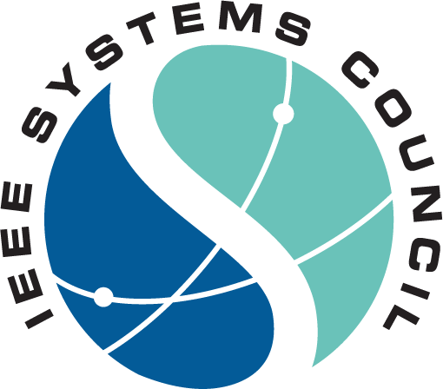
IEEESYSTEMSCOUNCIL.ORG

Slide 2
About the Systems Council
Formed in June 2005
The IEEE Systems Council promotes, encourages, and supports the technical, academic and application aspects of systems engineering and systems thinking through its own activities, and with its Society members through joint activities for the growth of Council Affiliate membership, member Society membership, and for addressing overall global challenges.
IEEESYSTEMSCOUNCIL.ORG/ABOUT

Slide 3
About the Systems Council
Field of Interest The Systems Council integrates IEEE activities regarding aspects of multiple disciplines and specialty areas of systems engineering, and covers, but is not limited to:
Systems thinking
Systems-engineering education, standards, processes, methodologies
Systems modeling, simulation, integration, resilience
Robust design, safety and human factors, security, usability, environmental aspects
Product transition: design, production, test, deployment, disposal
Program and project management
Quality assurance
Mission assurance
Requirements development and management
Risk management
Systems architecture
Systems of systems

Slide 4
Executive Committee
President Walt Downing Southwest Research Institute
President-Elect Andy Chen Catronic Enterprise
VP Publications Fabrice Labeau
VP Conferences Paolo Carbone
VP Finances Shreekanth Mandayam
VP Member Services Stephanie White
VP Technical Operations Andre Oboler
Secretary Katie Wilson
Treasurer Robert Rassa
IEEESYSTEMSCOUNCIL.ORG/EXECUTIVE-COMMITTEE

Slide 5
Member Societies
Aerospace and Electronic Systems Circuits and Systems Communications Computer Consumer Technology Control Systems Electromagnetic Compatibility
Industry Applications Industrial Electronics Information Theory Instrumentation and Measurement Microwave Theory and Techniques Power Electronics Product Safety Engineering
Reliability Society Robotics and Automation Social Implications of Technology Systems, Man, and Cybernetics Technology and Engineering Management Vehicular Technology
IEEESYSTEMSCOUNCIL.ORG/MEMBER-SOCIETIES

Slide 6
2024 Member Society Representatives
AESS |
CASS |
COMSOC |
CS |
CTSOC |
CSS |
EMC |
IAS |
IES |
IMS |
ITS |
MTT-S |
PELS |
PSES |
RAS |
RS |
SSIT |
SMC |
TEMS |
VTS |
Greg Lyons and Ke Wu
Antonio J. Marques Cardoso and Alireza Safaee
Stefan Mozar and Kim Fung Tsang
Emanuele Menegatti and TBD
Jason Rupe and Wei Zhang
Bozenna Pasik-Duncan and Prasanta Ghosh
Haibin Zhu and Ferat Sahin
Sudeendra Koushik and Karl Arunski
Alexander Wyglinski and Fabrice Labeau
Athina Petropulu and Bob Rassa
Hiroo Sekiya and Kiran Gunnam
Michele Nogueira and Ruidong Li
Wei-Ren Chen and Shashikant Patil
Norbert Herencsar and Yu-Cheng Fan
Rifat Sipahi and Tansel Yucelen
Karen Burnham and Henry Benitez
Wei-Jen Lee and Andy Knight
Stamatis Karnouskos and Yang Shi
Marco Parvis and Vincenzo Piuri
Matthieu Bloch and Stark Draper
IEEESYSTEMSCOUNCIL.ORG/MEMBER-SOCIETY-REPS

Slide 7
Technical Committees
Analytics and Risk
Cyber Physical Systems
Human System Integration
Intelligent Transportation Design
Networked Systems
Systems Biology and Biomedical Systems
Systems Education
Security and Privacy in Complex Information Systems
Hyper-Intelligence
Joint INCOSE/IEEE Systems Engineering and Software Interface
System Engineering Methods
Joint IEEE Systems Engineering/TEMS TC on Carbon Neutrality
Systems Thesaurus
The Systems Council offers opportunities to participate in technical committees in several technical fields of interest related to Systems Engineering. The technical committees hold meetings around the world, typically in conjunction with relevant conferences. Objectives of technical committees include to create IEEE standards and to support IEEE conferences.
IEEESYSTEMSCOUNCIL.ORG/TECHNICAL-OPERATIONS

Slide 8
Systems Council Chapters/Joint Chapter Locations
28
Section Chapters
24
Student Chapters
18
Countries
7
IEEE Regions
Updated: July 2024
IEEESYSTEMSCOUNCIL.ORG/CHAPTERS

Slide 9
Publications
IEEE Systems Journal
Established 2007
Impact factor 4.4
Median time-to-publication <7 weeks
Co-Sponsored Publications
Journal on Miniaturization for Air and Space Systems (J-MASS)
Open Journal of Systems Engineering (OJSE)
Systems Engineering Body of Knowledge (SEBoK)
Transactions on Big Data (T-Data)
Transactions on Cloud Computing (TCC)
Transactions on Privacy (T-P)
Newsletter
Publishes quarterly
Reach of over 22,000 subscribers
Updated: February 2024
IEEESYSTEMSCOUNCIL.ORG/PUBLICATIONS

Slide 10
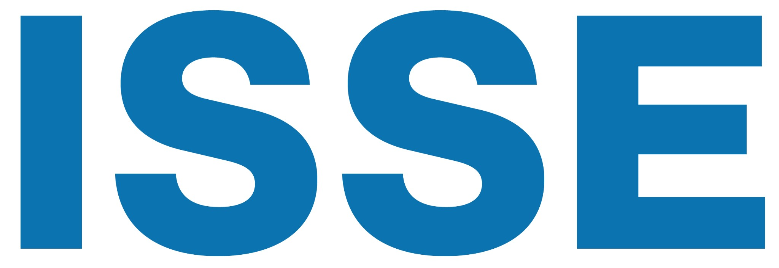
Conferences
International Symposium on Systems Engineering
International Conference on Recent Advances in Systems Science and Engineering
International Systems Conference
A full list of events and conferences, calls for papers, and registration information can be found on the website.
The IEEE Systems Council is willing to sponsor, co-sponsor or technically co-sponsor conferences and workshops in its field of interest.
If you are interested in organizing a conference or workshop with the IEEE Systems Council, please submit a preliminary proposal to the VP Conferences by specifying title, location, dates, topics, general and program chairs, and expected number of attendees.
IEEESYSTEMSCOUNCIL.ORG/CONFERENCES

Slide 11
Distinguished Lecturer Program
Objective
Highlights
Information
Access experts promoting the field of systems engineering.
Over 35 DLs with various backgrounds and geo-locations
Online Biography and Talk Titles
Request a Distinguished Lecturer for your event by visiting the website and filling out the form.
IEEESYSTEMSCOUNCIL.ORG/ DISTINGUISHED-LECTURERS

Slide 12
Awards
The Council recognizes the contributions and achievements in the systems engineering community by sponsoring numerous awards in the field including the following:
Systems Journal Best Paper Award
Given annually to the papers deemed the best among those published in the IEEE Systems Journal during the preceding calendar year
Prize: A certificate presented to each author and $500 to be shared among the authors.
Outstanding Service Award
To honor long and distinguished service to the IEEE Systems Council at a level of dedication and achievement rarely demonstrated.
Prize: Plaque and $1,000
Chapter and Student Branch Chapter of the Year
To recognize one Systems Council Chapter/Student Branch Chapter for significant activity and service to its members.
Prize: Certificate and $1,000
Scholarships
James O. Gray Graduate Scholarship
Recognizes students pursuing graduate studies in process control systems engineering, plant automation, or instrumentation measurement.
1 - $6,000 scholarship available
IEEE Systems Council Engineering Undergraduate Scholarship
Recognizes students pursuing their first professional degree in any engineering discipline.
2 - $5,000 scholarships available
All awards, forms, and previous winners are available on the website.
IEEESYSTEMSCOUNCIL.ORG/AWARDS

Slide 13
What Can the Council Do For You?
As Systems Council is an IEEE Technical Council and unlike Member Societies, individuals cannot be members of a council. However, IEEE Members can register as Systems Council participants, receive newsletters, attend Systems Council sponsored events, and volunteer. Participation in the Council is free.
Conferences
Awards
Publications
Education
Technical Activities
Networking

Slide 14
How to Get Involved
Become a Systems participant
For free on the IEEE website
Subscribe to Systems Council Mailing List
Conferences and Events
Organize a meeting, workshop or conference
Review for Systems conferences and Journals
Get involved with local chapters and volunteer to organize activities
Volunteer to Serve on Systems Committees
Calls are announced on the website and social media
Distinguished Lecturers Program
Request a DL at your next event Apply to become a DL

Slide 15
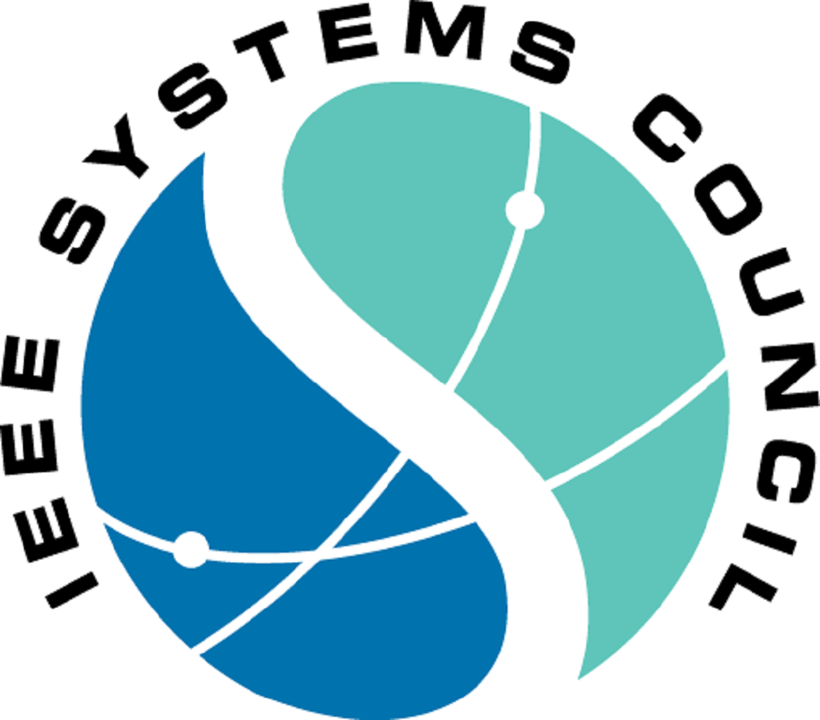
Website
ieeesystemscouncil.org
Facebook
facebook.com/IEEESystemsCouncil
Twitter
Stay up to date on all Systems news and events!
@SystemsCouncil
LinkedIn
linkedin.com/company/ieee-systems-council
IEEESYSTEMSCOUNCIL.ORG/MARKETING-REQUESTS

