Slide 1
IEEE Systems Council
Members Services Chapters Committee Report
Fabrice Labeau
September 2022
Fall 2022 AdCom

Slide 2
Current Status & Achievements
Main mandates:
Grow # chapters and support to chapters
Chapters Status:
19 chapters (out of which 8 joint), 6 student chapter branches (growth by 4 chapters and 2 student chapter branches since 2020)
Committee activities:
Organized Chapter Chairs Summit in May 2021 with IEEE SYSCON 2021 (virtual)
Hybrid Chapter Chairs Summit to be organized in conjunction with IEEE ISSE 2022 (Vienna)
Offer up to $500 to up to 5 R8 chapter chairs to help with travel costs

Slide 3
Challenges
Chapter formation opportunities:
In 2020, explored potential of new chapter creation through (i) joint chapters with existing NANO, SEN chapters (ii) sections where AdCom members reside.
Very little success rate (60 sections contacted, 55% never responded, only 4 new chapters came out of this effort)
In 2022, will start exploring possibilities by cross-referecing sections with a large number of Systems Council participants (>50) with list of 102 Systems engineering university programs in the US.
27 programs identified– see next page

Slide 4
1st Phase: List of identified sections and systems engineering programs in the US
Atlanta Section
Georgia Institute of Technology
Baltimore Section
Morgan State University (Mitchell)
University of Maryland, Baltimore County (UMBC)
Boston Section
Boston University
Massachusetts Institute of Technology
Northeastern University
University of Massachusetts Lowell
Central Texas Section
University of Texas Austin (Cockrell)
Chicago Section
Northwestern University (McCormick)
University of Illinois Chicago
Dallas Section
Southern Methodist University (Lyle)
University of Texas Arlington
Denver Section
University of Denver
Houston Section
Texas A&M University – College Station
University of Houston
Oakland-East Bay Section
University of California – Berkeley
Orange County Section
University of California – Irvine (Samueli)
Oregon Section
Oregon State University
Santa Clara Valley Section
Naval Postgraduate School, California
Stanford University
Seattle Section
University of Washington, Seattle, WA 98195, United States
Southeastern Michigan Section
Oakland University
University of Michigan – Ann Arbor
University of Michigan Dearborn
Wayne State University
Twin Cities Section
University of Minnesota
University of Minnesota Twin Cities

Slide 5
Additional Background

Slide 6
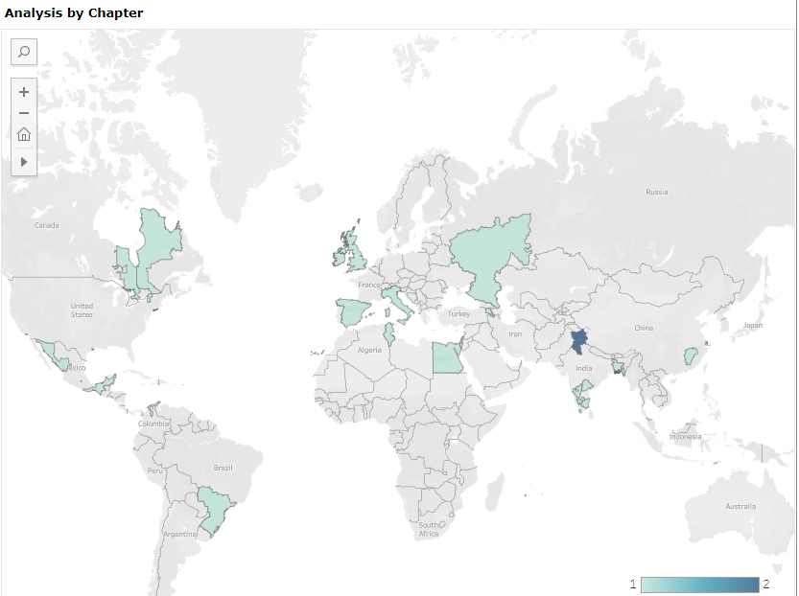
Current Chapters
19 chapters (out of which 8 joint)
6 student branch chapters
+3 chapters and +2 student branches since 2020

Slide 7
Chapter Activities in 2021
Section | # Events | # Attendees
Bangalore Section | 5 | 742
Galveston Bay Section | 13 | 399
Israel Section | 4 | 756
Italy Section | 2 | 148
Long Island Section | 1 | 12
Mauritius Section | 3 | 52
Mexico Section | 10 | 904
New York Section | 1 | 105
North Jersey Section | 1 | 55
Toronto Section | 2 | 37
Tunisia Section | 2 | 56
United Kingdom and Ireland Section | 1 | 38
Grand Total | 45 | 3304

Slide 8
Number of reported chapter activities

