Slide 1

Application of Systems Engineering with Data Science to Address Emergent Behavior in Human Decision Making
Paul Hershey, Ph. D.
IEEE Fellow
Principal Engineering Fellow, Raytheon Technologies
ieeesystemscouncil.org
©2023 Raytheon Company. All rights reserved.

Slide 2
Role of System Engineering
Emergent Complex Systems
  Systems Engineering provides a framework within which:
    To derive the specification, requirements, design, and development of Complex Systems
    To adapt to the dynamic nature of Emergent Behavior within Complex Systems
Data Science
  The science of analyzing raw data (data analytics)
    Focused on deriving conclusions about the information derived from the results
  Systems Engineering supports the application of data analytics to assist with complexities of human decision making
2

Slide 3
Complex Systems Engineering
Used to manage and guide the enterprise.
Brings together independent, disparate organizations and entities to provide them with a sense of “pressure” related to complex system issues and challenges and a set of processes to resolve these pressures.
  Norman D.O., Kuras M.L. (2006) Engineering Complex Systems. In: Braha D., Minai A., Bar-Yam Y. (eds) Complex Engineered Systems. Understanding Complex Systems. Springer, Berlin, Heidelberg© Springer 2006, pp 206-245.
3

Slide 4
Definitions:
“Complex Systems Engineering” includes:
  Complexity
  Systems
  Engineering
  Norman D.O., Kuras M.L. (2006) Engineering Complex Systems. In: Braha D., Minai A., Bar-Yam Y. (eds) Complex Engineered Systems. Understanding Complex Systems. Springer, Berlin, Heidelberg© Springer 2006, pp 206-245.
4

Slide 5
Complexity
“Complexity” does not mean “difficult to understand”
Complex:
  1.a. Consisting of interconnected or interwoven parts; composite.
  1.b. Composed of two or more units
  The American Heritage Dictionary, https://ahdictionary.com/, accessed May 8, 2019.
Complexity is strongly related to the number of possible states of a collection, or its complete description.
  Mina A., Braha D., Bar-Yam Y. (2006) Complex Engineered Systems: A New Paradigm. In: Braha D., Minai A., Bar-Yam Y. (eds) Complex Engineered Systems. Understanding Complex Systems. Springer, Berlin, Heidelberg, © Springer 2006, pp. 40-71.
Complexity in terms of behavior and emergence.
  Heylighen, F., C. Joslyn; 2001; “Entropy and Information,” Principia Cybernetica Web, Sep 3,; pespmc1.vub.ac.be/entrinfo.html.
5

Slide 6
System
A group of interacting, interrelated, or interdependent elements forming a complex whole
A set of objects or phenomena grouped together for classification or analysis.
  The American Heritage Dictionary, https://ahdictionary.com/, accessed May 8, 2019.
6

Slide 7
Complex System
Complex System is a system:
  Whose structure and behavior is not deducible, nor may it be inferred, from the structure and behavior of its component parts;
  Whose elements can change in response to imposed “pressures” from neighboring elements (note the reciprocal and transitive implications of this);
  Which has a large number of useful potential arrangements of its elements;
  That continually increases its own complexity given a steady influx of energy (raw resources);
  Characterized by the presence of independent change agents.
  Norman D.O., Kuras M.L. (2006) Engineering Complex Systems. In: Braha D., Minai A., Bar-Yam Y. (eds) Complex Engineered Systems. Understanding Complex Systems. Springer, Berlin, Heidelberg© Springer 2006, pp 206-245.
  Mina A., Braha D., Bar-Yam Y. (2006) Complex Engineered Systems: A New Paradigm. In: Braha D., Minai A., Bar-Yam Y. (eds) Complex Engineered Systems. Understanding Complex Systems. Springer, Berlin, Heidelberg, © Springer 2006, pp. 40-71.
  Heylighen, F., C. Joslyn; 2001; “Entropy and Information,” Principia Cybernetica Web, Sep 3,; pespmc1.vub.ac.be/entrinfo.html.
  Kauffman S.A; 1993; The Origins of Order: Self-Organization and Selection in Evolution, Oxford University Press, New York.
7

Slide 8
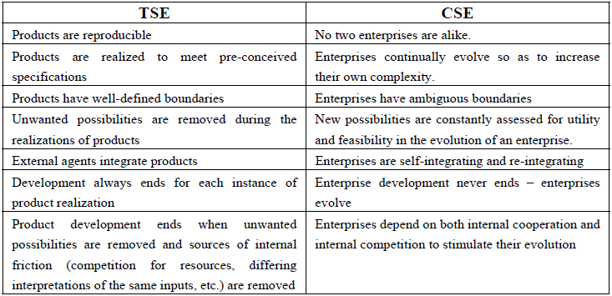
Issues Addressed by
Complex Systems Engineering (CSE) vs. Traditional System Engineering (TSE)
  Norman D.O., Kuras M.L. (2006) Engineering Complex Systems. In: Braha D., Minai A., Bar-Yam Y. (eds) Complex Engineered Systems. Understanding Complex Systems. Springer, Berlin, Heidelberg© Springer 2006, pp 206-245.
8

Slide 9
Complex Systems Challenges for Emergent Behavior
Emergent behavior is a new behavior that develops from the interactions among constituent systems
  In a System of Systems (SoS), constituent systems must be: (i) operationally independent; (ii) managerially independent; (iii) physically decoupled, and geographically distributed.
  The SoS as a whole must: (iv) have evolutionary development; and (v) produce emergent behaviors.
Emergent behavior cannot be deduced from the behaviors of the constituent systems themselves, considered individually or in subgroups.
An emergent behavior is a global behavior that arises out of the interactions between parts of a whole and which cannot be predicted or extrapolated from the behavior of the individual parts.
* Flavio Oquendo, “Architecturally Describing the Emergent Behavior of Software-intensive System-of-Systems with SosADL,” IRISA – UMR CNRS / Univ. Bretagne Sud, France flavio.oquendo@irisa.fr, 2017 12th System of Systems Engineering Conference (SoSE), June 18-21, 2017 Waikoloa Hawaii, USA
9

Slide 10
Summary
“Complex Systems Engineering” includes Complexity, Systems, Engineering
Complexity consists of interconnected or interwoven parts and can be defined in terms of behavior and emergence.
Complex System is a system is one whose structure and behavior is not deducible from the structure and behavior of its component parts;
Complex Systems Engineering brings together independent, disparate organizations and entities to provide them with set of processes to resolve complex system challenges and issues.
Complex Systems Challenges for Emergent Behavior evolve from constituent systems that must be operationally and managerially independent, physically decoupled, and geographically distributed.
12

Slide 11
Application of Systems Engineering with Data Science to Assist Human Decision Making
Data analytics is the science of collecting and processing raw data to improve human decision making
11

Slide 12
What is Data Analytics
Definition:
  Data analytics is the science of collecting and processing raw data in order to improve human decision making
  Data analytics encompasses many types of data and data analyses
  Data analytics can be processed by many different hardware and software techniques
  Data analytics support cyber security and autonomous systems
  Data analytics techniques can reveal trends and metrics that would otherwise be lost in the mass of raw data
Agile,
Scalable
Software
Data to
Decision
Data Analytics
Programmable Hardware
Intelligence, Surveillance, Reconnaissance
High Performance Processing
Computational Social Science
DevSecOps, Cybersecurity
Multi-Intelligence
12

Slide 13
What are Big Data?
High Volume
Big Data are:
  High-volume
  High-velocity
    Velocity: speed with which data are generated
    High-velocity: data generated at a fast pace that requires distinct (distributed) processing techniques
    Examples: Twitter messages and Facebook posts
  High-variety information assets
Big Data require changes in how we approach data:
  Massive data volumes over small amounts & sampling
  Favor use of lots of data, even if messy and dirty, over small amounts of clean and accurate data
  Focus on probabilities and correlations over causality and certainty
Big Data require new forms of processing to enable enhanced human decision making, insight, and discovery
Correlations
High Velocity
Big Data
Analytics
Probabilities
High Variety
Dirty Data
Massive
Amounts of
Data over Small
Amounts
Messy Data
*Cukier, Kenneth, and Viktor Mayer-Schoenberger. “The Rise of Big Data: How It's Changing the Way We Think About the World,” Foreign Affairs, vol. 92, no. 3, 2013, pp. 28–40. JSTOR, www.jstor.org/stable/23526834. Accessed 7 July 2021.
13

Slide 14
The 4th Paradigm of Science
“Quantity has its own quality”
The 4th Paradigm of Science
  Manipulate, explore, and mine massive data sets
More data beats more effective algorithms
More data leads to better accuracy
  linear to the log of the data size
At a large enough data size, the accuracy of different algorithms converge
Large
Data
Sophisticated
Algorithm
Simple
algorithm
Small
Data
+
>
+
* J. Lin and C. Dyer, Data-Intensive Text Processing with MapReduce (Synthesis Lectures on Human Language Technologies) , Morgan and Claypool Publishers; 1st edition (April 30, 2010), SBN-10 ‏ : ‎ 1608453421
14

Slide 15
Data Analyst vs Data Engineer vs Data Scientist
Data Analyst
  Analyses large variety of data to extract information about system, service, or organization performance and presents them in usable/actionable form to support human decision making.
  Example: Someone who helps people understand the results of specific queries.
Data Scientist
  Finds and interprets rich data sources, manages large amounts of data, merges data sources, ensures consistency of data-sets, and creates visualizations to assist with human understanding of the data.
  Example: Someone who builds mathematical models, presents and communicates data insights and findings to specialists and scientists, and recommends ways to apply the data.
Data Engineer
  Focuses on coding, cleaning up data sets, and implementing requests that come from data scientists.
  Knows and applies a broad variety of programming languages.
  Example: Someone who takes the predictive model from the data scientist and implements it in code.
Data Analyst
Data Scientist
Data Cleaning
Visualization
Communicate Results
Data conversion
Statistics
Machine Learning
Performance Assessment
Math
Data modeling
Complex Data at Scale
Data Engineer
Tools
Data at Scale
SW
* J. Saltz and N. Grady, “The Ambiguity of Data Science Team Roles and the Need for a Data Science Workforce Framework,” 2017 IEEE International Conference on Big Data (BIGDATA),
11-14 Dec. 2017, 978-1-5386-2715-0/17/$31.00 ©2017 IEEE.
15

Slide 16




Data Analytics Systems Architecture Drivers
ATTRIBUTE | RATIONALE
SCALABILITY | The ability of the system to increase capacity to handle greater amounts of load
PERFORMANCE | The ability of the system to provide fast responses and low latency
AVAILABILITY | The ability of the system to have consistently high uptimes, rapid recovery, and graceful degradation
RELIABILITY | The ability of the system to consistently return the same data for a request
MANAGEABILITY | The ability of the system to scale operations including maintenance and updates
COST | The Total Cost of Ownership (TCO) including hardware, software, deployment, training, operations, etc.
Data-Driven Support for
Human Decision Making
Data
Analysis
Data
Science
Mass Scale
Data Engineering
& Processing
16

Slide 17
Architecture Attributes
ATTRIBUTE | RATIONALE
FAULT TOLERANCE | The system must remain operational in the face of chronic and pervasive failure in hardware, software, networks, wetware (Human error). Downtime is highly destructive to business.
HORIZONTALLY SCALABLE | Ability to maintain performance by adding resources to the system in the face of increasing data and load. System must be horizontally scalable across all layers.
GENERAL | Supports a wide range of applications across diverse markets and business verticals.
EXTENSIBLE | Add functionality at minimal development cost.
AD HOC QUERIES | Supports queries of the system that are not pre-defined.
CLOUD VENDOR LOCK-IN AVOIDANCE | As much as possible, leverage Infrastructure as a Service (IaaS) cloud resources over Platform as a Service (PaaS) resources
ATTRIBUTE | RATIONALE
MINIMAL MAINTENANCE | Minimize implementation and accidental complexity (vs. essential complexity).
DEBUGGABLE | Ability to trace for each value in the system exactly what caused it to have that value.
RECOMPUTABLE & REPROCESSABLE | Raw data inputs can be reprocessed to recompute outputs.
IMMUTABLE, TIME-STAMPED DATA | Immutable & Timestamped Data Inputs
COMPLETE and RELIABLE DATA FLOW | Making all the data that an organization has available in all its services and systems
CO-LOCATED COMPUTE and STORAGE | Combine storage & compute for increased agility, increased performance, & reduced costs
17

Slide 18
Architectural Design Constraint Factors for Big Data Systems
Constraint | Description
WORKING SET SIZE | The set of data a system needs to address during normal operation.
AVERAGE TRANSACTION SIZE | The working set of a single transaction performed by the system
REQUEST RATE | How many transactions are expected per hour / minute / second?
UPDATE RATE | This is a measure of how often data is added, deleted, and edited
CONSISTENCY | How quickly does an update have to spread through the system?
LOCALITY | What portion of the working set does one request need access to? How is that portion defined? What is the overlap between requests?
COMPUTATION | What math do you need to run on the data? Can it be pre-computed and cached? Are you doing intersections of large arrays? Are you bringing the computation to the data, or the other way around? Why?
LATENCY | How quickly are transactions supposed to return success or failure?
InfoQ: Carlos Bueno, Shaping Big Data Through Constraints Analysis (infoq.com), accessed June 6, 2021.
18

Slide 19




















Data Analytics Models
19

Slide 20
Types of Data Analytics
Data analytics is broken down into four basic types:
  Descriptive analytics describes what has happened over a given time period;
  Diagnostic analytics focuses on why something happened;
  Predictive analytics describes what is likely going to happen in the near term;
  Prescriptive analytics suggests a course of action.
      *”Descriptive, Predictive & Prescriptive Analytics: What are the differences?” UNSW Sydney Online, 29 JANUARY 2020, https://studyonline.unsw.edu.au/blog/descriptive-predictive-prescriptive-analytics accessed June 25, 2021.

Slide 21
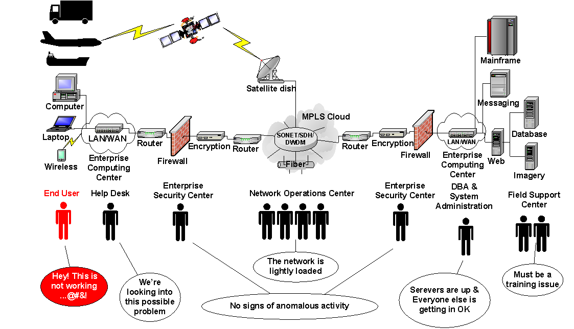
Application of Descriptive Data Analytics
Descriptive analytics describes what has happened over a given period of time
  Historical data is collected, organized and then presented in a way that is easily understood.
  Focused only on what has already happened and not on what draws inferences or predictions from its findings.
  Foundational starting point used to inform or prepare data for further analysis down the line.
  Uses simple math and statistical tools, such as arithmetic, averages and per cent changes
  Uses two key methods,
    Data aggregation: the process of collecting and organizing data to create manageable data sets.
    Data mining (also known as data discovery): the process of discovering historical data
      Uses data aggregation to identify patterns, trends and meaning and then presents these in an understandable way.
Descriptive Analytics Example
This figure provides a systems-level view showing the components and interfaces within and between the nodes of an enterprise communications system. This system enhances information sharing within the enterprise and enables monitoring and analysis.
21

Slide 22
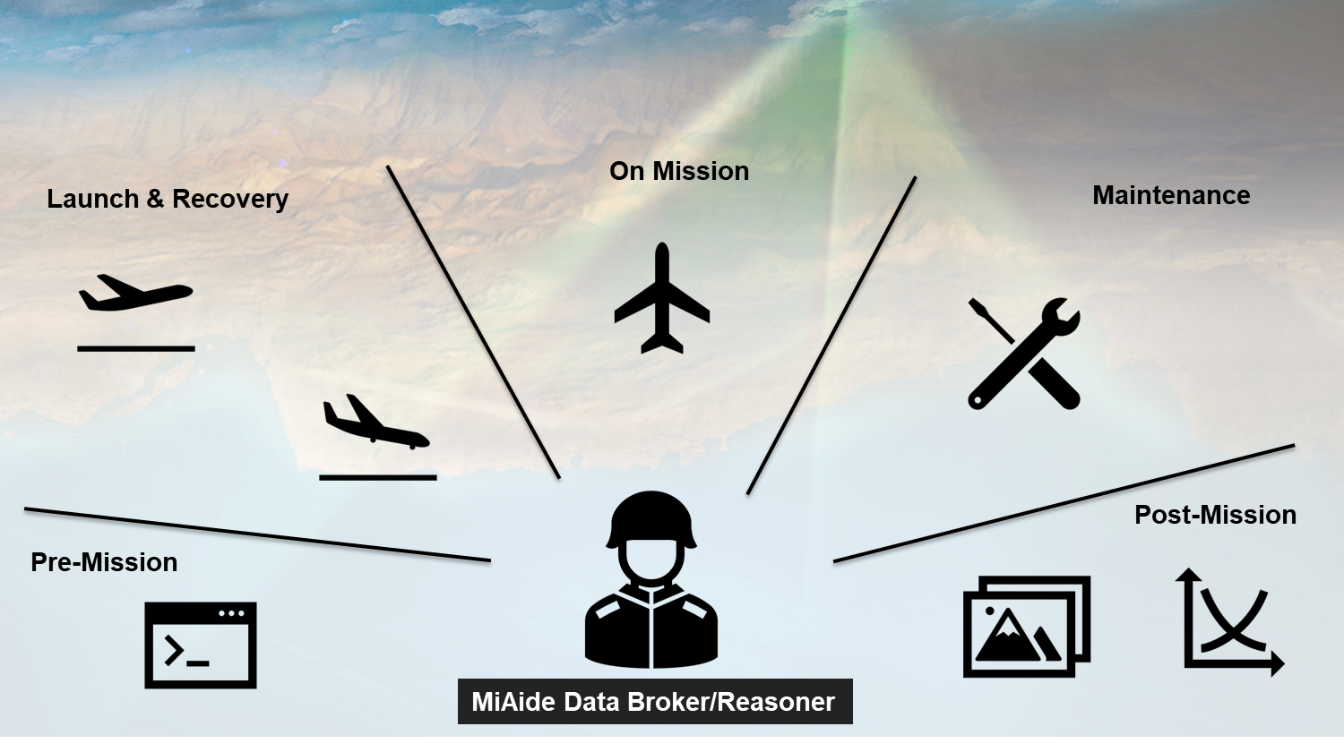
Application of Diagnostic Data Analytics
Diagnostic analytics focuses on why something happened
    Takes descriptive data to answer the question: Why did this happen?
    Performed using such techniques as data discovery, drill-down, data mining, and correlations.
      For discovery, analysts identify the data sources that help interpret results
      Drilling down focuses on a particular characteristic of the data
      Data mining is an automated process to get information from a massive set of raw data
      Consistent correlations in the data helps pinpoint the parameters of the investigation.
    Example: Diagnostic analytics would be used to explore the data and make correlations in industries such as healthcare, insurance, and weather.
MiAide Operational View (OV1)
MiAide supports all mission phases throughout the complete mission life cycle. i.e., pre-mission, launch and recovery, on-mission, maintenance, and post-mission. MiAide enables a single operator to execute all mission phases from a single control station, thereby improving both efficiency and consolidating mission resources.
    * Diagnostic Analytics, https://www.sisense.com/glossary/diagnostic-analytics/, accessed June 25, 2021, Copyright © 2021 Sisense Inc.

Slide 23
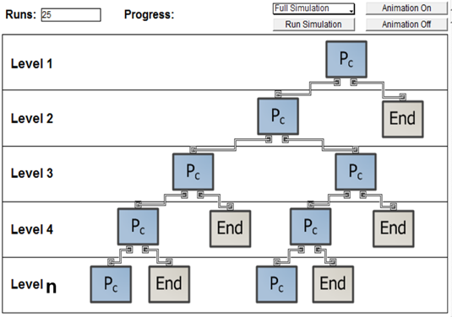
Application of Predictive Data Analytics
Predictive analytics describes what is likely going to happen in the near term;
    Focused on predicting and understanding what could happen in the future.
    Analyzes past data patterns and trends by looking at historical data and customer insights in order to predict what might happen going forward and,
    Informs many aspects of human decision-making
      Example: a business, including setting realistic goals, effective planning, managing performance expectations and avoiding risks.
    Predictive analytics is based on probabilities.
      Uses a variety of techniques – such as data mining, statistical modelling (mathematical relationships between variables to predict outcomes) and machine learning algorithms (classification, regression and clustering techniques)
      Attempts to forecast possible future outcomes and the likelihood of those events.
    A newer branch of machine learning is deep learning
      Mimics the construction of human neural networks as layers of nodes that learn a specific process area but are networked together into an overall prediction.
Predictive Analytics based on the Stochastic Math Model (SMM)
SMM computes Probability of Correctness (Pc) with respect to successfully identifying objects of interest from amongst many images. The structure for SMM is hierarchical consisting of algorithmic levels of fidelity. Measures of Effectiveness (i.e. metrics) are assigned to each level. Confidence intervals are then derived by applying Monte Carlo analysis.
23

Slide 24
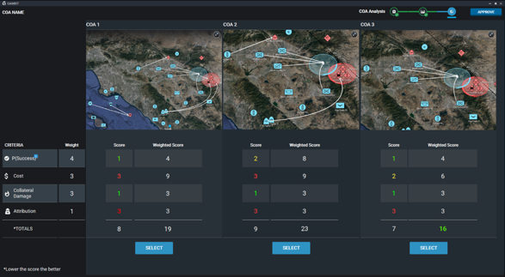
Application of Prescriptive Data Analytics
Prescriptive analytics suggests a course of action.
    Helping executives, commanders, managers and operational employees make the best possible decisions based on the data available to them.
    Takes what has been learned through descriptive and predictive analysis and goes a step further by recommending the best possible courses of action for a business or mission.
    This is the most complex stage of the analytics process.
    Techniques and tools – such as rules, statistics and machine learning algorithms – can be applied to available data, including both internal data (from within the business) and external data (such as data derived from social media).
    Use of machine learning improves prescriptive data analytics beyond what a human can do when trying to achieve the same results.
Decision Matrix
This figure presents a decision matrix from which a commander may select the best Course of Action (COA) from amongst alternative COAs. The three alterative COAs are presented with respect to how each one meets the Commander’s criteria for selected metrics including Psuccess, Cost, Collateral Damage, and Attribution.
24

Slide 25
Conclusions and Areas for Future Work
This presentation discussed how the combination of complex systems engineering and data science can be applied to address human decision making and the associated complexities of its emergent behavior.
To do so, four basic data analytics techniques were discussed along with and their individual and combined contributions to human decision making
  Descriptive analytics describes what has happened over a given time period.
  Diagnostic analytics focuses on why something happened.
  Predictive analytics describes what is likely going to happen in the near term.
  Prescriptive analytics suggests a course of action.
Specific use cases were presented to showcase the application and value of these techniques for specific commercial and Department of Defense (DoD) systems.
Future – Application of Systems Engineering with Data Science has tremendous growth potential
  Data Science roles have grown over 650% since 2012.
  Job growth is expected to create 11.5M jobs by 2026 (U.S. Bureau of Labor Statistics).
  Key areas for growth include support for cloud computing and Joint All Domain Command and Control (JADC2) military defense.
  Application of Systems Engineering with Data Science has tremendous growth potential
25

Slide 26
Backup
26
Notes:
26

Slide 27
Abstract
Systems Engineering plays a key role in addressing the challenges of emergent complex systems. A complex system is one whose structure and behavior is not deducible, nor may it be inferred from the structure and behavior of its component parts. Emergent behavior is a new behavior that develops from the interactions among constituent systems. Complex system engineering provides methods to address these issues. Data Analytics is the science of analyzing raw data to make conclusions about the information derived from it. Many data analytics methods have been designed to autonomously transform raw data into information for human consumption. This presentation discusses how the combination of complex systems engineering and data science can be applied to address human decision making and the associated complexities of its emergent behavior.
27

Slide 28
Primary References
Norman D.O., Kuras M.L. (2006) Engineering Complex Systems. In: Braha D., Minai A., Bar-Yam Y. (eds) Complex Engineered Systems. Understanding Complex Systems. Springer, Berlin, Heidelberg© Springer 2006, pp 206-245.
Mina A., Braha D., Bar-Yam Y. (2006) Complex Engineered Systems: A New Paradigm. In: Braha D., Minai A., Bar-Yam Y. (eds) Complex Engineered Systems. Understanding Complex Systems. Springer, Berlin, Heidelberg, © Springer 2006, pp. 40-71.
Heylighen, F., C. Joslyn; 2001; “Entropy and Information,” Principia Cybernetica Web, Sep 3,; pespmc1.vub.ac.be/entrinfo.html.
Kauffman S.A; 1993; The Origins of Order: Self-Organization and Selection in Evolution, Oxford University Press, New York.
NIST Special Publication 1500-1 “NIST Big Data Interoperability Framework: Volume 1, Definitions,” Final Version 1, NIST Big Data Public Working Group Definitions and Taxonomies Subgroup, http://dx.doi.org/10.6028/NIST.SP.1500-1, September 2015
J. Ward and A. Barker, “Undefined By Data: A Survey of Big Data Definitions,” School of Computer Science University of St Andrews, UK, arXiv:1309.5821v1 [cs.DB], 20 Sep 2013
P. Hershey and C. Silio, “Surmounting Data Overflow Problems in the Collection of Information for Emerging High-Speed Network Systems.” IEEE Systems Journal, Vol. 4, No. 2, ISJEB2, June 2010, ISSN 1932-8184, pp 147-155.
IBM Systems and Technology Group, “IBM System Storage DS6800,” TSD00605-USEN-03, Aug. 2006, © Copyright IBM Corporation 2006.
P.C. Hershey, “Information collection architecture for performance measurement of computer networks," Ph.D. Dissertation, University of Maryland, College Park, MD, May 1994.
P. Hershey and M Wang, “Composable, Distributed System to Derive Actionable Mission Information from Intelligence, Surveillance, and Reconnaissance (ISR) Data,” Proc. of the 2013 IEEE Systems Conference, Orlando, FL, April 17, 2013.
Lt. Gen. David A. Deptula, Keynote Address, GEOINT 2009, Oct. 2009.
“Pentagon Struggles with Avalanche of Data,” SPACE NEWS, Oct. 19, 2011.
N. Heinze, et al., “Automatic Image Exploitation System for Small UAVs,” Proc. of SPIE, Vol. 6946, 2008.
P. Hershey, M. Wang, and D. Toppin, “System of Systems for Autonomous Mission Decisions,” Proc. of the 2013 IEEE International System of Systems Engineering Conf., Maui, HW, Jun. 5, 2013.
Defense Science Board (DSB) Task Force Report, “The Role of Autonomy in DoD Systems,” Jul. 2012.
Colorado's DigitalGlobe Says It Found 'Objects' in Malaysia Airlines Search - ABC News, accessed March 20, 2014.
Nick Macfie, “6 months since MH370 vanished without a trace, grim reminders of aviation mystery linger,” Reuters, accessed Sept. 5, 2014, 1:40PM.
T. Blaschke, et al., “Geographic Object-Based Image Analysis – Towards a new paradigm,” ISPRS J Photogram Remote Sens. Jan 2014; 87(100): 180–191, doi: 10.1016/j.isprsjprs.2013.09.014.
D. Erhan, et al., “Scalable Object Detection using Deep Neural Networks,” arXiv: 1312.2249v1 [cs.CV], Google, 8 Dec 2013.
M. Pedram, A. Ebrahimi-Moghadam, and S. Shirani. "Subjective and Objective Quality Assessment of Image: A Survey." Majlesi Journal of Electrical Engineering 9.1 (2015): 55.
13

Slide 29

Bio
Paul Hershey works for Raytheon Technologies Company, where he is a Principal Engineering Fellow focusing on data analytics, autonomous systems, modeling and simulation, and cyber security. He has been a member of IEEE since 1980 and was elevated to IEEE Fellow in 2021. He received his Ph.D. and M.S. degrees in electrical engineering from the University of Maryland, College Park, MD, USA, and the A.B. degree in mathematics from the College of William and Mary, Williamsburg, VA, USA. Dr. Hershey has published 41 patents (granted) and 75 peer-reviewed technical articles. Previously, he was an adjunct professor at George Washington University where he also served on the Curriculum Advisory Board. He presently serves on technical program committees for the IEEE International Systems Conference and the IEEE International System of Systems Engineering Conference. Dr. Hershey is a Distinguished Lecturer on data analytics for the IEEE Systems Council.
29

